Slide 1
Loops and Arrays in JavaScript
MIS 2402
Department of MIS
Fox School of Business
Temple University

Slide 2
Agenda
Syntax for writing “for” loops in JavaScript
Some practical examples of loops

Slide 3
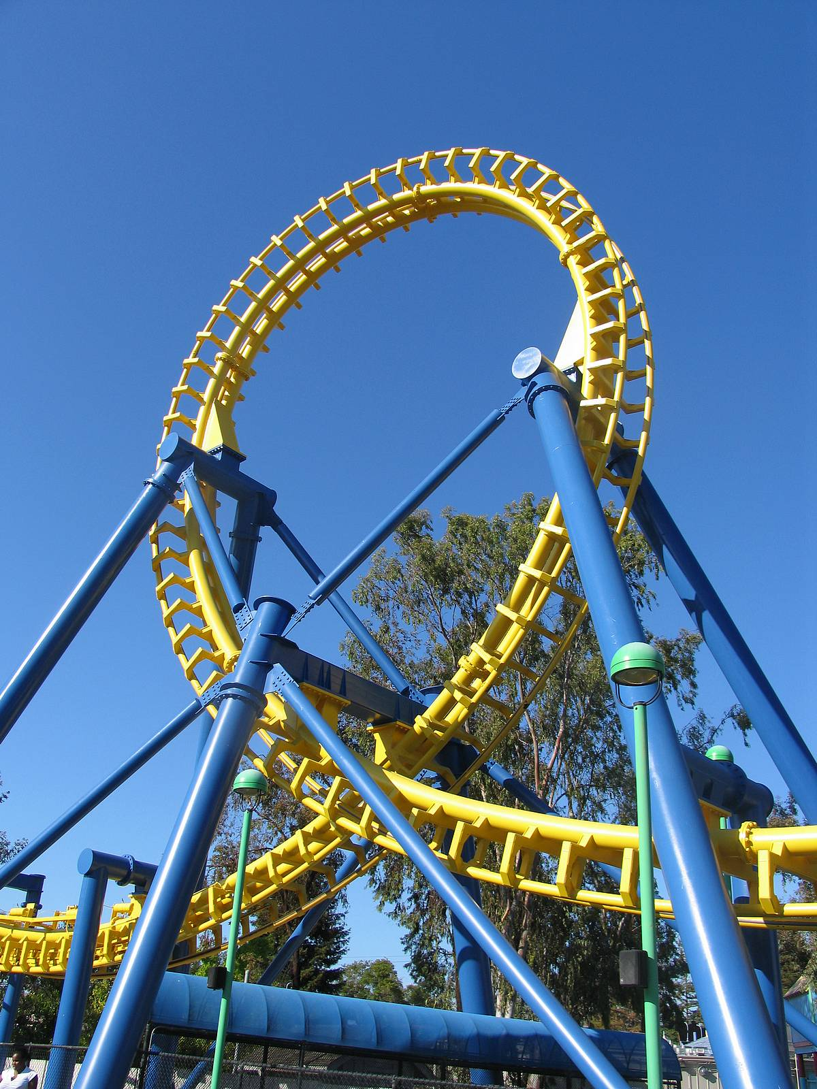
What’s a loop?
In programming, a “loop” is a series of commands (called “a block of code”) that repeats for a specified number of iterations.
It’s a programmatic way of doing the same thing over and over again.

Slide 4
Advisory
JavaScript supports several different kinds of loop structures.
for
for/in
for/of
while
do/while
All those structures do similar things. In most situations, they are interchangeable!
In this class, we will only use the first one: the “for” loop.
For the new programmer, learning one general purpose loop structure and knowing it well, is better than trying to learn several different structures, each with a slightly different syntax!

Slide 5
The syntax of a JavaScript for loop
For example: Write the numbers 1 to 3 to the console.
for (let x = 1; x <= 3; x++) {
console.log(x);
}
x is declared and assigned a value.
The loop continues while this expression is true.
A shorthand way of saying x = x + 1
The code block begins and ends.

Slide 6
Let’s see that with some animation …
The code
The computer’s memory
console.log("Starting");
for (let x = 1; x <= 3; x++) {
console.log(x);
}
x = 1
X 4
X 2
X 3
The console
Starting
1
2
3
This code can be found in loopexamples.zip, loop01.html

Slide 7
Another (simple) example of a for loop
Thinking ahead! We establish sumOfNumbers here so we can use it later in the loop.
We’re using this variable to control the number of iterations.

Slide 8
Let’s see that with some animation …
The code
The computer’s memory
let sumOfNumbers = 0;
let numberOfLoops = 3;
for (let counter=1;counter <= numberOfLoops;counter++){
sumOfNumbers = sumOfNumbers + counter;
}
console.log(sumOfNumbers);
sumOfNumbers = 0
X 1
X 3
X 6
numberOfLoops=3
counter=1
X 2
X 3
X 4
The console
6
This code can be found in loopexamples.zip, loop02.html

Slide 9
Another example of a “for” loop
Let’s see this loop at work! (see loop03.html in loopexamples.zip)

Slide 10
More examples
Loops can be used to generate repetitive blocks of text.
(see loop04.html in loopexamples.zip)
Loops can be nested inside other loops
(see loop05.html in loopexamples.zip)
ALERT! – In that last example we use the jQuery .append() method to add text to a message div tag. Appending text is different from replacing text!

Slide 11
So… what are loops good for?
Performing a calculation that requires iterations.
-OR-
Generating repetitive text. Sometimes that text is HTML. Tags like these can often be generated with a loop:
<table> rows
<select> options
<ul> items
<ol> items.
NOTE! Loops are often used in combination with other loops, conditional statements, and functions!

Slide 12
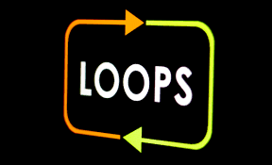
Now let’s work on an exercise …

