Slide 1
JavaScript Arrays
MIS 2402
Department of MIS
Fox School of Business
Temple University

Slide 2
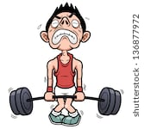
Agenda
A gentle introduction to arrays
Some practice writing loops that iterate through arrays
HOT TIP! Arrays are used heavily in MIS3502. So, the time and energy you invest today will pay off in your future.

Slide 3
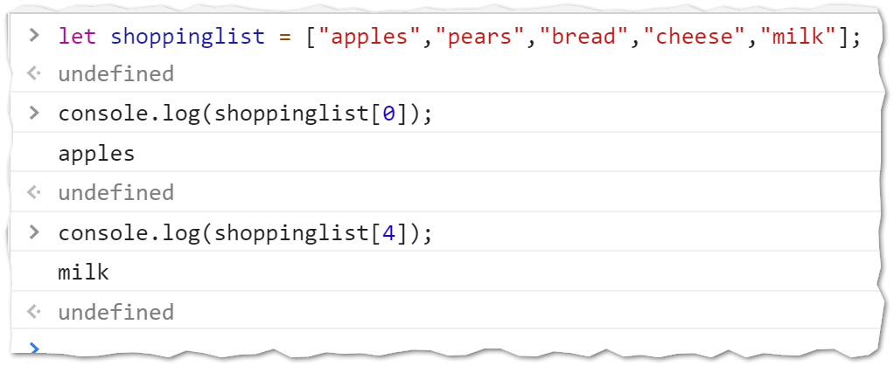
Let’s get started
Open up Chrome
Open up the Developer Tools Console
Type in the following…

Slide 4
What you just did
In the last slide you created a variable called shopping list. That variable held multiple values. The variable shoppinglist is an array!
Each element of the array is identified by a number.
The number 0 is the index to the first element of the array.
So… on the last slide we learned that:
JavaScript allows us to create arrays using the square brackets
JavaScript arrays are zero based

Slide 5
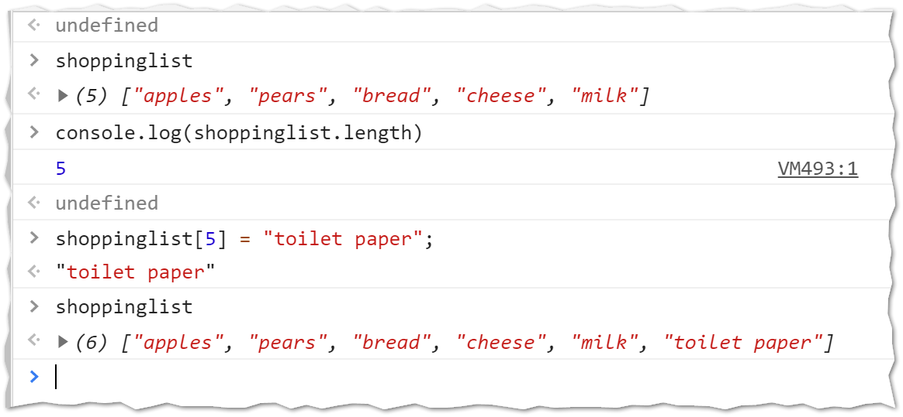
Let’s play some more

Slide 6
What you just did
In the last slide you saw that an array has a length attribute (just like a string does)
You also saw that you could add a new element (in this case, “toilet paper”) on to the end of the array by simply using a new index
Let’s try something fun… type shoppinglist.sort();
What did it do?
Would you describe sort() as a property or a method?

Slide 7
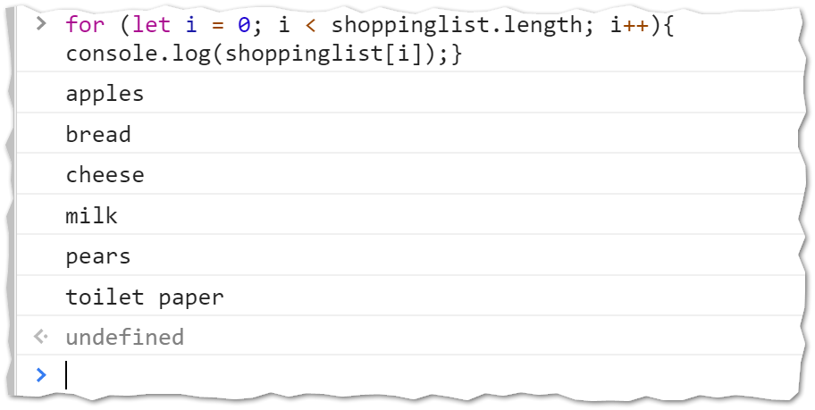
Iterating through an array
Let’s try iterating through an array using a loop.

Slide 8
An array of numbers
Now that we’ve had some fun with an array of strings… let’s see what we can do with an array of numbers.

