Slide 1
JavaScript Strings
MIS 2402
Department of MIS
Fox School of Business
Temple University

Slide 2
Agenda – JavaScript Strings
What we have already seen
New stuff
Accessing individual characters
length
trim()
slice()
substr()
toUpperCase()
toLowerCase()
indexOf()
Fun fact: This is just a small subset of the string methods available to you in JavaScript. A more complete list can be found here:
https://www.w3schools.com/jsref/jsref_obj_string.asp

Slide 3
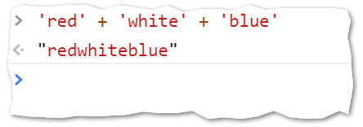
What we have already seen:
Concatenation… putting strings together.
From the web developer console…
Try it!

Slide 4
New Stuff
Strings have one really important attribute (length) and many useful methods. A string is an object.
Ok… that was a little bit of a lie. Technically, a string is not object, it’s a data type. Your textbook explains this fact and related information in considerable detail.
However, the JavaScript language is set up so that you can work with strings “as if” they were objects. And that is how we will think about them.

Slide 5
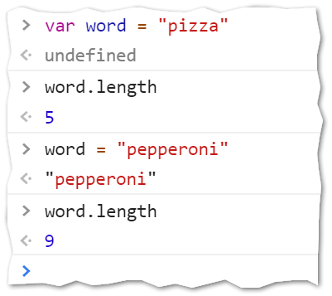
The length attribute
Every variable that is a string has a length attribute. The length attribute automatically represents the number of characters in the string. If the contents of the string variable change, the length attribute changes accordingly.
Try it!

Slide 6
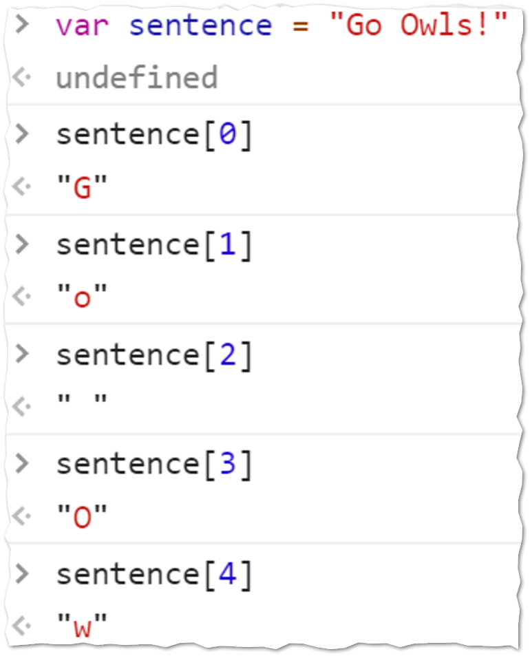
Strings – individual characters
A string can be thought of as a numerically indexed collection of characters. Each character in the string has a numeric index. The numbering of the index starts with zero.
To retrieve a character at a location in the string, specify the variable name, and a pair of square brackets. Put the numeric index value inside the square brackets.
Try it!
DISCUSS: Does a blank space “ ” count as a character?

Slide 7
Writing a loop that uses length
Consider the following example. It takes a string of input, and reverses it. For example, if the input is “abcd” then the output would be “dcba”
The computer’s memory
The code
‘Tom’
function reverseString(input){
// The variable output is made to be built
// as the loop iterates.
var output = "";
for(var i = 0; i < input.length; i++){
output = input[i] + output;
}
return output;
}
input = ‘Tom’
0 < 3
1 < 3
3 < 3
2 < 3
output = ‘’
X ‘T’
X ‘oT’
X X ‘moT’
i = 0
X 1
X 2
‘m’ + ‘oT’
‘T’ + ‘’
‘o’ + ‘T’
‘moT’

Slide 8
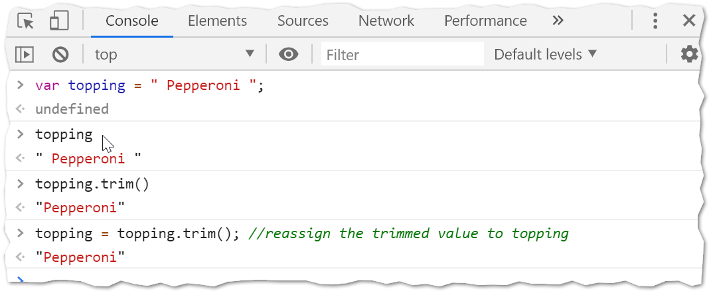
trim()
The trim() method of any string variable can be used to remove any leading or trailing spaces. This method is very handy for cleaning up user input. Try it!

Slide 9
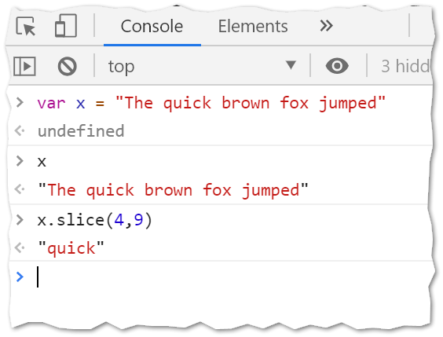
slice()
The slice() method of any string variable can be used to return a portion of a string.
The slice method takes two parameters. The start position and the end position. The character at the end position is not included in the string.
0 (T)
4 (q)
9 ( )
25 (d)
“The quick brown fox jumped”

Slide 10
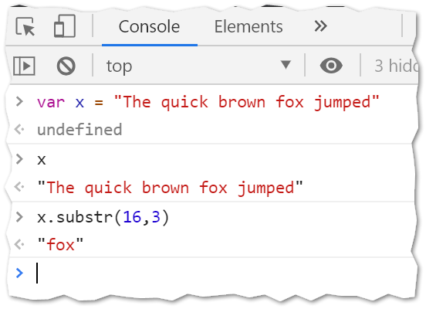
substr()
The substr() method of any string variable can also be used to return a portion of a string. It is a lot like the slice() method!
The substr method takes two parameters. The start position and the length of the desired string segment.
0
25
16
“The quick brown fox jumped”

Slide 11
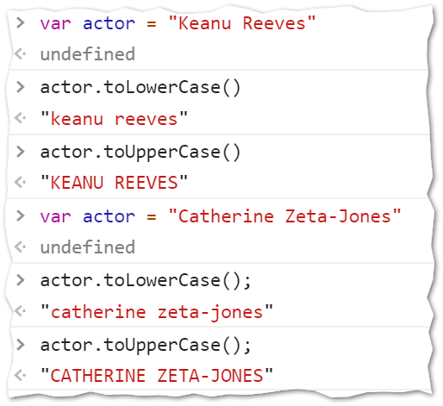
toUpperCase() and toLowerCase()
The toUpperCase() and toLowerCase() methods do exactly what you think they should do. They return all the alphabet characters converted to upper or lower case (and the rest of the non-alphabet characters as they were in the original string!)
These two methods are good for “cleaning up” user input.
Try it!

Slide 12
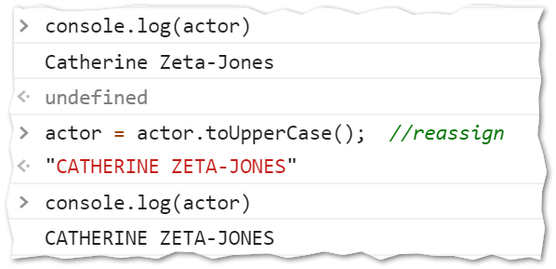
Clarification
With any of these string methods, keep in mind that they don’t change the original string. As seen in the prior slide, issuing the command actor.toUpperCase() does not change the value held by the actor variable.
If that is what you want to do, you need to reassign the variable with the output of the method. Like this:

Slide 13
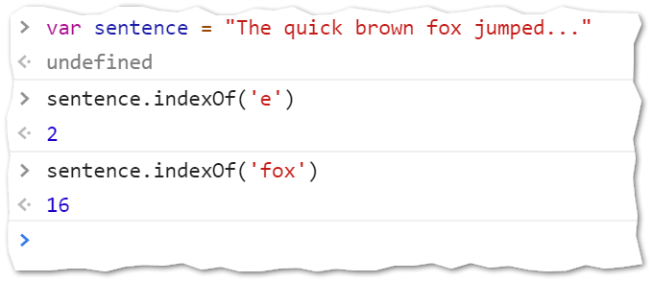
This one is tricky
The last string method we will cover is indexOf() and it seems simple enough. But it has something new! It has an optional parameter.
A.indexOf(B) will return the position of the string B inside of A.

Slide 14
The special case
A.indexOf(B) will return the position of the string B inside of A but if B cannot be found in A then the value -1 is returned.

Slide 15
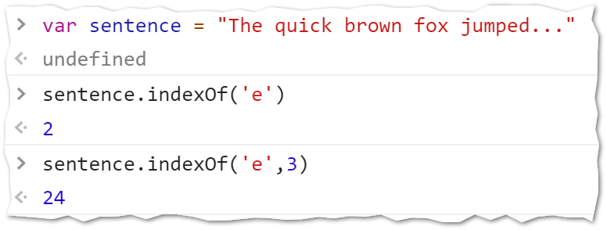
The optional parameter
A.indexOf(B,x) will return the position of the string B inside of A with the search starting at position x. This second parameter is optional.

Slide 16
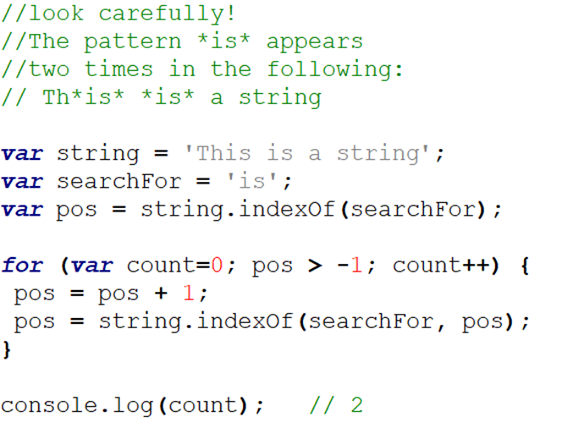
An example

Slide 17
Time for some practice

