Slide 1

jQuery, Ajax & JSON
MIS 2402
Jeremy Shafer
Department of MIS
Fox School of Business
Temple University

Slide 2
Agenda
What is jQuery again?
What is JSON?
What is Ajax?
$.getJSON - One technique for making an Ajax call

Slide 3
Let’s remember - jQuery
Recall that jQuery is a library.
“The jQuery library is a collection of JavaScript functions that are professionally developed and free for use. They are meant to help you do common tasks more simply.”
We introduced a few jQuery methods early in the semester and we have been quietly using them all semester long.
.html()
.val()
.append()
Discuss: What do each of the above do?
Notes:
We first saw jQuery in week 2 of the semester.

Slide 4

JSON
JSON is a data format.
Most of you have already encountered JSON in another course, MIS2502 Data Analytics.
JSON is short for JavaScript Object Notation.
JSON is the convention for representing arrays and simple objects in JavaScript.
[ ] for numerically indexed arrays
{ } for simple objects (a.k.a. associative arrays,
a.k.a key / value pairs )
JSON is an extremely popular data
format used to exchange data between systems.
It is pronounced “Jay - Sawn” not “Jason”
Notes:
We first saw jQuery in week 2 of the semester.

Slide 5
What does JSON look like?
A JSON object often looks like a collection of key/value pairs as illustrated here:
[{
“KEY” : “VALUE”,
“KEY” : “VALUE”,
“KEY” : “VALUE”
}]
There are many acceptable variations on this theme, but this is common!

Slide 6
For example…
DISCUSS: How would you get to the piece of data “Tyler”?
Notes:
[0][“Dependents”][1]

Slide 7
So, what’s Ajax?
AJAX is short for Asynchronous JavaScript and XML
It is the combination of these technologies, not a separate technology in itself

Slide 8
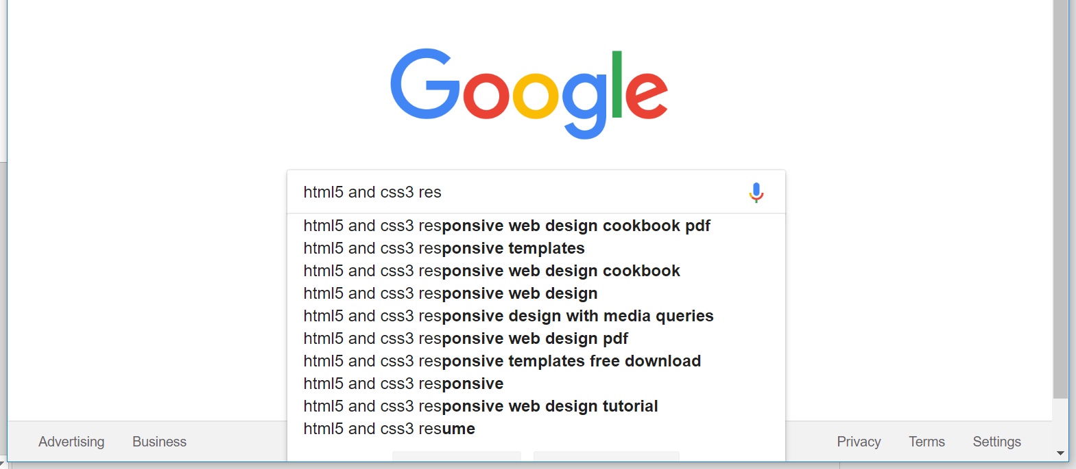
An Ajax call we see every day…

Slide 9
AJAX uses JavaScript to call resources
Web server
HTTP Request
Browser
JavaScript Engine
The data we asked for.
Database
The format of the data might be JSON, or XML, or CSV, or something else.
No matter what the format is, this is still and Ajax request.

Slide 10
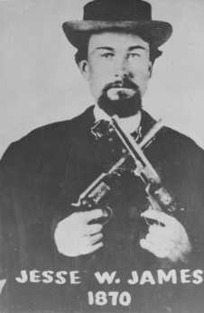
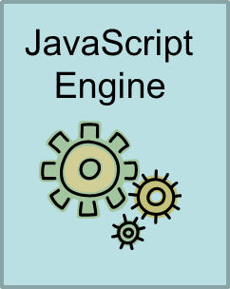
A little Ajax history
Not this Jesse James! ☺
The term "Ajax" was publicly stated on 18 February 2005 by Jesse James Garrett in an article titled "Ajax: A New Approach to Web Applications", based on techniques used on Google pages.
This object acts like a browser, inside the browser. The object is used to retrieve a web resource.
XMLHttpRequest()

Slide 11
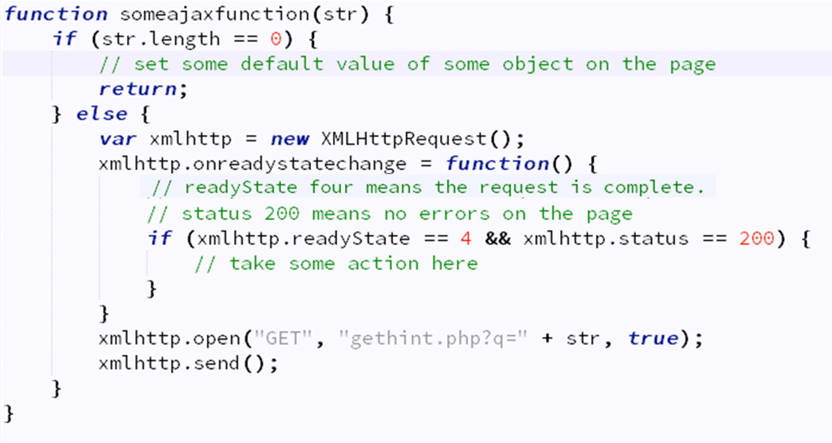
XMLHttpRequest allows us to do things like this…
Yuck! ☹

Slide 12
Or… using jQuery ☺
Yes, there really is a dot here.
There’s actually a piece here that we’re intentionally leaving out for now. We would use an optional parameter here to send data to someurl
$.getJSON(someurl, function(result) { some things to do })
There are other jQuery methods used to do make Ajax calls:
.ajax()
.load()
.get()
.post()
A list of jQuery Ajax methods can be found here:
https://www.w3schools.com/jquery/jquery_ref_ajax.asp
This piece is called “the callback function”.
It is the function, that runs, when the call to someurl comes back.

Slide 13
One more time…
This is the callback function that will execute when the Ajax call is a success.
$.getJSON(someurl, function(result) { some things to do});
The URL to visit
Result is the simple object returned by the getJSON method.
One or more commands.
I can use the data in result here!

Slide 14

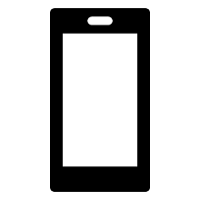
Concluding thoughts
CDN
(jQuery)
Web API
Web Server
CDN
(Bootstrap)
CDN
(other ?)
Web API

Slide 15

Time for some work

