Slide 1

Single Page Architecture (SPA)
MIS 2402
Department of MIS
Fox School of Business
Temple University

Slide 2
Agenda
Define what a Single Page Architecture is.
Why SPA applications are rising in prominence.
Revisit some jQuery commands we can use to make a simple SPA application.

Slide 3
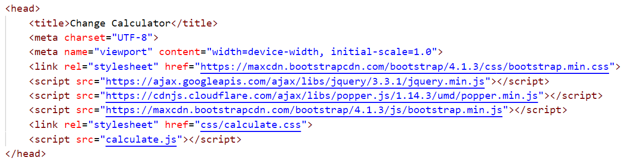
What’s a SPA?
A SPA application is designed so that all user interactions are driven through one, single, page … usually index.html.
While a SPA application may have one page that dominates the user’s attention, that single page usually references many other supporting resources.
Supporting
Resource
More supporting
resources!
A good way to think about SPA applications: the goal is to get is much data and functionality delivered to the user in the initial page load as possible. Once that’s done, keep all other interactions with the network as light as possible.

Slide 4
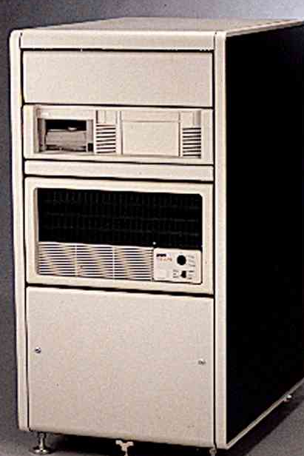
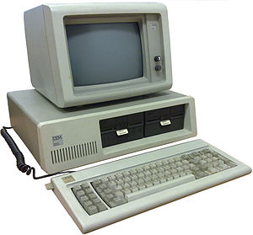



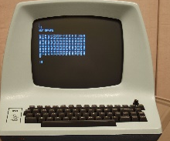
A little (simplified) history
1950-1980
1981-2000
2001-2005
2006-present
Many CPUs, connected by a ubiquitous, wireless, high speed internet connection. Each application leverages multiple resources in “the cloud.”
Client and server, with a broadband internet connection. (“Hot” languages – PHP, ASP.Net, JSP, etc.)
One big shared CPU and a lot of dumb terminals. (“Hot” languages – COBOL, Fortran.)
Now anyone can have their own CPU! (“Hot” languages – Basic, C.)
(“Hot” languages – JavaScript for the client, Node.js for the cloud.)

Slide 5

The role of JavaScript in Web Applications
1995 (approx.)
(Present!)
100%
90%
50%
10%
?
Initial download
0%
10%
50%
90%
?
Client doesn’t use any logic at all. Every web request causes the page to be completely reloaded. (A “round trip”.)
Hey! This JavaScript stuff might be good for some things.
Google Docs and similar feature-rich applications make full use of the JavaScript language!
JavaScript, HTML and CSS can be bundled into a mobile application.
How much network interaction you need depends on the application’s features.
See: http://blog.venturepact.com/8-high-performance-apps-you-never-knew-were-hybrid/

Slide 6

Where we are headed …
In this course we won’t be developing hybrid mobile apps, but we’ll get close to it.
Initial download
10%
?
Initial download from the class server.
50%
?
90%
?
50%
?
(No.)
(Yes!)
Publishing to an App Store can get complicated!
Similar thought process to mobile development, but easier to build.

Slide 7
Some simple jQuery commands…
Recall that the way we select a tag in jQuery is by referencing it by its id.
$(“#the_tag”).some_method();
Two jQuery methods that we will rely on heavily are .show(), and .hide()
Other useful jQuery methods are:
Method | Usage
.val() | Used to read or write the value of a input tag. (Usually an input tag.)
.html() | Used to read or write the inner html of a tag. (Only works on tags that have inner html.)
.addClass() | Add a CSS class to the selected tag.
.removeClass() | Remove a CSS class from a selected tag. Or, remove all the CSS classes from the selected tag.

Slide 8

Let’s give it a try…

