Slide 1
Introduction to MIS2402
MIS MIS2402
Taha Havakhor
Department of MIS
Fox School of Business
Temple University

Slide 2
Agenda for today…
What we’ll be learning about this semester
Review the class site and discuss syllabus
What is a typical week in MIS2402?
A recipe for success
A problem-solving exercise

Slide 3
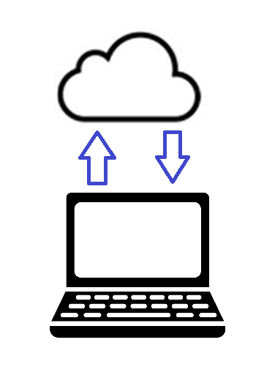
Basic idea: request and response
The URL you asked for …
The HTTP response you got back.

Slide 4
What’s in the response?
A successful response will return at least one text file. (Really, usually more than one… but let’s start here!)
HTML
CSS
JavaScript
In the HTTP response you are likely to find all three of these languages in a single text file. HTML and CSS are special purpose languages, while JavaScript is a general-purpose programming language.
Each language is interpreted by the browser and each language has a job to do.

Slide 5
Why three languages?
Each language is interpreted by the browser and each language has a job to do.
HTML
HTML provides us with the structure of a document.
CSS
CSS is used to control the visual appearance (or style) of the HTML document
CSS is analogous to how your term paper looks. (Choice of font, margins, etc.)
JavaScript
JavaScript is is used to manipulate the HTML document in response to one or more events.
HTML structure should convey some meaning, like the outline to term paper.
Fun fact: HTML is short for: HyperText Markup Language
Fun fact: CSS is short for Cascading Style Sheet
Fun fact: JavaScript is officially managed by the Mozilla Foundation. It is based on a language specification defined by the ECMA International organization.

Slide 6
Review the class site and syllabus

Slide 7
A typical week
TUESDAY | THURSDAY | FRIDAY through MONDAY
Assignment review Assignments may be briefly reviewed. Brief lecture The week’s topic is briefly introduced. Lab / Assignment A supporting assignment is begun together in class. The instructor guides students through the first part of the assignment. Students are expected to complete the assignment on their own, outside of class. | Lab / Assignment Again, one or two supporting assignments (more difficult than the first one) are begun in class. In this class the instructor acts as a resource to the students but will not guide students step-by-step. | Students are to continue work on the assignment outside of class. Students should bring to resolution any tasks that could not be finished in class. Students should read/view any assigned material for the coming week.

Slide 8
Our focus for this semester …
These three languages are part of your every-day Internet experience.
We’ll start our semester learning a little HTML and CSS.
We will quickly move on to JavaScript and spend most of the semester learning that, and related topics.
HTML
CSS
JavaScript

Slide 9
Let’s see some examples
HTML
CSS
JavaScript
Examples:
http://misdemo.temple.edu/jeremy/demo_hello/
http://misdemo.temple.edu/jeremy/demo_html/
http://misdemo.temple.edu/jeremy/ice_cream/
Use the “View page source” feature of Chrome to see the HTML, CSS and JavaScript behind these pages.
You can also use the “Inspect” feature to quickly zero in on one portion of HTML.

Slide 10
Tips for success…
Starting today ... you have two weeks to learn some basic HTML. Jump on that and take it seriously.
Accept that this is a different sort of class. It will require more time and effort outside of class than most students are accustomed to.
Get the book. Do the assigned readings. Note that we are using the same textbook as students encountered previously MIS2101. Students will notice some overlap between the exercises used in these two courses. This overlap is intentional.

Slide 11
More tips for success…
Treat each assignment as a learning opportunity. Your attitude towards the assignments is very important!
Option 1 - Ask your friends for a lot of “help”, Google the answers and copy and paste a lot. (This is a good way to fail the course.)
Option 2 - Get one working solution more or less on your own and the moment you have it drop it like a hot potato. (You *might* pass with this strategy).
Option 3 - Get working solution with little or no outside assistance. Submit it early, and then immediately start to solve the same problem one or two different ways. Decide for yourself which solution you like the best. Put in about an hour a day outside of class. (You will most definitely succeed!)

Slide 12
A final tip.
Stay positive.
You *can* learn this. Programming is not some unobtainable super-power that only a few can develop.
Belief in Self
Time Investment
Belief in Value
Programming skills have value in the workplace. They will be an important asset in your future career.
Success in MIS2402
Plan on putting in approximately 1 hour a day, outside of class

Slide 13
Problem solving exercise

Slide 14
Next class …
Next class we will be introducing you to the software you will be using in this class.
Bitvise for PC Users
FileZilla for Mac Users
Visual Studio Code
Students should get these titles installed on their own computers.

