Slide 1
System Basics
MIS MIS2402
Department of MIS
Fox School of Business
Temple University

Slide 2
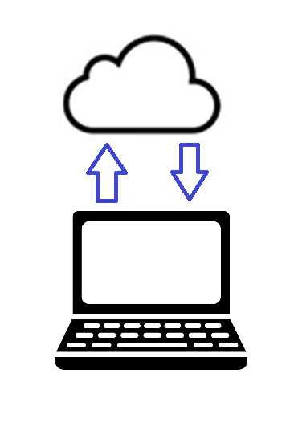
Recall from last time: request and response
The URL you asked for …
The response you got back.

Slide 3
The components of an HTTP URL used by the Internet
URL is short for “Uniform Resource Locator”

Slide 4
Three ways to call an HTML page on the Internet
Type the URL of a web page into the browser’s address bar.
Click on a link in the current web page to load the URL.
Click a “submit” button on a form that references the URL
Of course, a programming language like JavaScript, can also reach out to a URL in response to one or more events… but let’s not get ahead of ourselves.

Slide 5
Time for an exercise…
Let’s start our first assignment together.

