Slide 1
Single Page Architecture (part 2)
MIS 2402
Department of MIS
Fox School of Business
Temple University

Slide 2
Last class we…
Defined what a Single Page Architecture is.
Discussed why SPA applications are rising in prominence.
Revisited some jQuery commands we can use to make a simple SPA application.

Slide 3
This class …
Introduce error trapping.
Review how all the elements we have studied this semester have brought us to this point.
Look at a more sophisticated Bootstrap layout.

Slide 4
Error Trapping
Error trapping is programming logic that prevents a user from performing a wrong, misleading, or even dangerous action.
Error trapping protects well-intentioned users from making innocent mistakes.
Error trapping also protects valuable resources from being exploited and/or damaged from the malicious users.
Good error trapping is implemented at multiple levels. If one level fails, another level provides the desired level of protection.

Slide 5
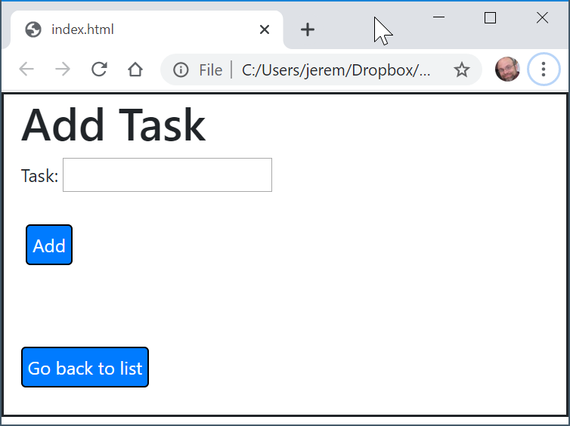
An example: Our task list application
What if a user enters a blank task… that’s bad data… what happens? What *should* happen?
There’s more than one acceptable response! But… as a general rule, the application should:
Give useful / meaningful feedback to the user
Prevent bad data from going into a database or other valuable resource system
Prevent any condition that would cause the application to crash and/or become unavailable!
Nothin’
Click Add

Slide 6
Client side vs. Server Side
We can conceptualize our “to do” list application like this:
Database
Client
API
Client-Side Error Trapping is implemented here. JavaScript conditional statements and jQuery commands are used to provide immediate (and meaningful) feedback to the user wherever possible!
Server-Side Error Trapping is implemented here. JavaScript conditional statements and Node JS commands are used to protect the database and ensure data quality. (You learn about this in MIS3502!)

Slide 7
Good error trapping exists at several levels
We can all agree that a blank to-do list item is pretty useless, right? So how do we stop that from going into our database
Database
Client
API
Client-Side Error Trapping This would be the first like of defense… and there’s absolutely no need to call the API if the task item is blank!
Server-Side Error Trapping – If the task is blank, don’t write it to the database!
Database level constraint – If it’s important, then there can be additional levels of error trapping!

Slide 8
To build a simple application
You need to be able to present an interface to the user.
HTML is the foundation for your presentation.
Adding Bootstrap CSS to your HTML makes a huge difference!
You need to be able to perform calculations.
JavaScript functions, conditional statements, arithmetic expressions, functions and loops are all important ingredients in any solution!
You need to be able to manipulate that interface.
JavaScript and jQuery are tools that let you get data from user input, respond to click events, and manipulate the appearance of HTML tags.
You need to be able interact with “Cloud” resources
Reading from and writing to APIs is what allows your code to interact with meaningful data and perform interesting tasks!
These are all things you have learned about this semester!

Slide 9
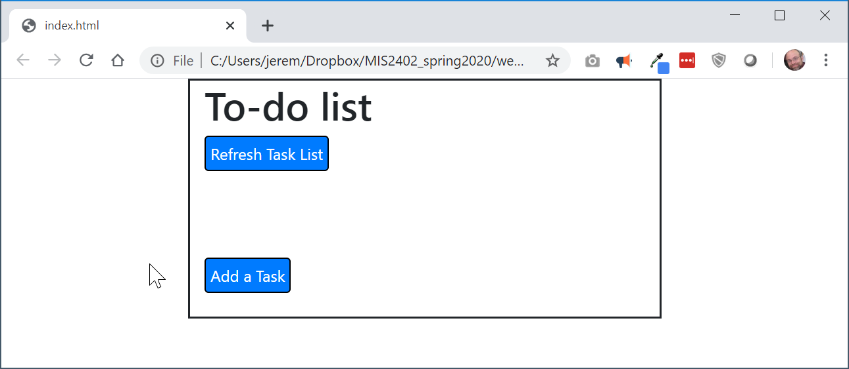
Building an interface with HTML, CSS and Bootstrap..
The Bootstrap layout we saw last time…
container
row
2 spans
8 spans
2 spans

Slide 10
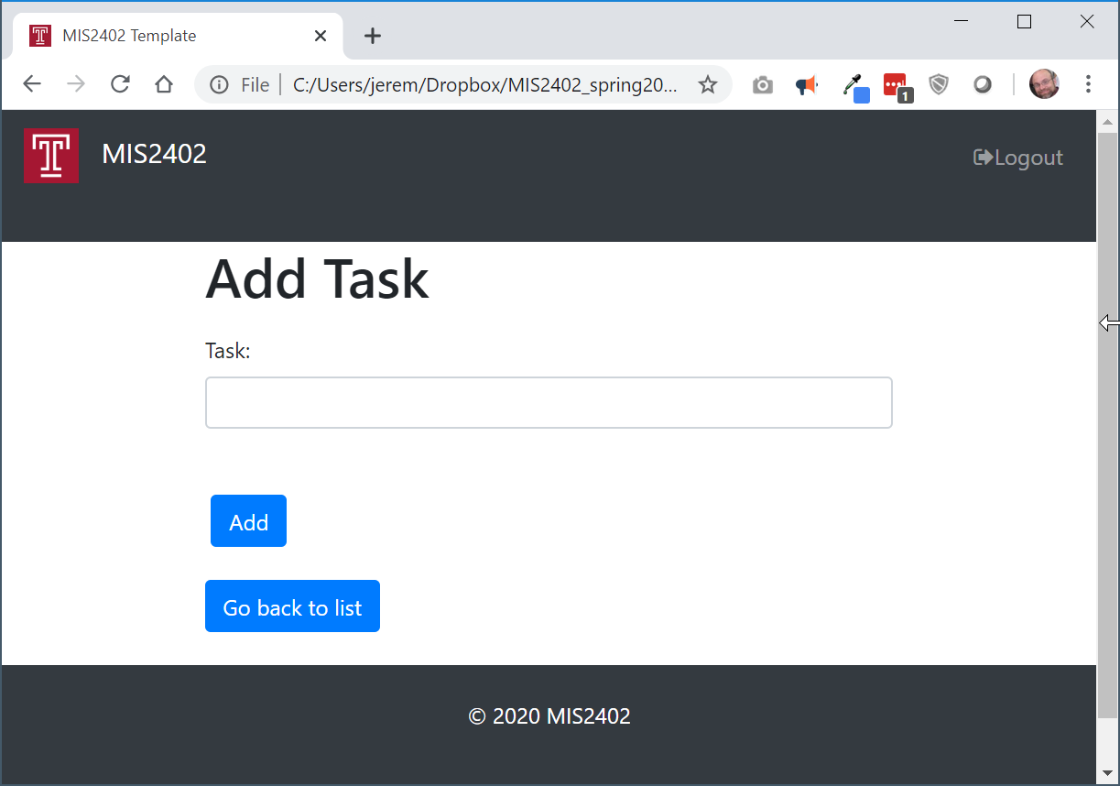
Some improvements…
Changes to a menu icon when the window is narrow
nav
container
row
Another container, row, and 12 span column
2 spans
8 spans
2 spans

Slide 11
Let’s give it a try…

