Slide 1
Introduction to MIS2402
MIS MIS2402
Taha Havakhor
Department of MIS
Fox School of Business
Temple University

Slide 2
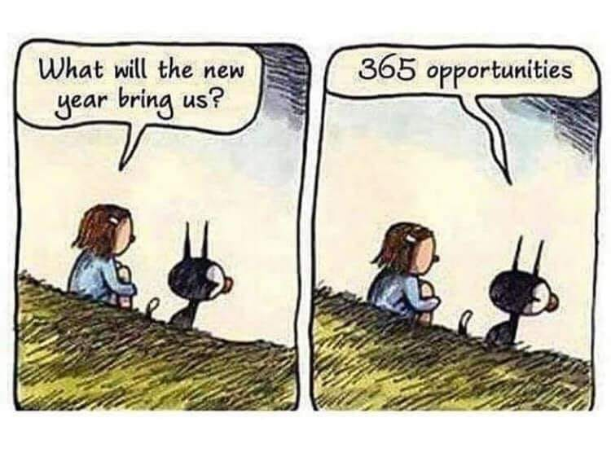
What lies ahead?

Slide 3
Agenda for today…
Review the class site and discuss:
What is a typical week in MIS2402?
An Introduction to HTML and CSS

Slide 4
A typical week
MON | TUE 5:30-6:40 | TUE 6:45-8:00 | WED | THURS | FRI | SAT-SUN
 | CLASS MEETS Lecture The week’s topic is introduced along with a light, supporting exercise or demo. Assignments may be reviewed as well. | CLASS MEETS Lab Apply the week’s material to an assignment. | Students are to continue work on the assignment outside of class. | Students should bring to resolution any tasks that could not be finished in class.

Slide 5
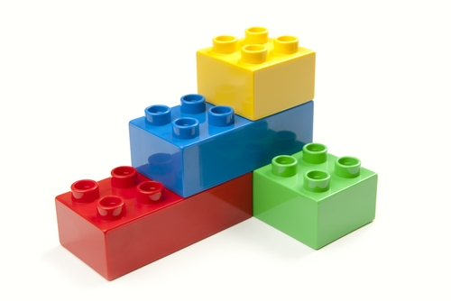
Let’s talk about…
Legos
Legos are easy!
Notes:
Hand out legos
Legos are easy!
I could spend the whole class talking about fine detail – this is a 2x6 brick, and this is a 2x2 brick, and this is a specialty brick.
Or, I could focus exclusively on the finished product – and present something that was overly complex, and ultimately not very useful.
Talk about the red brick – perspective that comes from building

Slide 6
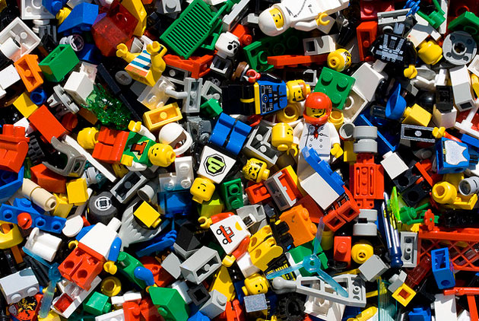
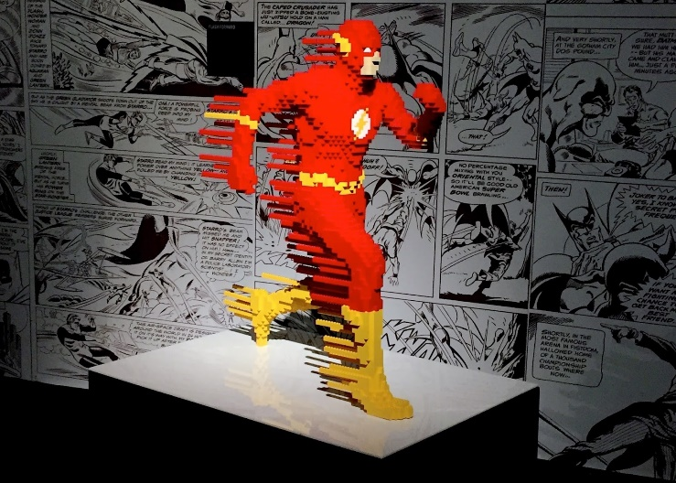
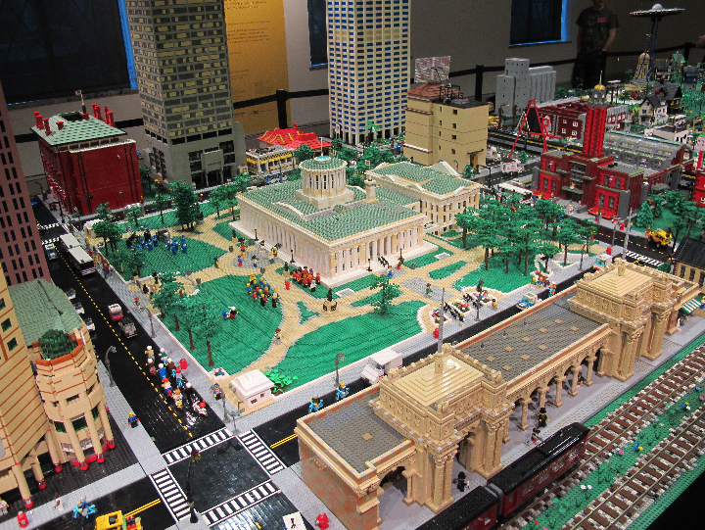
Let’s talk about…
Legos are hard…
Notes:
Hand out legos
Legos are easy!
I could spend the whole class talking about fine detail – this is a 2x6 brick, and this is a 2x2 brick, and this is a specialty brick.
Or, I could focus exclusively on the finished product – and present something that was overly complex, and ultimately not very useful.
Talk about the red brick – perspective that comes from building

Slide 7
The most basic building block of all: request and response
The URL you asked for …
The response you got back.

Slide 8
The components of an HTTP URL used by the Internet
URL is short for “Uniform Resource Locator”

Slide 9
Three ways to call an HTML page on the Internet
Type the URL of a web page into the browser’s address bar.
Click on a link in the current web page to load the URL.
Click a “submit” button on a form that references the URL
Of course, a programming language like JavaScript, can also reach out to a URL in response to one or more events… but let’s not get ahead of ourselves.

Slide 10
What’s in the response?
A successful response will return at least one text file. (Really, usually more than one… but let’s start here!)
HTML
CSS
JavaScript
In the HTTP response you are likely to find all three of these languages in a single text file. HTML and CSS are special purpose languages, while JavaScript is a general purpose programming language.
Each language is interpreted by the browser and each language has a job to do.

Slide 11
Why three languages?
Each language is interpreted by the browser and each language has a job to do.
HTML
HTML provides us with the structure of a document.
CSS
CSS is used to control the visual appearance (or style) of the HTML document
CSS is analogous to how your term paper looks. (Choice of font, margins, etc.)
JavaScript
JavaScript is is used to manipulate the HTML document in response to one or more events.
HTML structure should convey some meaning, like the outline to term paper.
Fun fact: HTML is short for: HyperText Markup Language
Fun fact: CSS is short for Cascading Style Sheet
Fun fact: JavaScript is officially managed by the Mozilla Foundation. It is based on a language specification defined by the ECMA International organization.

Slide 12
Our focus for this week …
HTML
CSS
JavaScript
HTML and CSS are the focus this week.
We will review a collection of essential HTML tags and CSS attributes.

Slide 13
Let’s see some examples of CSS and HTML
HTML
CSS
JavaScript
Exercise Time!
We can use the “View page source” feature of Chrome to see the HTML and CSS behind these pages.
We can also use the “Inspect” feature to quickly zero in on one portion of HTML.

Slide 14
A checklist for you …
Review the HTML Essentials document.

