Slide 1
Conditional Statements with JavaScript
MIS 2402
Department of MIS
Fox School of Business
Temple University

Slide 2
Let’s talk about…
Sandwiches:
How is programming like a sandwich?
Some other food for thought:
How do we assign a value to a JavaScript variable?
When we say two things are equal, are we assigning or comparing those two things?

Slide 3
Agenda
Using breakpoints in the Chrome Developer Tools
A new data type
Logical Expressions
Putting logical expressions to work:
If statements
A couple remarks about variables

Slide 4
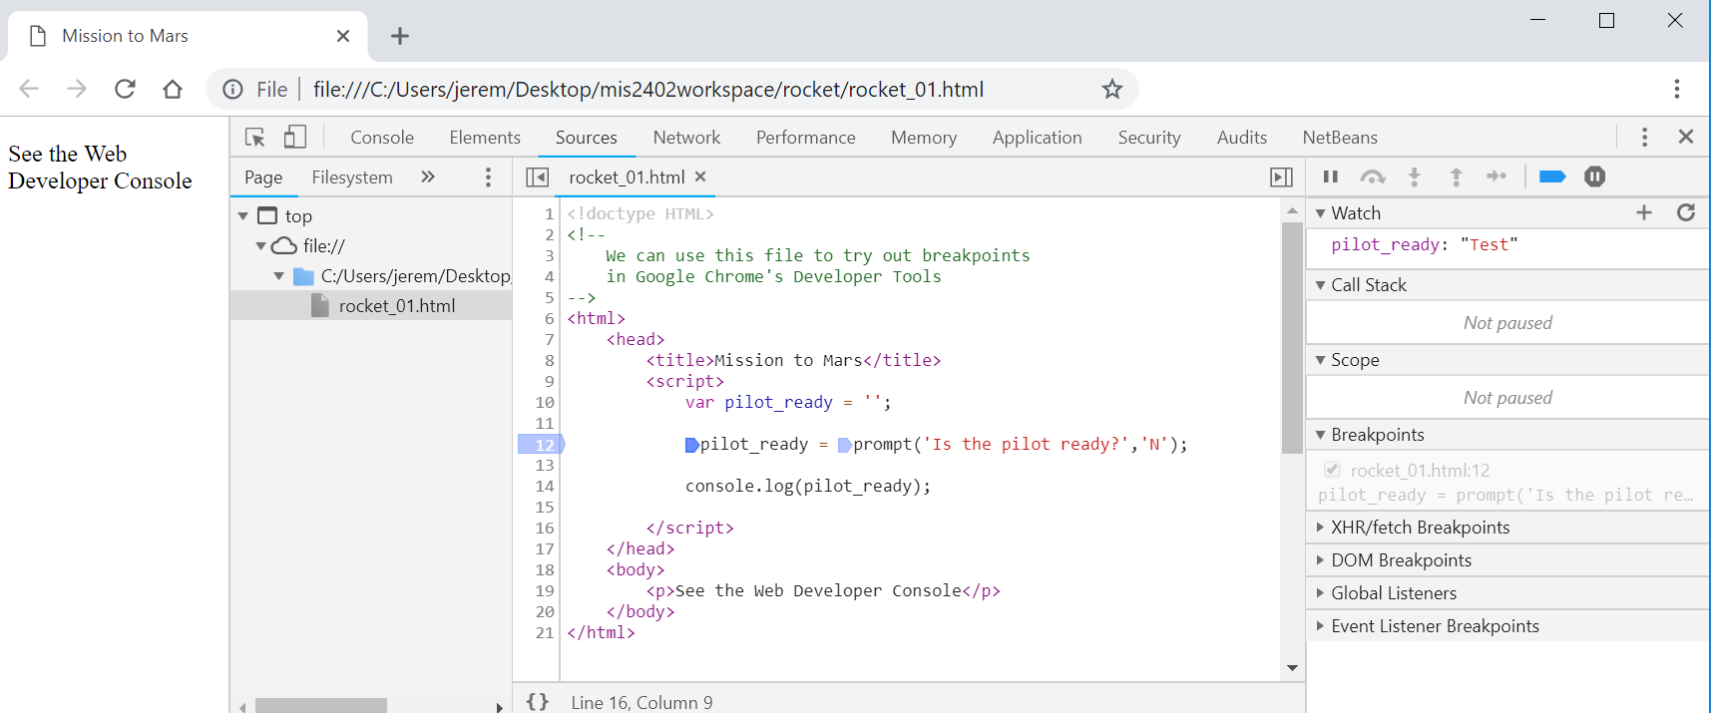
Breakpoints
Setting one or more breakpoints in your code will allow you, the developer, to get a better understanding of how your code is working.
Let’s see an example of this. (see rocket.zip)

Slide 5
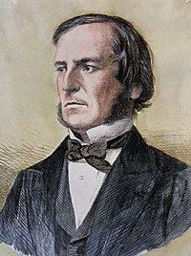
A new data type
Discuss: What were the two data types we introduced last class?
Today we are going to introduce another data type: the Boolean value.
Boolean means “true” or “false” and… it gets its name from a famous mathematician named George Boole.
George Boole lived long before computers were invented. If only he could see where his ideas have taken us!
In JavaScript we can explicitly assign a Boolean value like this:
var some_name = true;
var some_other_name = false;

Slide 6
The relational operators
Usually we are more interested in determining true or false values by comparing two things. We use the following operators to compare values.

Slide 7
Conditional expressions
This code illustrates some logical expressions. Logical expressions evaluate to true or false.
What do each of these expressions evaluate to?
Think quick! If == is a comparison operator, what is the assignment operator in JavaScript?

Slide 8
Another test
Sometimes we need to test a variable and figure if it is a number or not. For that we use something called isNaN.
The abbreviation isNaN means “is Not a Number”.
The syntax of the global isNaN method
isNaN() is a global method. The term “global” means it is available everywhere in your JavaScript code. Global methods are also sometimes called functions.

Slide 9
The logical operators
OK, now we are getting fancy! It is often useful to consider two or more boolean expressions at the same time. For example: we might want to know if condition “A” and condition “B” are both true.
To build such compound expressions, we use logical operators.

Slide 10
Conditional expressions with logical operatiors
Expressions evaluate to true or false. Given:
var testScore = 100;
var age = 55;
var limit = 60;
What do each of these expressions evaluate to?
So – what does this evaluate to:
!(1 == 2) && 'monkey' == 'monkey' || 'elephant' == 'hippo'

Slide 11
Putting conditional expressions to work!
The syntax of the if statement
It’s a code block “sandwich”. The “{“ and “}” hold one or more lines of code.

Slide 12
An if statement with multiple else clauses

Slide 13
Let’s give this a try…
( See rocket_01.html through rocket_05.html )

Slide 14
Variables don’t live for long…
When the script in index.html runs, the variables x and y get briefly created, used, and destroyed.
Those variable just don’t exist in file01.html and file02.html.
If we try, the JavaScript will not run in file01 and file02 because x and y simply don’t exist in that context.
The browser’s “brain”
index.html
file01.html
file02.html
var x = ‘Fred’;
var y = 3.14;
console.log(x);
console.log(y);
x and y are used and immediately discarded.
Error!
Error!

Slide 15
It would be nice if …
It would be nice if there was a way to declare a variable in such a way that it stayed in the browser’s brain.
Surprise! Such a thing exists! It’s called “Local Storage” and it allows you to store data in the browser’s memory indefinitely until it is deliberatrly cleared. The localStorage object is built into the browser for you to use.
So, what this object allows you to do is to specify the reserved word “localStorage” followed by a dot “.” followed by an identifier of your own choosing. It’s a pretty easy syntax!
localStorage.myMadeUpName = "owl";

Slide 16
Let’s try localStorage
x and y are now in the browser’s memory:
The browser’s “brain”
localStorage.x = ‘Fred’;
localStorage.y = 3.14;
index.html
file01.html
file02.html
localStorage.x = ‘Fred’;
localStorage.y = 3.14;
console.log(localStorage.x );
console.log(localStorage.y);
This runs
Works!
Works!

Slide 17
Historic note
There are a variety of ways to achieve this effect of “remembering” data from page to page – but the Local Storage option is probably the easiest. This option came into existence as part of the HTML 5 specification. So, all major browsers now support the local storage object. (There is also a “session storage” object which is subtly different.)
So... You were born at the right time! Other/older approaches used something called “cookies” and were pretty complicated.

Slide 18
What does this have to do with “if” statements?
Sometimes we want to check if a localStorage item exists before we try to use it. We use a conditional statement to check if the item is present.
If “x” exists this will evaluate as true, and false if “x” doesn’t exist!
Like this:
if (localStorage.x){
console.log("I remembered what x is!");
console.log(localStorage.x);
} else {
console.log("I never heard of x. What are you talking about?");
}
See “remembering” and “forgetting” in brain.zip

Slide 19
Next time …

