Slide 1
Loops and Arrays in JavaScript
MIS 2402
Department of MIS
Fox School of Business
Temple University

Slide 2
Agenda
Syntax for writing “for” loops in JavaScript
Introduction to arrays
Some practical examples of loops

Slide 3
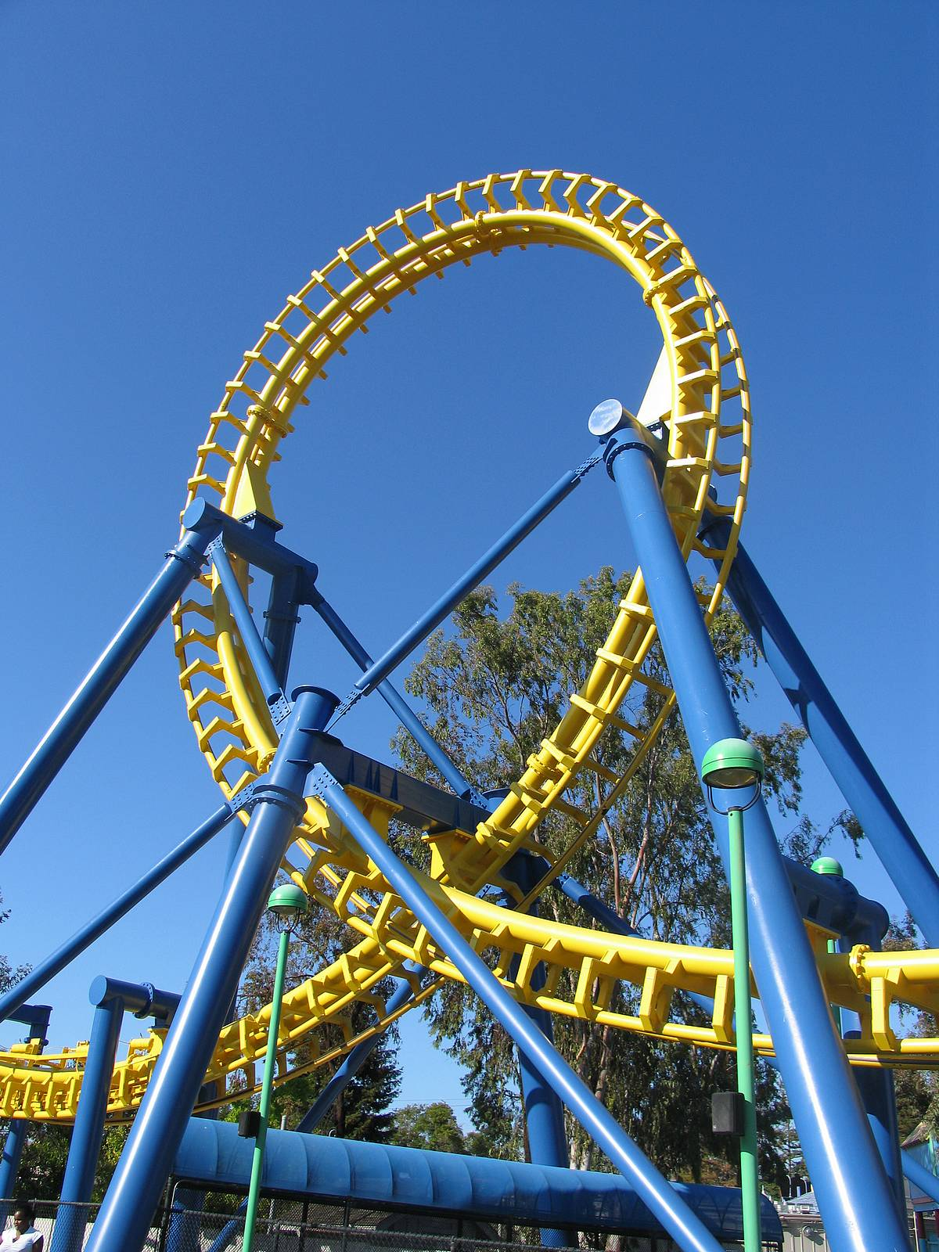
What’s a loop?
In programming, a “loop” is a series of commands (called “a block of code”) that repeats for a specified number of iterations.
It’s a programmatic way of doing the same thing over and over again.

Slide 4
The syntax of a JavaScript for loop
For example: Write the numbers 1 to 100 to the console.
for (var x = 1; x <= 100; x++) {
console.log(x);
}
x is declared and assigned a value.
The loop continues while this expression is true.
A shorthand way of saying x = x + 1
The code block begins and ends.

Slide 5
Another (simple) example of a for loop
Thinking ahead! We establish sumOfNumbers here so we can use it later in the loop.
We’re using a variable to control the number of iteration.

Slide 6
Another example of a for loop
Let’s see a loop at work! (see rocket_06.html in rocket2.zip)

Slide 7
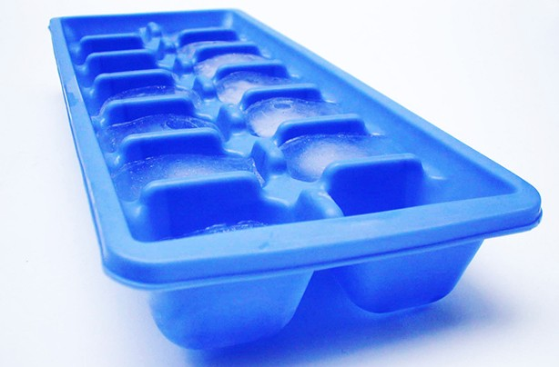
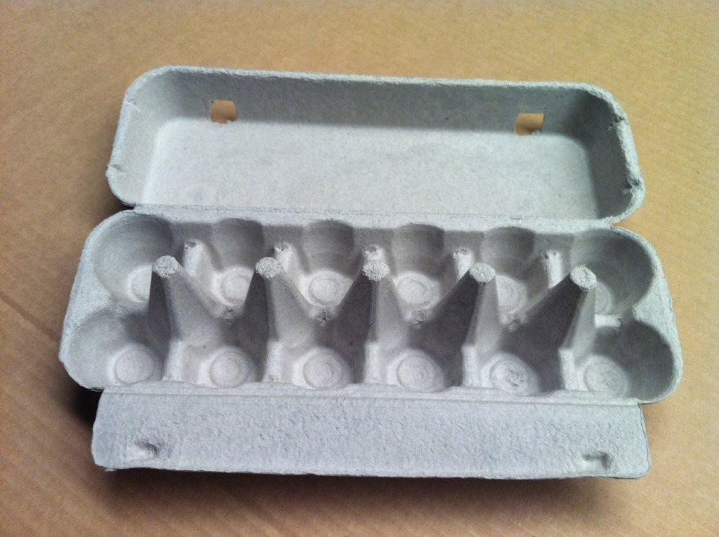
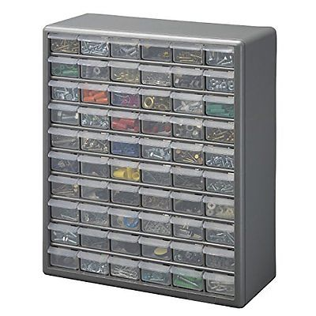
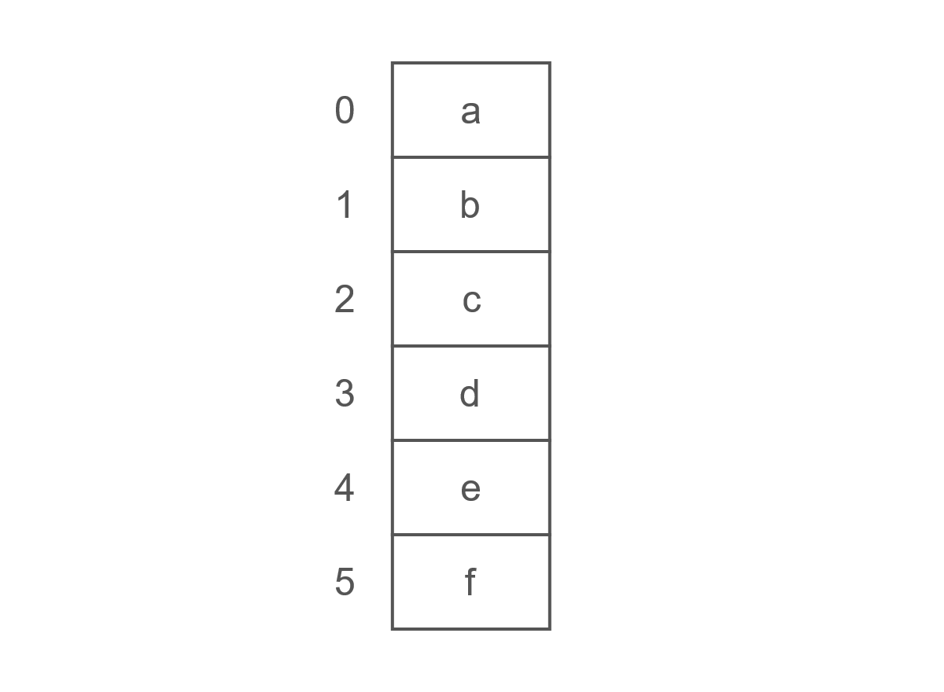
What’s an array?
An array is a data type that can contain one or more items called elements. Each element stores a value that you can refer to with an index. The length of the array indicates the number of elements that it contains. In short, an array is a structure that allows us to store multiple pieces of similar data.

Slide 8
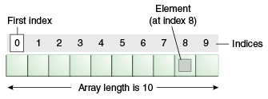
Flat array structure

Slide 9
The syntax for creating an array

Slide 10
How to add values to an array
This number, inside the square brackets, is the index to the array. It indicates what piece of the array we are going to add a value to.
QUESTION: What is the index of the first value in the above array?
Careful! JavaScript arrays are zero-based and that is often a source of trouble for first-time coders.
Now that the totals array exist, and some values have been assigned to it, I can use totals[2], totals[1] and totals[0] like any other primitive variable.

Slide 11
How big is the array?
QUESTION: Using the totals array from the last slide, what number would this command display? console.log(totals.length);

Slide 12
Putting arrays to work

Slide 13
Putting arrays to work(2)
QUESTION: What one line of code here could we add after “what’s next” that would write the sum of totals to the console? What about the average? Recalling last week’s challenge, what else could we do to report the result of our calculation?
(see rocket_07.html)

Slide 14
So… what are loops good for?
Performing a calculation that requires iterations.
Stepping though each element of an array.
Generating repetitive HTML. <table> rows, <select> options, <ul> items, <ol> items.
Any combination of the above!
(see rocket_08.html)

Slide 15
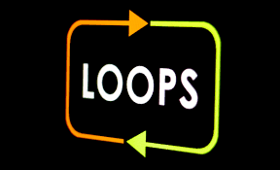
Next time…

