Slide 1
JavaScript objects, functions, and events
MIS 2402
Department of MIS
Fox School of Business
Temple University

Slide 2
Advisory!
This lecture presents some *big* ideas that will be very important in the days ahead.
It’ll be extra important to think both in terms of generalities (What is it we are trying to do? And why?) and in specifics (How do we express these ideas in JavaScript? What’s the syntax?)
Every lecture is important, but this one in particular will lay the groundwork for the rest of the semester.
Functions are even more important than loops!

Slide 3
Before we begin …
Let’s talk about… $
What is that crazy $ thing we keep seeing?
We saw it in week 4 …
$("#quantity_of_gnomes").html(gnomes_needed);
We saw it in week 5…
$('#answer').append(the_li_tag);
What does it all mean?

Slide 4
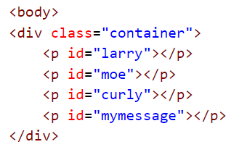
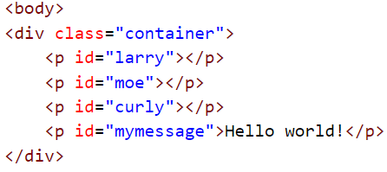
The $ function, explained
OK, it’s time to come clean.
The $ function is really at the heart of something called jQuery. Next week we’ll learn more about what jQuery is, and what it can do. But, for now, think of it this way: the “$” means “Select”.
So, when we say:
$('#mymessage').html('Hello world!’);
The browser selects the tag with the id “mymessage”
!
Now take action on the tag you found.
We haven’t seen the last of the $ function!

Slide 5
Agenda
Talk about what functions are
Talk about what objects are
Talk about the things that make objects special: properties, methods and events
Introduce you to the only events you will ever need (in this course, anyway)
Equip you with the ability to make your own functions
Discuss why you might want to do that

Slide 6
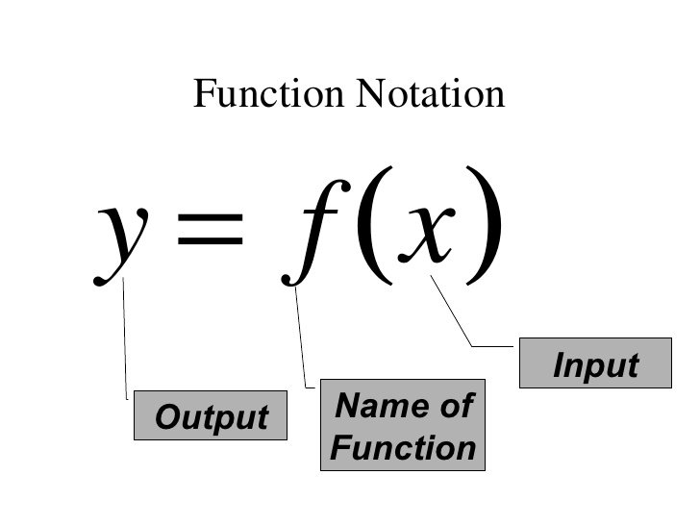
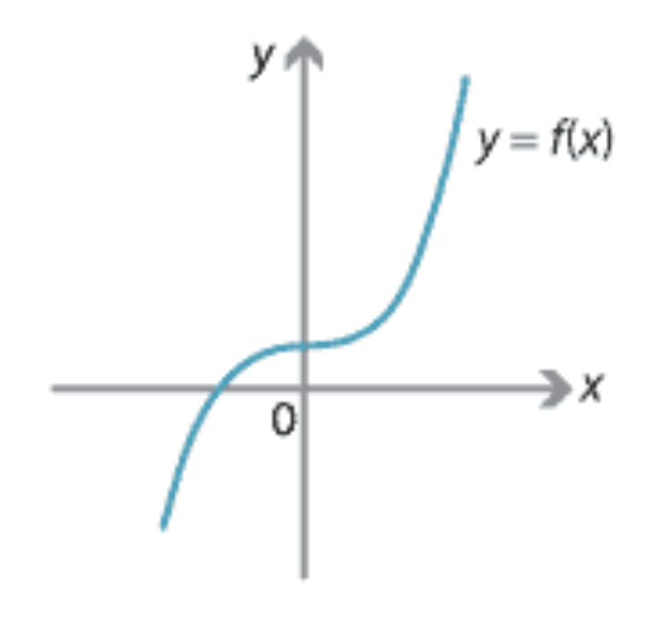
What’s a function?
In mathematics, a function is one or more rules that are applied to an input in order to generate an output.
The input is the number or value put into the function.
The output is the number or value that the function generates.

Slide 7
What is a function? (2)
In programming, a function is a collection of statements grouped together in such a way that they can receive zero, one, or more pieces of input. One or more programming statements are then used by the function to generate some output.
Here are some examples of functions:
var feet_to_inches = function(HowManyFeet){
var x = HowManyFeet * 12;
return x;
}
var convertToCelcius = function(degrees_fahrenheit){
var the_answer = (degrees_fahrenheit - 32) * ( 5 / 9 );
return the_answer;
}

Slide 8
What is a function? (3)
The last two examples illustrated functions which returned a value. In JavaScript, sometimes we don’t worry about what value the function returns. Occasionally, we just want to group a bunch of commands together because it is it convenient to do so. In those cases we leave the return value undefined. For example:
var bottles_of_beer_song = function(iterations){
for (var i = iterations; i > 0; i--){
console.log(i + ' bottles of beer on the wall, ' );
console.log(i + ' bottles of beer!');
console.log('Take one down, pass it around, ' );
console.log((i - 1) + ' bottles of beer on the wall!');
console.log(' '); //print a blank line
}
}
See fun01.html and fun02.html in funtimes.zip
Don’t forget to set and use breakpoints in the Chrome Developer Tools!

Slide 9
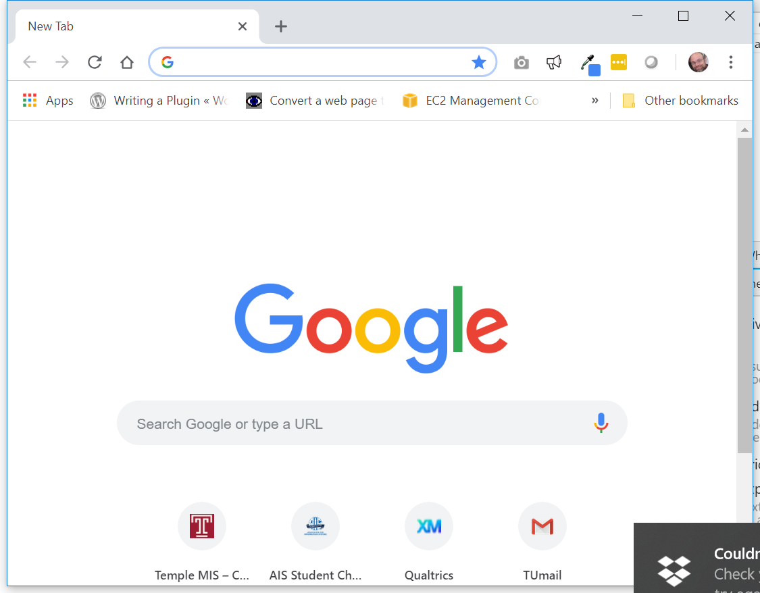
Objects

Slide 10
What’s an object?
In JavaScript, an object is known as a complex data type. It’s “complex” because, unlike primitive data types (like number and string) objects can hold more than one value. We call the values stored in objects, properties.
What makes objects even more special is that they can have methods and events. Methods enable the object to perform actions. Methods are like verbs. Events describe what can happen to an object. Events are like triggers. Being able to specify properties, methods, and events makes the object data type a very powerful tool for any programming task.

Slide 11
An hypothetical example – a car
Properties
car.color = “red”;
car.fuel_type = “regular”;
car.engine_type = “v6”;
Methods:
car.unlockDoors(key);
car.applyBreak(speed);
car.turnIgnition(key,position);
car.changeGear(gearType);
car.isEngineRunning();
car.releaseBrake(speed);
Events:
car.onObstacle( function (){ takeEvasiveAction()
} );
With this convention, anything can be expressed as an object.

Slide 12
Objects are everywhere: Strings
Properties and methods of a String object
Take note: name.length is a property. It has a single value.
Meanwhile, name.toLowerCase() is a method. The method does something. Method names all end with a pair of parenthesis.

Slide 13
Objects are everywhere: Numbers
Methods of a Number object
Congratulations. You are now part of the very secret society that understand that *everything* in JavaScript is object-oriented.

Slide 14
The only events you need…
Recall that events are things that happen. In this course, we will limit ourselves to two events.
#1. The “click” event. The “click” event takes place when a tag (usually a button) is clicked.
We can use jQuery to detect the click event, like this:
$(‘#some_id_here’).click();
Here we are identifying the tag being clicked.
When the click event happens, the command inside these parenthesis executes.

Slide 15
But wait, there’s more…
When we specify the commands that are to be executed in response to the click event, we *must* bundle them together as a single function. This is true if we have one command to execute or many.
$(‘#some_id_here’).click();
Like this.
$(‘#some_id_here’).click(function(){
// … all the commands go here
});

Slide 16
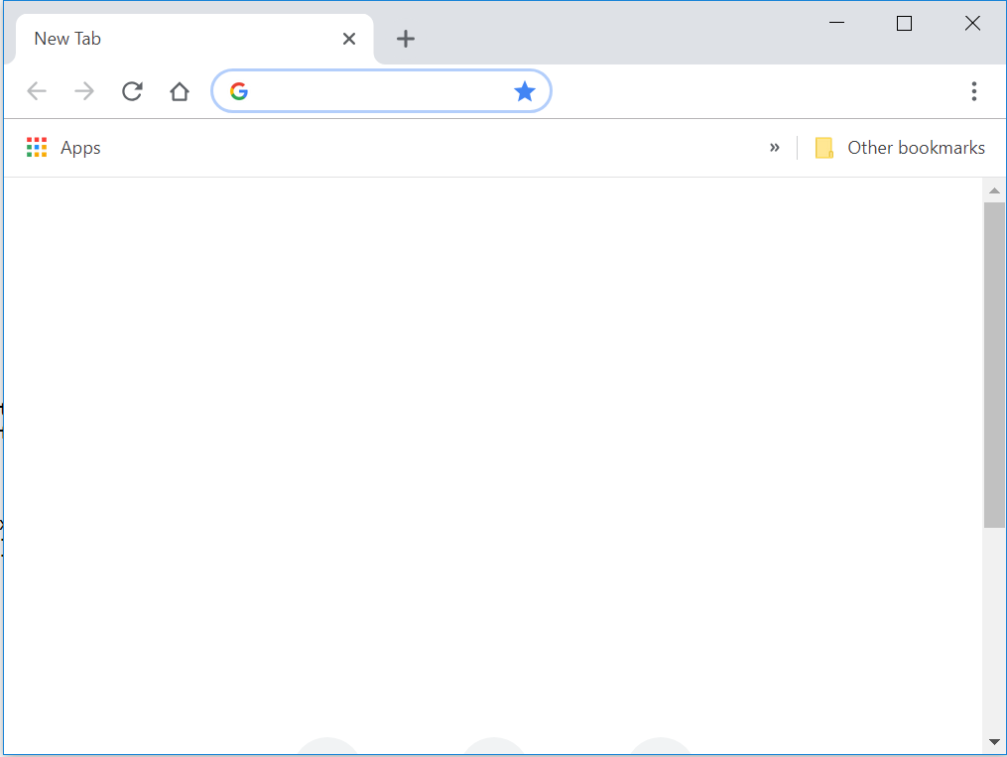
The “document ready” event.
#2. The “document ready” event takes place when an html document is completely loaded into the browser.
We can use jQuery to detect the document ready event, like this:
$(document).ready();
I am ready!
Again the function to execute goes inside these parenthesis.
See fun03.html, fun04.html and fun05.html)

Slide 17
Putting it all together
In fun06.html let’s write some HTML and JavaScript that waits for a user to click on a button.
When the user clicks on the button, prompt the user for degrees Fahrenheit and calculate the degrees Celsius.
Define a function named convertFtoC to do the math for you.

Slide 18
Why would you want to do all that?
Functions in JavaScript (or any other programming language) allow us to “divide and conquer”. They provide a mechanism to break large, complicated problems down into a collection of smaller, simpler problems.
Functions allow use assign meaningful names to blocks of code. For example: the name convertFtoC is more understandable that y = (x - 32) * (5/9);
Functions help us avoid writing the same sort of code, over and over. Once I write a convertFtoC function, why would I ever write that formula ever again? I shouldn’t have to.

Slide 19
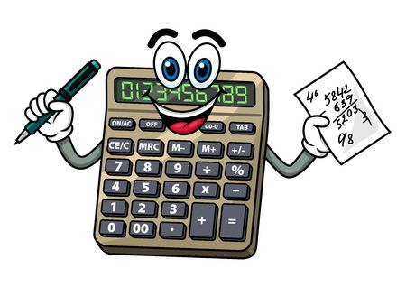
Next time…
Next time we’ll practice writing functions to do some calculations for us. We’ll integrate these simple calculations with buttons on a web page.

