Slide 1
Single Page Architecture (SPA)
MIS 2402
Jeremy Shafer
Department of MIS
Fox School of Business
Temple University

Slide 2
Agenda
Define what a Single Page Architecture is.
Why SPA applications are rising in prominence.
Introduce some jQuery commands we’ll use next time

Slide 3
What’s a SPA?
A SPA application is designed so that all user interactions are driven through one, single, page … usually index.html.
While a SPA application may have one page that dominates the user’s attention, that single page usually references many other supporting resources.
Supporting Resource
More supporting resources!
A good way to think about SPA applications: the goal is to get is much data and functionality delivered to the user in the initial page load as possible. Once that’s done, keep all other interactions with the network as light as possible.

Slide 4
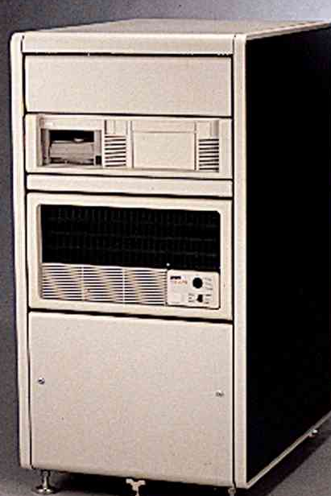
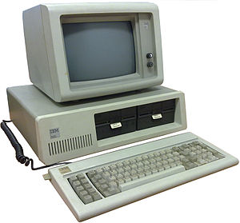
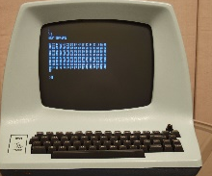
A little (simplified) history
1950-1980
1981-2000
2001-2005
2006-present
Many CPUs, connected by a ubiquitous, wireless, high speed internet connection. Each application leverages multiple resources in “the cloud.”
Client and server, with a broadband internet connection. (“Hot” languages – PHP, ASP.Net, JSP, etc.)
One big shared CPU and a lot of dumb terminals. (“Hot” languages – COBOL, Fortran.)
Now anyone can have their own CPU! (“Hot” languages – Basic, C.)
(“Hot” languages – JavaScript for the client, Node.js for the cloud.)

Slide 5
The role of JavaScript in Web Applications
1995 (approx.)
(Present!)
100%
90%
50%
10%
?
Initial download
0%
10%
50%
90%
?
Client doesn’t use any logic at all. Every web request causes the page to be completely reloaded. (A “round trip”.)
Hey! This JavaScript stuff might be good for some things.
Google Docs and similar feature-rich applications make full use of the JavaScript language!
JavaScript, HTML and CSS can be bundled into a mobile application.
How much network interaction you need depends on the application’s features.
See: http://blog.venturepact.com/8-high-performance-apps-you-never-knew-were-hybrid/

Slide 6
Where we are headed …
In this course we won’t be developing hybrid mobile apps, but we’ll get close to it.
Initial download
10%
?
Initial download from the class server.
50%
?
90%
?
50%
?
(No.)
(Yes!)
Publishing to an App Store can get complicated!
Similar thought process to mobile development, but easier to build.

Slide 7
What we’ll need for next time …
In a previous class, we saw the jQuery operator .next()
To get a little more control over the appearance and behavior of our user interface we’ll use a similar method called .parent()
As a convenience, we’ll expand our knowledge of CSS selectors just a tiny bit, and we’ll also add the new jQuery methods .show(), .hide(), and .focus()
But the biggest thing we should add is…
this
The reserved word “this” is a way to reference the object that triggered an event.

Slide 8
Today, we are going to stop and examine each one of these pieces. See pieces.zip
Then, when we meet next as a class, we’ll assemble them to make a simple application.

