Slide 1

MIS2502:
Data Analytics
Extract, Transform, Load
Jaclyn Hansberry
jaclyn.hansberry@temple.edu

Slide 2

Where we are…
Now we’re here…
Data entry
Transactional Database
Data extraction
Analytical Data Store
Data analysis
Stores real-time transactional data
Stores historical transactional and summary data

Slide 3
Getting the information into the data mart
The data in the operational database…
…which feeds the data mart…
…and is analyzed as a cube.
…is put into a data warehouse…
Now let’s address this part…

Slide 4

Extract, Transform, Load (ETL)
Extract data from the operational data store
Transform data into an analysis-ready format
Load it into the analytical data store

Slide 5
The Actual Process
Extract
Transform
Load
Transactional Database 1
Data conversion
Query
Query
Data Mart
Transactional Database 2
Data conversion
Query
Query
Relational database
Dimensional database

Slide 6
ETL’s Not That Easy!
Data Consistency
What if the data is in different formats?
Data Quality
How do we know it’s correct?
What if the data we need isn’t there?
What if there is missing data?

Slide 7
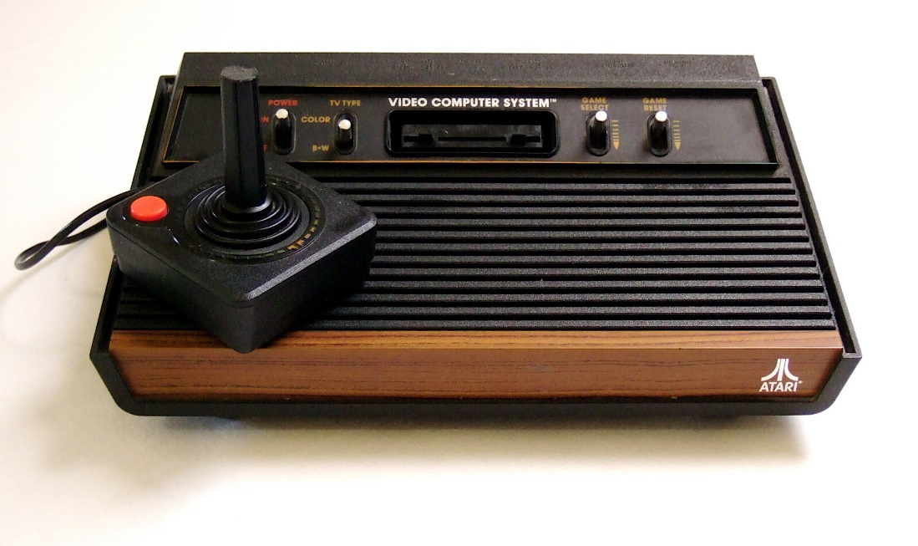
Data Consistency:
The Problem with Legacy Systems
An IT infrastructure evolves over time
Systems are created and acquired by different people using different specifications
This can happen through:
Changes in management
Mergers & Acquisitions
Externally mandated standards
Generally poor planning

Slide 8
This leads to many issues
Redundant data across the organization
Customer record maintained by accounts receivable and marketing
The same data element stored in different formats
Social Security number (123-45-6789 versus 123456789)
Different naming conventions
“Doritos” versus “Frito-Lay’s Doritos” verus “Regular Doritos”
Different unique identifiers used
Account_Number versus Customer_ID
What are the problems with each of these
?

Slide 9
What’s the big deal?
This is a fundamental problem for creating data cubes
We often need to combine information from several transactional databases
How do we know if we’re talking about the same customer or product?

Slide 10
Now think about this scenario
Hotel Reservation Database
Café Database
What are the differences between a “guest” and a “customer”?
Is there any way to know if a customer of the café is staying at the hotel?

Slide 11
Solution: “Single view” of data
The entire organization understands a unit of data in the same way
It’s both a business goal and a technology goal
but it’s really more this…
...than this

Slide 12
Closer look at the Guest/Customer
Guests
Guest_number
Guest_firstname
Guest_lastname
Guest_address
Guest_city
Guest_zipcode
Guest_email
Customer
Customer_number
Customer_name
Customer_address
Customer_city
Customer_zipcode
vs.
Getting to a “single view” of data:
What would you use to uniquely identify a guest/customer?
Would you include email address?
How would you represent “name?”
How do you figure out if you’re talking about the same person?

Slide 13
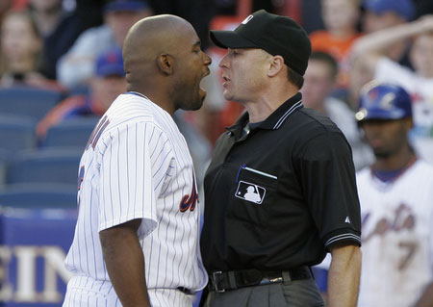
Organizational issues
Why might there be resistance to data standardization?
Is it an option to just “fix” the transactional databases?
If two data elements conflict, who’s standard “wins?”

Slide 14
Data Quality
The degree to which the data reflects the actual environment
Do we have the right data?
Is the collection process reliable?
Is the data accurate?

Slide 15

Finding the right data
Choose data consistent with the goals of analysis
Verify that the data really measures what it claims to measure
Include the analysts in the design process
Adapted from http://www2.ed.gov/about/offices/list/os/technology/plan/2004/
site/docs_and_pdf/Data_Quality_Audits_from_ESP_Solutions_Group.pdf

Slide 16

Ensuring accuracy
Know where the data comes from
Manual verification through sampling
Use of knowledge experts
Verify calculations for derived measures
Adapted from http://www2.ed.gov/about/offices/list/os/technology/plan/2004/
site/docs_and_pdf/Data_Quality_Audits_from_ESP_Solutions_Group.pdf

Slide 17

Reliability of the collection process
Build fault tolerance into the process
Periodically run reports, check logs, and verify results
Keep up with (and communicate) changes
Adapted from http://www2.ed.gov/about/offices/list/os/technology/plan/2004/
site/docs_and_pdf/Data_Quality_Audits_from_ESP_Solutions_Group.pdf

