Slide 1

MIS2502:
Data Analytics
Advanced Analytics - Introduction

Slide 2

The Information Architecture of an Organization
Now we’re here…
Data entry
Transactional Database
Data extraction
Analytical Data Store
Data analysis
Stores real-time transactional data
Stores historical transactional and summary data

Slide 3


The difference between OLAP and data mining
OLAP can tell you what is happening, or what has happened
Analytical Data Store
…like a pivot table
Data mining can tell you why it is happening, and help predict what will happen
The (dimensional) data warehouse feed both…
…like what we’ll do with SAS

Slide 4
The Evolution of
Advanced Data Analytics
Evolutionary Step | Business Question | Enabling Technologies | Characteristics
Data Collection (1960s) | "What was my total revenue in the last five years?" | Storage: Computers, tapes, disks | Retrospective, static data delivery
Data Access (1980s) | "What were unit sales in New England last March?" | Relational databases (RDBMS), Structured Query Language (SQL) | Retrospective, dynamic data delivery at record level
Data Warehousing/ Decision Support (1990s) | "What were unit sales in New England last March?” Now “drill down” to Boston? | On-line analytical processing (OLAP), dimensional databases, data warehouses | Retrospective, dynamic data delivery at multiple levels
Data Mining and Predictive Analytics (2000s and beyond) | "What’s likely to happen to Boston unit sales next month? Why?" | Advanced algorithms, parallel computing, massive databases | Prospective, proactive information delivery

Slide 5
Origins of Data Mining
Artificial
intelligence
Pattern recognition
Statistics
Database systems
Draws ideas from
  Artificial intelligence
  Pattern recognition
  Statistics
  Database systems
Traditional techniques may not work because of
  Sheer amount of data
  High dimensionality
  Heterogeneous, distributed nature of data
Data Mining

Slide 6

Data Mining and Predictive Analytics is
Extraction of implicit, previously unknown, and potentially useful information from data
Exploration and analysis of large data sets to discover meaningful patterns

Slide 7
What data mining is not…
Sales analysis
What are the sales by quarter and region?
How do sales compare in two different stores in the same state?
Profitability analysis
Which is the most profitable store in Pennsylvania?
Sales force analysis
Which salesperson produced the most revenue this year?
Does salesperson X meet this quarter’s target?
Which product lines are the highest revenue producers this year?
If these aren’t data mining examples, then what are they
?

Slide 8
Data Mining Tasks
Prediction Methods
Use some variables to predict unknown or future values of other variables
Likelihood of a particular outcome
Description Methods
Find human-interpretable patterns that describe the data
from Fayyad et al., Advances in Knowledge Discovery and Data Mining, 1996

Slide 9
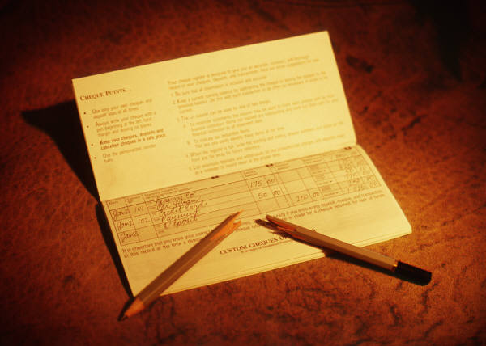
Case Study
A marketing manager
for a brokerage
company
Problem:
High churn (customers leave)
  Turnover (after 6 month introductory period) is 40%
  Customers get a reward (average: $160) to open an account
  Giving incentives to everyone who might leave is expensive
  Getting a customer back after they leave is expensive

Slide 10
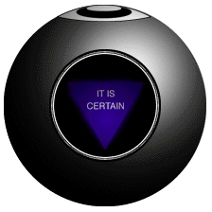
…a solution
One month before the end of the introductory period, predict which customers will leave
Offer those customers something based on their future value
Ignore the ones that are not predicted to churn

Slide 11
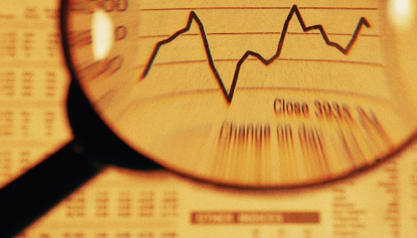

Data Mining Tasks
Descriptive
Clustering
Association Rule Discovery
Sequential Pattern Discovery
Predictive
Classification
Regression
Neural Networks
Deviation Detection
Visualization

Slide 12
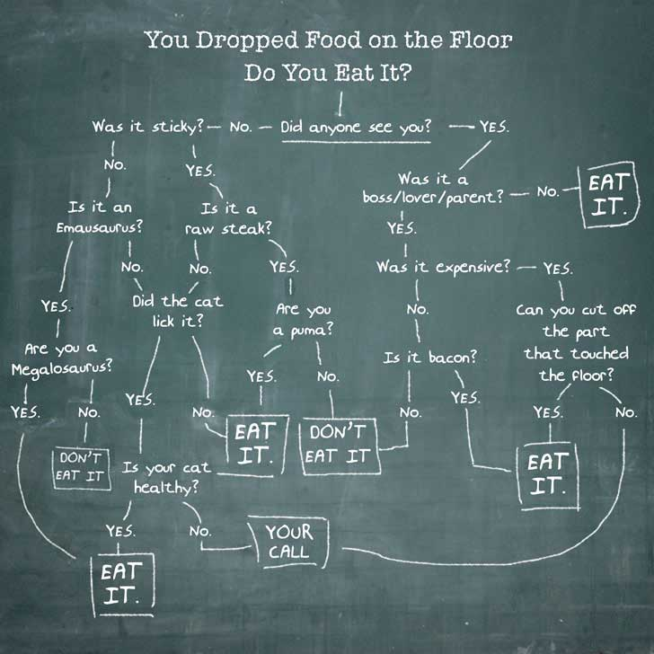
Decision Trees
Used to classify data
according to a
pre-defined outcome
Based on characteristics
of that data
http://www.mindtoss.com/2010/01/25/five-second-rule-decision-chart/
Uses
Predict whether a customer should receive a loan
Flag a credit card charge as legitimate
Determine whether an investment will pay off

Slide 13
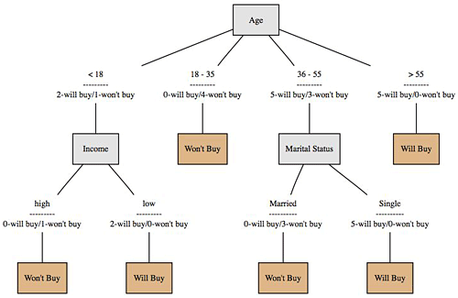
A more realistic one…
Will a customer buy some product given their demographics?
What are the characteristics of customers who are likely to buy?
http://onlamp.com/pub/a/python/2006/02/09/ai_decision_trees.html

Slide 14
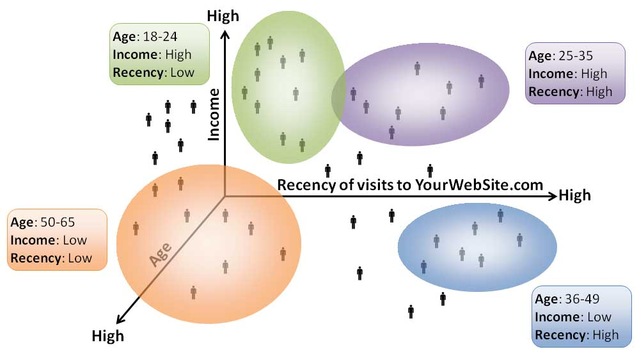
Clustering
Used to determine distinct groups of data
Based on data across multiple dimensions
Here you have four clusters of web site visitors.
What does this tell you?
Uses
Customer segmentation
Identifying patient care groups
Performance of business sectors
http://www.datadrivesmedia.com/two-ways-performance-increases-targeting-precision-and-response-rates/

Slide 15
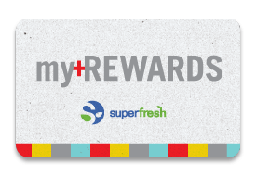
Association Mining
Find out which items predict the occurrence of other items
Also known as “affinity analysis” or “market basket” analysis
Uses
What products are bought together?
Amazon’s recommendation engine
Telephone calling patterns

Slide 16
Bottom line
In large sets of data, these patterns aren’t obvious
And we can’t just figure it out in our head
We need analytics software
We’ll be using SAS to perform these three analyses on large sets of data

