Slide 1
Final Exam Review

Slide 2
Data Mining and Data Analytics Techniques
Explain the three data analytics techniques we covered in the course
Decision Trees, Clustering, and Association Rules
What kinds of problems can each solve? Provide a business-oriented example.
Make recommendations to a business based on the results of each type of analysis.
Explain how data mining differs from OLAP analysis
Why would you use this instead of a data cube and a pivot table?

Slide 3
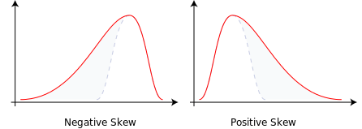
Understanding Descriptive Statistics
Be able to read and interpret a histogram
Negative Skew/Positive Skew
Be able to read and interpret sample statistics

Slide 4
Sample Statistics
Variable | Min | Max | Mean
Male | 0 | 1 | .7
Female | 0 | 1.05 | .2
Did not reply | 0 | 1 | .1

Slide 5
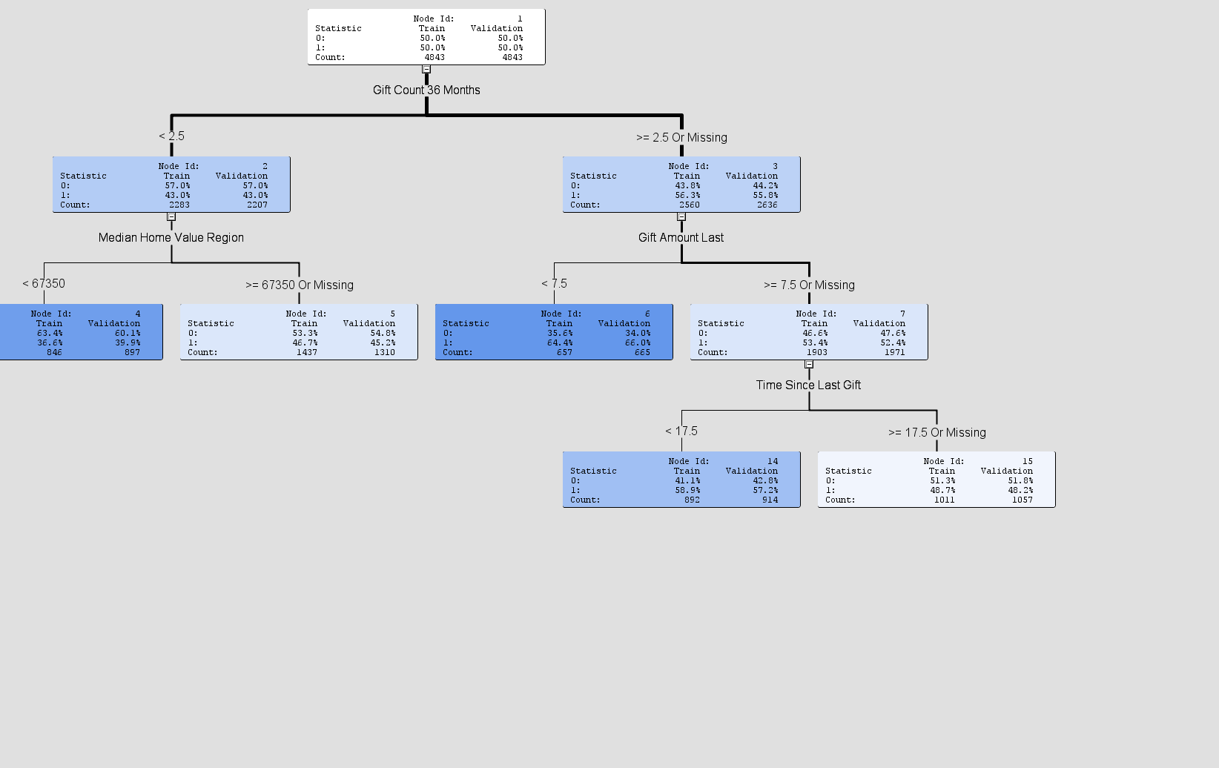
Decision Tree Analysis

Slide 6
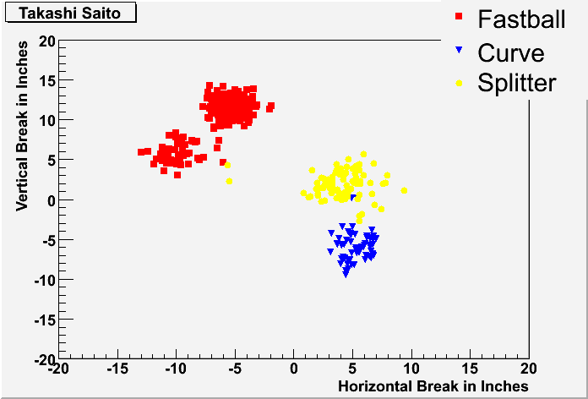
Cluster Analysis
Scatter Plot
What do you look for in a histogram to tell if a variable should be included?

Slide 7
Cluster Analysis
Cohesion: Similar items being grouped together.
Separation: Separate different clusters away from each other.
Which cluster has the highest cohesion? Cluster 1. Why?
Which cluster has the highest separation? Cluster 3. Why?

Slide 8
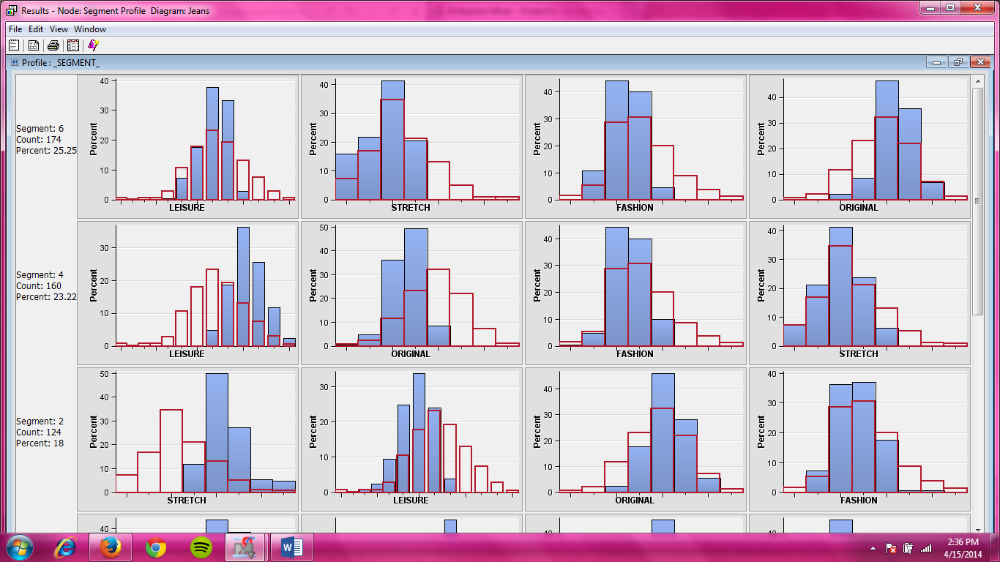
Cluster Analysis
Segment profile Plot
Segment 6: Does ORIGINAL have higher values than the data or lower? Higher. Why?

Slide 9
Association Rules
Be able to read and interpret the output from an association rule analysis
Find the strongest (or weakest) rule from a set of output
Understand the difference between confidence, lift, and support
You should be able to explain the difference between them
Can you have high confidence and low lift?
You won’t have to compute them, but you should understand how they are computed so you can interpret the statistics

Slide 10
What’s the difference between a standard association rule analysis and a sequence analysis?
What situations would a sequence analysis make sense? When wouldn’t it?
What activity is most likely to be undertaken if website is visited first? Archive. Why?
What is a situation where you may have high confidence but not a high lift? Musicstream-> Website. What is happening here?

