Slide 1
The Information Architecture of an Organization
MIS2502: Data Analytics
Sunil Wattal
Associate Professor MIS
Irvin L Gross Senior Research Fellow

Slide 2




What Do You Do With Data?
Gather
Store
Retrieve
Interpret

Slide 3
Components of an information infrastructure
Transactional Database
Captures data describing an event
Analytical Data Store
Used in analysis and reporting
For everyday transactions
Extracted from transactional data
Supports management of an organization’s data
Supports managerial decision-making
This is what is commonly thought of as “database management”
This is the foundation for “advanced data analytics”

Slide 4

The Information Architecture of an Organization
Data entry
Transactional Database
Data extraction
Analytical Data Store
Data analysis
Stores real-time transactional data in a relational or NoSQL database
Stores historical transactional and summary data

Slide 5
The Transactional Database
Definition of Transaction
Examples of transactions
  Purchase a product
  Enroll in a course
  Hire an employee
In business, a transaction is the exchange of information, goods, or services.
For databases, a transaction is an action performed in a database management system.
Data is in real-time
  Reflects current state
  How things are “now”
Transactional databases deal with both: they store information about business transactions using database transactions

Slide 6
Relational Database (RDBMS)
The Relational Paradigm:
  How transactional data is collected and stored
Primary Goal: Minimize redundancy
  Reduce errors
  Less space required
Most database management systems are based on the relational paradigm
  MySQL, Oracle, Microsoft Access, SQL Server
?
Which of these do you think
is more important today

Slide 7
Relational Database
Student-Class enrollment Example
This is good because:
Information is entered and stored once
Minimizes redundancy

Slide 8
The Relational Database
Student-Class enrollment Example
A series of tables with logical associations between them
The associations (relationships) allow the data to be combined
Student
StudentID
Name
Major
GPA
Student-Class
StudentClassID
StudentID
ClassID
Class
ClassID
Name

Slide 9
NoSQL Database
Stands for “Not only SQL”
  Supports unstructured data
Primary Goal: flexibility and scalability
  schema-less and nested data
  Less space required
Better fit for Digital Economy requirements
  Facebook, Airbnb, Netflix, LinkedIn, …
?

Slide 10
NoSQL Database
Schema-less and embedded documents
LastName: “WELLS”
GPA: 3.0
Major: “MIS”
Class: {ClassID: 1234,
ClassName:“MIS2101”}
LastName: “NORBERT”
Major: “FIN”
Class: [{ClassID: 1235,
ClassName:“MIS2502”,…}
… ]
LastName: “KENDALL”
GPA: 3.5
Class: [{ClassID: 1234,
ClassName:“MIS2101”}
… ]
This is good because:
More flexible – easily insert/delete data
More faster – requires less merging (join)

Slide 11
NoSQL Database
Database
Collection
Collection
Document
Document
Document
Document
Document
RDBMS | NoSQL
Database | Database
Table | Collection
Column | Field
Row | Document
Join | Embedded Document Linking across Documents
Foreign Key | Reference

Slide 12
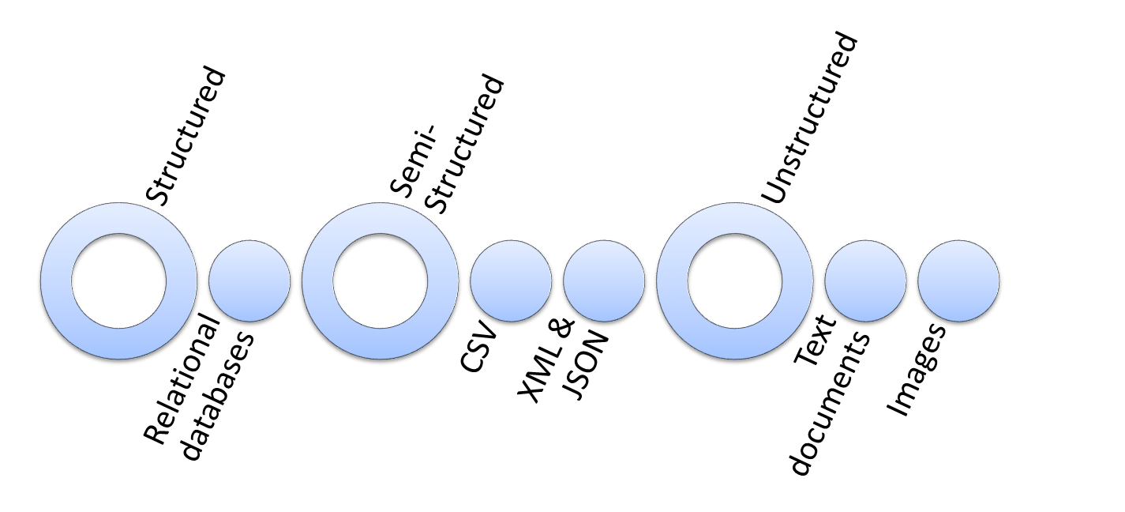
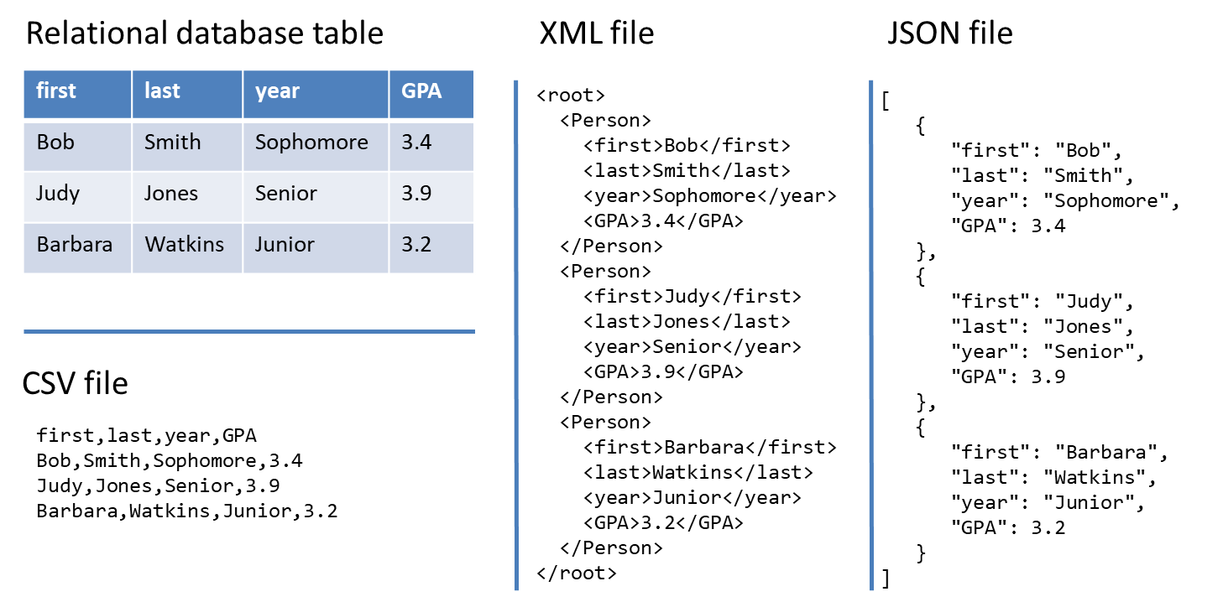
From structured to unstructured data

Slide 13
The Analytical Data Store
Stores historical and summarized data
  “Historical” means we keep everything
Data is extracted from the transactional database and reformatted for the analytical data store
Extract
Transform
Load
Transactional Database
Data conversion
Analytical Data Store
Query
Query
We’ll discuss this in much more detail later in the course!!

Slide 14
Comparing Transactional and Analytical Data Stores
Transactional Database | Analytical Data Store
Storage of real-time transactional data | Storage of historical transactional data
Optimized for storage efficiency and data integrity | Optimized for data retrieval and summarization
Supports day-to-day operations | Supports periodic and on-demand analysis

Slide 15
The agenda for the course
Weeks 1 through 6
Weeks
7 through 8
Weeks 9 through 15
Data entry
Transactional Database
Analytical Data Store
Data analysis
Data extraction
Stores real-time transactional data in a relational or NoSQL database
Stores historical transactional and summary data
Data interpretation,
visualization, communication

