Slide 1
Relational Data Modeling
MIS2502: Data Analytics
Sunil Wattal
Associate Professor MIS
Irwin Gross Senior Research Fellow

Slide 2

The information architecture of an organization
Now we’re here…
Data entry
Transactional Database
Data extraction
Analytical
Data Store
Data analysis
Stores real-time transactional data in a relational or NoSQL database
Stores historical transactional and summary data

Slide 3
The Transactional Database
Stores real-time, transactional data
In business, a transaction is the exchange of information, goods, or services.
For databases, a transaction is an action performed in a database management system.
Operational databases deal with both: they store information about business transactions using database transactions
Examples of transactions
  Purchase a product
  Enroll in a course
  Hire an employee
Data is in real-time
  Reflects current state
  How things are “now”

Slide 4
The Relational Database (RDBMS)
How transactional data is collected and stored
Primary Goal: Minimize redundancy
  Reduce errors
  Less space required
Most database management systems are relational
  Oracle, Microsoft Access, SQL Server, MySQL
?
Which of these do you think
is more important today

Slide 5
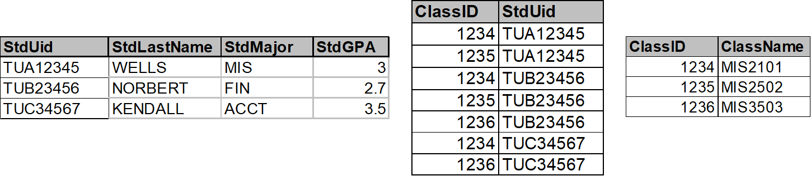
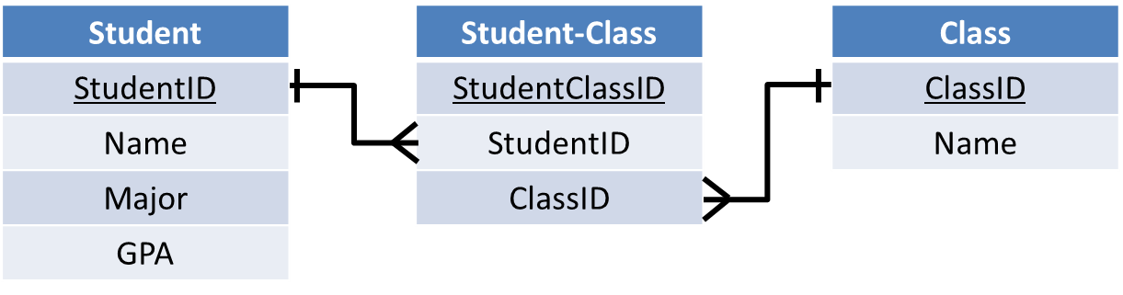
The Relational Database
A series of tables with logical associations between them
The associations (relationships) allow the data to be combined
We use database schema
Notes:
Schema 에 대한 slide 추가?

Slide 6
What is Database Schema?
Database Schema is
  A map of the tables and fields in the database
  This is what is implemented in the database management system
  Part of the “design” process
A database schema allows us to understand
  Entities in a database
  Attributes in a database
  Relationships between entities

Slide 7
Understanding Database Schema
Table Name
(Entity)
Table
Customer
CustomerID
FirstName
LastName
City
State
Zip
Order
OrderNumber
CustomerID
OrderDate
Primary Key
Foreign
Key
Field
(Attributes
of the
Entity)
Cardinality

Slide 8
Entity and Attribute
Table Name
(Entity)
Customer
CustomerID
FirstName
LastName
City
State
Zip
Entity represents an object/construct we want to manage
Attribute is a characteristic of an entity (or relationship)
Field
(Attributes)
This depicts a Customer table with 6 columns.
CustomerID | FirstName | LastName | City | State | Zip
1001 | Greg | House | Princeton | NJ | 09120
1002 | Lisa | Cuddy | Plainsboro | NJ | 09123
1003 | James | Wilson | Pittsgrove | NJ | 09121
1004 | Eric | Foreman | Warminster | PA | 19111

Slide 9
Primary Key
Customer
CustomerID
FirstName
LastName
City
State
Zip
Entities need to be uniquely identifiable
  So you can tell them apart
Use a primary key
  One or more attributes that
  uniquely identifies an entity
Primary Key
How about these as primary keys for Customer:
First name and/or last name?
Social security number?
This depicts a Customer table with 6 columns.
CustomerID | FirstName | LastName | City | State | Zip
1001 | Greg | House | Princeton | NJ | 09120
1002 | Lisa | Cuddy | Plainsboro | NJ | 09123
1003 | James | Wilson | Pittsgrove | NJ | 09121
1004 | Eric | Foreman | Warminster | PA | 19111

Slide 10
Cardinality
Cardinality describes the rules of the association (relationship) between entities
  There are many ways of denoting cardinality, but we will use crows feet notation.
Customer
CustomerID
FirstName
LastName
City
State
Zip
Order
OrderNumber
CustomerID
OrderDate
Cardinality

Slide 11
Cardinality
Maximum
Cardinality
Customer
CustomerID
FirstName
LastName
City
State
Zip
Order
OrderNumber
CustomerID
OrderDate
Minimum
Cardinality
Maximum cardinality
  Describes the maximum number of entities that participate in a relationship (either or )
Minimum cardinality
  Describes the minimum number of entities that participate in a relationship (either or )

Slide 12
Maximum Cardinality
How to understand the notations:
at most - one
at most - many
Customer
CustomerID
FirstName
LastName
City
State
Zip
Order
OrderNumber
CustomerID
OrderDate
  One customer can have many orders.
  One order can only belong to one customer.

Slide 13
Minimum Cardinality
How to understand the notations:
at least - one
at least - zero
Customer
CustomerID
FirstName
LastName
City
State
Zip
Order
OrderNumber
CustomerID
OrderDate
  One customer can have no (zero) orders.
  One order has to belong to at least one customer.

Slide 14
Cardinality
Maximum cardinality (type of relationship)
  Describes the maximum number of entity instances that participate in a relationship
    One-to-one
    One-to-many
    Many-to-many
A
B
A
B
A
B

Slide 15
One-to-One Relationship
One-to-One (1:1)
  A single instance of one entity is related to a single instance of another entity
Governor
State
A state has (at most) one governor
A governor governs (at most) one state

Slide 16
One-to-Many Relationship
One-to-Many (1:n or 1:m)
  A single instance of one entity is related to multiple instances of another entity
Publisher
Book
A publisher can publish many books
A book is published by (at most) one publisher

Slide 17
Many-to-Many Relationship
Many-to-Many (n:n or m:m)
  Each instance of one entity is related to multiple instances of another entity, and vice versa
Book
Author
A book can be written by many authors
An author can write many books

Slide 18
Minimum Cardinality
Minimums are generally stated as either zero or one:
  0 (optional): participation in the relationship by the entity is optional.
  1 (mandatory): participation in the relationship by the entity is mandatory.
A programmer is mandatory for a certificate); or a certificate has to be issued to (at least) one programmer.
A certificate is optional for a programmer; or a programmer may not have any certificates
Programmer
Certificate
1:m maximum cardinality: a programmer
can have many certificates; a certificate is issued to (at most) one programmer
Notes:
When checking the requirement statement, you should check for the cardinality
If none, then you should make an assumption and own judement which may make more sense.
In many cases, regarding maximum cardinality there is an right and wrong answer.

Slide 19
Cardinality is defined by business rules
What would the cardinality be in these entities?
?
?
Order
Product
?
?
Course
Section
?
?
Employee
Office

Slide 20
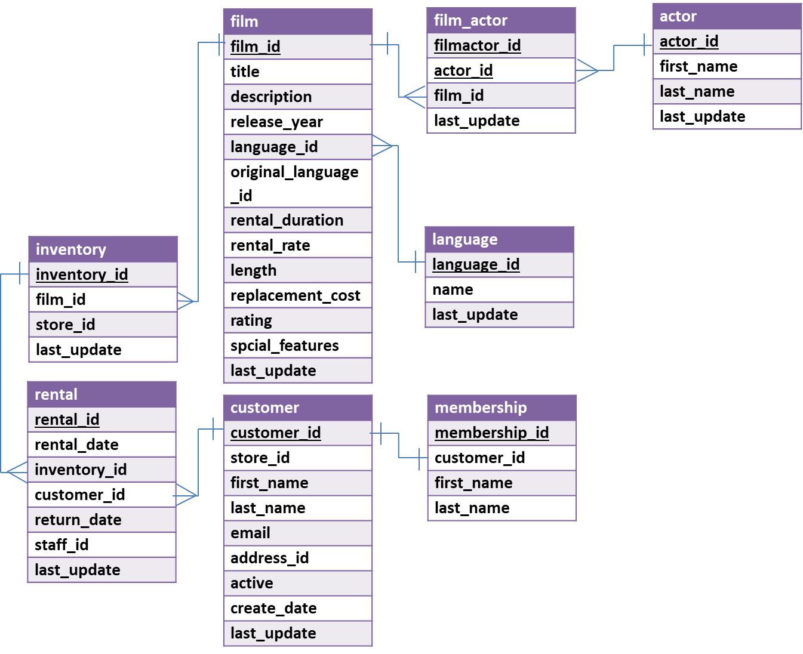
Understanding Database Schema
How many tables are there in this schema?
What are the attributes for entity actor?
What is the primary key for customer?
What is the primary key for rental?
What foreign keys does rental table contain?

Slide 21
The Rules
1. Define entities and attributes and the relationship between entities
2. Create a table for every entity and table fields for every entity’s attributes
3. Implement relationships between the tables
1:1 relationships
  Put primary key field of one table into other table as foreign key field
1:many relationships
  Primary key field of “1” table put into “many” table as foreign key field
many:many relationships
  Create new table
  1:many relationships with original tables

Slide 22
Create Tables and Fields
Entity | Attribute
Customer | CustomerID, FirstName, LastName, City, State, Zip
Membership | MembershipID, Level, Points
Order | OrderNumber, OrderDate
Product | ProductID, ProductName, Price
Other attributes | Quantity (Attribute of both order and product)
Customer
CustomerID
FirstName
LastName
City
State
Zip
Membership
MembershipID
Level
Points
Order
OrderNumber
OrderDate
Product
ProductID
ProductName
Price

Slide 23
Implement relationships
Entity | Type of Relationship
Customer, Membership | One-to-one
Customer, Order | One-to-Many
Order, Product | Many-to-Many
Customer
CustomerID
FirstName
LastName
City
State
Zip
Membership
MembershipID
Level
Points
Order
OrderNumber
OrderDate
Product
ProductID
ProductName
Price

Slide 24
The Customer and Membership Tables:
The 1:1 Relationship
1:1 relationships
  Put primary key field of one table into other table as foreign key field
Customer
CustomerID
FirstName
LastName
City
State
Zip
Membership
MembershipID
Level
Points
CustomerID

Slide 25
The Customer and Membership Tables:
The 1:1 Relationship
Customer Table
CustomerID | FirstName | LastName | City | State | Zip
1001 | Greg | House | Princeton | NJ | 09120
1002 | Lisa | Cuddy | Plainsboro | NJ | 09123
1003 | James | Wilson | Pittsgrove | NJ | 09121
1004 | Eric | Foreman | Warminster | PA | 19111
Membership Table
MembershipID | Level | Points | CustomerID
101 | 3 | 3200 | 1001
102 | 2 | 1100 | 1002
103 | 1 | 600 | 1004
104 | 1 | 680 | 1003
Customer ID is a foreign key in the Membership table.
We can associate each customer with each membership information!

Slide 26
The Customer and Membership Tables:
The 1:1 Relationship
Customer Table
CustomerID | FirstName | LastName | City | State | Zip | MembershipID
1001 | Greg | House | Princeton | NJ | 09120 | 101
1002 | Lisa | Cuddy | Plainsboro | NJ | 09123 | 102
1003 | James | Wilson | Pittsgrove | NJ | 09121 | 104
1004 | Eric | Foreman | Warminster | PA | 19111 | 103
Membership Table
MembershipID | Level | Points
101 | 3 | 3200
102 | 2 | 1100
103 | 1 | 600
104 | 1 | 680
Alternatively, we can use Membership ID is a foreign key in the Customer table.
We can associate each customer with each membership information!

Slide 27
The Customer and Order Tables:
The 1:m Relationship
1:many relationships
  Primary key field of “1” table put into “many” table as foreign key field
Customer
CustomerID
FirstName
LastName
City
State
Zip
Order
OrderNumber
CustomerID
OrderDate

Slide 28
The Customer and Order Tables:
The 1:m Relationship
Customer Table
CustomerID | FirstName | LastName | City | State | Zip
1001 | Greg | House | Princeton | NJ | 09120
1002 | Lisa | Cuddy | Plainsboro | NJ | 09123
1003 | James | Wilson | Pittsgrove | NJ | 09121
1004 | Eric | Foreman | Warminster | PA | 19111
Order Table
Customer ID is a foreign key in the Order table. We can associate multiple orders with a single customer!
In the Order table, Order Number is unique;
Customer ID is not!
Order Number | OrderDate | Customer ID
101 | 3-2-2011 | 1001
102 | 3-3-2011 | 1002
103 | 3-4-2011 | 1001
104 | 3-6-2011 | 1004

Slide 29
The Customer and Order Tables:
Normalization
Customer Table
CustomerID | FirstName | LastName | City | State | Zip
1001 | Greg | House | Princeton | NJ | 09120
1002 | Lisa | Cuddy | Plainsboro | NJ | 09123
1003 | James | Wilson | Pittsgrove | NJ | 09121
1004 | Eric | Foreman | Warminster | PA | 19111
No repeating orders or customers.
Every order is unique.
This is an example of normalization..
Every customer is unique.
Order Table
Order Number | OrderDate | Customer ID
101 | 3-2-2011 | 1001
102 | 3-3-2011 | 1002
103 | 3-4-2011 | 1001
104 | 3-6-2011 | 1004

Slide 30
To figure out who ordered what
Match the Customer IDs of the two tables, starting with the table with the foreign key (Order):
We now know which order belonged to which customer
  This is called a join
Order Table
Customer Table
Order Number | OrderDate | Customer ID | Customer ID | FirstName | LastName | City | State | Zip
101 | 3-2-2011 | 1001 | 1001 | Greg | House | Princeton | NJ | 09120
102 | 3-3-2011 | 1002 | 1002 | Lisa | Cuddy | Plainsboro | NJ | 09123
103 | 3-4-2011 | 1001 | 1001 | Greg | House | Princeton | NJ | 09120
104 | 3-6-2011 | 1004 | 1004 | Eric | Foreman | Warminster | PA | 19111

Slide 31
The Customer and Order Tables:
The m:m Relationship
many:many relationships
  Create new table
  1:many relationships with original tables
Order
OrderNumber
OrderDate
OrderProduct
OrderProductID
OrderNumber
ProductID
Quantity
Product
ProductID
ProductName
Price

Slide 32
Now the many:many relationship
Order Table
OrderProduct Table
Order Number | OrderDate | Customer ID
101 | 3-2-2011 | 1001
102 | 3-3-2011 | 1002
103 | 3-4-2011 | 1001
104 | 3-6-2011 | 1004
Order ProductID | Order number | Product ID | Quantity
1 | 101 | 2251 | 2
2 | 101 | 2282 | 3
3 | 101 | 2505 | 1
4 | 102 | 2251 | 5
5 | 102 | 2282 | 2
6 | 103 | 2505 | 3
7 | 104 | 2505 | 8
8 | 101 | 2684 | 2
9 | 104 | 2282 | 3
10 | 104 | 2700 | 2
Product Table
ProductID | ProductName | Price
2251 | Cheerios | 3.99
2282 | Bananas | 1.29
2505 | Eggo Waffles | 2.99
2684 | French Toast | 3.99
2700 | Granola Bars | 2.99
This table relates Order and Product to each other!

Slide 33
To figure out what each order contains
Match the Product IDs and Order IDs of the tables, starting with the table with the foreign keys (Order-Product):
OrderProduct Table
Order Table
Product Table
Order ProductID | Order Number | Product ID | Quantity | Order Number | Order Date | Customer ID | Product ID | Product Name | Price
1 | 101 | 2251 | 2 | 101 | 3-2-2011 | 1001 | 2251 | Cheerios | 3.99
2 | 101 | 2282 | 3 | 101 | 3-2-2011 | 1001 | 2282 | Bananas | 1.29
3 | 101 | 2505 | 1 | 101 | 3-2-2011 | 1001 | 2505 | Eggo Waffles | 2.99
4 | 102 | 2251 | 5 | 102 | 3-3-2011 | 1002 | 2251 | Cheerios | 3.99
5 | 102 | 2282 | 2 | 102 | 3-3-2011 | 1002 | 2282 | Bananas | 1.29
6 | 103 | 2505 | 3 | 103 | 3-4-2011 | 1001 | 2505 | Eggo Waffles | 2.99
7 | 104 | 2505 | 8 | 104 | 3-6-2011 | 1004 | 2505 | Eggo Waffles | 2.99
So which customers ordered Eggo Waffles (by their Customer IDs)?

Slide 34
This is a join
Order-Product Table
Order Table
Product Table
Order ProductID | Order Number | Product ID | Quantity | Order Number | Order Date | Customer ID | Product ID | Product Name | Price
1 | 101 | 2251 | 2 | 101 | 3-2-2011 | 1001 | 2251 | Cheerios | 3.99
2 | 101 | 2282 | 3 | 101 | 3-2-2011 | 1001 | 2282 | Bananas | 1.29
The ProductIDs match!
The
OrderNumbers match!
Keep in mind…
The field names don’t have to match (i.e., OrderNumber)
But they have to represent the same thing
This is “denormalized” data (it repeats)

Slide 35
Relationship attribute
OrderProduct Table
quantity is a relationship attribute because the value of the quantity is determined by more than one attribute
In other words, quantity describes the combination of both order and product
Order ProductID | Order number | Product ID | Quantity
1 | 101 | 2251 | 2
2 | 101 | 2282 | 3
3 | 101 | 2505 | 1
4 | 102 | 2251 | 5
5 | 102 | 2282 | 2
6 | 103 | 2505 | 3
7 | 104 | 2505 | 8
8 | 101 | 2684 | 2
9 | 104 | 2282 | 3
10 | 104 | 2700 | 2
We add relationship attribute into the new table we created

Slide 36
Our Order Database schema
Customer
CustomerID
FirstName
LastName
City
State
Zip
Order
OrderNumber
CustomerID
OrderDate
OrderProduct
OrderProductID
OrderNumber
ProductID
Quantity
Product
ProductID
ProductName
Price
Membership
MembershipID
CustomerID
Level
Points

Slide 37
Summary of Database Schema
Understand and draw database schema of an ERD
  Identify tables based on entities and relationships
  Implement primary key/foreign key relationships
  Decompose many-to-many relationships into one-to-many relationships in the schema
Best practices for normalization
Be able to match up (join) multiple tables

Slide 38
In Class Activity #1

