Slide 1
SQL – Getting Information Out of a Database
Part 2: Advanced Queries
MIS2502: Data Analytics
JaeHwuen Jung
jaejung@temple.edu
http://community.mis.temple.edu/jaejung

Slide 2
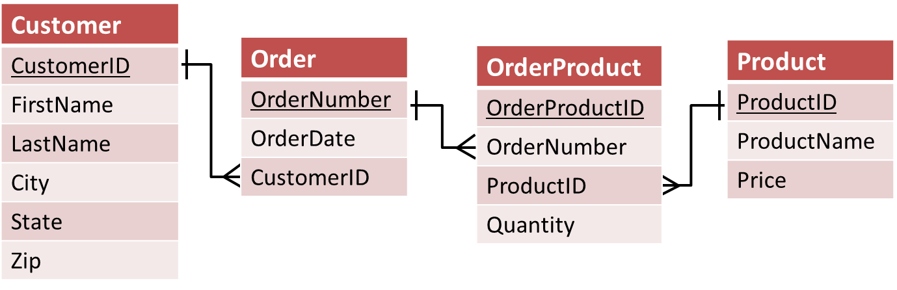
Querying multiple tables
Right now, you can answer with data from a single table
What if you need to combine two (or more) tables?
  For example, what if we want to find out the orders a customer placed?

Slide 3
The (Inner) Join
We’ve seen this before
We matched the Order and Customer tables based on the common field (CustomerID)
We can construct a SQL query to do this
Order Table
Customer Table
`Order` Number | OrderDate | Customer ID | Customer ID | FirstName | LastName | City | State | Zip
101 | 2011-3-2 | 1001 | 1001 | Greg | House | Princeton | NJ | 09120
102 | 2011-3-3 | 1002 | 1002 | Lisa | Cuddy | Plainsboro | NJ | 09123
103 | 2011-3-4 | 1001 | 1001 | Greg | House | Princeton | NJ | 09120
104 | 2011-3-6 | 1004 | 1004 | Eric | Foreman | Warminster | PA | 19111

Slide 4
Joining tables
Syntax :
SELECT column_name(s) FROM schema_name.table_name1
JOIN schema_name.table_name2
ON table_name1.column = table_name2.column;
SELECT * FROM orderdb.Customer
JOIN orderdb.`Order`
ON Customer.CustomerID=`Order`.CustomerID;
Returns this:
Customer. CustomerID | FirstName | LastName | City | State | Zip | Order Number | OrderDate | Order. CustomerID
1001 | Greg | House | Princeton | NJ | 09120 | 101 | 2011-3-2 | 1001
1002 | Lisa | Cuddy | Plainsboro | NJ | 09123 | 102 | 2011-3-3 | 1002
1001 | Greg | House | Princeton | NJ | 09120 | 103 | 2011-3-4 | 1001
1004 | Eric | Foreman | Warminster | PA | 19111 | 104 | 2011-3-6 | 1004

Slide 5
A closer look at the JOIN syntax
SELECT * FROM orderdb.Customer
JOIN orderdb.`Order`
ON Customer.CustomerID=`Order`.CustomerID;
SELECT * | Return all the columns from both tables
FROM orderdb.Customer JOIN orderdb.`Order` | The two tables to be joined
ON Customer.CustomerID = `Order`.CustomerID | Only choose records where the CustomerID exists in both tables
Another way to say it:
Choose customers that have placed an order
The “.” notation is table_name.column_name
We need this when two tables have the same column name.

Slide 6
A more complex join
Question: What products did each customer order?
We want to wind up with this view of the database
OrderNumber | FirstName | LastName | ProductName | Quantity | Price
101 | Greg | House | Cheerios | 2 | 3.99
101 | Greg | House | Bananas | 3 | 1.29
101 | Greg | House | Eggo Waffles | 1 | 2.99
102 | Lisa | Cuddy | Cheerios | 5 | 3.99
102 | Lisa | Cuddy | Bananas | 2 | 1.29
103 | Greg | House | Eggo Waffles | 3 | 2.99
104 | Eric | Foreman | Eggo Waffles | 8 | 2.99

Slide 7
How to do it?
We need information from Customer and Product (and OrderProduct)
To associate Customer table with Product table, we need to follow the path from Customer to Product

Slide 8

Here’s the query
SELECT `Order`.OrderNumber, Customer.FirstName, Customer.LastName, Product.ProductName, OrderProduct.Quantity, Product.Price
FROM orderdb.Customer
JOIN orderdb.`Order` ON Customer.CustomerID=`Order`.CustomerID JOIN orderdb.OrderProduct ON `Order`.OrderNumber=OrderProduct.OrderNumber JOIN orderdb.Product ON Product.ProductID=OrderProduct.ProductID;
It looks more complicated than it actually is!
Note that we have three join statements.

Slide 9
Now there are endless variations
Question: What is the total cost (prices) of all products bought by the customer “Greg House”?
SELECT SUM(Product.Price*OrderProduct.Quantity)
FROM orderdb.Customer
JOIN orderdb.`Order` ON Customer.CustomerID=`Order`.CustomerID
JOIN orderdb.OrderProduct
ON `Order`.OrderNumber=OrderProduct.OrderNumber
JOIN orderdb.Product ON Product.ProductID=OrderProduct.ProductID;
WHERE Customer.CustomerID=1001;
Answer:
You could have also said Customer.LastName=‘House’, but it’s better to use the unique identifier.
31.79

Slide 10
What’s with the SUM() function?
Notice that we’ve introduced something new
SELECT SUM(Product.Price*OrderProduct.Quantity)
This multiplies price by quantity for each returned record, and then adds them together.
You can perform arithmetic operations as long as the fields are numeric
Question: What do you think would get returned if you left off the SUM() and just had
SELECT Product.Price * Product.Quantity?

Slide 11
Consider another example
Question: Get a full list of ALL customers and their orders information
This is the view of the database we want
Customer. CustomerID | FirstName | LastName | City | State | Zip | Order Number | OrderDate | Order. CustomerID
1001 | Greg | House | Princeton | NJ | 09120 | 101 | 2011-3-2 | 1001
1002 | Lisa | Cuddy | Plainsboro | NJ | 09123 | 102 | 2011-3-3 | 1002
1001 | Greg | House | Princeton | NJ | 09120 | 103 | 2011-3-4 | 1001
1004 | Eric | Foreman | Warminster | PA | 19111 | 104 | 2011-3-6 | 1004
1003 | James | Wilson | Pittsgrove | NJ | 09121 | NULL | NULL | NULL

Slide 12
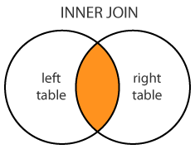
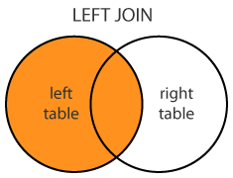
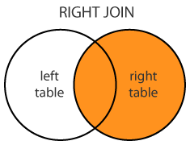
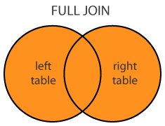
Outer Join
We need another operator
  for the item that have a match, it behaves like a Join,
  but for the items that have NO MATCH, it appends the record with NULLs
The operators with these properties are called outer joins. (There are several of them)
The operators that we studied already are also called inner joins (To distinguish them from outer joins)
reference: www.dofactory.com/sql/join

Slide 13
Left Join
Syntax :
SELECT column_name(s) FROM schema_name.table_name1
LEFT JOIN schema_name.table_name2
ON table_name1.column = table_name2.column;
(INNER) JOIN:
Select records that have matching values in both tables.
LEFT (OUTER) JOIN:
Select records from the first (left-most) table with matching right table records.

Slide 14
Joining tables using Left Join
SELECT * FROM orderdb.Customer
LEFT JOIN orderdb.`Order`
ON Customer.CustomerID=`Order`.CustomerID;
Returns this:
Customer. CustomerID | FirstName | LastName | City | State | Zip | Order Number | OrderDate | Order. CustomerID
1001 | Greg | House | Princeton | NJ | 09120 | 101 | 2011-3-2 | 1001
1002 | Lisa | Cuddy | Plainsboro | NJ | 09123 | 102 | 2011-3-3 | 1002
1001 | Greg | House | Princeton | NJ | 09120 | 103 | 2011-3-4 | 1001
1004 | Eric | Foreman | Warminster | PA | 19111 | 104 | 2011-3-6 | 1004
1003 | James | Wilson | Pittsgrove | NJ | 09121 | NULL | NULL | NULL

Slide 15
Another example
Question: What is the number of orders of all customers?
SELECT Customer.customerID, Count(ordernumber)
FROM m1orderdb.Customer
Left JOIN m1orderdb.`Order` ON Customer.CustomerID=`Order`.CustomerID
GROUP BY CustomerID;
Answer:
CustomerID | Count(ordernumber)
1001 | 2
1002 | 1
1003 | 0
1004 | 1
Here, we use Count(ordernumber) not Count(*). Why?

Slide 16
In Class Activity #3
Notes:
More than 50-60 mins

Slide 17
The LIMIT Clause
We could try to use LIMIT to find the least expensive product:
SELECT * FROM orderdb.Product
ORDER BY Price ASC LIMIT 1;
But what if there is more than one product with the lowest value for price AND we don’t know how many there are?

Slide 18
Where MIN() alone fails us…
SELECT MIN(price)
FROM orderdb.Product;
BUT
SELECT MIN(price),ProductName
FROM orderdb.Product;
Price
1.29
Price | ProductName
1.29 | Cheerios
Wait…. Cheerios’ price should be 3.99.
So what’s going on??

Slide 19
What’s wrong…
SELECT MIN(price),ProductName
FROM orderdb.Product;
It returns the MIN(price): $1.29
MIN() will always return only one row
So for ProductName, it chooses the first row in the Product column, i.e., Cheerios
Price | ProductName
1.29 | Cheerios
And it will do this for any function (AVG, SUM, etc.)

Slide 20
So we need a SQL subselect statement
It’s where you have a SELECT statement nested inside another SELECT statement!
SELECT Price,ProductName
FROM orderdb.Product
WHERE Price=
(SELECT MIN(Price) FROM orderdb.Product);
Now you get all records back with that (lowest) price and avoid the quirk of the MIN() function.
This is a temporary table from the database with one column and one row.

Slide 21
How would SQL execute this query?
SELECT Price,ProductName
FROM orderdb.Product
WHERE Price=
(SELECT MIN(Price) FROM orderdb.Product);
SELECT MIN(Price)
FROM orderdb.Product
Step 1: Execute what is in the parentheses to find the lowest price
Step 2: Plug the lowest price into the main query, and execute the main query
MIN(Price)
1.29
SELECT Price,ProductName
FROM orderdb.Product
WHERE Price=1.29;
Price | ProductName
1.29 | Bananas

Slide 22
And it also handles ties!
SELECT Price,ProductName
FROM orderdb.Product
WHERE Price=
(SELECT MAX(Price) FROM orderdb.Product);
Now you get all records back with that highest price and avoid the quirk of the MAX() and MIN() functions.
Price | ProductName
3.99 | Cheerios
3.99 | French Toast
But these are the highest-priced products overall, not the highest-priced products bought by a particular customer…

Slide 23
Subselects come in handy in other situations too…
We want to get a COUNT of how many DISTINCT states there are in the table.
SELECT COUNT(*) FROM (SELECT DISTINCT State FROM orderdb.Customer) AS tmp1;
To see how this works:
  Start with what is in the parentheses
  SELECT DISTINCT State FROM orderdb.Customer
  …then COUNT those values
State
NJ
PA
2

Slide 24
Why do we need AS?
SELECT COUNT(*) FROM (SELECT DISTINCT State FROM orderdb.Customer) AS tmp1;
You’re basically SELECTing from the temporary table generated by the nested query.
But since you’re SELECTing FROM that temporary table you have to give it a name (i.e., tmp1)

Slide 25
Subselects with Joins
Question: What is the least expensive product bought by customers from New Jersey?
To do this, we will need all the tables.

Slide 26
Subselects with Joins
First, we need to figure out the lowest price of products by customers from New Jersey?
But this is not enough… We also need to find the product name.
SELECT MIN(Product.Price)
FROM orderdb.Customer, JOIN orderdb.`Order` ON Customer.CustomerID=`Order`.CustomerID JOIN orderdb.OrderProduct ON `Order`.OrderNumber=OrderProduct.OrderNumber JOIN orderdb.Product ON Product.ProductID=OrderProduct.ProductID
AND Customer.State='NJ';
Price
1.29

Slide 27
Subselects with Joins
So we nest the previous query in a big query:
SELECT Product.ProductName, Product.Price FROM orderdb.Customer, JOIN orderdb.`Order` ON Customer.CustomerID=`Order`.CustomerID JOIN orderdb.OrderProduct ON `Order`.OrderNumber=OrderProduct.OrderNumber JOIN orderdb.Product ON Product.ProductID=OrderProduct.ProductID WHERE Customer.State='NJ' AND Product.Price=(
SELECT MIN(Product.Price) FROM orderdb.Customer, JOIN orderdb.`Order` ON Customer.CustomerID=`Order`.CustomerID JOIN orderdb.OrderProduct ON `Order`.OrderNumber=OrderProduct.OrderNumber JOIN orderdb.Product ON Product.ProductID=OrderProduct.ProductID
WHERE Customer.State='NJ');
ProductName | Price
Bananas | 1.29

Slide 28
Summary
Given a schema of a database, we now should be able to create a SQL statement (query) to answer a question
Understand how to use
  SELECT … FROM …
  DISTINCT
  WHERE (and how to specify conditions)
  AND/OR
  ORDER BY (ASC/DESC)
  Functions: COUNT, AVG, MIN, MAX, SUM
  GROUP BY
  LIMIT
  Joins (and differences between inner/outer join)
  Subselects

Slide 29
In Class Activity #4
Notes:
More than 50-60 mins

