Slide 1

MIS2502:
Data Analytics
Association Rule Mining
David Schuff
David.Schuff@temple.edu
http://community.mis.temple.edu/dschuff

Slide 2

Association Rule Mining
Find out which items predict the occurrence of other items
Also known as “affinity analysis” or “market basket” analysis
Uses
What products are bought together?
Amazon’s recommendation engine
Telephone calling patterns

Slide 3
Examples of Association Rule Mining
Market basket analysis/affinity analysis
  What products are bought together?
  Where to place items on grocery store shelves?
Amazon’s recommendation engine
  “People who bought this product also bought…”
Telephone calling patterns
  Who do a set of people tend to call most often?
Social network analysis
  Determine who you “may know”

Slide 4
Market-Basket Transactions
Basket | Items
1 | Bread, Milk
2 | Bread, Diapers, Beer, Eggs
3 | Milk, Diapers, Beer, Coke
4 | Bread, Milk, Diapers, Beer
5 | Bread, Milk, Diapers, Coke
X → Y
(antecedent → consequent)
{Diapers} → {Beer},
{Milk, Bread} → {Diapers}
{Beer, Bread} → {Milk},
{Bread} → {Milk, Diapers}
Association Rules from these transactions

Slide 5
Core idea: The itemset
Itemset
A group of items of interest
{Milk, Beer, Diapers}
Association rules express relationships between itemsets
  X → Y
  {Milk, Diapers} → {Beer}
  “when you have milk and diapers, you also have beer”
Basket | Items
1 | Bread, Milk
2 | Bread, Diapers, Beer, Eggs
3 | Milk, Diapers, Beer, Coke
4 | Bread, Milk, Diapers, Beer
5 | Bread, Milk, Diapers, Coke

Slide 6
Support
Support count (σ)
  In how many baskets does the itemset appear?
  σ{Milk, Beer, Diapers} = 2
  (i.e., in baskets 3 and 4)
Support (s)
  Fraction of transactions that contain all items in X → Y
  s({Milk, Diapers, Beer}) = 2/5 = 0.4
You can calculate support for both X and Y separately
  Support for X = 3/5 = 0.6
  Support for Y = 3/5 = 0.6
Basket | Items
1 | Bread, Milk
2 | Bread, Diapers, Beer, Eggs
3 | Milk, Diapers, Beer, Coke
4 | Bread, Milk, Diapers, Beer
5 | Bread, Milk, Diapers, Coke
2 baskets have milk, beer, and diapers
5 baskets total
X
Y

Slide 7
Confidence
Confidence is the strength of the association
  Measures how often items in Y appear in transactions that contain X
Basket | Items
1 | Bread, Milk
2 | Bread, Diapers, Beer, Eggs
3 | Milk, Diapers, Beer, Coke
4 | Bread, Milk, Diapers, Beer
5 | Bread, Milk, Diapers, Coke
This says 67% of the times when you have milk and diapers in the itemset you also have beer!
c must be between 0 and 1
1 is a complete association
0 is no association

Slide 8
Calculating and Interpreting Confidence
Basket | Items
1 | Bread, Milk
2 | Bread, Diapers, Beer, Eggs
3 | Milk, Diapers, Beer, Coke
4 | Bread, Milk, Diapers, Beer
5 | Bread, Milk, Diapers, Coke
Association Rule (a→b) | Confidence (a→b) | What it means
{Milk,Diapers} → {Beer} | 2/3 = 0.67 | 2 baskets have milk, diapers, beer 3 baskets have milk and diapers So, 67% of the baskets with milk and diapers also have beer
{Milk,Beer} → {Diapers} | 2/2 = 1.0 | 2 baskets have milk, diapers, beer 2 baskets have milk and beer So, 100% of the baskets with milk and beer also have diapers
{Milk} → {Diapers,Beer} | 2/4 = 0.5 | 2 baskets have milk, diapers, beer 4 baskets have milk So, 50% of the baskets with milk also have diapers and beer

Slide 9
But don’t blindly follow the numbers
i.e., high confidence suggests a strong association…
But this can be deceptive
Consider {Bread} →{Diapers}
Support for the total itemset is 0.6 (3/5)
And confidence is 0.75 (3/4) – pretty high
But is this just because both are frequently occurring items (s=0.8)?
You’d almost expect them to show up in the same baskets by chance

Slide 10
Lift
Takes into account how co-occurrence differs from what is expected by chance
  i.e., if items were selected independently from one another
Support for total itemset X and Y
Support for X times support for Y

Slide 11
Lift Example
Basket | Items
1 | Bread, Milk
2 | Bread, Diapers, Beer, Eggs
3 | Milk, Diapers, Beer, Coke
4 | Bread, Milk, Diapers, Beer
5 | Bread, Milk, Diapers, Coke
What’s the lift for the rule:
{Milk, Diapers} → {Beer}
So X = {Milk, Diapers}
Y = {Beer}
s({Milk, Diapers, Beer}) = 2/5 = 0.4
s({Milk, Diapers}) = 3/5 = 0.6
s({Beer}) = 3/5 = 0.6
So
When Lift > 1, the occurrence of
X → Y together is more likely than what you would expect by chance

Slide 12
Another example
 | Netflix
Cable TV |  | No | Yes
 | No | 200 | 3800
 | Yes | 8000 | 1000
What is the effect of Netflix on Cable TV?
{Netflix → xfinityTV)
People with both services = 1000/13000 → 7%
People with Cable TV = 9000/13000 → 69%
People with Netflix = 4800/13000 → 37%
Having one negatively effects the purchase of the other
(lift closer to 0 than 1)

Slide 13
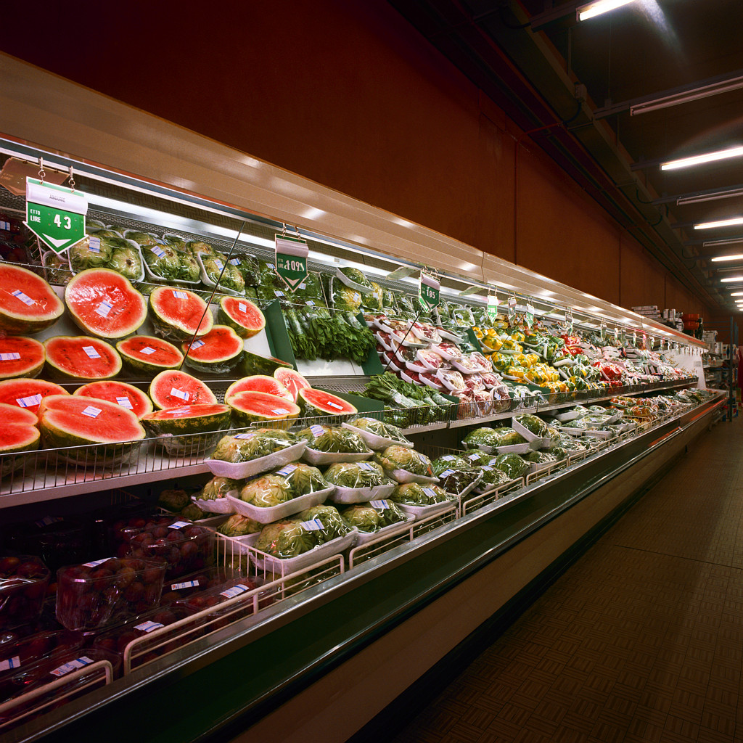
But this can be overwhelming
Thousands of products
Millions of combinations
Many customer types
So where do you start?

Slide 14
Selecting the rules
The steps
List all possible association rules
Compute the support and confidence for each rule
Drop rules that don’t make the thresholds
Use lift to further check the association
We know how to calculate the measures for each rule
  Support
  Confidence
  Lift
Then we set up thresholds for the minimum rule strength we want to accept

Slide 15
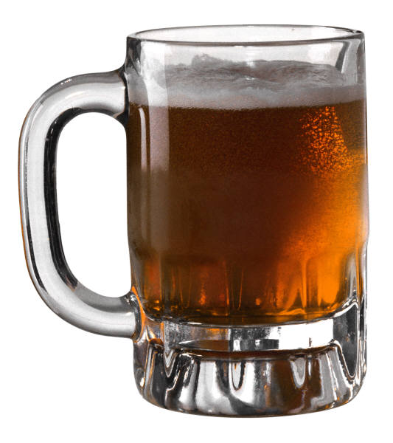
Once you are confident in a rule, take action
{Milk, Diapers} → {Beer}
Possible Marketing Actions
Create “New Parent Coping Kits” of beer, milk, and diapers
What are some others?

