Slide 1

MIS2502:
Data Analytics
Principles of Data Visualization

Slide 2
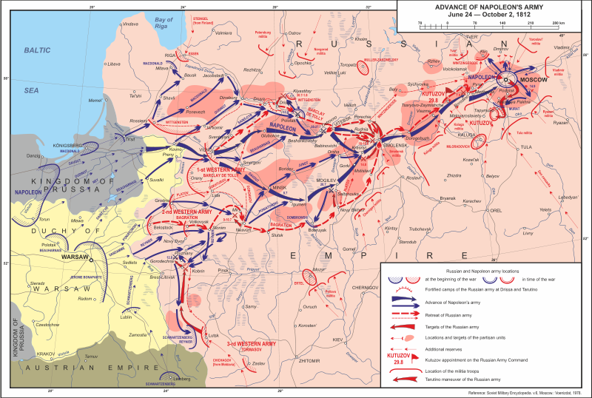
What makes a good chart?
Wikipedia: Patriotic War of 1812
http://en.wikipedia.org/wiki/File:Patriotic_War_of_1812_ENG_map1.svg

Slide 3
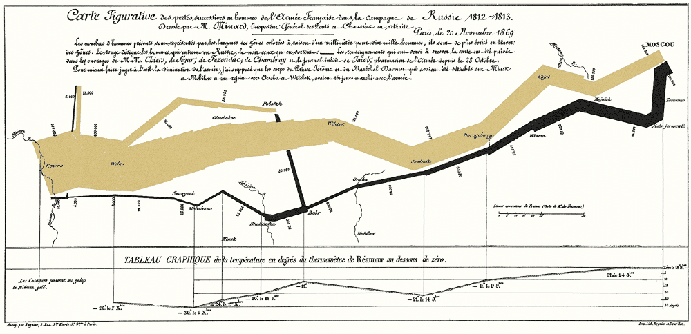
What makes a good chart?
Minard’s map of Napoleon’s campaign into Russia, 1869
Reprinted in Tufte (2009), p. 41

Slide 4

Video Games do this well…
Notes:
From the game “Pikmin 3”

Slide 5
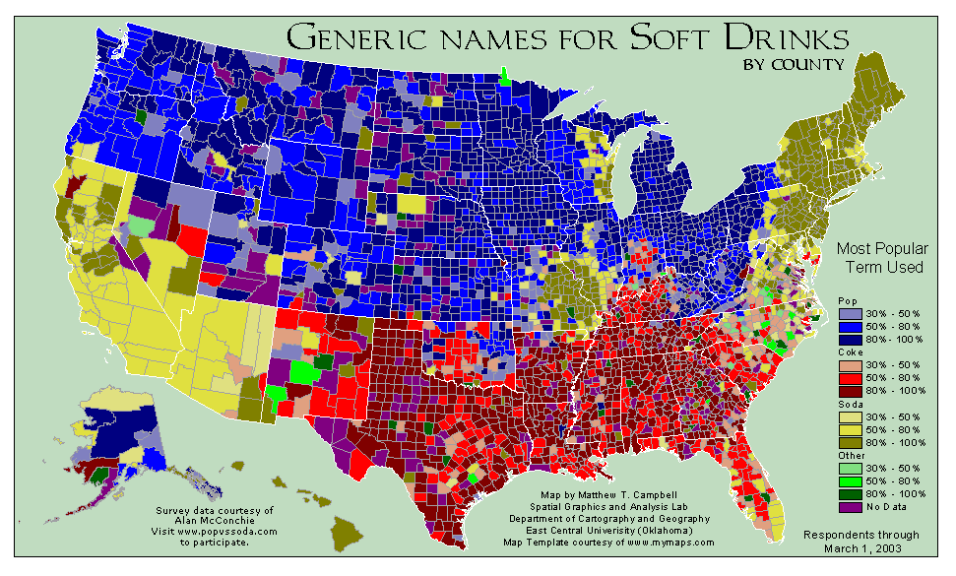
What can you learn from this map?
http://www.popvssoda.com/countystats/total-county.html

Slide 6
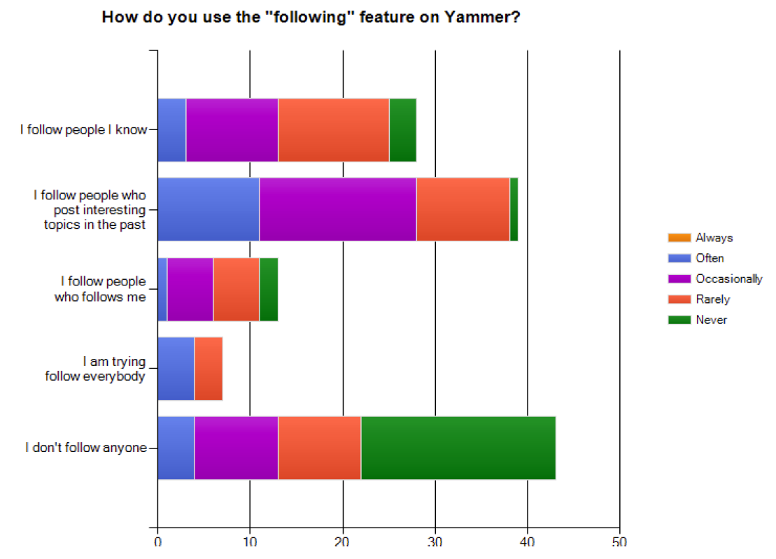
What makes a good chart?
This is from an academic conference paper.
What are the problems with this chart?
Zhang et al. (2010), “A case study of micro-blogging in the enterprise: use, value, and related issues,” Proceedings of the 28th International Conference on Human Factors in Computing Systems.
Notes:
The legend is for how often they find relevant information (given their “following” behavior”)

Slide 7
Some basic principles (adapted from Tufte 2009)
1
2
3
The chart should tell a story
The chart should have graphical integrity
The chart should minimize graphical complexity
Tufte’s fundamental principle:
Above all else show the data

Slide 8
Principle 1: The chart should tell a story
Graphics should be clear on their own
The chart should yield insight beyond the text
“If the statistics are boring, then you’ve got the wrong numbers.” (Tufte 2009)
The depictions should enable meaningful comparison

Slide 9
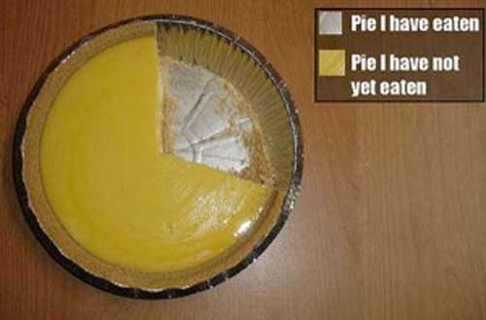
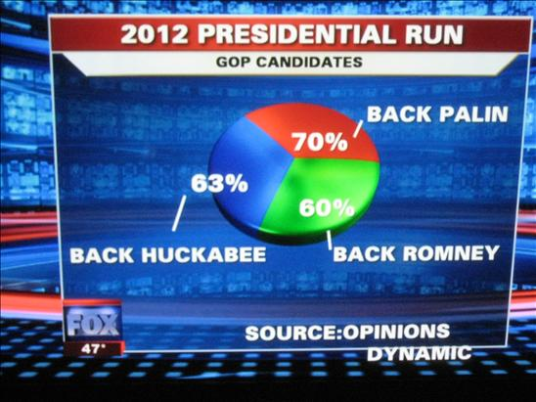
Do these tell a story?
http://www.evl.uic.edu/aej/491/week03.html
http://flowingdata.com/2009/11/26/fox-news-makes-the-best-pie-chart-ever/

Slide 10
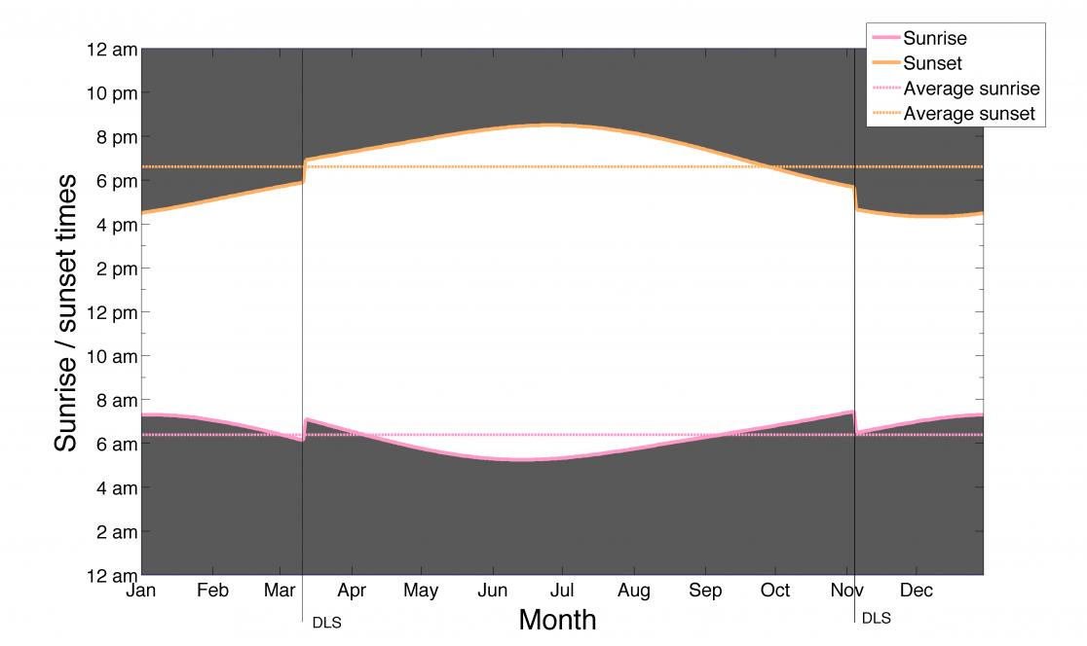
Daylight Savings Time Explained
http://visual.ly/daylight-saving-time-explained

Slide 11
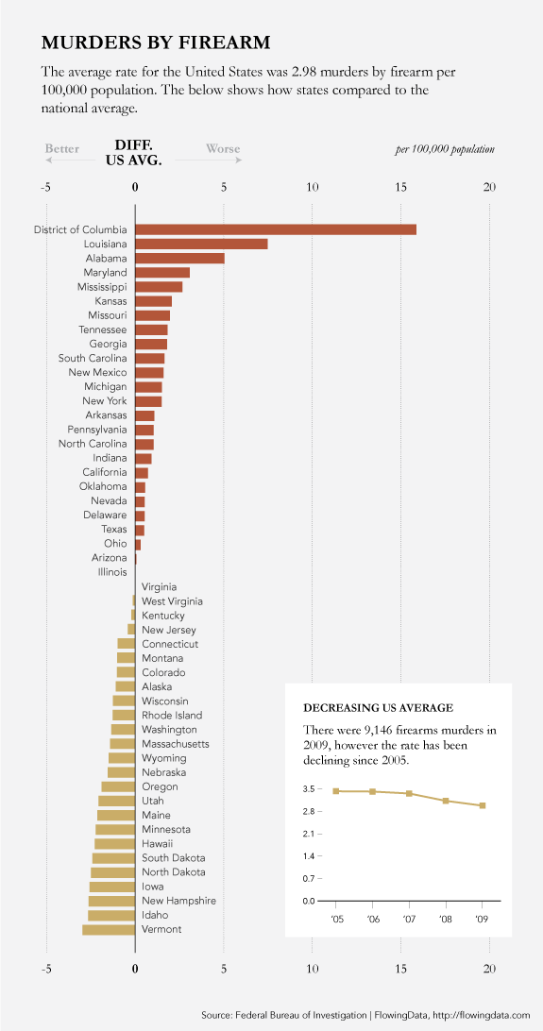
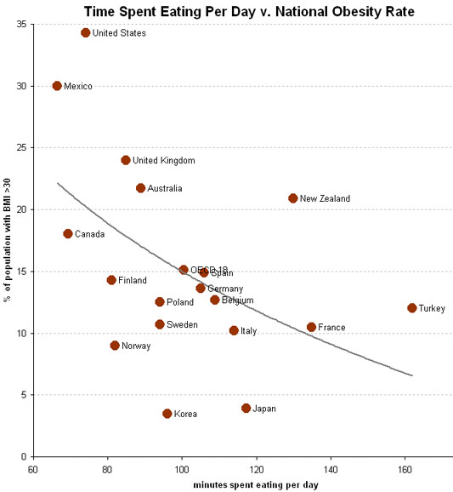
Telling a Story
http://flowingdata.com/2011/01/19/states-with-the-most-and-least-firearms-murders/
http://economix.blogs.nytimes.com/2009/05/05/obesity-and-the-fastness-of-food/

Slide 12
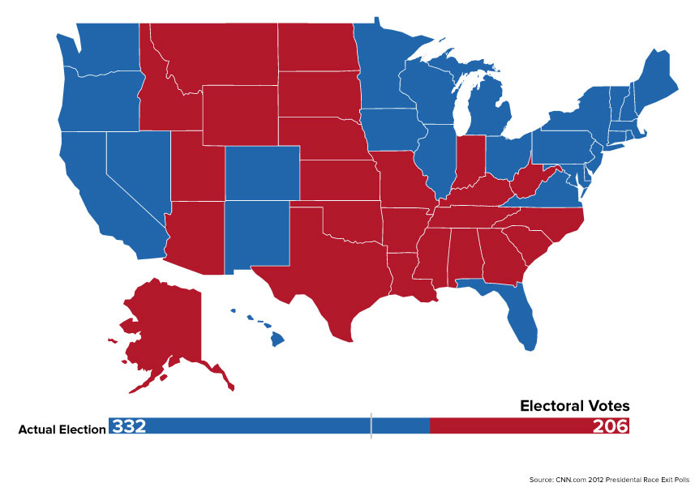
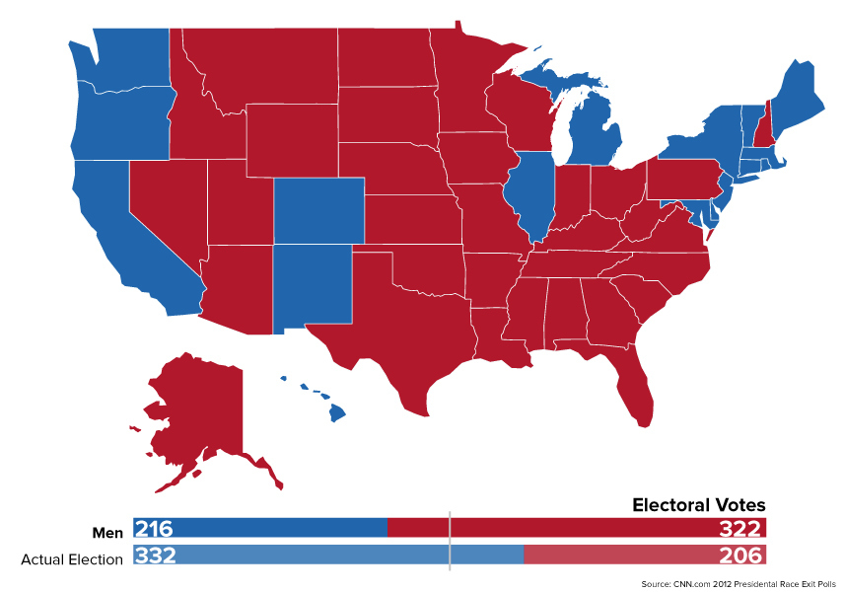
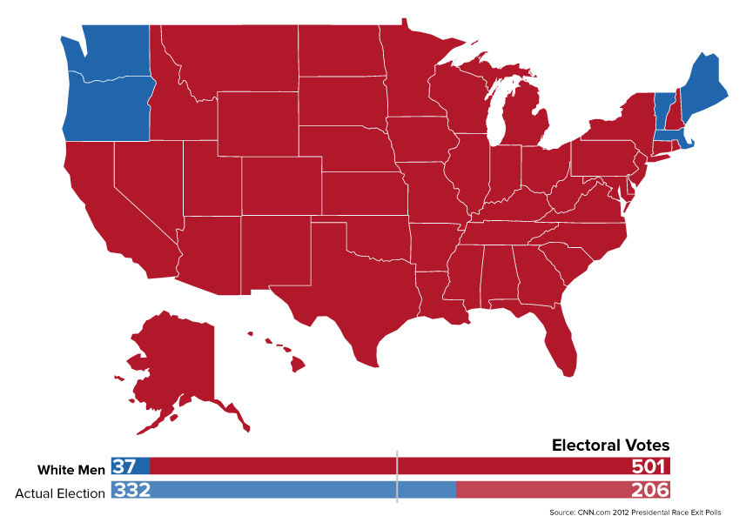
Telling a story
The electoral result of the 2012 election
Under pre-1920 rules: men only
Under 1850 rules: white men only
http://www.buzzfeed.com/buzzfeedpolitics/what-the-2012-election-would-have-looked-like-with

Slide 13
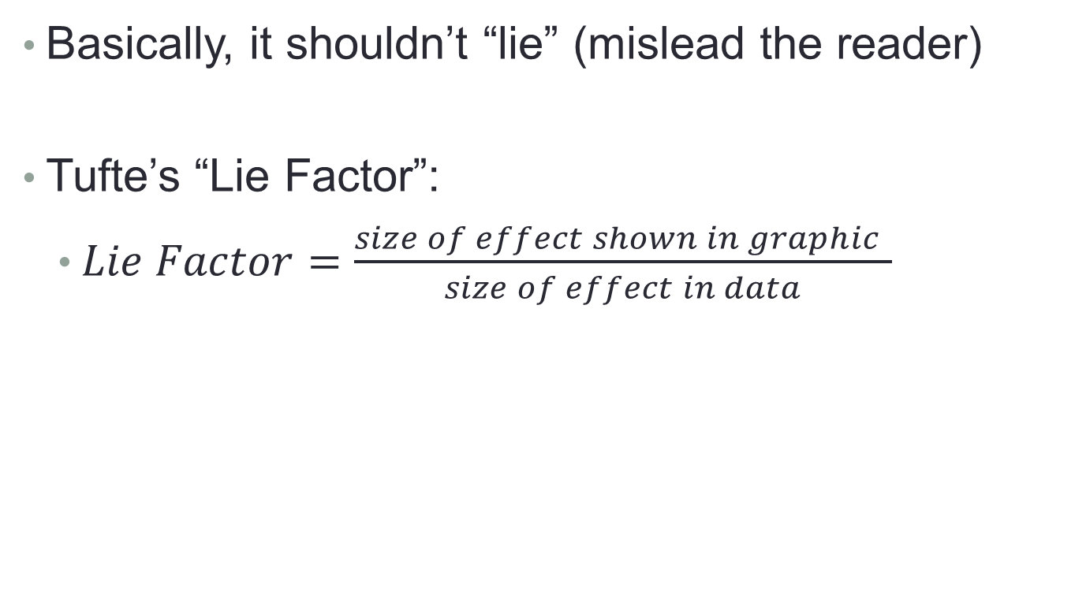
Principle 2: The chart should have graphical integrity
Basically, it shouldn’t “lie” (mislead the reader)
Tufte’s “Lie Factor”:
  $Lie Factor=\frac{size of effect shown in graphic }{size of effect in data}$
Should be ~ 1
< 1 = understated effect
> 1 = exaggerated effect

Slide 14
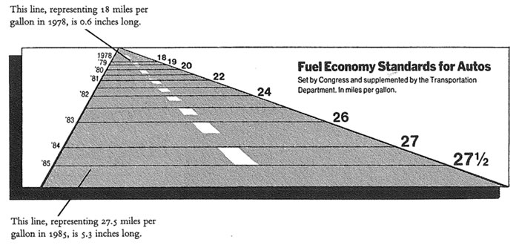
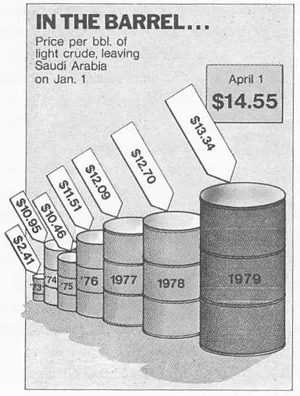
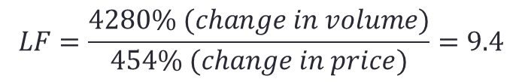
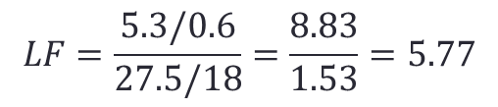
Examples of the “lie factor”
$$LF=\frac{5.3/0.6}{27.5/18}=\frac{8.83}{1.53}=5.77$$
Reprinted from Tufte (2009), p. 57 & p. 62
$$LF=\frac{4280\% (change in volume)}{454\% (change in price)}=9.4$$

Slide 15
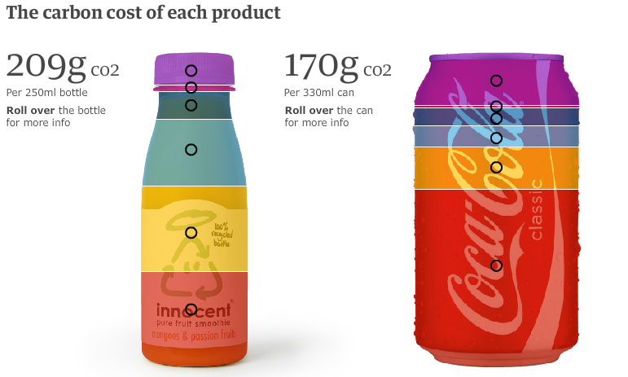
How is this deceptive?
http://www.guardian.co.uk/environment/interactive/2009/mar/09/
food-carbon-emissions

Slide 16
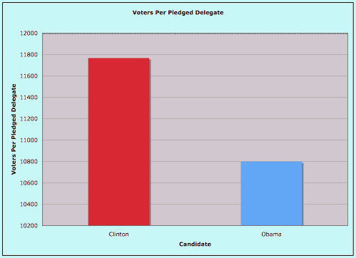
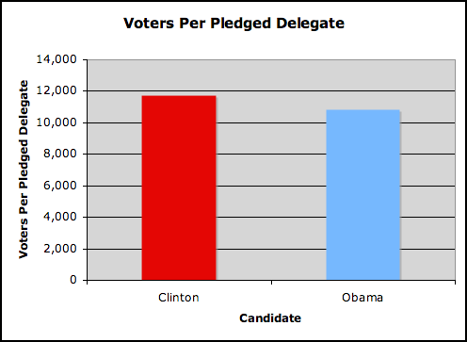
How about this?
The original graphic from Real Clear Politics, 2008.
(Look at the y-axis)
The adjusted graphic.
http://20bits.com/articles/politics-and-tuftes-lie-factor/

Slide 17
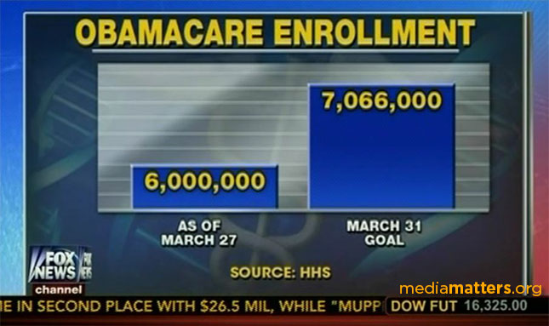
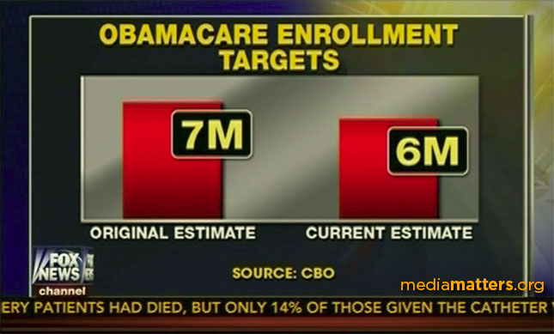
Or this?
The original graphic from Fox News, March 2014.
A different graphic, the next day...
http://mediamatters.org/blog/2014/03/31/dishonest-fox-charts-obamacare-enrollment-editi/198679

Slide 18
Other tips to avoid “lying”
Adjust for inflation
Make sure the context is presented
vs.

Slide 19
Principle 3: The chart should minimize graphical complexity
Generally, the simpler the better…
Key concepts
Data-ink
Sometimes a table is better
Chartjunk

Slide 20
When a table is better than a chart
For a few data points, a table can do just as well…
Salesperson | Total Sales
Peacock | $225,763.68
Leverling | $201,196.27
Davolio | $182,500.09
Fuller | $162,503.78
Callahan | $123,032.67
King | $116,962.99
Dodsworth | $75,048.04
Suyama | $72,527.63
Buchanan | $68,792.25
The table carries more information in less space
and is more precise.

Slide 21
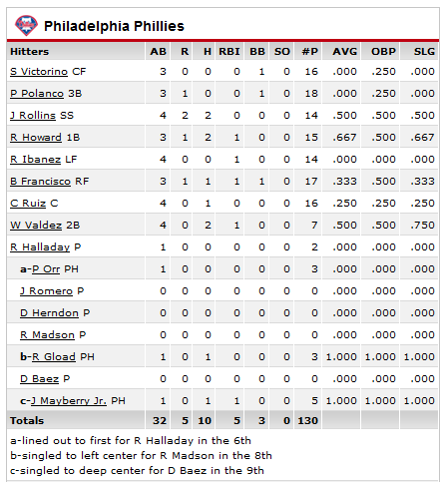
The Ultimate Table: The Box Score
Large amount of information in a very small space
So why does this work?
  Depends on the reader’s knowledge of the data

Slide 22
The Business Box Score?
Applying the same concept to our salesforce example.
How does this help? How could it hurt?
Sales Performance – March 2011
Salesperson | TS | WD | BD | NC | DOR
Peacock | 225 | 3 | 40 | 20 | 28
Leverling | 201 | 2 | 45 | 18 | 27
Davolio | 182 | 5 | 38 | 22 | 28
Fuller | 162 | 2 | 22 | 16 | 20
Callahan | 123 | 1 | 15 | 14 | 15
King | 116 | 0.5 | 20 | 12 | 18
Dodsworth | 75 | 0.3 | 12 | 10 | 20
Suyama | 72 | 0 | 8 | 10 | 8
Buchanan | 68 | 0 | 8 | 8 | 12
Key:
TS – total sales
WD – worst day
BD – best day
NC – number of customers
DOR – days on the road

Slide 23

Data Ink
The amount of “ink” devoted to data in a chart
Tufte’s Data-Ink ratio:
  $Data−ink ratio=\frac{data−ink}{total ink used in graphic}$
Should be ~ 1
< 1 = more non-data related ink in graphic
= 1 implies all ink devoted to data
Tufte’s principle:
Erase ink whenever possible

Slide 24
Being conscious of data ink
Lower data-ink ratio
(worse)
Higher data-ink ratio
(better)

Slide 25
What makes a good chart?
Sometimes it’s really a matter of preference.
These both minimize data ink.
Why isn’t a table better here?

Slide 26
3-D Charts
Evaluate this from a data-ink perspective.
How does it affect the clarity of the chart?

Slide 27
Chartjunk: Data Ink “gone wild”
Unnecessary visual clutter that doesn’t provide additional insight
Distraction from the story the chart is supposed to convey
When the data-ink ratio is low, chartjunk is likely to be high

Slide 28
Example: Moiré effects (Tufte 2009)
Creates illusion of movement
Stands out, in a bad way

Slide 29
Example: The Grid
Why are these examples of chartjunk?
What could you do to remedy it?

Slide 30
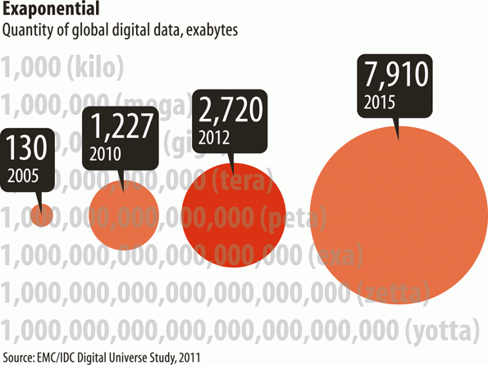
Data Ink Working Against Us
http://www.economist.com/node/21537922

Slide 31
Data Ink Working For Us
Evaluate this chart in terms of Data Ink.
Imagine this as a bar chart. As a table!!

Slide 32
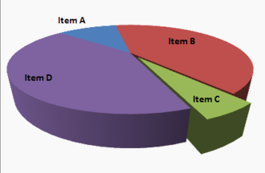
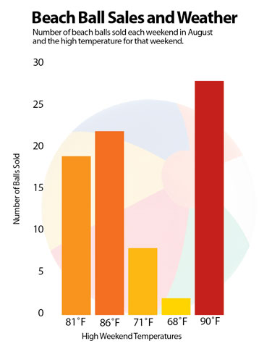
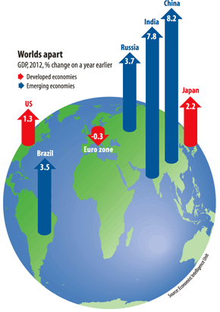
Review: What do you think of these?
https://www.boundless.com/statistics/frequency-distributions/frequency-distributions-for-qualitative-data/interpreting-distributions-constructed-by-others/images/3-d-pie-chart/
http://www.economist.com/node/21537909
http://images.macworld.com/images/howto/graphics/134708-create-charts-good_376.jpg

