Slide 1
MIS2502: Data Analytics Introduction to Advanced Analytics and R

Slide 2
Introduction to R and RStudio

Slide 3
Software development platform and language
Open source
Many, many, many statistical add-on “packages” that perform data analysis
Integrated Development Environment for R
Nicer interface that makes R easier to use
Requires R to run

Slide 4
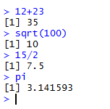
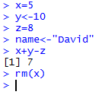
The Basics: Calculations and Variables
R will do math for you
R has variables
<- and = do the same thing
rm() removes the variable from memory
Type commands into R and it will give you an answer
x, y, and z are objects that can be manipulated

Slide 5
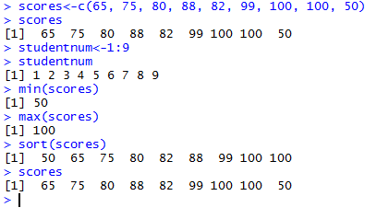
Arrays of values
Called a vector or collection
c(), min(), max(), and sort() are functions
functions accept parameters and return a value
note that sort() puts the scores in order but doesn’t change the original collection

Slide 6
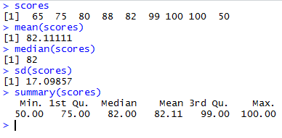
Simple statistics with R
You can get descriptive statistics from a collection

Slide 7
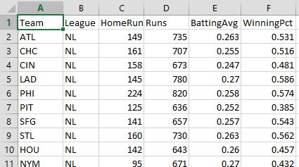
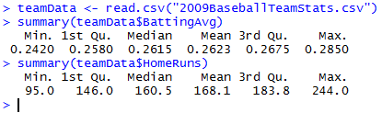
Reading from a file
Usually you won’t type in data manually, you’ll get it from a file
Example: 2009 Baseball Statistics http://www2.stetson.edu/ ~jrasp/data.htm
reads data from CSV file and creates collections using the headers and the data
reference a collection using datasetname$variablename

Slide 8
Looking for differences across groups: The setup
We want to know if National League (NL) teams scored more runs than American League (AL) Teams
And if that difference is statistically significant
To do this, we need a package (add-on) that will do this analysis
In this case, it’s the “psych” package
Downloads and installs the package (once per R installation)

Slide 9
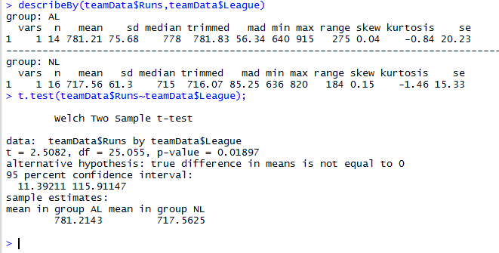
Looking for differences across groups: The analysis
Descriptive statistics, broken up by group (League)
Results of t-test for differences in Runs by League)

Slide 10
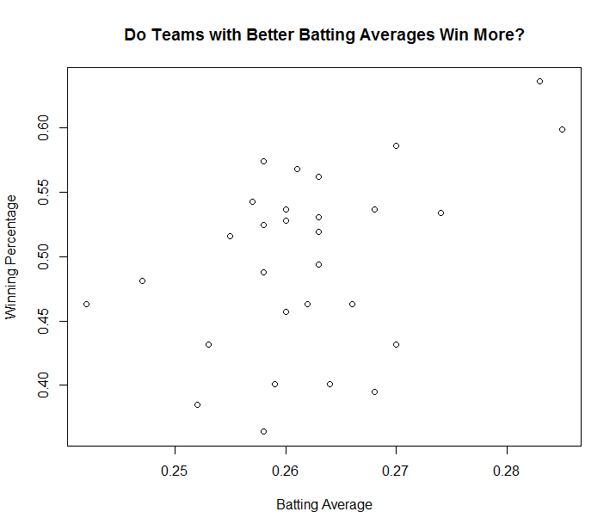
Plotting data
plot()
first parameter – x data values
second parameter – y data values
xlab parameter – label for x axis
ylab parameter – label for y axis
title()
sets title for chart

Slide 11
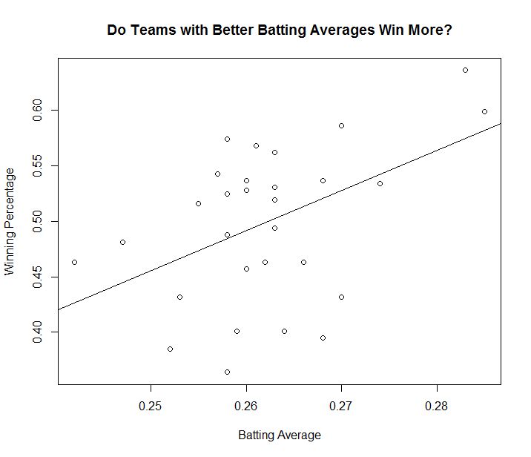
Drawing a regression (trend) line
Calculates the regression line (lm())
And plots the line (abline())

Slide 12
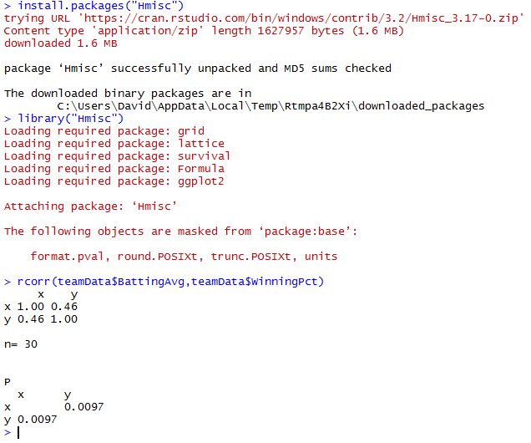
But is the correlation statistically significant?
So we can say:
“Teams with a better overall batting average tend to have a better winning percentage.”
“medium” strength correlation
strongly statistically significant

Slide 13
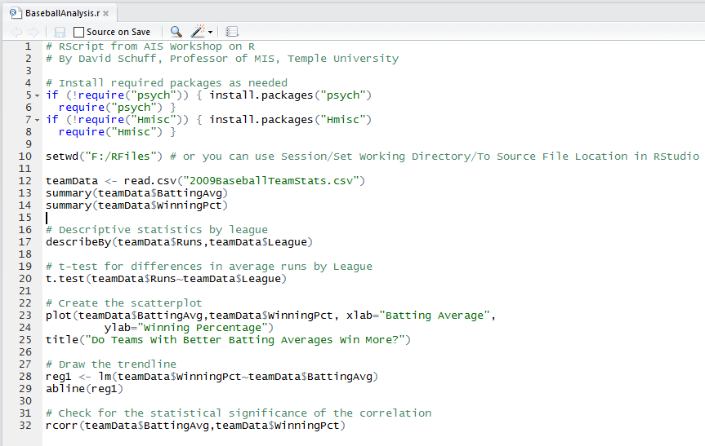
Running this analysis as a script
Commands can be entered one at a time, but usually they are all put into a single file that can be saved and run over and over again.

