Slide 1

MIS2502:
Data Analytics
Association Rule Mining
Alvin Zuyin Zheng
zheng@temple.edu
http://community.mis.temple.edu/zuyinzheng/

Slide 2
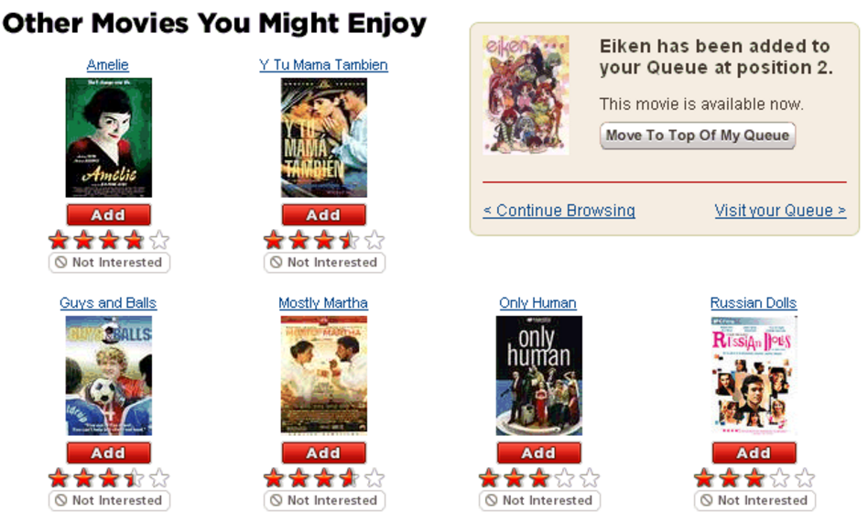
Share Your Story: Netflix

Slide 3
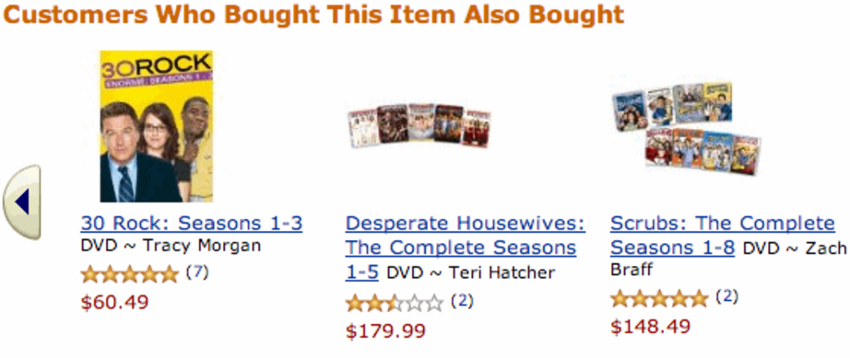
Share Your Story: Amazon

Slide 4
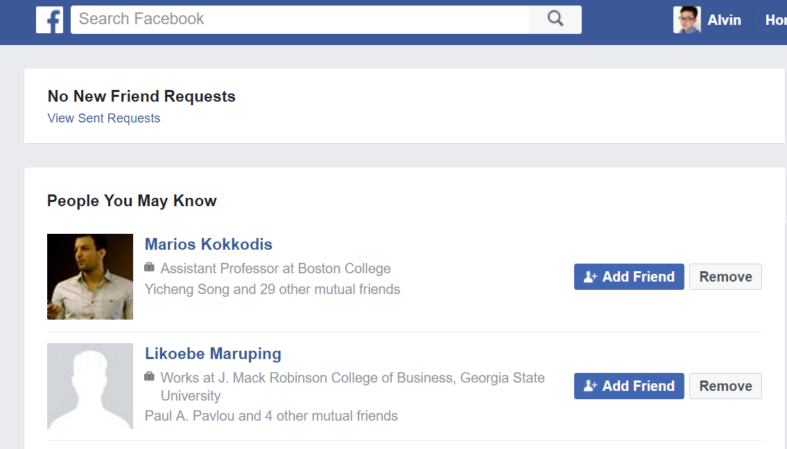
Share Your Story: Facebook

Slide 5
What did you buy in the most recent CVS/Grocery shopping?

Slide 6
Association Rule Mining
Find out which items predict the occurrence of other items
Also known as “affinity analysis” or “market basket” analysis

Slide 7
Applications
Market basket analysis/affinity analysis
  What products are bought together?
  Where to place items on grocery store shelves?
Amazon’s recommendation engine
  “People who bought this product also bought…”
Social network analysis
  Determine who you “may know”

Slide 8
Basket Analyses
Basket | Items
1 | Bread, Milk
2 | Bread, Diapers, Beer, Eggs
3 | Milk, Diapers, Beer, Coke
4 | Bread, Milk, Diapers, Beer
5 | Bread, Milk, Diapers, Coke
We usually start from a data set like this – with baskets of transactions
And the idea is to find associations between products

Slide 9
Basket Analyses
Basket | Items
1 | Bread, Milk
2 | Bread, Diapers, Beer, Eggs
3 | Milk, Diapers, Beer, Coke
4 | Bread, Milk, Diapers, Beer
5 | Bread, Milk, Diapers, Coke
X → Y
(antecedent → consequent)
(aka LHS →RHS)
{Diapers} → {Beer},
{Milk, Bread} → {Diapers}
{Beer, Bread} → {Milk},
{Bread} → {Milk, Diapers}
Association Rules from these transactions

Slide 10
Core idea: The itemset
Itemset
A collection of items of interest
{Milk, Diapers, Beer}
  Example in math: {1,4,2,6}
Association rules express relationships between itemsets
  X → Y
  {Milk, Diapers} → {Beer}
  “when you have milk and diapers, you are also likely to have beer”
Basket | Items
1 | Bread, Milk
2 | Bread, Diapers, Beer, Eggs
3 | Milk, Diapers, Beer, Coke
4 | Bread, Milk, Diapers, Beer
5 | Bread, Milk, Diapers, Coke

Slide 11
Support Count (σ)
Basket | Items
1 | Bread, Milk
2 | Bread, Diapers, Beer, Eggs
3 | Milk, Diapers, Beer, Coke
4 | Bread, Milk, Diapers, Beer
5 | Bread, Milk, Diapers, Coke
Support count (σ)
  In how many baskets does the itemset appear?
  Examples:
  σ{Milk, Diapers, Beer} = 2
  (i.e., in baskets 3 and 4)
  σ{Milk, Diapers} = 3
  σ{Beer} = 3
2 baskets have milk, beer, and diapers
5 baskets total

Slide 12
Support (s)
Basket | Items
1 | Bread, Milk
2 | Bread, Diapers, Beer, Eggs
3 | Milk, Diapers, Beer, Coke
4 | Bread, Milk, Diapers, Beer
5 | Bread, Milk, Diapers, Coke
Support (s)
  Fraction of baskets that
  contain the items in the itemset
  Examples:
  s({Milk, Diapers, Beer})
  = σ{Milk, Diapers, Beer} /(# of transactions)
  =2/5 = 0.4
  s{Milk, Diapers}= 3/5 = 0.6
  s{Beer}= 3/5 = 0.6
This means 40% of the baskets contain Milk, Diapers and Beers

Slide 13
Confidence (c)
Basket | Items
1 | Bread, Milk
2 | Bread, Diapers, Beer, Eggs
3 | Milk, Diapers, Beer, Coke
4 | Bread, Milk, Diapers, Beer
5 | Bread, Milk, Diapers, Coke
Confidence (c) is the strength of the association between two itemsets
  Itemset X
  Itemset Y
Support for total itemset X and Y
Support for X
This says 67% of the times when you have milk and diapers in the itemset you also have beer!
C must be between 0 and 1
--1 is a complete association
-- 0 is no association

Slide 14
Calculating and Interpreting Confidence
Basket | Items
1 | Bread, Milk
2 | Bread, Diapers, Beer, Eggs
3 | Milk, Diapers, Beer, Coke
4 | Bread, Milk, Diapers, Beer
5 | Bread, Milk, Diapers, Coke
Association Rule (a→b) | Confidence (a→b) | What it means
{Milk,Diapers} → {Beer} | 0.4/0.6 = 0.67 | 2 baskets have milk, diapers, beer 3 baskets have milk and diapers So, 67% of the baskets with milk and diapers also have beer
{Milk,Beer} → {Diapers} | 0.4/0.4 = 1.0 | 2 baskets have milk, diapers, beer 2 baskets have milk and beer So, 100% of the baskets with milk and beer also have diapers
{Milk} → {Diapers,Beer} | 0.4/0.8 = 0.5 | 2 baskets have milk, diapers, beer 4 baskets have milk So, 50% of the baskets with milk also have diapers and beer

Slide 15
A Problem of the Confidence
Confidence doesn’t account for that X and Y are frequently purchased items
Confidence alone can be deceptive
Example : {Bread} →{Diapers}
s(Bread, Diapers)= 3/5=0.6
s(Bread)=4/5=0.8
c(Bread → Diapers)=0.6/0.8=0.75 (pretty high)
Is this just because both are frequently occurring items
-s(Bread)=0.8
-s(Diapers)=0.8
Basket | Items
1 | Bread, Milk
2 | Bread, Diapers, Beer, Eggs
3 | Milk, Diapers, Beer, Coke
4 | Bread, Milk, Diapers, Beer
5 | Bread, Milk, Diapers, Coke

Slide 16
Lift
Takes into account how co-occurrence differs from what is expected by chance
  i.e., if items were selected independently from one another
Support for itemset X and Y
Support for X times support for Y

Slide 17
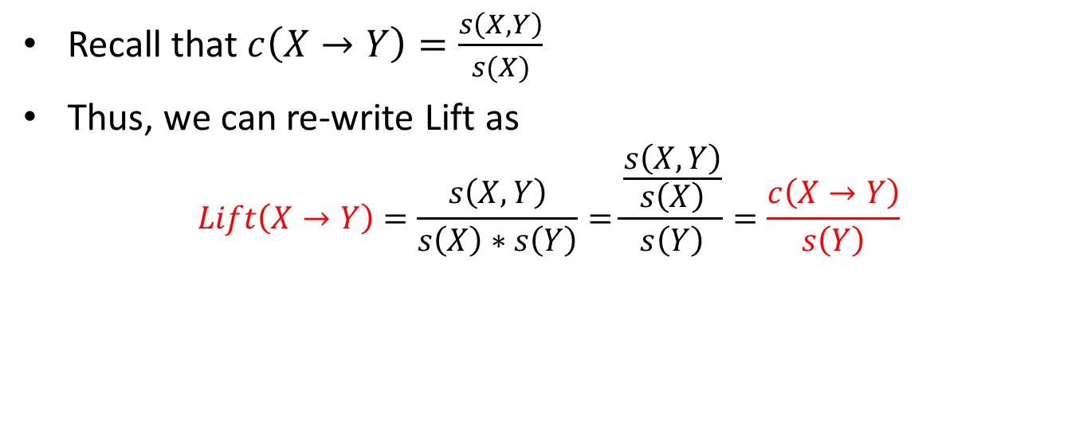
What does the Lift mean?
    Recall that$c\left(X→Y\right)=\frac{s\left(X,Y\right)}{s(X)}$
Thus, we can re-write Lift as
$$Lift\left(X→Y\right)=\frac{s\left(X,Y\right)}{s\left(X\right)∗s\left(Y\right)}=\frac{\frac{s\left(X,Y\right)}{s\left(X\right)}}{s\left(Y\right)}=\frac{c\left(X→Y\right)}{s\left(Y\right)}$$
Lift > 1 | The occurrence of X , Y together is more likely than what you would expect by chance [Good]
Lift<1 | The occurrence of X , Y together is less likely than what you would expect by chance [Bad]
Lift=1 | The occurrence of X , Y together is the same as what you would expect by chance

Slide 18
Lift Example
Basket | Items
1 | Bread, Milk
2 | Bread, Diapers, Beer, Eggs
3 | Milk, Diapers, Beer, Coke
4 | Bread, Milk, Diapers, Beer
5 | Bread, Milk, Diapers, Coke
What’s the lift for the rule:
{Milk, Diapers} → {Beer}
So X = {Milk, Diapers}
Y = {Beer}
s(X,Y)= 2/5 = 0.4
s(X) = 3/5 = 0.6
s(Y) = 3/5 = 0.6
So
When Lift > 1, the occurrence of
X → Y together is more likely than what you would expect by chance

Slide 19
How to Do Association Rule Mining
Step 1:
Step 2:
Step 3:
List all possible associations
Compute support, confidence and lift
Set up thresholds for confidence and lift
Step 4:
Drop associations that don’t meet the thresholds

Slide 20

Once you are confident in a rule, take action
{Milk, Diapers} → {Beer}
Possible Marketing Actions
Create “New Parent Coping Kits” of beer, milk, and diapers
What are some others?

Slide 21
Computing Lift with Aggregate Basket Data
 | Netflix
Cable TV |  | No | Yes
 | No | 200 | 3800
 | Yes | 8000 | 1000
What is the effect of Netflix on Cable TV?
{Netflix → Cable TV)
s (Netflix, Cable TV) = 1000/13000 → 7%
s (Cable TV ) = 9000/13000 → 69%
s (Netflix ) = 4800/13000 → 37%
Having one service negatively affects the purchase of the other
(lift closer to 0 than 1)

Slide 22
Summary
Support, confidence, and lift
  Explain what each means
    Can you have high confidence and low lift?
  How to compute
In-Class Activity:
  Part 1: Computing Confidence, Support, and Lift (today)
  Part 2: Association Rule Mining Using R

