Slide 1
Exam #3 Review
Zuyin (Alvin) Zheng

Slide 2
Important Notes
Time 2 hours NOT 50 minutes
Monday, May 8, 8:00am –10:00am
Location
Regular Class Room Alter Hall 231
Calculator
Do please bring your own calculator
You will NOT be allowed to share calculators during the exam

Slide 3
Overview of the Exam (Time Matters)
Part 1: Multiple Choice (50 Points)
25 questions * 2.5 points each
Part 2: Interpreting Decision Tree Output (16 Points)
6 questions, short answers are required
Part 3: Interpreting Clustering Output (14 Points)
5 questions, short answers are required
Part 4: Computing Support, Confidence, and Lift (20 Points)
4 questions, calculations and short answers are needed
Bonus Questions:
2 questions * 2 points each

Slide 4
Using R and R-Studio

Slide 5
R and R-Studio
Open source, free
Many, many, many statistical add-on “packages” that perform data analysis
R Packages contain additional functionality
Integrated Development Environment for R
Nicer interface that makes R easier to use
Requires R to run
(The base/engine)
(The pretty face)

Slide 6
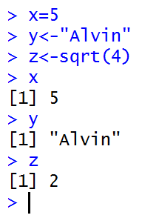
R Syntax 1
Define variables
R is case sensitive
Variable names can start with a letter or digits
The assignment operator in R is <- or =
Functions
c(), rep(), and sort() are functions
Each function consists of function name and ()

Slide 7
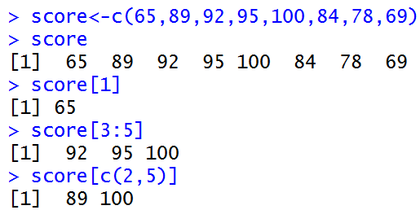
R Syntax 2
Define and Index Vectors
We use combine function to define a vector c()
We use brackets [ ] to index elements in a vector
Access a variable from a dataset
We use $ to index a variable (column) from a data set (a table)
Load Data into R
Access a Variable

Slide 8
Understanding Descriptive Statistics

Slide 9
Summary Statistics
summary
Provides basic summary statistics
describe
Provides detailed summary statistics
describeBy
Provide summary statistics by groups

Slide 10
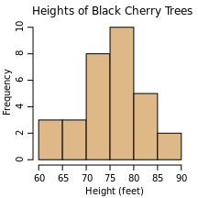
Read and Interpret a Histogram
For a histogram
What does x axis represent?
What does y axis represent?
Basic statistics
Mean
Median
1,3,3,6,7,8,9
1,2,3,4,5,6,7,8
What does it mean if the mean is greater (or smaller) than the median?

Slide 11
Hypotheses Testing: t-test and P-value
T-test
Compares the mean between two groups/ samples
P-value
<0.05, means the difference between the means is statistically significant
>=0.05, means the difference between the means is statistically insignificant

Slide 12
Decision Tree Analysis

Slide 13
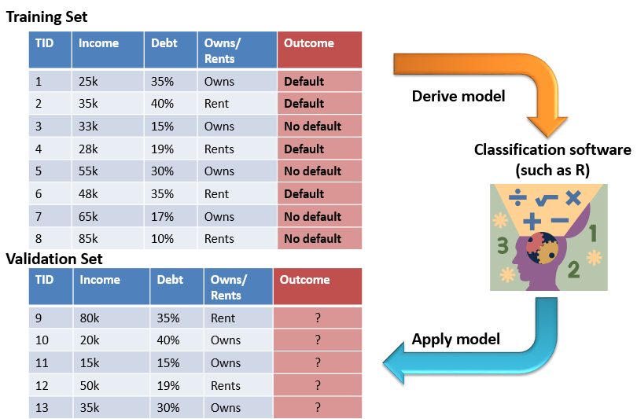
What is Classification?
A statistical method used to determine to what category (or “class”) a new observation belongs
Pay off the loan / Purchase organic food/ Legitimate Charge
How to classify?
Decision Tree
Training Set
Validation Set
How to evaluate decision tree?
Correct classification rate
Error rate
Error rate + Correct classification rate =1

Slide 14
Read the Decision Tree
How many leaf nodes? /What’s the size of the tree?
What does 0.85 mean？
How likely a person with a 50k income and 10% debt is going to default?
Who are most likely to default?
Who are least likely to default?
1-Default
0-No Default
Credit Approval
Income <40k
Income >40k
Debt >20%
Debt <20%
Debt >20%
Debt <20%
1
Owns house
Rents
0
0
Owns house
Rents
0
1
0
0.85
0.20
0.30
Answer: Customers whose
income is less than 40k,
debt is smaller than 20% and
house is owned are the least likely to default.
0.22
0.60
0.26

Slide 15
How to calculate the classification accuracy?
A Confusion Matrix compares the predicted outcomes to the observed (actual) outcomes
Correct classification rate=(600+650)/1500=0.83
Error rate=1-0.83=0.17
The Confusion Matrix
 |  | Predicted outcome:
 |  | Default | No default
Observed outcome: | Default | 600 | 100
 | No default | 150 | 650 | Total: 1500

Slide 16
Control Tree Size
Tree size and classification accuracy
A bigger tree =using more predictor=more leaf nodes = a larger size
Larger tree leads to higher classification accuracy but makes the tree more complex
Goal: a simple tree with high classification accuracy (high correct classification rate)
Minimum split
Complexity factor
Minimum number of observations in each node needed to add an additional split.
Minimum reduction in error needed to add an additional split.
Smaller complexity factor → More complex tree
Smaller minimum split → More complex tree

Slide 17
Clustering Analysis

Slide 18
What is Cluster Analysis?
Grouping data so that elements in a group will be
Similar (or related) to one another
Different (or unrelated) from elements in other groups
We don’t know how many groups we have beforehand
How to cluster: K-means
Grouping data based on distances
Red dots are centroid (centers)

Slide 19
How to Evaluate Clusters?
Within-cluster SSE
Between-cluster SSE
1
1.3
SSE₁ = 1² + 1.3² + 2² = 1 + 1.69 + 4 = 6.69
2
Within-cluster SSE: SMALL –High Cohesion
Between-cluster SSE: LARGE –High Separation
We want High Cohesion and High Separation
Cluster 1
We want Small Within-SSE and Large Between-SSE
Cluster 5
More Clusters →Higher Cohesion (Good)
More Clusters →Lower Separation (Bad)

Slide 20
Interpreting Clustering Results 1
Summary Statistics for Each Cluster
What’s the characteristics of cluster 1 compared to the population?
What does a positive / negative value mean?
> aggregate(kData,by=list(MyKMeans$cluster),FUN=mean)
Group.1 RegionDensityPercentile MedianHouseholdIncome AverageHouseholdSize
1 1 0.8835353 -0.2681572 -0.5992532
2 2 -1.1224866 -0.5594931 -0.5055258
3 3 -0.4836836 -0.1400215 0.3502257
4 4 0.9557776 -0.3145690 1.3672892
5 5 0.8561222 1.3520755 0.2790425

Slide 21
Interpreting Clustering Results 2
Within-Cluster SSE
What’s the Within-Cluster SSE for Cluster 4?
Which cluster has the highest cohesion?
Which cluster has the lowest cohesion?
What is the range of the Within-Cluster SSE ?
> # Display withinss (i.e. the within-cluster SSE for each cluster)
> print("Within cluster SSE for each cluster (Cohesion):")
[1] "Within cluster SSE for each cluster (Cohesion):"
> MyKMeans$withinss
[1] 6523.491 4990.183 6772.426 2707.390 5102.896

Slide 22
Interpreting Clustering Results 3
Between-Cluster SSE
What’s the average Between-Cluster SSE?
What’s the total Between-Cluster SSE?
> # Display betweenss (i.e. the between-cluster SSE between clusters)
> print("Total between-cluster SSE (Seperation):")
[1] "Total between-cluster SSE (Seperation):"
> MyKMeans$betweenss
[1] 45301.67
> # Compute average separation: more clusters = less separation
> print("Average between-cluster SSE:");
[1] "Average between-cluster SSE:"
> MyKMeans$betweenss/NUM_CLUSTER
[1] 9060.334

Slide 23
Association Rules Mining

Slide 24
What is Association Rule Mining?
Find out which items (X) predict the occurrence of other items (Y)
Basket Analyses
Itemset: A collection of items of interest
Support count (σ)
In how many baskets does the itemset appear?
σ{Milk, Diapers, Beer} = 2
σ{Milk, Diapers} = 3
Basket | Items
1 | Bread, Milk
2 | Bread, Diapers, Beer, Eggs
3 | Milk, Diapers, Beer, Coke
4 | Bread, Milk, Diapers, Beer
5 | Bread, Milk, Diapers, Coke

Slide 25
Support and Confidence
Support (s)
Support count (σ) / total number of baskets
Measures whether the itemset appears often
s{Milk, Diapers}= 3/5 = 0.6
s{Bread}= 4/5 = 0.8
Bread appears very often in shopping baskets
Is s(X,Y) always greater/smaller/equal to s(X)?
Confidence (c) is the strength of the association between two itemsets
c(X→Y): use X to predict Y, X is the attendant and Y is the consequent
c(X→Y) is always between 0 and 1
Basket | Items
1 | Bread, Milk
2 | Bread, Diapers, Beer, Eggs
3 | Milk, Diapers, Beer, Coke
4 | Bread, Milk, Diapers, Beer
5 | Bread, Milk, Diapers, Coke

Slide 26
Lift
What’s the problem with confidence?
The purpose of association rule mining is to predict Y with X
If X and Y are frequently purchased items, the confidence will be large but X is a bad predictor of Y
So we need to account for the natural occurrence of both X and Y
Lift
Measures whether two itemsets X and Y appear together at the same frequency as random chance
Lift > 1 | The occurrence of X , Y together is more likely than what you would expect by chance [Good]
Lift<1 | The occurrence of X , Y together is less likely than what you would expect by chance [Bad]
Lift=1 | The occurrence of X , Y together is the same as what you would expect by chance

Slide 27
Example 1
What’s the lift for the rule:{Milk, Diapers} → {Beer}
X = {Milk, Diapers} ; Y = {Beer}
s(X,Y)= 2/5 = 0.4 s(X) = 3/5 = 0.6 s(Y) = 3/5 = 0.6
c(X→Y)=0.4/0.6=0.67
The support is 0.4, meaning that {Milk, Diapers, Beer} appears very often
The confidence is 0.67, indicating there is a strong association between {Milk Diaper} and {Beer}
The Lift is greater than 1, suggesting that {Milk, Diapers} and {Beer} occur together more often than a random chance, thus is predictive.
Basket | Items
1 | Bread, Milk
2 | Bread, Diapers, Beer, Eggs
3 | Milk, Diapers, Beer, Coke
4 | Bread, Milk, Diapers, Beer
5 | Bread, Milk, Diapers, Coke

Slide 28
Example 2
 | Netflix
Cable TV |  | No | Yes
 | No | 200 | 3800
 | Yes | 8000 | 1000
What is the effect of Netflix on Cable TV? {Netflix → Cable TV)
s (Netflix, Cable TV) = 1000/13000 → 7%
s (Cable TV ) = 9000/13000 → 69%
s (Netflix ) = 4800/13000 → 37%
Having one service negatively affects the purchase of the other (lift closer to 0 than 1)

Slide 29
Good Luck!

