Slide 1

MIS2502:
Data Analytics
The Things You Can Do With Data
Acknowledgement: David Schuff

Slide 2

Why Data Analytics?
40%
61%
Say this is because there is “no good data”
72%
Want to increase their organization’s use of data analytics
Of decisions by managers are made by using their “gut”
Source: http://advice.cio.com/thomas_wailgum/to_hell_with_business_intelligence_40_percent_of_execs_trust_gut

Slide 3

It all starts with data
Data
Gathering
Storing
Retrieving
Interpreting
Almost every business action requires at least one of these!

Slide 4
Data versus information
Data
Discrete, unorganized, raw facts
Information
The transformation of those facts into meaning

Slide 5
Examples of Data
Data
Product price
Information
Course enrollment
Student grade
Bank deposit amount
?

Slide 6


So then how do you turn data into information?

Slide 7
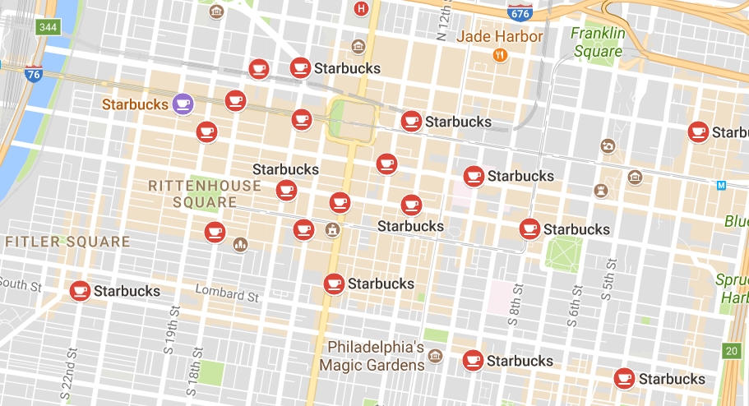

Example:
Starbucks
Have you ever wondered how Starbucks can open three branches on the same street and not have their business suffer?
https://www.icas.com/ca-today-news/10-companies-using-big-data

Slide 8

Example:
Starbucks
The coffee shop uses big data to determine the potential success of each new location, taking information on location, traffic, area demographic and customer behavior into account.
https://www.icas.com/ca-today-news/10-companies-using-big-data

Slide 9

Example: Netflix
  Predict viewing habits
  Find the next smash-hit series.
    e.g. House of Cards, Orange is the New Black
  Personalize promotions
  Account for 1/3 of peak-time internet traffic in the US.
“The foundation of the streaming business was analytics.”
–Dave Hastings
Video
http://knowledge.wharton.upenn.edu/article/how-data-analytics-is-shaping-what-you-watch/
https://www.linkedin.com/pulse/amazing-ways-netflix-uses-big-data-drive-success-bernard-marr
https://blog.kissmetrics.com/how-netflix-uses-analytics/

Slide 10
Two types of data
Transactional
Captures data describing an event
An exchange between actors
Analytical
Captures data to support analysis and reporting
An aggregated view of the business
Real-time
Historical
!
Explain the role of transactional and analytical data in the examples on the previous slides.

Slide 11

The Information Architecture of an Organization
Data entry
Transactional Database
Data extraction
Analytical Data Store
Data analysis
Stores real-time transactional data
Stores historical transactional and summary data
Called OLTP:
Online transaction processing
Called OLAP:
Online analytical processing
!
But this is changing rapidly….

Slide 12
Components of an information infrastructure
Transactional Database
Supports management of an organization’s data
Analytical Data Store
For periodic analysis
For everyday transactions
Supports managerial decision-making
This is what is commonly thought of as “database management”
This is the foundation for “advanced data analytics”

Slide 13

Proceed with Cautions!
Data is a complement to “intuition” or past experience – Not a substitute
“Analytics cannot replace execution. If you can’t deliver a good experience, analytics are irrelevant.”
–Bill Franks, Chief Analytics Officer at Teradata

Slide 14
The agenda for the course
Weeks 1 through 5
Weeks
6 through 8
Weeks 10 through 15
Data entry
Transactional Database
Analytical Data Store
Data analysis
Data extraction
Stores real-time transactional data
Stores historical transactional and summary data
Data interpretation,
visualization, communication

