Slide 1

MIS2502:
Data Analytics
Relational Data Modeling
Acknowledgement: David Schuff

Slide 2


Slide 3


Slide 4
Comparing Transactional and Analytical Data Stores
Transactional Database | Analytical Data Store
Based on Relational paradigm | Based on Dimensional paradigm
Storage of real-time transactional data | Storage of historical transactional data
Optimized for storage efficiency and data integrity | Optimized for data retrieval and summarization
Supports day-to-day operations | Supports periodic and on-demand analysis

Slide 5

Where we are…
Now we’re here…
Data entry
Transactional Database
Data extraction
Analytical Data Store
Data analysis
Stores real-time transactional data
Stores historical transactional and summary data

Slide 6
Modeling a database
A representation of the information to be captured
Describes the data contained in the database
Explains how the data interrelates

Slide 7
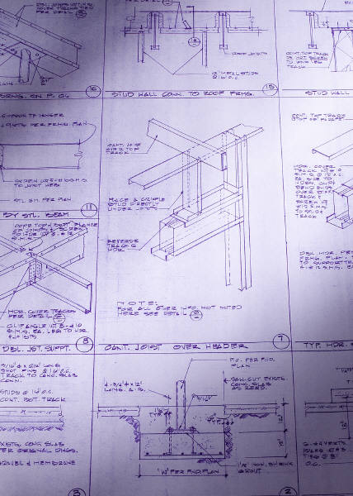
Why bother modeling?
Creates a blueprint before you start building the database
Gets the story straight: easy for non-technical people to understand
Minimize having to go back and make changes in the implementation stage

Slide 8
Start with a problem statement
Design a database to track orders for a store. A customer places an order for a product. People can place an order for multiple products.
Record first name, last name, city, state, and zip code for customers. We also want to know the date an order was placed.
Finally, we want to track the name and price of products and the quantity of each product for each order.

Slide 9
The Entity Relationship Diagram (ERD)
The primary way of modeling a relational database
Three main diagrammatic elements
Entity
A uniquely identifiable thing (i.e., person, order)
Relationship
Describes how two entities relate to one another
(i.e., makes)
Attribute
A characteristic of an entity or relationship (i.e., first name, order number)

Slide 10
Begin with Identifying the Entities
This is what your database is about.
What’s left are your entities!
Step 1
List the nouns in the problem statement.
Step 2
When nouns are synonyms for other nouns, choose the best one.
Step 3
Make a note of nouns that describe other nouns. These will be your entities’ attributes.
Step 4
Rule out the nouns that don’t relate to the process to be captured.

Slide 11
Start with a problem statement
Design a database to track orders for a store. A customer places an order for a product. People can place an order for multiple products.
Record first name, last name, city, state, and zip code for customers. We also want to know the date an order was placed.
Finally, we want to track the name and price of products and the quantity of each product for each order.

Slide 12
So here are the nouns…
Design a database to track orders for a store. A customer places an order for a product. People can place an order for multiple products.
Record first name, last name, city, state, and zip code for customers. We also want to know the date an order was placed.
Finally, we want to track the name and price of products and the quantity of each product for each order.
Which nouns are entities
Which nouns are attributes?
Which nouns are irrelevant?

Slide 13
Here’s where it gets tricky…
store is not an entity because we are not tracking specific information about the store (i.e., store location)
BUT…if there were many stores and we wanted to track sales by store, then store would be an entity!
In this case, “store” is the context
But that isn’t part of the problem statement….

Slide 14
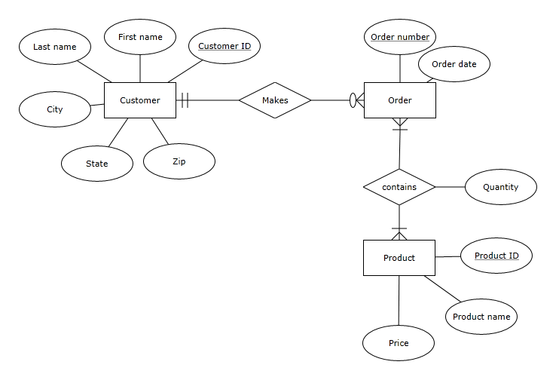
The ERD Based on the Problem Statement

Slide 15
The primary key
Entities need to be uniquely identifiable
  So you can tell them apart
  They may not be explicitly part of the problem statement, but you need them!
Use a primary key
  One or more attributes that
  uniquely identifies an entity
How about these as primary keys for Customer:
First name and/or last name?
Social security number?
Customer
ID
Uniquely identifies a customer
Order
number
Uniquely identifies an order

Slide 16
Last component: Cardinality
Defines the rules of the association between entities
Customer
makes
Order
Minimum cardinality:
at least – one
at most - one
at least – zero (optional)
at most - many
Maximum cardinality:
This is a one-to-many (1:m) relationship:
  One customer can have many orders.
  One order can only belong to one customer.
Additionally
  A customer could have no orders.
  An order has to belong to at least one customer.

Slide 17
Maximum and Minimum Cardinality
Maximum cardinality (type of relationship)
  Describes the maximum number of entity instances that participate in a relationship
    One-to-one
    One-to-many
    Many-to-many
Minimum cardinality
  Describes the minimum number of entity instances that must participate in a relationship

Slide 18
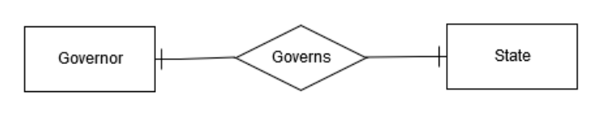
One-to-One Relationship
One-to-One (1:1)
  A single instance of one entity is related to a single instance of another entity
A state has (at most) one governor
A governor governs (at most) one state

Slide 19
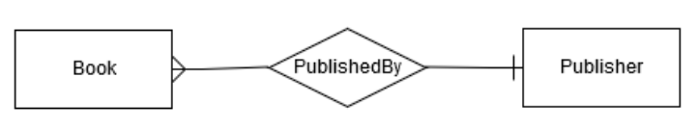
One-to-Many Relationship
One-to-Many (1:n or 1:m)
  A single instance of one entity is related to multiple instances of another entity
A publisher can publish many books
A book is published by (at most) one publisher

Slide 20
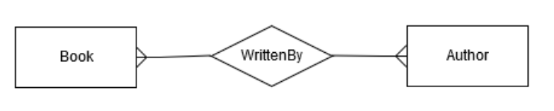
Many-to-Many Relationship
Many-to-Many (n:n or m:m)
  Each instance of one entity is related to multiple instances of another entity, and vice versa
A book can be written by many authors
An author can write many books

Slide 21
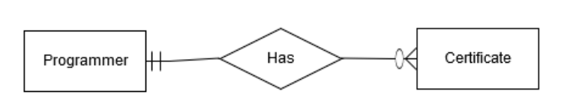
Minimum Cardinality
Minimums are generally stated as either zero or one:
  0 (optional): participation in the relationship by the entity is optional.
  1 (mandatory): participation in the relationship by the entity is mandatory.
A programmer is mandatory for a certificate); or a certificate has to be issued to (at least) one programmer.
A certificate is optional for a programmer; or a programmer may not have any certificates
1:m maximum cardinality: a programmer
can have many certificates; a certificate is issued to (at most) one programmer

Slide 22
Crows Feet Notation
Customer
makes
Order
There are other ways of denoting cardinality, but this one is pretty standard.
So called because this…
…looks something like this
There are also variations of the crows feet notion!

Slide 23
The Order-Product Example:
A Many-to-Many (m:m) Relationship
An order can be composed of many products.
An order has to have at least one product.
A product can be a part of many orders.
A product has to be associated with at least one order.
Order
number
Order Date
Order
at most – many
at least – one
contains
Quantity
Does it make sense for the maximum cardinality to be 1 for either entity?
Does it make sense for the minimum cardinality to be 0 (optional) for either entity?
at least – one
at most - many
Product
Product
name
Price
Product
ID

Slide 24
Cardinality is defined by business rules
What would the cardinality be in these situations?
Order
?
contains
?
Product
Course
?
has
?
Section
Employee
?
has
?
Office

Slide 25
Relationship Attributes
Name
TUID
The grade and semester describes the combination of student and course
(i.e., Bob takes MIS2502 in Fall 2011 and receives a B; Sue takes MIS2502 in Fall 2012 and receives an A)
Student
Grade
contains
Semester
Course
Course
number
Course Title

Slide 26
A scenario: The auto repair shop
A car is described by a VIN, make, and model.
A mechanic is described by a name and SSN.
A repair is described by a price.
A transaction occurs on a particular date.
An invoice has an invoice number and a billing name, city, state, and zip code.
Each transaction is associated with a car, a mechanic, and a repair.
Many transactions can make up an invoice.
A transaction can only belong to one invoice.
Cars, mechanics, and repairs can all be part of multiple transactions.

Slide 27
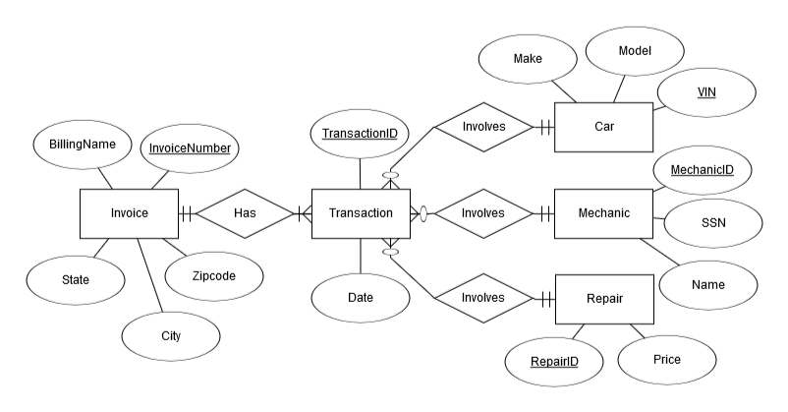
Solution

Slide 28
Normalization
Organizing data to minimize redundancy (repeated data)
This is good for several reasons
  The database takes up less space
  Fewer inconsistencies in your data
  Easier to search and navigate the data
It’s easier to make changes to the data
  The relationships take care of the rest

Slide 29

Normalizing your ER Model
If an entity has multiple sets of related attributes, split them up into separate entities
Don’t do this…
Vendor Name
Vendor Name
Vendor Phone
Vendor Address
Vendor Phone
Vendor Address
Vendor
Vendor ID
Product
ID
Product
Product
name
sells
Price
…do this →
Then you won’t have to repeat vendor information for each product.
Product
Product
name
Price
Product
ID

Slide 30
Normalizing your ER Model
Each attribute should be atomic – you can’t (logically) break it up any further.
Don’t do this…
…do this
Phone
Address
Phone
First Name
Customer
ID
Customer
First/Last
Name
Customer
ID
Customer
Last Name
Street
City
State
Zip
This way you can search or sort by last name OR first name, and by city, state, or zip code.

Slide 31
Summary of ERD
Key concepts
  Entity
  Relationship
  Cardinality
    Minimum cardinality: 0 (optional) or 1 (mandatory)
    Maximum cardinality: One-to-one, One-to-many, Many-to-many
  Attributes
    Entity attributes: primary key vs. non-key
    Relationship attributes
Key skills
  Interpret simple ERDs
  Draw an ERD based on a scenario description

Slide 32
Drawing ERD: A Checklist
Entities
Entity attributes
  Primary key
  Non-key attributes
Relationships
  Minimum cardinality
  Maximum cardinality
Relationship attributes

Slide 33
Question:
What do you think is the trickiest thing about creating an ERD from a problem description?
What advice would you give to deal with that issue?

Slide 34
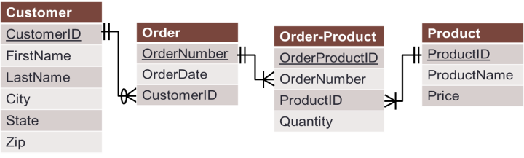
Let Move From Model to Implementation…

Slide 35
Implementing the ERD
As a Database Schema
  A map of the tables and fields in the database
  This is what is implemented in the database management system
  Part of the “design” process
A schema actually looks a lot like the ERD
  Entities become tables
  Attributes become fields
  Relationships can become additional tables

Slide 36
The Rules
1. Create a table for every entity
2. Create table fields for every entity’s attributes
3. Implement relationships between the tables
1:many relationships
Primary key field of “1” table put into “many” table as foreign key field
many:many relationships
Create new table
1:1 relationships
Primary key field of one table put into other table as foreign key field
1:many relationships with original tables

Slide 37
The ERD Based on the Problem Statement

Slide 38
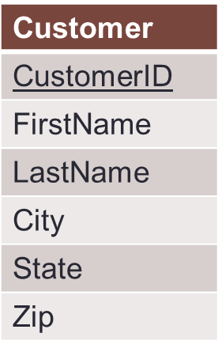
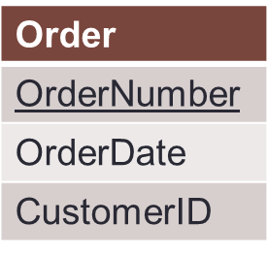
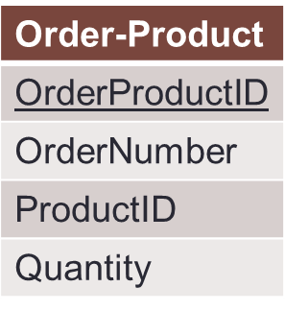
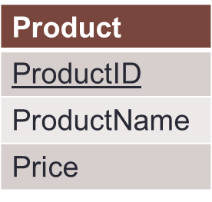
Our Order Database schema
Original 1:m relationship
Original m:m relationship
Order-Product is a decomposed many-to-many relationship
Order-Product has a 1:m relationship with Order and Product
Now an order can have multiple products, and a product can be associated with multiple orders

Slide 39
The Customer and Order Tables:
The 1:m Relationship
Customer Table
CustomerID | FirstName | LastName | City | State | Zip
1001 | Greg | House | Princeton | NJ | 09120
1002 | Lisa | Cuddy | Plainsboro | NJ | 09123
1003 | James | Wilson | Pittsgrove | NJ | 09121
1004 | Eric | Foreman | Warminster | PA | 19111
Order Table
Customer ID is a foreign key in the Order table. We can associate multiple orders with a single customer!
In the Order table, Order Number is unique;
Customer ID is not!
Order Number | OrderDate | Customer ID
101 | 3-2-2011 | 1001
102 | 3-3-2011 | 1002
103 | 3-4-2011 | 1001
104 | 3-6-2011 | 1004

Slide 40
The Customer and Order Tables:
Normalization
Customer Table
CustomerID | FirstName | LastName | City | State | Zip
1001 | Greg | House | Princeton | NJ | 09120
1002 | Lisa | Cuddy | Plainsboro | NJ | 09123
1003 | James | Wilson | Pittsgrove | NJ | 09121
1004 | Eric | Foreman | Warminster | PA | 19111
No repeating orders or customers.
Every order is unique.
This is an example of normalization..
Every customer is unique.
Order Table
Order Number | OrderDate | Customer ID
101 | 3-2-2011 | 1001
102 | 3-3-2011 | 1002
103 | 3-4-2011 | 1001
104 | 3-6-2011 | 1004

Slide 41
To figure out who ordered what
Match the Customer IDs of the two tables, starting with the table with the foreign key (Order):
We now know which order belonged to which customer
  This is called a join
Order Table
Customer Table
Order Number | OrderDate | Customer ID | Customer ID | FirstName | LastName | City | State | Zip
101 | 3-2-2011 | 1001 | 1001 | Greg | House | Princeton | NJ | 09120
102 | 3-3-2011 | 1002 | 1002 | Lisa | Cuddy | Plainsboro | NJ | 09123
103 | 3-4-2011 | 1001 | 1001 | Greg | House | Princeton | NJ | 09120
104 | 3-6-2011 | 1004 | 1004 | Eric | Foreman | Warminster | PA | 19111

Slide 42
Now the many:many relationship
Order Table
Order-Product Table
Order Number | OrderDate | Customer ID
101 | 3-2-2011 | 1001
102 | 3-3-2011 | 1002
103 | 3-4-2011 | 1001
104 | 3-6-2011 | 1004
Order ProductID | Order number | Product ID | Quantity
1 | 101 | 2251 | 2
2 | 101 | 2282 | 3
3 | 101 | 2505 | 1
4 | 102 | 2251 | 5
5 | 102 | 2282 | 2
6 | 103 | 2505 | 3
7 | 104 | 2505 | 8
Product Table
ProductID | ProductName | Price
2251 | Cheerios | 3.99
2282 | Bananas | 1.29
2505 | Eggo Waffles | 2.99
This table relates Order and Product to each other!

Slide 43
To figure out what each order contains
Match the Product IDs and Order IDs of the tables, starting with the table with the foreign keys (Order-Product):
Order-Product Table
Order Table
Product Table
Order ProductID | Order Number | Product ID | Quantity | Order Number | Order Date | Customer ID | Product ID | Product Name | Price
1 | 101 | 2251 | 2 | 101 | 3-2-2011 | 1001 | 2251 | Cheerios | 3.99
2 | 101 | 2282 | 3 | 101 | 3-2-2011 | 1001 | 2282 | Bananas | 1.29
3 | 101 | 2505 | 1 | 101 | 3-2-2011 | 1001 | 2505 | Eggo Waffles | 2.99
4 | 102 | 2251 | 5 | 102 | 3-3-2011 | 1002 | 2251 | Cheerios | 3.99
5 | 102 | 2282 | 2 | 102 | 3-3-2011 | 1002 | 2282 | Bananas | 1.29
6 | 103 | 2505 | 3 | 103 | 3-4-2011 | 1001 | 2505 | Eggo Waffles | 2.99
7 | 104 | 2505 | 8 | 104 | 3-6-2011 | 1004 | 2505 | Eggo Waffles | 2.99
So which customers ordered Eggo Waffles (by their Customer IDs)?

Slide 44
This is denormalized data necessary for querying but bad for storage…
The redundant data seems harmless, but:
What if the price of “Eggo Waffles” changes?
And what if Greg House changes his address?
And if there are 1,000,000 records?

Slide 45
Summary of Database Schema
Draw the corresponding schema of an ERD
  Identify tables based on entities and relationships
  Implement primary key/foreign key relationships
  Decompose many-to-many relationships in an ERD into one-to-many relationships in the schema
Best practices for normalization
Be able to match up (join) multiple tables

