Slide 1

MIS2502:
Data Analytics
Dimensional Data Modeling
Acknowledgement: David Schuff

Slide 2

Where we are…
Now we’re here…
Data entry
Transactional Database
Data extraction
Analytical Data Store
Data analysis
Stores real-time transactional data
Stores historical transactional and summary data

Slide 3

What do we know so far?
Why are relational databases good for storing transaction data?
Why are they bad for analytical processing?
What’s the solution?

Slide 4
Some terminology
Data Warehouse
Takes many forms
Really is just a repository for historical data
Data Mart
Subset of the Data Warehouse
Designed for specific analysis
Data Cube
Organization of data as a “multidimensional matrix”
Implementation of a Data Mart

Slide 5
The Actual Process
Analytical Data Store
Transactional Database 1
ETL
Data Warehouse
Data Mart
(Sales)
Transactional Database 2
ETL
Data Mart
(Finance)
Other Sources
ETL
Data Mart
(Inventory)

Slide 6
How they all relate
The data in the transactional database…
…which feeds the data mart…
…and is analyzed as a cube.
…is put into a data warehouse…
We’ll start here.

Slide 7
The Data Cube
Product
Core component of
Online Analytical Processing (OLAP)
and
Multidimensional
Data Analysis
Made up of “facts” and “dimensions”
M&Ms
Diet
Coke
Doritos
Famous
Amos
quantity
& total price
quantity
& total price
quantity
& total price
quantity
& total price
Ardmore,
PA
quantity
& total price
quantity
& total price
quantity
& total price
quantity
& total price
Temple
Main
Store
quantity
& total price
quantity
& total price
quantity
& total price
quantity
& total price
Cherry Hill,
NJ
quantity
& total price
quantity
& total price
quantity
& total price
quantity
& total price
Mar. 2013
King of
Prussia, PA
Feb. 2013
Jan. 2013
Time
Quantity sold and total price are measured facts.
Why isn’t product price a measured fact?

Slide 8
The Data Cube
Product
M&Ms
Diet
Coke
Doritos
Famous
Amos
The highlighted element represents all the M&Ms sold in Ardmore, PA in January, 2011
quantity
& total price
quantity
& total price
quantity
& total price
quantity
& total price
Ardmore,
PA
quantity
& total price
quantity
& total price
quantity
& total price
quantity
& total price
Temple
Main
A single summary record representing a business event (monthly sales).
Store
quantity
& total price
quantity
& total price
quantity
& total price
quantity
& total price
Cherry Hill,
NJ
quantity
& total price
quantity
& total price
quantity
& total price
quantity
& total price
Mar. 2013
King of
Prussia, PA
Feb. 2013
Jan. 2013
Time

Slide 9
Slicing the Data
Product
M&Ms
Diet
Coke
Doritos
Famous
Amos
The highlighted elements represent Famous Amos cookies sold on Temple’s Main campus from January to March, 2013
quantity
& total price
quantity
& total price
quantity
& total price
quantity
& total price
Ardmore,
PA
quantity
& total price
quantity
& total price
quantity
& total price
quantity
& total price
Temple
Main
Store
quantity
& total price
quantity
& total price
quantity
& total price
quantity
& total price
This is called “slicing the data.”
Cherry Hill,
NJ
quantity
& total price
quantity
& total price
quantity
& total price
quantity
& total price
Mar. 2013
King of
Prussia, PA
Feb. 2013
Jan. 2013
Time

Slide 10
Dicing the Data
Product
M&Ms
Diet
Coke
Doritos
Famous
Amos
What do the orange highlighted elements represent?
quantity
& total price
quantity
& total price
quantity
& total price
quantity
& total price
Ardmore,
PA
quantity
& total price
quantity
& total price
quantity
& total price
quantity
& total price
Temple
Main
Store
quantity
& total price
quantity
& total price
quantity
& total price
quantity
& total price
What do the purple highlighted elements represent?
Cherry Hill,
NJ
quantity
& total price
quantity
& total price
quantity
& total price
quantity
& total price
Mar. 2013
King of
Prussia, PA
Feb. 2013
Jan. 2013
Time
This is called
“dicing the data”

Slide 11

Could you have a data mart with five dimensions?
Then why does our example (and most others) only have three?

Slide 12
Modeling a data cube:
The Star Schema
Store
Store_ID
Store_Address
Store_City
Store_State
Store_Type
Transactional databases aren’t built around dimensions
They don’t map well to cubes
So we build a star schema
Built around “dimensions” and “facts”
The star schema facilitates
Aggregating individual transactions
Creation of cubes
They aren’t set up for summarization
Simplified relational model
Dimension
Sales
Sales_ID
Product_ID
Store_ID
Time_ID
Quantity Sold
Total Price
Fact
Product
Product_ID
Product_Name
Product_Price
Product_Weight
Time
Time_ID
Day
Month
Year
Dimension
Dimension

Slide 13
Fact Table
Contain facts (numeric measurements) associated with a specific business process
Contain foreign keys that refer to dimension tables
Sales
Sales_ID
Product_ID
Store_ID
Time_ID
Quantity Sold
Total Price
Fact

Slide 14
Dimension Tables
Store
Store_ID
Store_Address
Store_City
Store_State
Store_Type
Dimension
Contain text and descriptive information
Provide the “who, what, where, when, why, and how” context surrounding a business process event
Sales
Sales_ID
Product_ID
Store_ID
Time_ID
Quantity Sold
Total Price
Fact
Product
Product_ID
Product_Name
Product_Price
Product_Weight
Time
Time_ID
Day
Month
Year
Dimension
Dimension

Slide 15
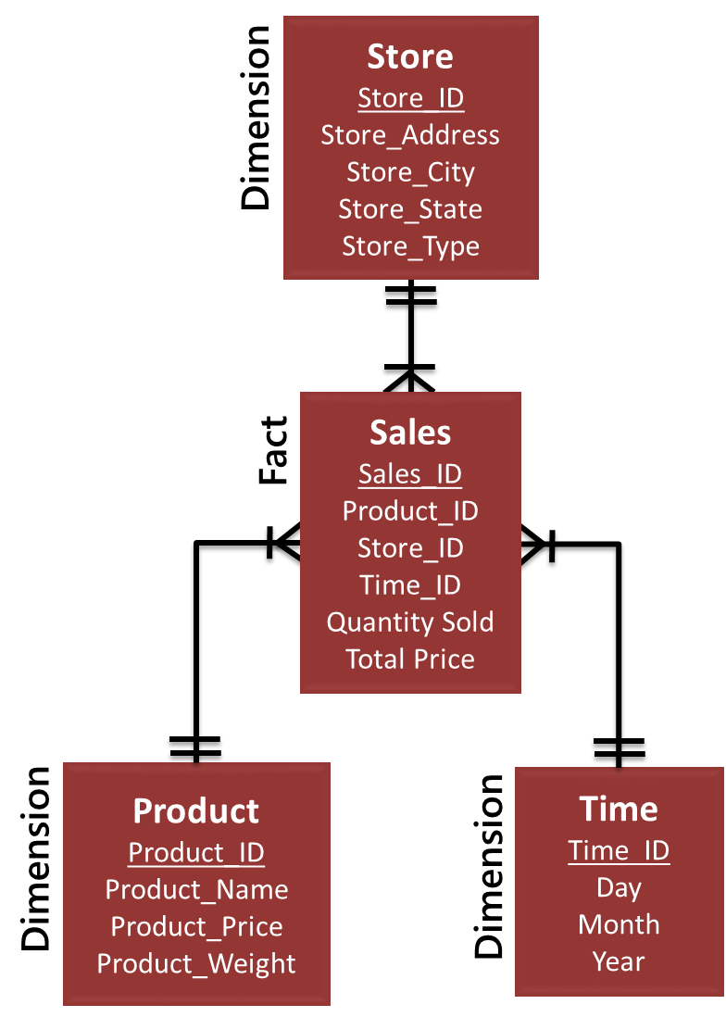
From Star Schema to Data Cube
and stores precomputed summarized (aggregated) data
Much more efficient, but can’t be changed (non-volatile)
A Cube typically uses a Star Schema as its source

Slide 16

Designing the Star Schema
1. Choose the business process
2. Decide on the level of granularity
3. Identify the dimensions
4. Identify the fact
Kimball’s Four Step Process for Data Cube Design
(Kimball et al., 2008)
http://www.kimballgroup.com/data-warehouse-business-intelligence-resources/kimball-techniques/dimensional-modeling-techniques/four-4-step-design-process/

Slide 17
Choose the business process
Business processes are the operational activities performed by your organization
  What your data cube is “about”
Determined by the questions you want to answer about your organization
Question | Business Process
Who is my best customer? | Sales
What are my highest selling products? | Sales
Which teachers have the best student performance? | Standardized testing
Which supplier is offering us the best deals? | Purchasing
Note that a “business process” is not always about business.
Notes:
Business processes: are the operational activities performed by an organization, such as taking an order, processing an insurance claim, registering students for a class. Business process events generate or capture performance metrics that translate into facts in a fact table. Most fact tables focus on the results of a single business process. Choosing the process is important because it defines a specific design target and allows the grain, dimensions, and facts to be
declared.

Slide 18
Decide on the level of granularity
Level of detail for each business process event (row in the table)
Will determine the data in the dimensions
Example: Who is my best customer?
  The “event” is a sales transaction
  Choices for time: yearly, quarterly, monthly, daily
  Choices for store: store, city, state
How would you select the right granularity?
Notes:
Granularity: Declaring the grain is the pivotal step in a dimensional design. The grain establishes exactly what a single fact table row represents.

Slide 19
Identify the dimensions
Description of the context of the business process
The key elements of the process needed to answer the question (“fact”)
  who, what, where, when, why, and how
Example: Sales transaction
  A “sale” is the fact
  Dimensions: product, store, and time
  Could this data mart tell you
    What is the best selling product?
    Who is the best customer?
Try it for the “student performance” example.
Notes:
Dimensions: Dimensions provide the “who, what, where, when, why, and how” context surrounding a business process event. Dimension tables contain the descriptive attributes used by BI applications for filtering
and grouping the facts

Slide 20
Identify the fact
The fact table contains data called facts associated with the business process event
Keys
Primary key for each event
Facts: Measured, numeric data
Facts: Quantifiable information for each business event – almost always numeric
Example: Sales has Sales_ID as primary key, and Product_ID, Store_ID, and Time_ID as foreign keys
Example: Sales has quantity_sold and total_price.
Describes a particular combination of dimensional data
Foreign keys for the associated dimensions
Notes:
Fact: Facts are the measurements that result from a business process event and are almost always numeric. In a retail sales transaction, the quantity of a product sold and its extended price are good Facts.

Slide 21
Advantages of data cube
Speed
Fast response to give you the information you have previously designed in the cube
Analysis
The data multi-dimensional data structure allows the data to be analyzed in the most logical way.

Slide 22
Data cube caveats
The cube is “non volatile,” so you’re locked in
  Measured facts
  Dimensions
  Granularity
So choose wisely!
  For example: You can’t track daily sales if “date” is monthly
  So why not include every single sale and do no aggregation?

Slide 23
Pivot tables in Excel
PivotTable is a data summarization tool in Excel
  the easiest way to learn multidimensional data and generate simple reports
Data cubes can act as the data source for Pivot Table in Excel

Slide 24
ICA #8
In ICA #8, we learned to how to create a pivot table in Excel
  Identify which fields are assigned as VALUES and which ones are assigned as ROWS
  Identify the correct function for aggregation: e.g., SUM, COUNT, AVERAGE, MAX, MIN

Slide 25
The star schema in ICA #8
Measured Fact: Order amount
Three dimensions: Salesperson, Country, and Time.

Slide 26
Pivot Table and Data Cube
The fields in the ROWS box correspond to dimensions in a data cube
The fields in the VALUES box correspond to measured facts in a data cube

Slide 27
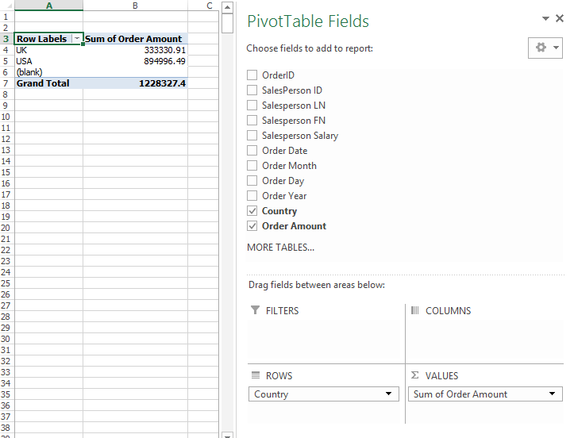
Example 1
Dimension
Measured Fact

Slide 28
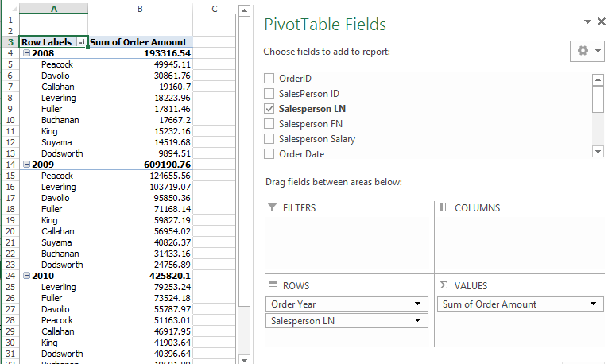
Example 2
Dimensions
Measured Fact

Slide 29
Summary
Data warehouse vs. data mart vs. data cube
Data Cube
Star schema
Kimball’s four step process for data mart design
Pivot tables in Excel

