Slide 1
MIS2502: Data Analytics ETL - Excel Basics

Slide 2
Excel References
Many Excel formulas refer to cells or ranges of cells.
For example, the simple formula =A1+B1 refers to cells A1 and B1
There are two types of cell references: relative and absolute.
Relative and absolute references behave differently when copied and filled to other cells.

Slide 3
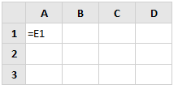
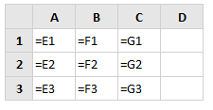
Relative Reference
When copied across multiple cells, they change based on the relative position of rows and columns.
By default, all cell references are relative references.
Example:

Slide 4
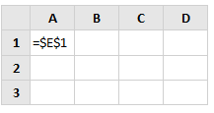
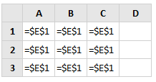
Absolute Reference
When copied across multiple cells, cell references remain constant
Example:

Slide 5
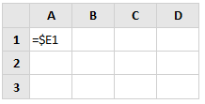
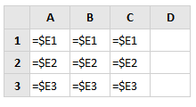
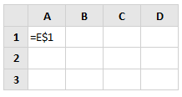
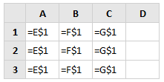
Mixing Relative and Absolute References
Using absolute referencing for the column and relative referencing for the row:
Using relative referencing for the column and absolute referencing for the row:

Slide 6
Basic Functions
LEN()
Return the number of characters in a text string
LEFT(), RIGHT(), MID()
Return a specific number of characters from a text string
CONCATENATE()
Join two text strings together
IF()
Check if a condition is met

Slide 7
LEN()
=LEN(value)
returns the number of characters contained in a string value
Example…
LEN(123) and LEN(“DOG”) both return 3.

Slide 8
LEFT(), RIGHT() or MID()
=LEFT(value, n)
Returns n characters from the start of a string value
Example: LEFT(“HELLO”, 2) will return “HE”.
=RIGHT(value, n)
Returns n characters from the end of a string value
Example: RIGHT(“HELLO”, 2) will return “LO”.
=MID(value, start_index, n)
Returns n characters from the middle of the text string given the index of first character to start at
Example: MID("HELLO",2,3) will return “ELL”

Slide 9
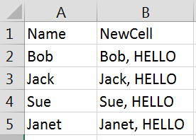
CONCATENATE()
=CONCATENATE(value1, value2…)
Combines two or more string values or data in cells
Example…
CONCATENATE(A2, “, HELLO”) will append the string “, HELLO” to the end of whatever is in cell A2. Like this:

Slide 10
IF()
=IF(condition, value_if_true, value_if_false)
condition = conditional statement (e.g., A2 > 3, C5 = “text”)
value_if_true = value to return if condition is met
value_if_false = value to return if condition is not met
Example…
IF(4 > 5, “red”, “yellow”) would give you a result of yellow

Slide 11
VLOOKUP()
Match values and get associated fields
Similar to SQL joins
=VLOOKUP(lookup_value, table_array, column_index, range_lookup)
lookup_value = value that you’re looking for
table_array = the table where you’re going to do your search (e.g., A2:E5)
column_index = column number to return from matched record
range_lookup = TRUE for approximate matches and FALSE for exact matches

Slide 12
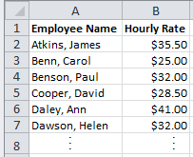
VLOOKUP()
=VLOOKUP(lookup_value, table_array, column_index, range_lookup)
Example
Hourly Pay
Sales Team Hours Worked with Vlookup Functions:
Sales Team Hours Worked with Vlookup Results:

