Slide 1
MIS2502: Data Analytics Field Experiments and Natural Experiments
Acknowledgement: Shuting Wang

Slide 2
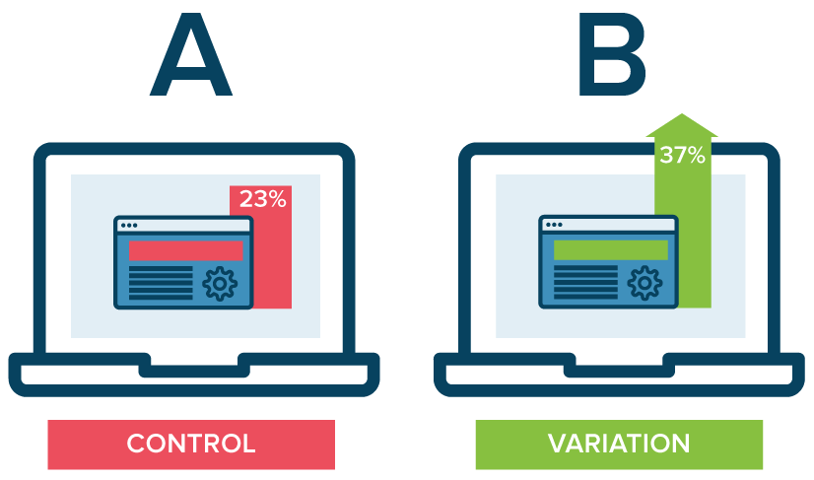
Field Experiments
Definition: A field experiment applies the scientific method to experimentally examine an intervention in the real world (or as many experimentalists like to say, naturally occurring environments) rather than in the laboratory.
Method (A/B testing): Field experiments generally randomize subjects (or other sampling units) into treatment and control groups and compare outcomes between these groups.

Slide 3
Field Experiments
Advantages: Field experiments are sometimes seen as having higher external validity than laboratory experiments.
Disadvantages: Field experiments suffer from the possibility of contamination: experimental conditions can be controlled with more precision and certainty in the lab.

Slide 4
Field Experiments
Advantages: Field experiments are sometimes seen as having higher external validity than laboratory experiments.
Disadvantages: Field experiments suffer from the possibility of contamination: experimental conditions can be controlled with more precision and certainty in the lab.

Slide 5
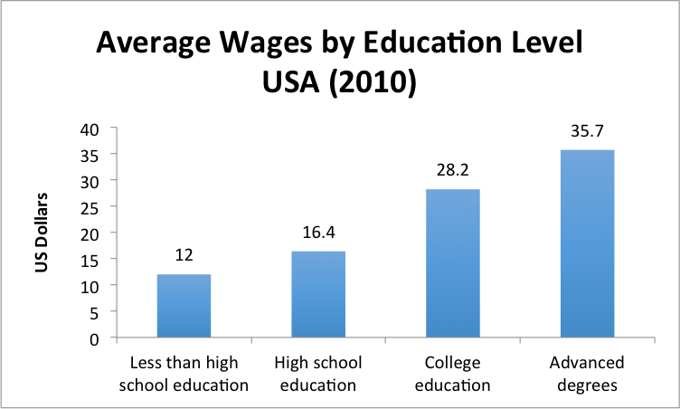
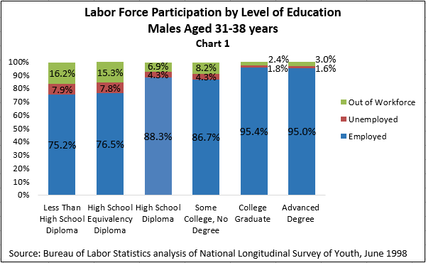
Field Experiments
Example 1: Compare student performance of two classes
Example 2: Test how advertisements on social media affect sales
Example 3: Test the impact of education on incomes

Slide 6
Natural Experiments
Definition: A natural experiment is an empirical study in which individuals (or clusters of individuals) are exposed to the experimental and control conditions that are determined by nature or by other factors outside the control of the investigators.
E.g., Philadelphia increased sales tax by 1% in July 2014
Method (Difference-in-Difference): A statistical technique attempts to mimic an experimental research design using observational study data, by studying the differential effect of a treatment on a 'treatment group' versus a 'control group' in a natural experiment.

Slide 7
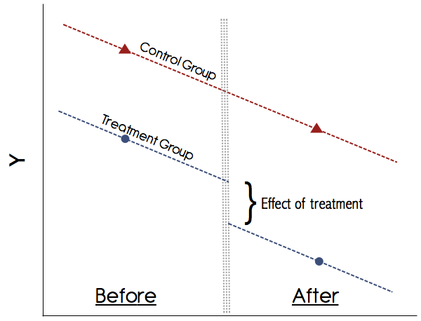
Natural Experiments
Advantages: Natural experiments can be employed as study designs when controlled experimentation is extremely difficult to implement or unethical.
E.g., test the impact of age or gender
Disadvantages: Natural experiments cannot control for all conditions that pave the way for causal inference.
E.g., reverse causality, the decision of the
policy change is made based on the future
outcome;
E.g., omitted variable bias, the decision of the
policy change is made based on an
unobserved factor that is related to
the future outcome;

Slide 8
Natural Experiments
Example 1: Test the impact of gender on incomes
Example 2: Test the impact of education on incomes
Example 3: Test the impact of learning SQL on incomes

