Slide 1

MIS2502:
Data Analytics
The Information Architecture of an Organization
David Schuff
David.Schuff@temple.edu
http://community.mis.temple.edu/dschuff

Slide 2




What Do You Do With Data?
Gather
Store
Retrieve
Interpret

Slide 3

The Information Architecture of an Organization
Data entry
Transactional Database
Data extraction
Analytical Data Store
Data analysis
Stores real-time transactional data
Stores historical transactional and summary data
Called OLTP:
Online transaction processing
Called OLAP:
Online analytical processing

Slide 4
The Transactional Database
Stores real-time, transactional data
In business, a transaction is the exchange of information, goods, or services.
For databases, a transaction is an action performed in a database management system.
Operational databases deal with both: they store information about business transactions using database transactions
Examples of transactions
  Purchase a product
  Enroll in a course
  Hire an employee
Data is in real-time
  Reflects current state
  How things are “now”

Slide 5
The Relational Paradigm
How transactional data is collected and stored
Primary Goal: Minimize redundancy
  Reduce errors
  Less space required
Most database management systems are based on the relational paradigm
  Oracle, Microsoft Access, SQL Server
?
Which of these do you think
is more important today

Slide 6
The Relational Database
Airline Reservation Example
A series of tables with logical associations between them
The associations (relationships) allow the data to be combined
Reservation
ReservationID
FlightID
PassengerID
SeatID
Name
DatePurchased
Price
Passenger
PassengerID
Name
Street
City
State
ZipCode
1
n
n
Flight
FlightID
AircraftID
FlightNumber
DepartureCity
ArrivalCity
DepartureTime
ArrivalTime
1
n
Aircraft Seat
SeatID
AircraftID
RowNumber
SeatNumber
Class
Aircraft
AircraftID
Type
Capacity
1
1
1
n

Slide 7
Why more than one table?
Every reservation has a passenger and a flight
Passengers and flights have an ID number
Split the details off into separate tables
Reservation
ReservationID
FlightID
PassengerID
SeatID
Name
DatePurchased
Price
Passenger
PassengerID
Name
Street
City
State
ZipCode
1
n
n
Flight
FlightID
AircraftID
FlightNumber
DepartureCity
ArrivalCity
DepartureTime
ArrivalTime
1
n
Aircraft Seat
SeatID
AircraftID
RowNumber
SeatNumber
Class
Aircraft
AircraftID
Type
Capacity
1
This is good because:
Information is entered and stored once
Minimizes redundancy
1
1
n

Slide 8
Analyzing transactional data
Can be difficult to do from a relational database
Having multiple tables is good for storage and data integrity, but bad for analysis
  All those tables must be “joined” together before analysis can be done
The solution is the Analytical Data Store
Operational databases are optimized for storage efficiency, not retrieval
Analytical databases are optimized for retrieval and analysis, not storage efficiency and data integrity

Slide 9
The Analytical Data Store
Stores historical and summarized data
  “Historical” means we keep everything
Data is extracted from the operational database and reformatted for the analytical database
Extract
Transform
Load
Operational Database
Data conversion
Analytical Database
Query
Query
We’ll discuss this in much more detail later in the course!!

Slide 10
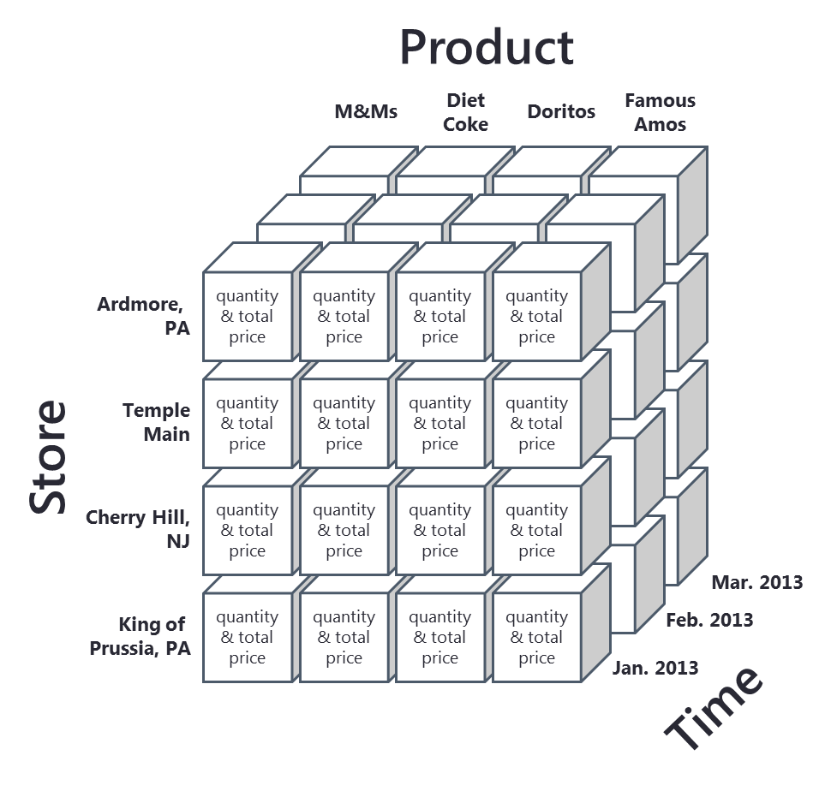
The Dimensional Paradigm
Store
StoreID
StoreAddress
StoreCity
StoreState
StoreType
Data is stored like this around a business event…
…and can be summarized like this for analysis…
Dimension
Fact
Sales
SalesID
ProductID
StoreID
TimeID
QuantitySold
TotalPrice
Product
ProductID
ProductName
ProductPrice
ProductWeight
Time
TimeID
Day
Month
Year
Dimension
Dimension

Slide 11
Dimensional Data and the Data Cube
…or it can be expanded in detail like this so that data mining (complex statistical analysis) can be done.
Sales ID | Qty. Sold | Total Price | Prod. ID | Prod. Name | Prod. Price | Prod. Weight | Store ID | Store Address | Store City | Store State | Store Type | Time ID | Day | Month | Year
1000
1001
1002
Sales Fact
Product Dimension
Store Dimension
Time Dimension

Slide 12
Comparing Operational and Analytical Data Stores
Operational Data Store | Analytical Data Store
Based on Relational paradigm | Based on Dimensional paradigm
Storage of real-time transactional data | Storage of historical transactional data
Optimized for storage efficiency and data integrity | Optimized for data retrieval and summarization
Supports day-to-day operations | Supports periodic and on-demand analysis

Slide 13
The agenda for the course
Weeks 1 through 5
Weeks
6 through 9
Weeks 10 through 14
Data entry
Transactional Database
Analytical Data Store
Data analysis
Data extraction
Stores real-time transactional data
Stores historical transactional and summary data
Data interpretation,
visualization, communication

