Slide 1

MIS2502:
Data Analytics
Coverting ERD into a DB Schema
David Schuff
David.Schuff@temple.edu
http://community.mis.temple.edu/dschuff

Slide 2

The agenda for the course
Weeks 1 through 5
Weeks
6 through 9
Weeks 10 through 14
Relational Modeling using ERD
Normalized Schema Creation
SQL
Dimensional Modeling
Star Schema Creation
ETL
Pivot Tables
Visualizations
SAS EM
Transactional Database
(Relational DB)
Analytical Data Store (Dimensional DB)
Data
extraction
Data analysis
Data entry
Stores real-time transactional data
Stores historical transactional and summary data
Data interpretation,
visualization, communication

Slide 3
Implementing the ERD
As a database schema
  A map of the tables and fields in the database
  This is what is implemented in the database management system
  Part of the “design” process
A schema actually looks a lot like the ERD
  Entities become tables
  Attributes become fields
  Relationships can become additional tables

Slide 4
The Rules
1. Create a table for every entity
2. Create table fields for every entity’s attributes
3. Implement relationships between the tables
1:many relationships
Primary key field of “1” table put into “many” table as foreign key field
many:many relationships
Create new table
1:1 relationships
Primary key field of one table put into other table as foreign key field
1:many relationships with original tables

Slide 5
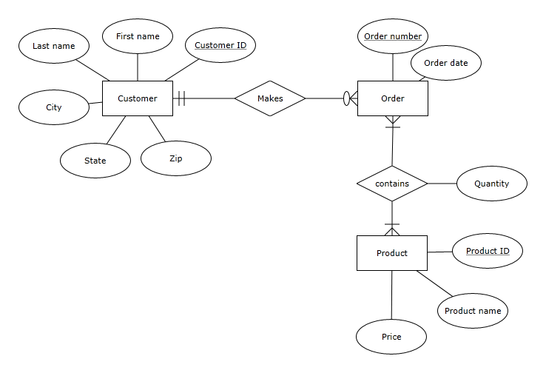
The ERD Based on the Problem Statement

Slide 6
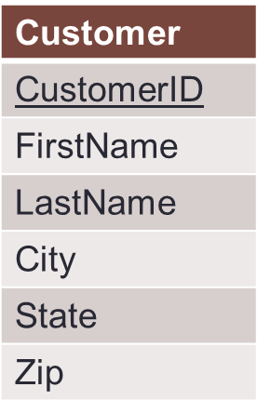
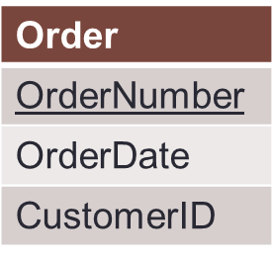
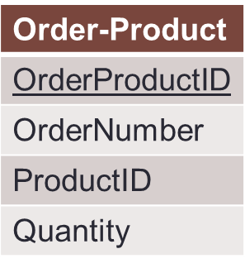
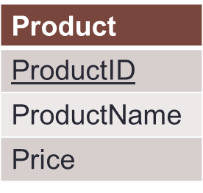
Our Order Database schema
Original 1:n relationship
Original n:n relationship
Order-Product is a decomposed many-to-many relationship
Order-Product has a 1:n relationship with Order and Product
Now an order can have multiple products, and a product can be associated with multiple orders

Slide 7
The Customer and Order Tables:
The 1:n Relationship
Customer Table
CustomerID | FirstName | LastName | City | State | Zip
1001 | Greg | House | Princeton | NJ | 09120
1002 | Lisa | Cuddy | Plainsboro | NJ | 09123
1003 | James | Wilson | Pittsgrove | NJ | 09121
1004 | Eric | Foreman | Warminster | PA | 19111
Order Table
Customer ID is a foreign key in the Order table. We can associate multiple orders with a single customer!
In the Order table, Order Number is unique;
Customer ID is not!
Order Number | OrderDate | Customer ID
101 | 3-2-2011 | 1001
102 | 3-3-2011 | 1002
103 | 3-4-2011 | 1001
104 | 3-6-2011 | 1004

Slide 8
The Customer and Order Tables:
Normalization
Customer Table
CustomerID | FirstName | LastName | City | State | Zip
1001 | Greg | House | Princeton | NJ | 09120
1002 | Lisa | Cuddy | Plainsboro | NJ | 09123
1003 | James | Wilson | Pittsgrove | NJ | 09121
1004 | Eric | Foreman | Warminster | PA | 19111
No repeating orders or customers.
Every order is unique.
This is an example of normalization..
Every customer is unique.
Order Table
Order Number | OrderDate | Customer ID
101 | 3-2-2011 | 1001
102 | 3-3-2011 | 1002
103 | 3-4-2011 | 1001
104 | 3-6-2011 | 1004

Slide 9
Normalization
Organizing data to minimize redundancy (repeated data)
This is good for two reasons
  The database takes up less space
  Fewer inconsistencies in your data
If you want to make a change to a record, you only have to make it in one place
  The relationships take care of the rest

Slide 10
To figure out who ordered what
Match the Customer IDs of the two tables, starting with the table with the foreign key (Order):
We now know which order belonged to which customer
  This is called a join
Order Table
Customer Table
Order Number | OrderDate | Customer ID | Customer ID | FirstName | LastName | City | State | Zip
101 | 3-2-2011 | 1001 | 1001 | Greg | House | Princeton | NJ | 09120
102 | 3-3-2011 | 1002 | 1002 | Lisa | Cuddy | Plainsboro | NJ | 09123
103 | 3-4-2011 | 1001 | 1001 | Greg | House | Princeton | NJ | 09120
104 | 3-6-2011 | 1004 | 1004 | Eric | Foreman | Warminster | PA | 19111

Slide 11
Now the many:many relationship
Order Table
Order-Product Table
Order Number | OrderDate | Customer ID
101 | 3-2-2011 | 1001
102 | 3-3-2011 | 1002
103 | 3-4-2011 | 1001
104 | 3-6-2011 | 1004
Order ProductID | Order number | Product ID | Quantity
1 | 101 | 2251 | 2
2 | 101 | 2282 | 3
3 | 101 | 2505 | 1
4 | 102 | 2251 | 5
5 | 102 | 2282 | 2
6 | 103 | 2505 | 3
7 | 104 | 2505 | 8
Product Table
ProductID | ProductName | Price
2251 | Cheerios | 3.99
2282 | Bananas | 1.29
2505 | Eggo Waffles | 2.99
This table relates Order and Product to each other!

Slide 12
To figure out what each order contains
Match the Product IDs and Order IDs of the tables, starting with the table with the foreign keys (Order-Product):
Order-Product Table
Order Table
Product Table
Order ProductID | Order Number | Product ID | Quantity | Order Number | Order Date | Customer ID | Product ID | Product Name | Price
1 | 101 | 2251 | 2 | 101 | 3-2-2011 | 1001 | 2251 | Cheerios | 3.99
2 | 101 | 2282 | 3 | 101 | 3-2-2011 | 1001 | 2282 | Bananas | 1.29
3 | 101 | 2505 | 1 | 101 | 3-2-2011 | 1001 | 2505 | Eggo Waffles | 2.99
4 | 102 | 2251 | 5 | 102 | 3-3-2011 | 1002 | 2251 | Cheerios | 3.99
5 | 102 | 2282 | 2 | 102 | 3-3-2011 | 1002 | 2282 | Bananas | 1.29
6 | 103 | 2505 | 3 | 103 | 3-4-2011 | 1001 | 2505 | Eggo Waffles | 2.99
7 | 104 | 2505 | 8 | 104 | 3-6-2011 | 1004 | 2505 | Eggo Waffles | 2.99
So which customers ordered Eggo Waffles (by their Customer IDs)?

Slide 13
In Class Exercise

Slide 14
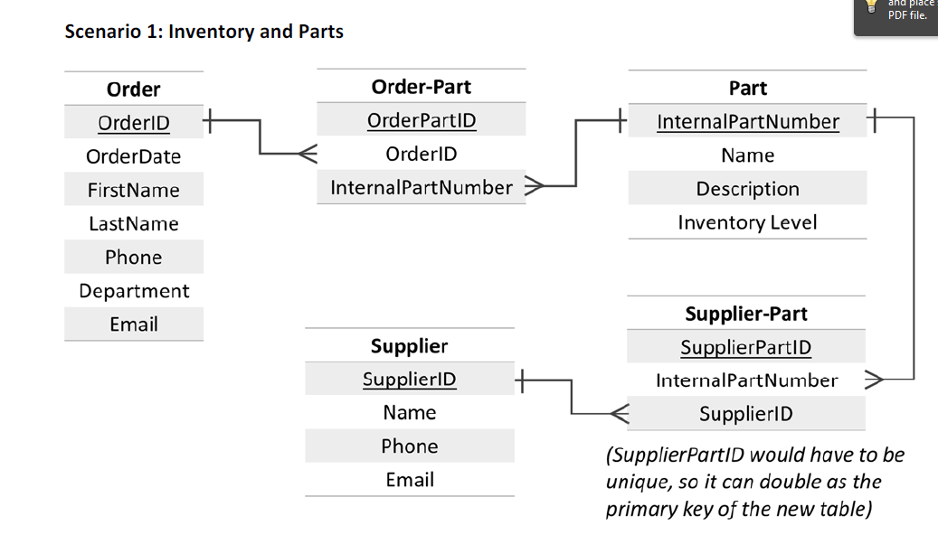
Converting to a DB Schema

Slide 15
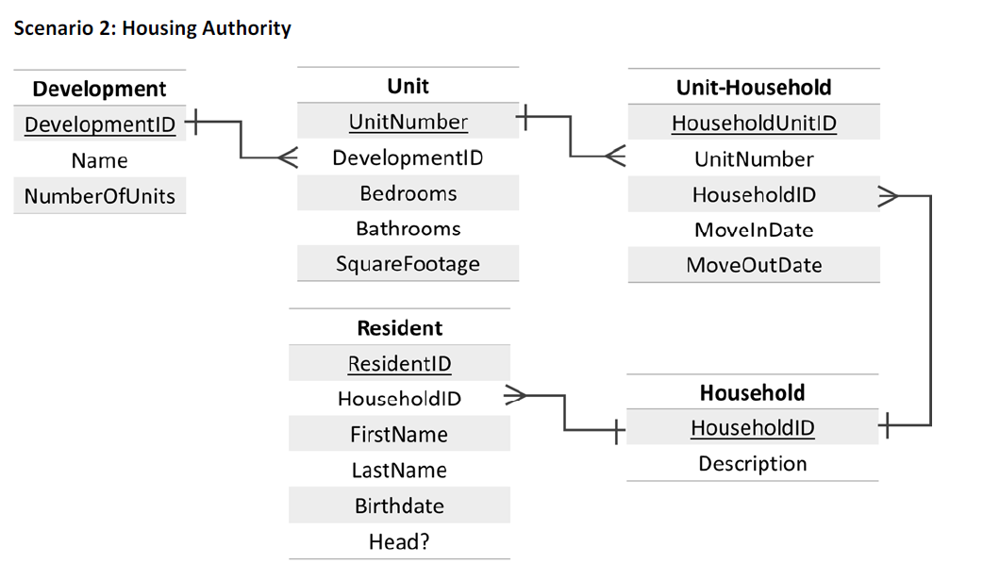
Converting to a DB Schema

