Slide 1

MIS2502:
Data Analytics
MySQL and SQL Workbench
David Schuff
David.Schuff@temple.edu
http://community.mis.temple.edu/dschuff

Slide 2

MySQL
MySQL is a database management system (DBMS)
Implemented as a server
What is a server?
Software specifically built to provide services to other applications
Examples
File server
Print server
Web server
Database server
MySQL Database

Slide 3


Example: The web server
The web server “serves” web pages to the web browser
The web browser allows the user to interact with the server
The web browser is the “client”
Web server
Request
http://fox.temple.edu
Response
a web page

Slide 4
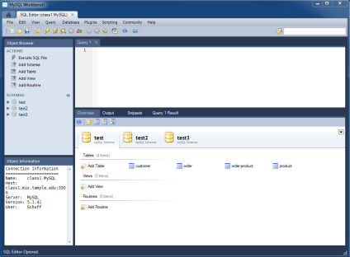
Interacting with MySQL
The client can either be a business application or a utility
We’re going to use the MySQL Workbench utility
MySQL Database
Request
SQL query
Response
Query results (data)

Slide 5
MySQL Workbench
Enables the user to interact directly with the database
Create and make changes to tables
Extract information from tables
Provide help creating SQL statements
Create ERDs
We’ll use SQL workbench to
Create and execute SQL commands
View query results
But we won’t use it for modeling
We want to do some things ourselves!

Slide 6
Limits of MySQL Workbench
Placing an order at Amazon
You don’t interact with Amazon’s database directly
Registering for a course
You do it through Amazon.com
You don’t interact with Temple’s database directly
You do it through Owlnet
It isn’t meant for business users
For that, we’d construct an application
Why do we create applications for users, instead of allowing direct database interaction?

Slide 7
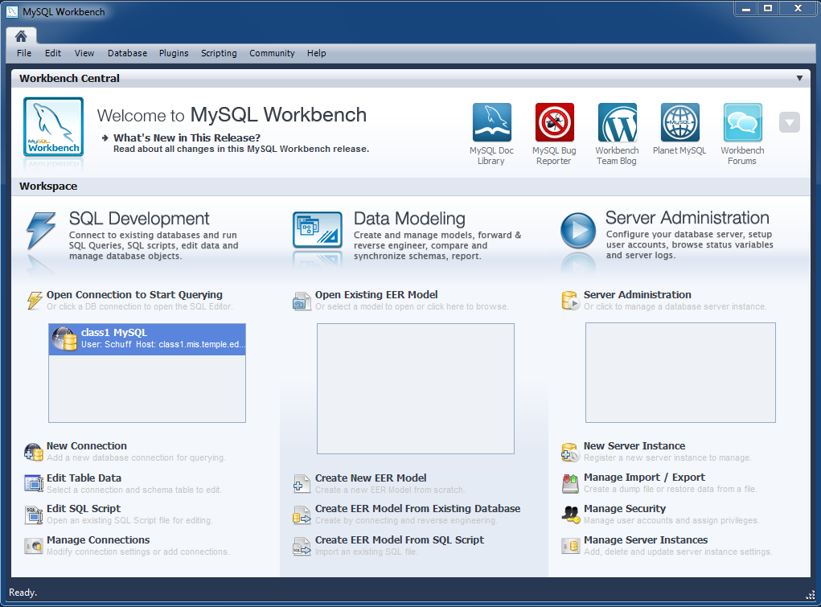
Connecting to a MySQL server
This is the opening screen
You double click on a connection to connect to a server
You’ll have access to your schemas on that server
We’ll give you instructions explaining how to set up your connection to the class server, based on your username and password.

Slide 8
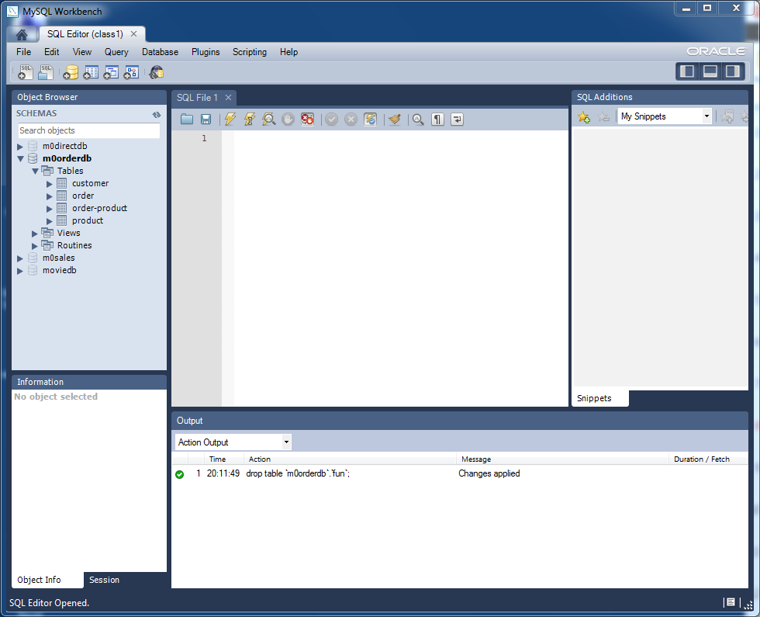
The MySQL Workbench interface
SQL Query panel
Overview tabsheet (the database schemas)
How many tables are in the m0orderdb schema?

Slide 9
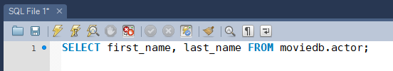
Composing a SQL statement
Let’s just type this into the query panel
Notice how the words SELECT and FROM are highlighted in blue.
  Those are the keywords (part of the SQL language)
  The black indicates it isn’t part of SQL
    So they are part of the database itself, like schemas, tables, and fields
Don’t worry about the syntax itself yet. We’ll get to that soon…

Slide 10
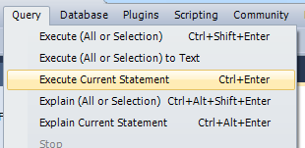
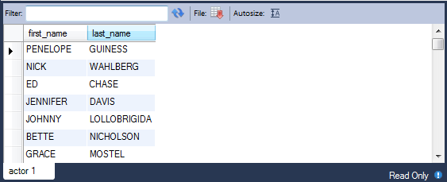
To execute the query
…or select “Execute Current Statement” from the Query menu
Click on the lightening bolt icon…
…and you’ll wind up with this result
These are the results of the query, displayed in table form

Slide 11
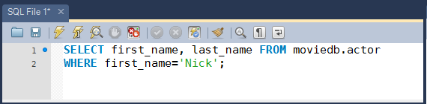
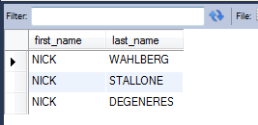
Another example
This query
gives us this
The green highlighting indicates this is a string literal, or a set of letters a numbers.
In other words, what’s between the quotes isn’t a SQL command OR an element in the database

Slide 12

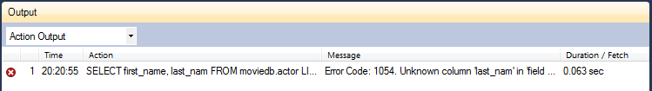
The editor will catch mistakes
This is a query with no answer
because “last_nam” isn’t a field in the table
Instead of query results, we now get this
indicating the source of the error

Slide 13


If the syntax is wrong…
We’ve spelled “FROM” wrong
And now we get this error
MySQL Workbench can’t tell quite what’s wrong, but it knows it isn’t a correctly formatted SQL command
It thinks “moviedb” is the source of the problem, but really it’s a misspelled keyword
FRM isn’t green because it is not recognized as a SQL keyword!

Slide 14
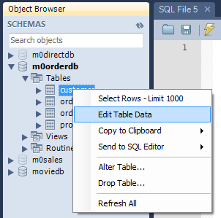
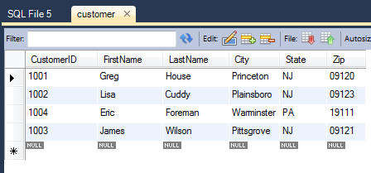
Automatically generated SQL
MySQL Workbench can generate the more complex queries for you
Right-click on the customer table in
mxorderdb…
…and you’ll see an editable table that you can work with.
Instead of m0orderdb, you’ll have your own number (i.e., m33orderdb). That’s ok.

Slide 15
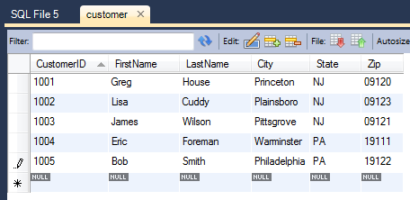

Example: Adding a row
Now we’ll add another row to the table, just like we’re filling in a spreadsheet
Click on the “Apply” button in the bottom right corner of the window

Slide 16
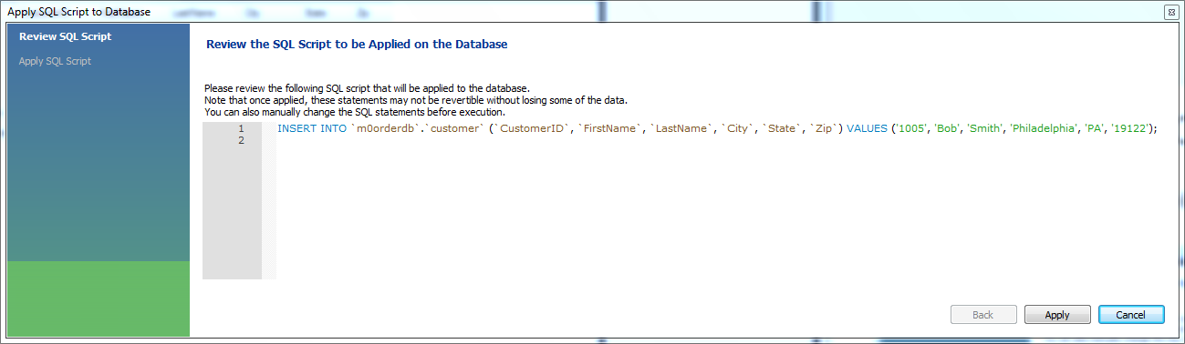
The generated SQL statement
This is the SQL statement that will add the row to the database
You can make changes to the SQL, or just click “Apply”
That will send the SQL statement to the MySQL database server for processing

Slide 17
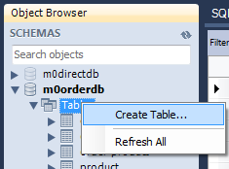
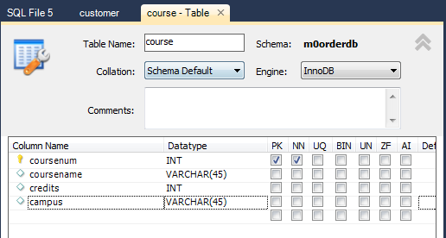
Adding a table
In the Object Browser, right-click on Tables under mxorderdb
Then select “Create Table” from the menu
Give the table a
name, then enter
column names
and data types
Then click the
“Apply” button
We’ll learn what the data types
mean a little later…

Slide 18
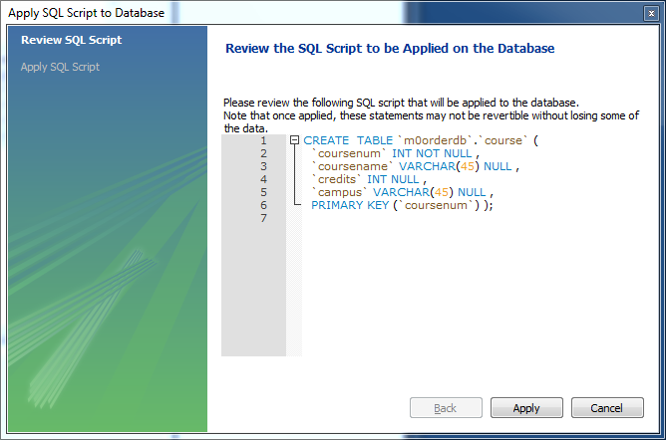
And the result is this…
We’ll learn the syntax for all of these statements.
But every query can be entered directly through the query panel.
You’ll need to know how to create the SQL yourself, even if you use MySQL Workbench for help.

Slide 19
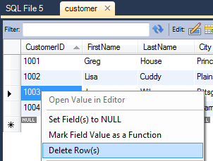
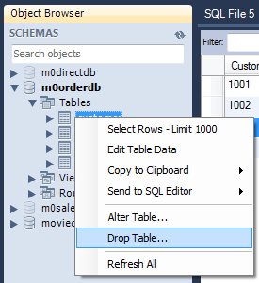
It will also generate statements for…
Deleting a row from the table (SQL DELETE)
  Right-click on a field in the row
  and select “Delete Row(s)”
Changing a row in a table (SQL UPDATE)
Delete an entire table (SQL DROP)
  Right-click on the table name and select “Drop Table…”
By the way…DON’T DO THIS!!

Slide 20
The bottom line
SQL Workbench makes it easy to interact with a MySQL database
It can help you compose queries through highlighting, syntax checking, and the automated query functions
In reality, a database administrator would use a combination of automated query generation and manual entry
The more complex the query, the more likely it will have to be entered manually

