Slide 1

MIS2502:
Data Analytics
Dimensional Data Modeling
David Schuff
David.Schuff@temple.edu
http://community.mis.temple.edu/dschuff

Slide 2

Where we are…
Now we’re here…
Data entry
Transactional Database
Data extraction
Analytical Data Store
Data analysis
Stores real-time transactional data
Stores historical transactional and summary data

Slide 3

What do we know so far?
Why are relational databases good for storing transaction data?
Why are they bad for analytical processing?
What’s the solution?

Slide 4
Some terminology
Data Warehouse
Takes many forms
Really is just a repository for data
Data Mart
More focused
Specially designed for analysis
Data Cube
Organization of data as a “multidimensional matrix”
Implementation of a Data Mart

Slide 5
How they all relate
The data in the operational database…
…which feeds the data mart…
…and is analyzed as a cube.
…is put into a data warehouse…
We’ll start here.

Slide 6
The Data Cube
Product
Core component of
Online Analytical Processing
and
Multidimensional
Data Analysis
Made up of “facts” and “dimensions”
M&Ms
Diet
Coke
Doritos
Famous
Amos
quantity
& total price
quantity
& total price
quantity
& total price
quantity
& total price
Ardmore,
PA
quantity
& total price
quantity
& total price
quantity
& total price
quantity
& total price
Temple
Main
Store
quantity
& total price
quantity
& total price
quantity
& total price
quantity
& total price
Cherry Hill,
NJ
quantity
& total price
quantity
& total price
quantity
& total price
quantity
& total price
Mar. 2013
King of
Prussia, PA
Feb. 2013
Jan. 2013
Time
Quantity sold and total price are measured facts.
Why isn’t product price a measured fact?

Slide 7
The Data Cube
Product
M&Ms
Diet
Coke
Doritos
Famous
Amos
The highlighted element represents all the M&Ms sold in Ardmore, PA in January, 2011
quantity
& total price
quantity
& total price
quantity
& total price
quantity
& total price
Ardmore,
PA
quantity
& total price
quantity
& total price
quantity
& total price
quantity
& total price
Temple
Main
A single summary record representing a business event (monthly sales).
Store
quantity
& total price
quantity
& total price
quantity
& total price
quantity
& total price
Cherry Hill,
NJ
quantity
& total price
quantity
& total price
quantity
& total price
quantity
& total price
Mar. 2013
King of
Prussia, PA
Feb. 2013
Jan. 2013
Time

Slide 8
The Data Cube
Product
M&Ms
Diet
Coke
Doritos
Famous
Amos
The highlighted elements represent Famous Amos cookies sold on Temple’s Main campus from January to March, 2013
quantity
& total price
quantity
& total price
quantity
& total price
quantity
& total price
Ardmore,
PA
quantity
& total price
quantity
& total price
quantity
& total price
quantity
& total price
Temple
Main
Store
quantity
& total price
quantity
& total price
quantity
& total price
quantity
& total price
This is called “slicing the data.”
Cherry Hill,
NJ
quantity
& total price
quantity
& total price
quantity
& total price
quantity
& total price
Mar. 2013
King of
Prussia, PA
Feb. 2013
Jan. 2013
Time

Slide 9
The Data Cube
Product
M&Ms
Diet
Coke
Doritos
Famous
Amos
What do the orange highlighted elements represent?
quantity
& total price
quantity
& total price
quantity
& total price
quantity
& total price
Ardmore,
PA
quantity
& total price
quantity
& total price
quantity
& total price
quantity
& total price
Temple
Main
Store
quantity
& total price
quantity
& total price
quantity
& total price
quantity
& total price
What do the purple highlighted elements represent?
Cherry Hill,
NJ
quantity
& total price
quantity
& total price
quantity
& total price
quantity
& total price
Mar. 2013
King of
Prussia, PA
Feb. 2013
Jan. 2013
Time

Slide 10

Could you have a data mart with five dimensions?
Then why does our example (and most others) only have three?

Slide 11
Designing the Cube: The Star Schema
Impractical to create cube directly from relational database
Too many joins
Required querying will be too slow
So we transform data into a star schema
Remove as many joins as possible
Most are one-level “deep”
Facilitates
Ad-hoc reporting
Creation of cubes
Store
Store_ID
Store_Address
Store_City
Store_State
Store_Type
Dimension
Sales
Sales_ID
Product_ID
Store_ID
Time_ID
Quantity Sold
Total Price
Fact
Product
Product_ID
Product_Name
Product_Price
Product_Weight
Time
Time_ID
Day
Month
Year
Dimension
Dimension

Slide 12
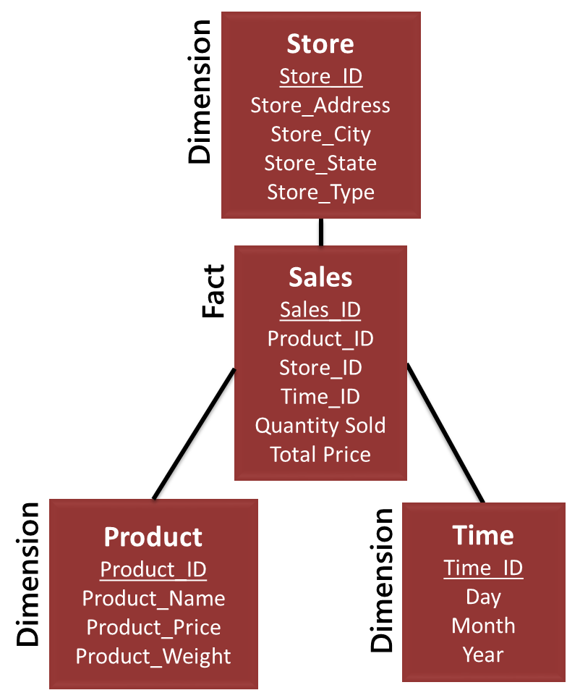
A join to make the cube?
Conceptually yes, but storing the join would create many, many, many rows!
Sales ID | Qty. Sold | Total Price | Prod. ID | Prod. Name | Prod. Price | Prod. Weight | Store ID | Store Address | Store City | Store State | Store Type | Time ID | Day | Month | Year
1000
1001
1002
Sales Fact
Product Dimension
Store Dimension
Time Dimension

Slide 13
So summaries get stored in a “multidimensional matrix”
Periodically summarize the data and store it in the cube
Retrieve only the summary, not the raw data
Much more efficient, but can’t be changed (non-volatile)

Slide 14

It adds up fast…
1000 products
365 days
300 stores
=109,500,000 records per year!

Slide 15

Designing the Star Schema
1. Choose the business process
2. Identify the fact
3. Decide on the level of granularity
4. Identify the dimensions
Kimball’s Four Step Process for Data Cube Design
(Kimball et al., 2008)

Slide 16
Choose the business process
What your data cube is “about”
Determined by the questions you want to answer about your organization
Question | Business Process
Who is my best customer? | Sales
What are my highest selling products? | Sales
Which teachers have the best student performance? | Standardized testing
Which supplier is offering us the best deals? | Purchasing
Note that a “business process” is not always about business.

Slide 17
Identify the fact
The data associated with the business event
Keys
Unique identifiers for each event
Measured, numeric data
Quantifiable information for each business event
Describes a particular combination of dimensional data
Associates a combination of the dimensions to a unique business event
Example: Sales has Product_ID, Store_ID, and Time_ID
Example: Sales has quantity_sold and total_price.
Does not describe any particular dimension
For the event itself and the associated dimensions
Try it for the “student performance” example.

Slide 18
Decide on the level of granularity
Level of detail for each event (row in the table)
Will determine the data in the dimensions
Example: Who is my best customer?
  The “event” is a sales transaction
  Choices for time: yearly, quarterly, monthly, daily
  Choices for store: store, city, state
How would you select the right granularity?

Slide 19
Identify the dimensions
The key elements of the process needed to answer the question (“fact”)
Example: Sales transaction
  A “sale” is the fact
  Occurs for a particular product, store, and time
  Could this data mart tell you
    The best selling product?
    The best customer?
Try it for the “student performance” example.

Slide 20
Data cube caveats
The cube is “non volatile,” so you’re locked in
  Measured facts
  Dimensions
  Granularity
So choose wisely!
  For example: You can’t track daily sales if “date” is monthly
  So why not include every single sale and do no aggregation?
“In memory” analytics is changing all of this, but not quite yet…

