Slide 1
Exam review
MIS2502
Data Analytics

Slide 2
Exam
What Tool to Use?
Evaluating
Decision Trees
Association Rules
Clustering

Slide 3
1. Using the Right Data Mining Technique
You run an e store for xtreme sporting goods and have collected a year of sales data from your website. You’re looking to identify customer segments to create some better target marketing.
On your e store you want to implement a feature that recommends other items to purchase based on items that other customers have purchased when buying
You’ve had a coupon program in place for the past 6 months. You are now redesigning the reprogram to target only those people who are likely to use the coupon.

Slide 4
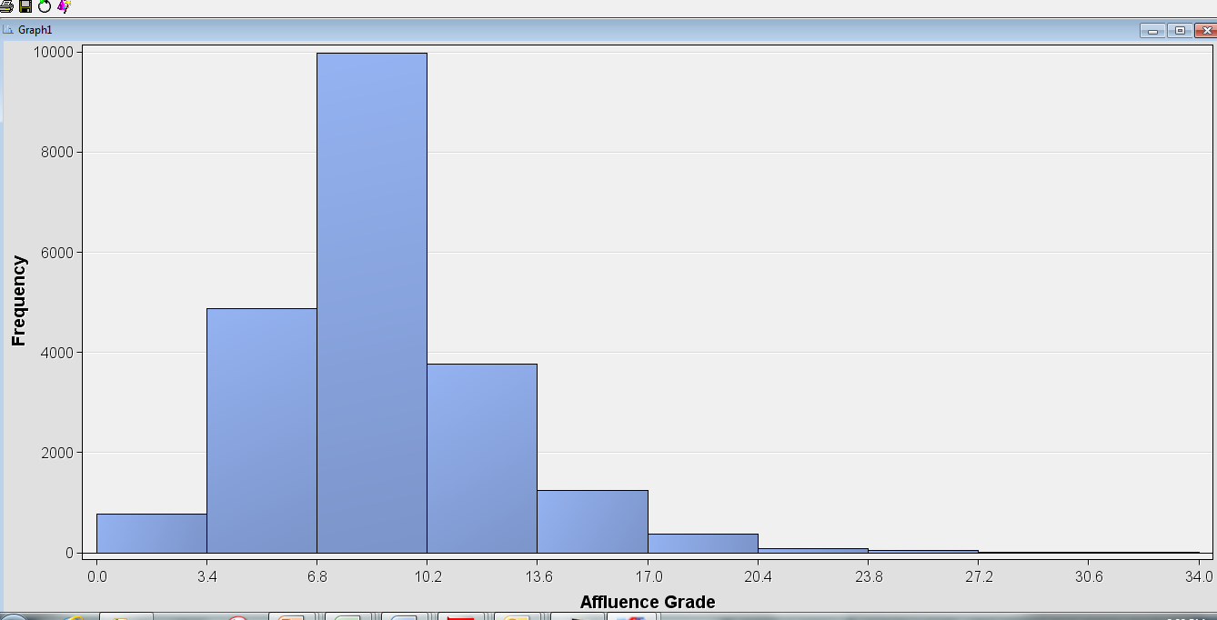
Understanding Descriptive Statistics
What is the mean for DemAge ?
What would it mean if min of DemAge was 0?

Slide 5
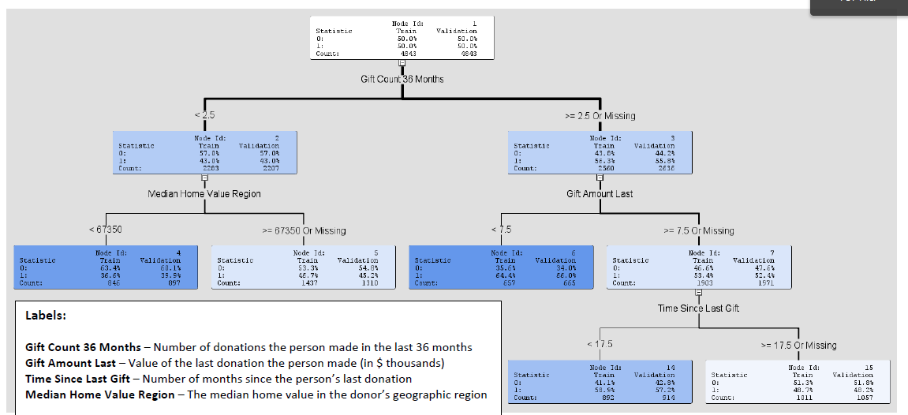
Navigating the Tree
Read Validation Amount. ‘1’ is a positive outcome
How many leaves ?
Which group more likely to give gift? Those who’ve made < 2.5 gifts in the last month, or those who have made 2.5 or more?
Describe donors least likely to give gift
Why no “Time Since Last Gift” split under “Gift Amount Last < 7.5” ?
What’s the probability that someone who has made less than 1 gifts in the last 36 months, and has median home value is 75K will make a gift?

Slide 6
What is Association Mining?
Discovering interesting relationships between variables in large databases (http://en.wikipedia.org/wiki/Association_rule_learning)
Find out which items predict the occurrence of other items
Also known as “affinity analysis” or “market basket” analysis

Slide 7
Core idea: The itemset
Itemset: A group of items of interest {Milk, Beer, Diapers}
This itemset is a “3 itemset” because it contains…3 items!
An association rule expresses related itemsets
X → Y, where X and Y are two itemsets
{Milk, Diapers} → {Beer} means “when you have milk and diapers, you also have beer)
Basket | Items
1 | Bread, Milk
2 | Bread, Diapers, Beer, Eggs
3 | Milk, Diapers, Beer, Coke
4 | Bread, Milk, Diapers, Beer
5 | Bread, Milk, Diapers, Coke

Slide 8
Support
Support count (σ)
Frequency of occurrence of an itemset
σ{Milk, Beer, Diapers} = 2 (i.e., it’s in baskets 4 and 5)
Support (s)
Fraction of transactions that contain all itemsets in the relationship X → Y
s({Milk, Diapers, Beer}) = 2/5 = 0.4
You can calculate support for both X and Y separately
Support for X = 3/5 = 0.6; Support for Y = 3/5 = 0.6
Basket | Items
1 | Bread, Milk
2 | Bread, Diapers, Beer, Eggs
3 | Milk, Diapers, Beer, Coke
4 | Bread, Milk, Diapers, Beer
5 | Bread, Milk, Diapers, Coke
2 baskets have milk, beer, and diapers
5 baskets total
X
Y

Slide 9
Confidence
Confidence is the strength of the association
Measures how often items in Y appear in transactions that contain X
Basket | Items
1 | Bread, Milk
2 | Bread, Diapers, Beer, Eggs
3 | Milk, Diapers, Beer, Coke
4 | Bread, Milk, Diapers, Beer
5 | Bread, Milk, Diapers, Coke
c must be between 0 and 1 1 is a complete association
0 is no association
This says 67% of the times when you have milk and diapers in the itemset you also have beer!

Slide 10
Lift
Takes into account how co-occurrence differs from what is expected by chance
i.e., if items were selected independently from one another
Based on the support metric
Support for total itemset X and Y
Support for X times support for Y
Independent Events
Two events are independent if the occurrence of one does not change the probability of the other occurring.
If events are independent, then the probability of them both occurring is the product of the probabilities of each occurring.
Specific Multiplication Rule
Only valid for independent events
P(A and B) = P(A) * P(B)

Slide 11
Process
Set rule thresholds
Define Item Sets
Read through Item Sets, create list of all possible association rules (X => Y) for the Item Sets
Compute Support, Confidence and Lift for each Rule
Drop those that don’t meet thresholds

Slide 12
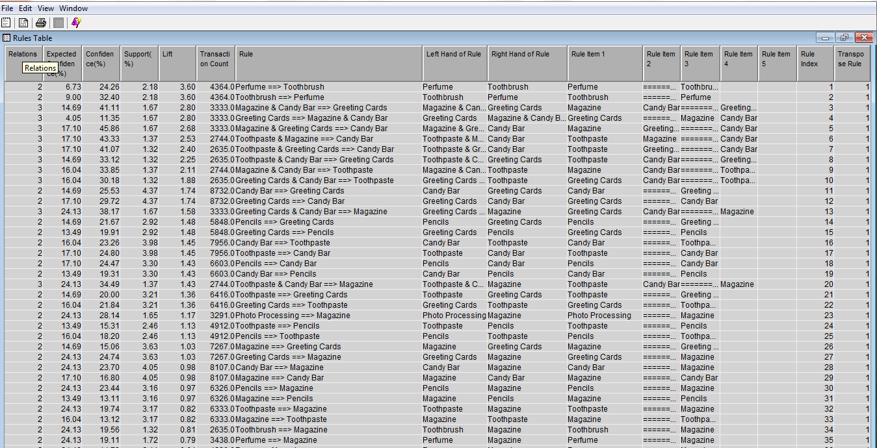
Evaluating Associative Rules Output
What product is most likely to be bought if someone buys a Pencil?
What stat did you use to answer this ?
Why might the highest confidence item not have the highest lift?
What might you recommend to a store manager given that the lift for PhotoProcessing>Magazine is 1.17

Slide 13
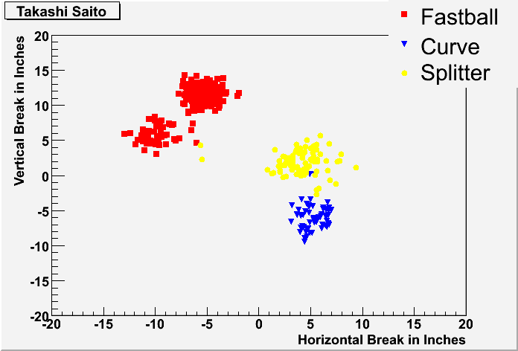
What is Cluster Analysis?
Grouping data so that elements in a group will be
Similar (or related) to one another
Different (or unrelated) from elements in other groups
Distance within clusters is minimized
Distance between clusters is maximized
http://www.baseball.bornbybits.com/blog/uploaded_images/ Takashi_Saito-703616.gif

Slide 14
Applications
Understanding
Group related documents for browsing
Discover which stocks have similar price fluctuations
Summarization
Reduce the size of large data sets
Those similar groups can be treated as a single data point
Create groups of similar customers

Slide 15
Process
Choose K clusters
The K-means algorithm is one method for doing partitional clustering
Select K points as initial centroids
Assign all points to clusters based on distance
Yes
Recompute the centroid of each cluster
No
Did the center change?
DONE!

Slide 16
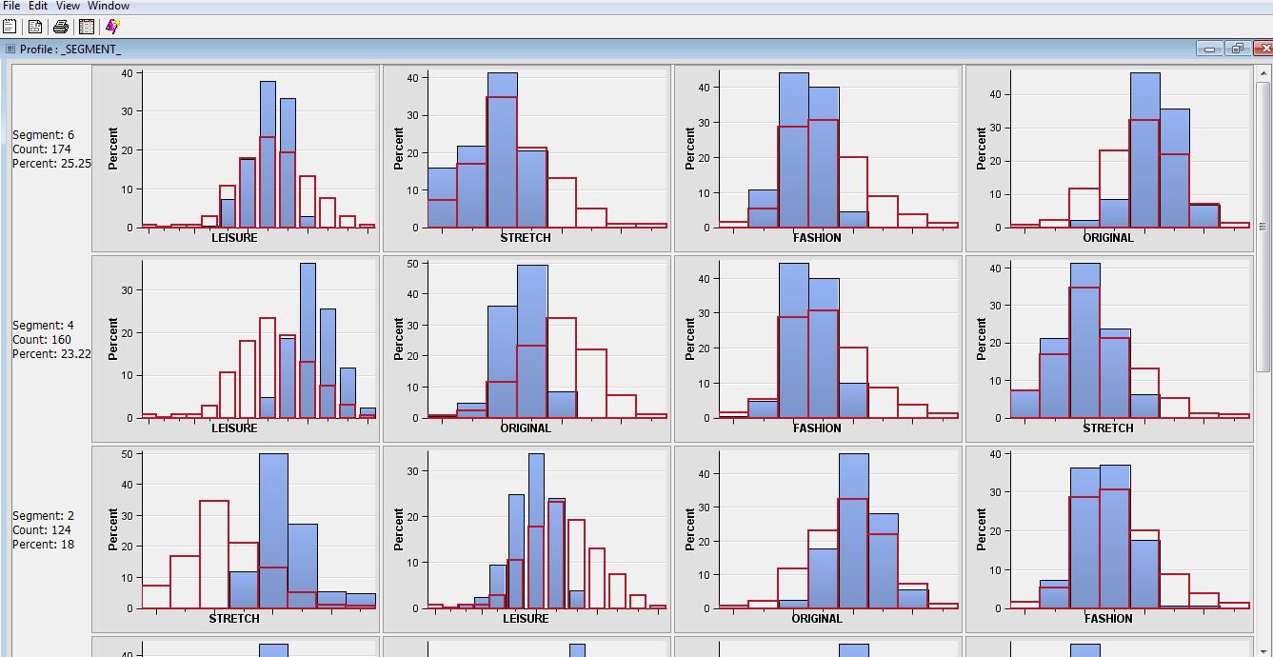
Clustering Output

Slide 17
Some Clustering Questions
Using the Mean Statistics, which cluster (identified by segment ID) has the highest cohesion?
(write the segment number: 1, 2, 3, or 4)
Using the Segment Profile plot, is the Original Jeans Sales of segment 2 (the first one) lower or higher than the average over the entire population? (write “lower” or “higher”)
Using the Segment Profile plot, is the Leisure Jeans Sales of segment 4 (the second one) lower or higher than the average over the entire population? (write “lower” or “higher”)
As a general rule, if we increase the number of clusters, is the cohesion within clusters likely to increase or decrease? (write “increase” or “decrease”)
As a general rule, if we increase the number of clusters, is the separation between clusters likely to increase or decrease? (write “increase” or “decrease”)

