Slide 1
MIS2502: Data Analytics Clustering and Segmentation

Slide 2
Data of Countries
Notes:
What is clustering?
What is segmentaiton?
Where would clustering and segmentation be useful?
So in this slide – we have a bunch of countries – what would the clusters look like?
Why would you place these countries in the same group and others in a different group?

Slide 3
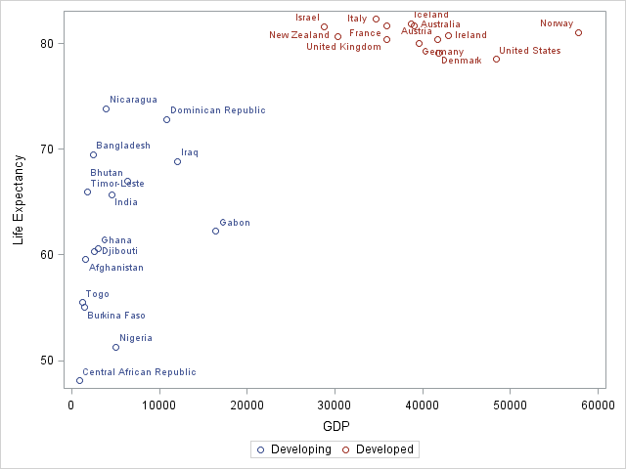
What is Cluster Analysis?
Distance within clusters is minimized
Grouping data so that elements in a group will be
Similar (or related) to one another
Different (or unrelated) from elements in other groups
Distance between clusters is maximized

Slide 4
Applications
Understanding data
Group related documents for browsing
Discover which stocks have similar price fluctuations
Summarizing data
Reduce the size of large data sets
Data in similar groups can be combined into a single data point
Create groups of similar customers

Slide 5
Even more examples
Marketing
Discover distinct customer groups for targeted promotions
Insurance
Finding “good customers” (low claim costs, reliable premium payments)
Healthcare
Find patients with high-risk behaviors

Slide 6
What cluster analysis is NOT
Manual (“supervised”) classification
People simply place items into categories
Simple segmentation
Dividing students into groups by last name
The clusters must come from the data, not from external specifications.
Creating the “buckets” beforehand is categorization, but not clustering.

Slide 7
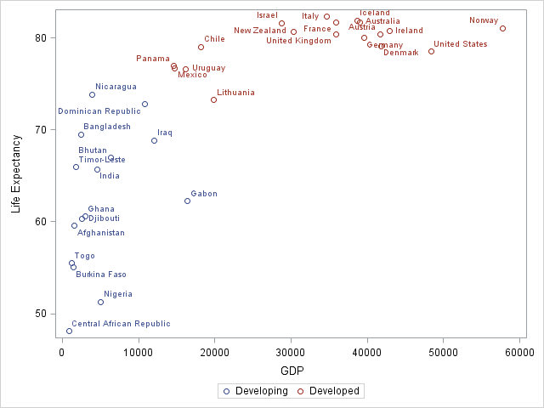
(Partitional) Clustering
Two distinct groups emerge, but…
…some Developing Countries look more like Developed Countries
Notes:
Now we add some more countries in to the analysis – however the clusters that are formed some countries are on the border and can go to perhaps the incorrect cluster.

Slide 8
Clusters can be ambiguous
How many clusters?
The difference is the threshold you set.
How distinct must a cluster be to be it’s own cluster?
adapted from Tan, Steinbach, and Kumar. Introduction to Data Mining (2004)

Slide 9
Clusters can be ambiguous
How many clusters?
6
2
4
The difference is the threshold you set.
How distinct must a cluster be to be it’s own cluster?
adapted from Tan, Steinbach, and Kumar. Introduction to Data Mining (2004)

Slide 10
K-means (partitional)
Choose K clusters
The K-means algorithm is one method for doing partitional clustering
Select K points as initial centroids
Assign all points to clusters based on distance
Yes
Recompute the centroid of each cluster
No
Did the center change?
DONE!

Slide 11
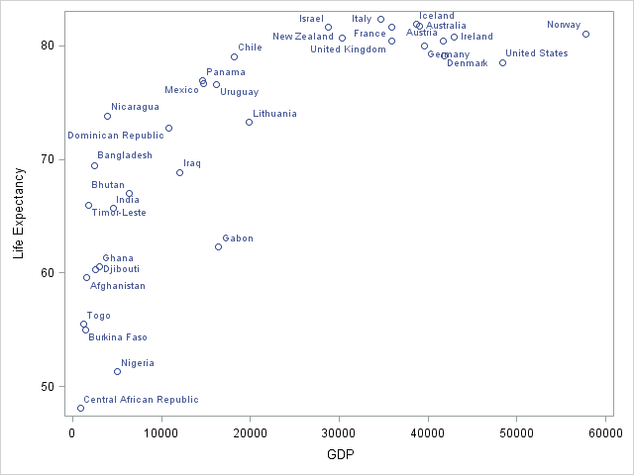
K-Means Demonstration
Here is the initial data set

Slide 12
K-Means Demonstration
Choose K points as initial centroids

Slide 13
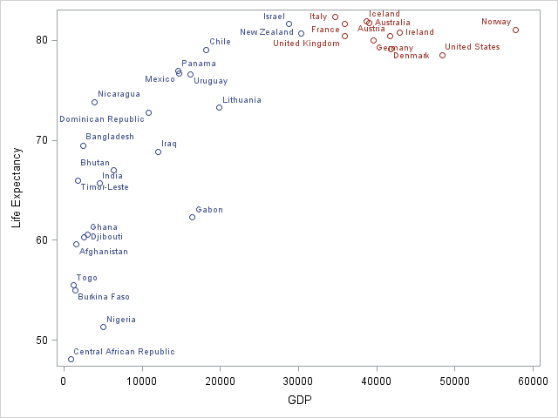
K-Means Demonstration
Assign data points according to distance

Slide 14
K-Means Demonstration
Recalculate the centroids

Slide 15
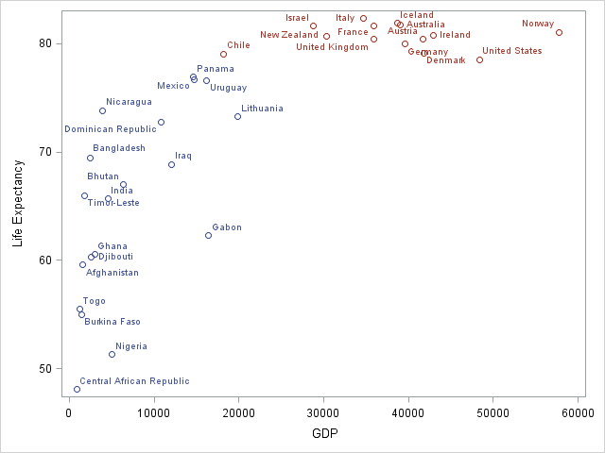
K-Means Demonstration
And re-assign the points

Slide 16
K-Means Demonstration
And keep doing that until you settle on a final set of clusters

Slide 17
Choosing the initial centroids
It matters
Choosing the right number
Choosing the right initial location
Bad choices create bad groupings
They won’t make sense within the context of the problem
Unrelated data points will be included in the same group

Slide 18
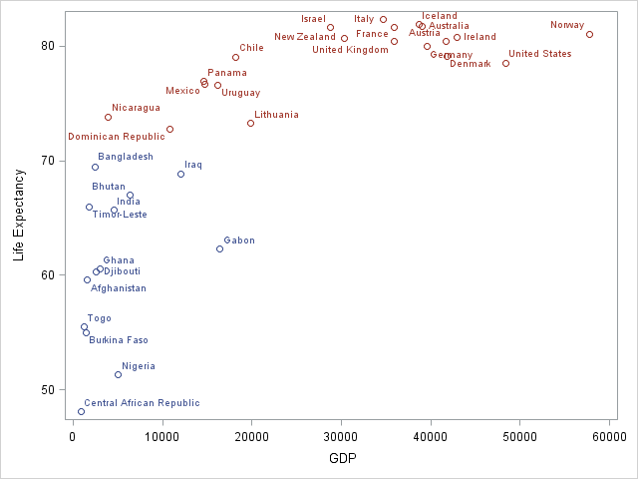
Example of Poor Initialization
This may “work” mathematically but the clusters don’t make much sense.

Slide 19
Evaluating K-Means Clusters
On the previous slides, we did it visually, but there is a mathematical test
Sum-of-Squares Error (SSE)
The distance to the nearest cluster center
How close does each point get to the center?
This just means
In a cluster, compute distance from a point (m) to the cluster center (x)
Square that distance (so sign isn’t an issue)
Add them all together

Slide 20
Example: Evaluating Clusters
Cluster 1
Cluster 2
3
3.3
1
1.3
1.5
2
SSE₁ = 1² + 1.3² + 2² = 1 + 1.69 + 4 = 6.69
SSE₂ = 3² + 3.3² + 1.5² = 9 + 10.89 + 2.25 = 22.14
Considerations
Lower individual cluster SSE = a better cluster
Lower total SSE = a better set of clusters
More clusters will reduce SSE
Reducing SSE within a cluster increases cohesion
(we want that)

Slide 21
Pre-processing: Getting the right centroids
There’s no single, best way to choose initial centroids
Normalize the data
Reduces dispersion and influence of outliers
Adjusts for differences in scale (income in dollars versus age in years)
Remove outliers altogether
Also reduces dispersion that can skew the cluster centroids
They don’t represent the population anyway

Slide 22
Limitations of K-Means Clustering
K-Means gives unreliable results when
Clusters vary widely in size
Clusters vary widely in density
The data set has a lot of outliers
Clusters are not in rounded shapes
The clusters may never make sense.
In that case, the data may just not be well-suited for clustering!

Slide 23
Similarity between clusters (inter-cluster)
Most common: distance between centroids
Also can use SSE
Look at distance between cluster 1’s points and other centroids
You’d want to maximize SSE between clusters
Increasing SSE across clusters increases separation
(we want that)

Slide 24
Figuring out if our clusters are good
“Good” means
Meaningful
Useful
Provides insight
The pitfalls
Poor clusters reveal incorrect associations
Poor clusters reveal inconclusive associations
There might be room for improvement and we can’t tell
This is somewhat subjective and depends upon the expectations of the analyst

Slide 25
The Keys to Successful Clustering
We want high cohesion within clusters (minimize differences)
Low SSE, high correlation
And high separation between clusters (maximize differences)
High SSE, low correlation
Choose the right number of clusters
Choose the right initial centroids
No easy way to do this
Trial-and-error, knowledge of the problem, and looking at the output
In SAS, cohesion is measured by root mean square standard deviation…
…and separation measured by distance to nearest cluster

