Slide 1

MIS2502:
Data Analytics
Principles of Data Visualization

Slide 2
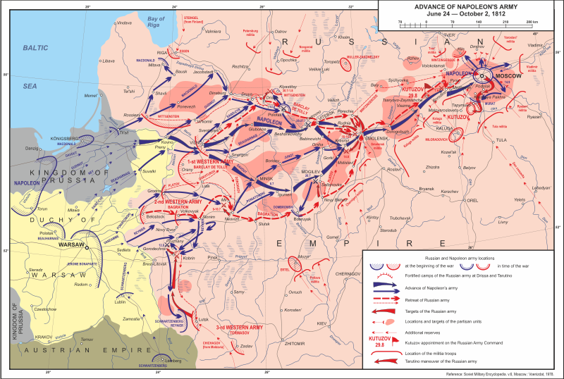
What makes a good chart?
Wikipedia: Patriotic War of 1812
http://en.wikipedia.org/wiki/File:Patriotic_War_of_1812_ENG_map1.svg

Slide 3
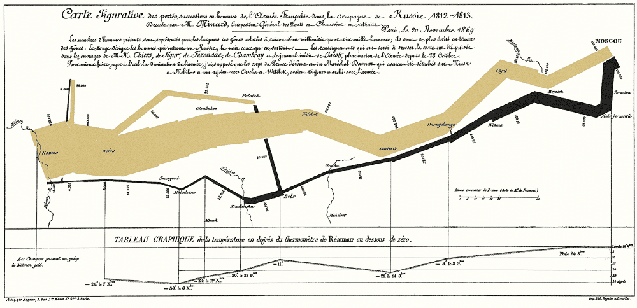
What makes a good chart?
Minard’s map of Napoleon’s campaign into Russia, 1869
Reprinted in Tufte (2009), p. 41

Slide 4
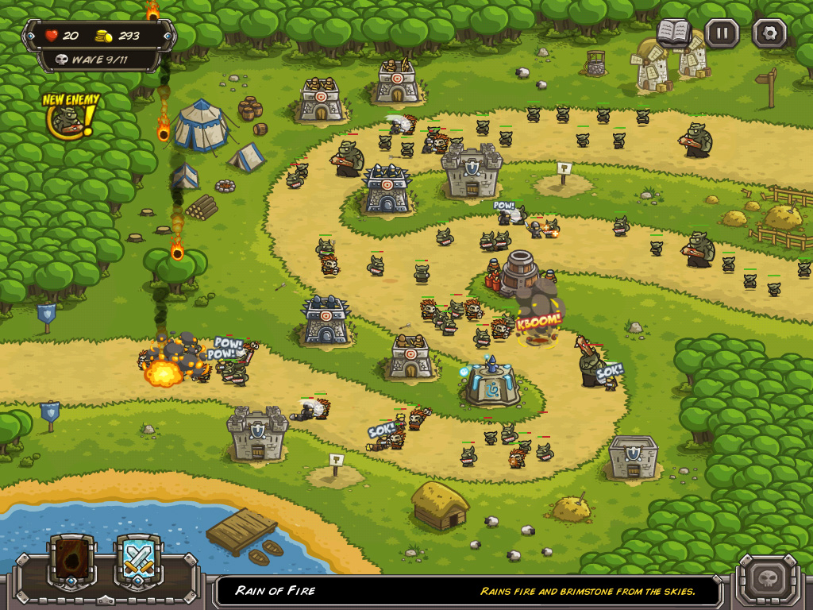
Video Games do this well…
Notes:
From the game “Pikmin 3”

Slide 5
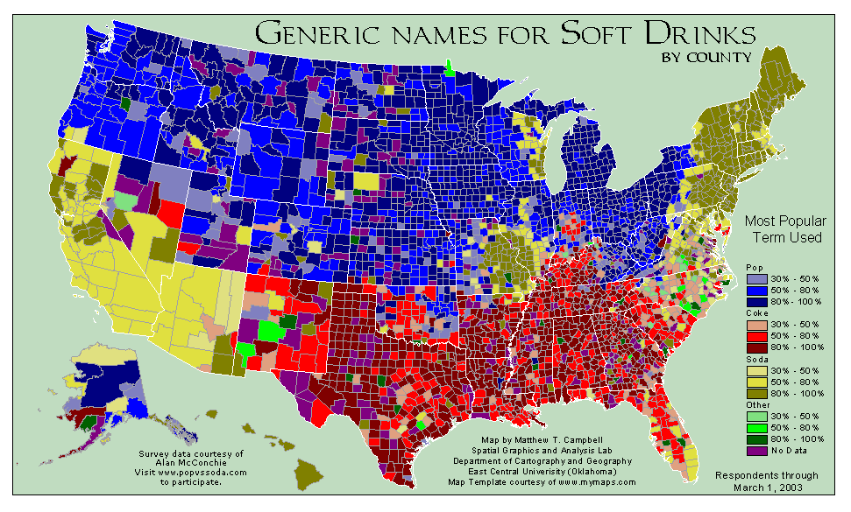
What can you learn from this map?
http://www.popvssoda.com/countystats/total-county.html

Slide 6
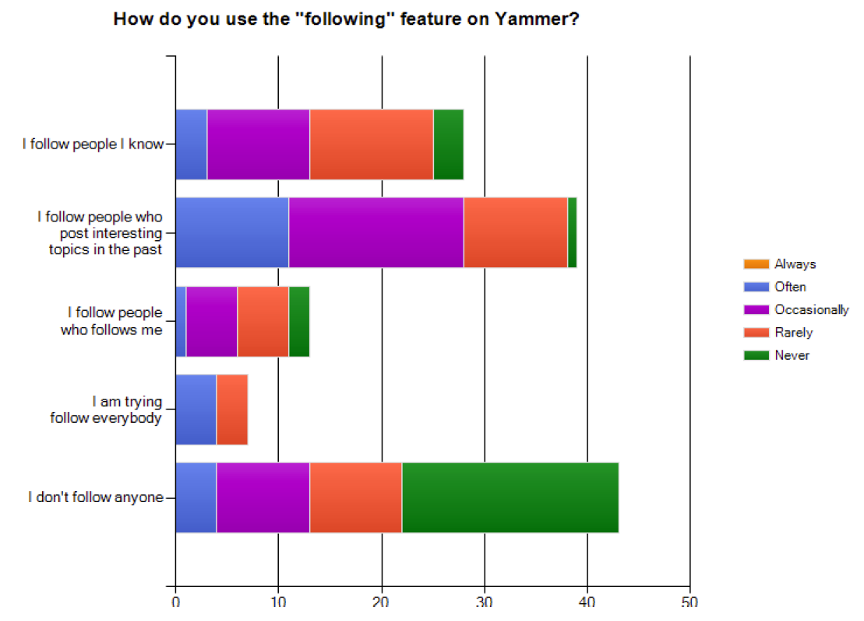
What makes a good chart?
This is from an academic conference paper.
What are the problems with this chart?
Zhang et al. (2010), “A case study of micro-blogging in the enterprise: use, value, and related issues,” Proceedings of the 28th International Conference on Human Factors in Computing Systems.
Notes:
The legend is for how often they find relevant information (given their “following” behavior”)

Slide 7
Some basic principles (adapted from Tufte 2009)
1
2
3
The chart should tell a story
The chart should have graphical integrity
The chart should minimize graphical complexity
Tufte’s fundamental principle:
Above all else show the data

Slide 8
Principle 1: The chart should tell a story
Graphics should be clear on their own
The chart should yield insight beyond the text
“If the statistics are boring, then you’ve got the wrong numbers.” (Tufte 2009)
The depictions should enable meaningful comparison

Slide 9
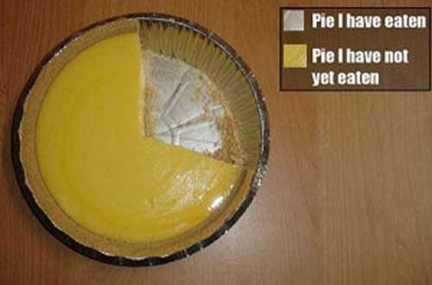
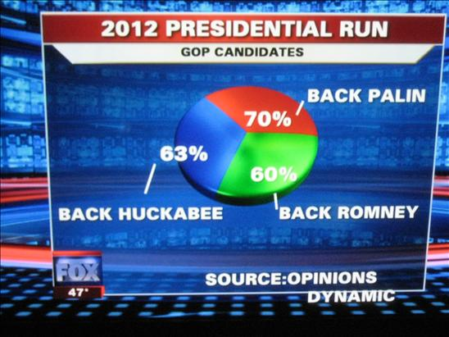
Do these tell a story?
http://www.evl.uic.edu/aej/491/week03.html
http://flowingdata.com/2009/11/26/fox-news-makes-the-best-pie-chart-ever/

Slide 10
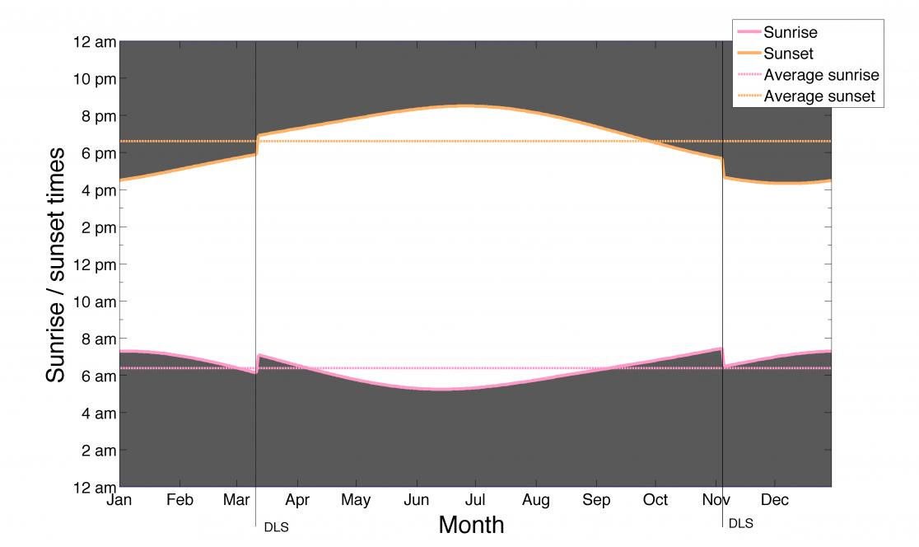
Daylight Savings Time Explained
http://visual.ly/daylight-saving-time-explained

Slide 11
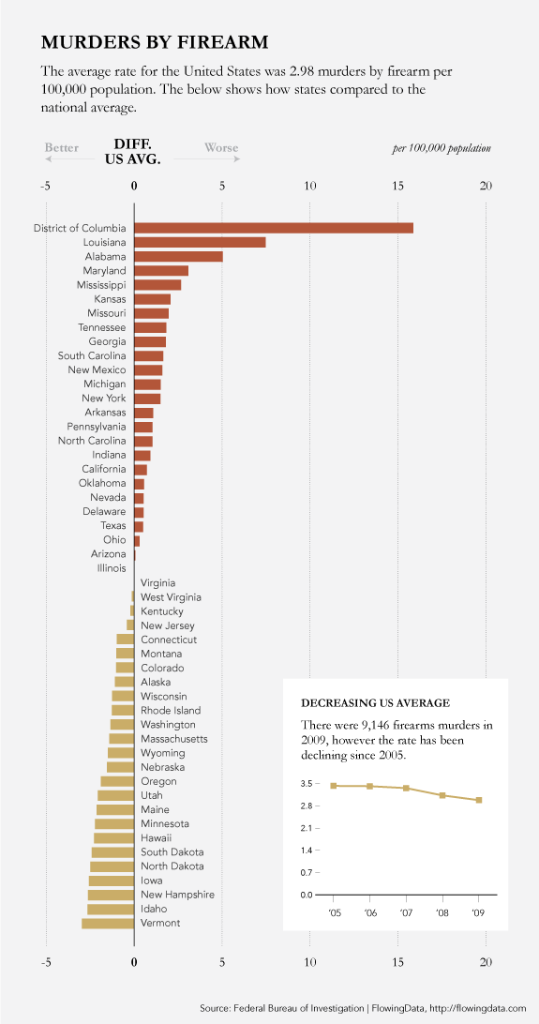
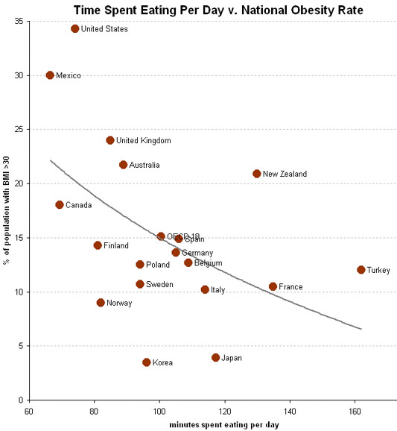
Telling a Story
http://flowingdata.com/2011/01/19/states-with-the-most-and-least-firearms-murders/
http://economix.blogs.nytimes.com/2009/05/05/obesity-and-the-fastness-of-food/

Slide 12
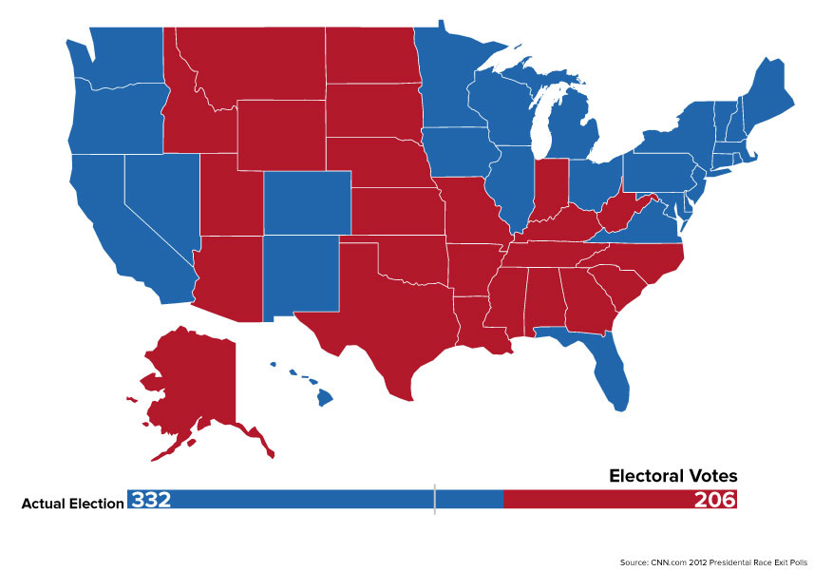
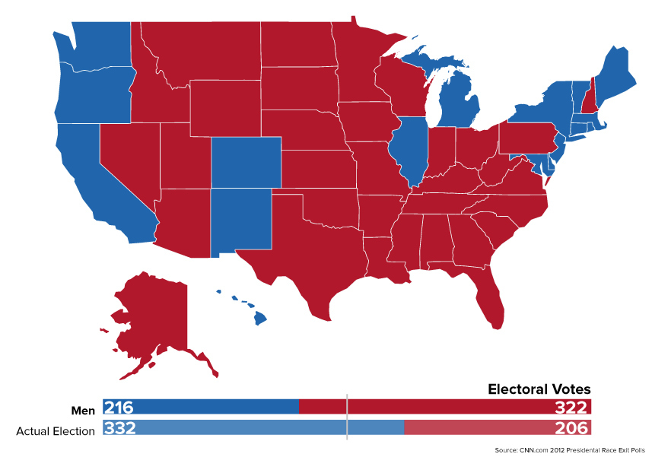
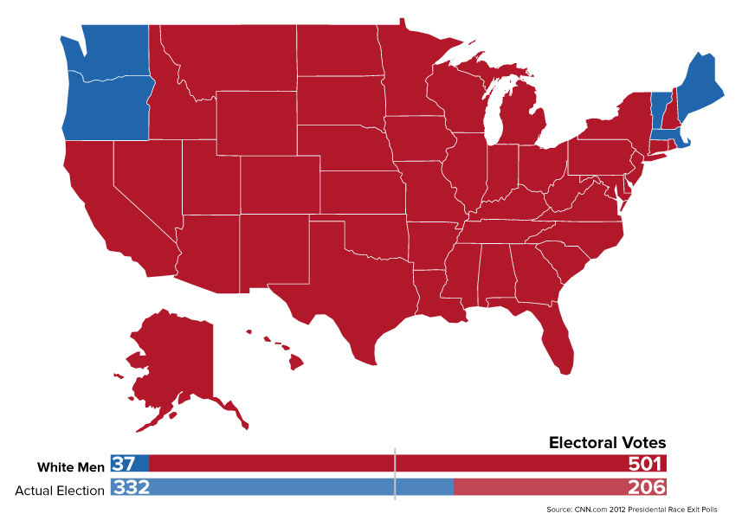
Telling a story
The electoral result of the 2012 election
Under pre-1920 rules: men only
Under 1850 rules: white men only
http://www.buzzfeed.com/buzzfeedpolitics/what-the-2012-election-would-have-looked-like-with

Slide 13
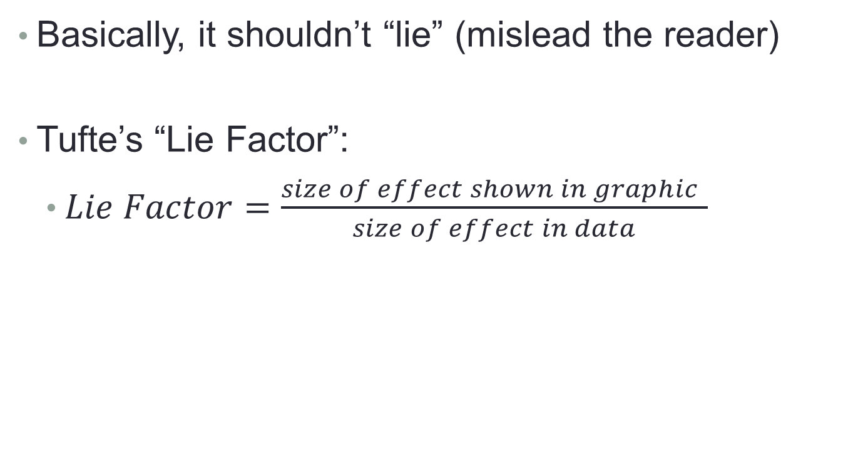
Principle 2: The chart should have graphical integrity
Basically, it shouldn’t “lie” (mislead the reader)
Tufte’s “Lie Factor”:
  $Lie Factor=\frac{size of effect shown in graphic }{size of effect in data}$
Should be ~ 1
< 1 = understated effect
> 1 = exaggerated effect

Slide 14
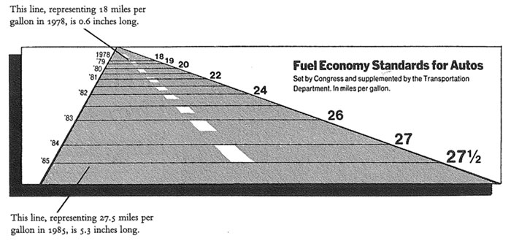
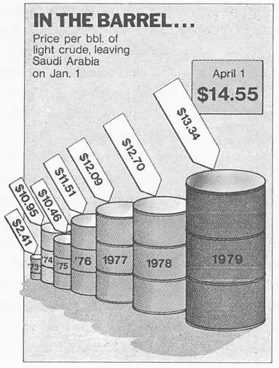
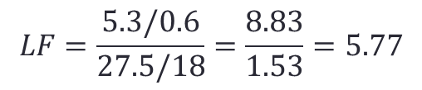
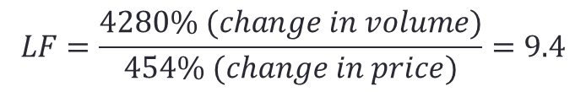
Examples of the “lie factor”
$$LF=\frac{5.3/0.6}{27.5/18}=\frac{8.83}{1.53}=5.77$$
Reprinted from Tufte (2009), p. 57 & p. 62
$$LF=\frac{4280\% (change in volume)}{454\% (change in price)}=9.4$$

Slide 15
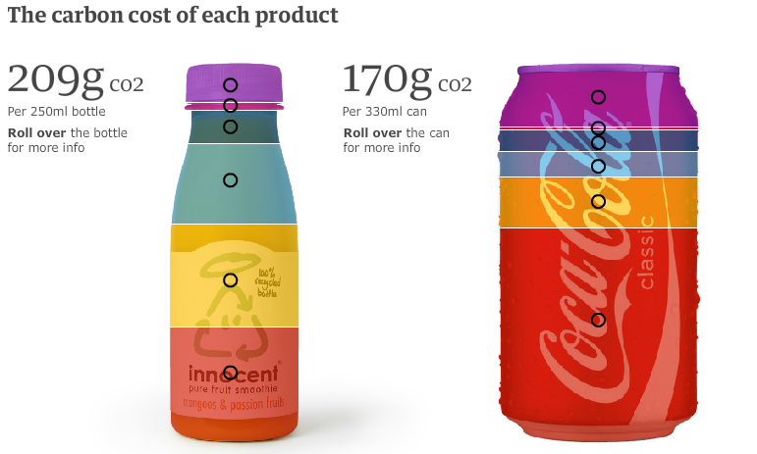
How is this deceptive?
http://www.guardian.co.uk/environment/interactive/2009/mar/09/
food-carbon-emissions

Slide 16
How is this deceptive?
http://www.guardian.co.uk/environment/interactive/2009/mar/09/
food-carbon-emissions

Slide 17
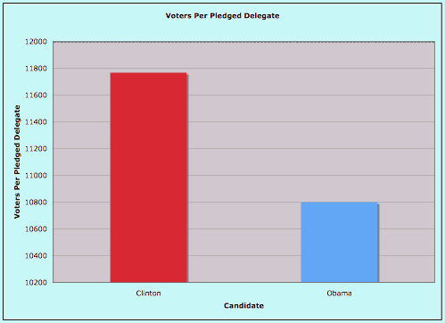
How about this?
The original graphic from Real Clear Politics, 2008.
(Look at the y-axis)
http://20bits.com/articles/politics-and-tuftes-lie-factor/

Slide 18
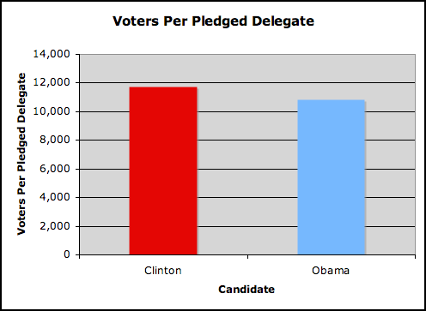
How about this?
The original graphic from Real Clear Politics, 2008.
(Look at the y-axis)
The adjusted graphic.
http://20bits.com/articles/politics-and-tuftes-lie-factor/

Slide 19
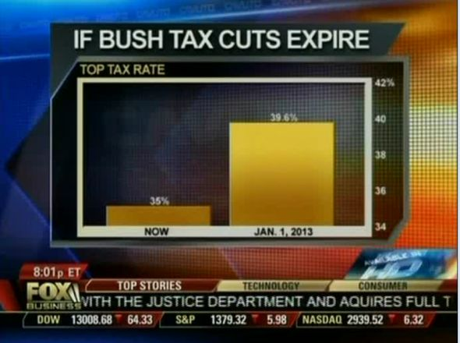
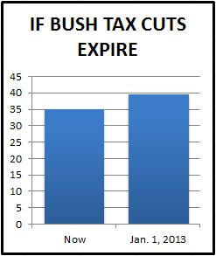
Or this?
The original graphic from Fox Business, 2012.
The adjusted graphic.
http://mediamatters.org/research/2012/10/01/a-history-of-dishonest-fox-charts/190225

Slide 20
Other tips to avoid “lying”
Adjust for inflation
Make sure the context is presented
vs.

Slide 21
Principle 3: The chart should minimize graphical complexity
Generally, the simpler the better…
Key concepts
Data-ink
Sometimes a table is better
Chartjunk

Slide 22
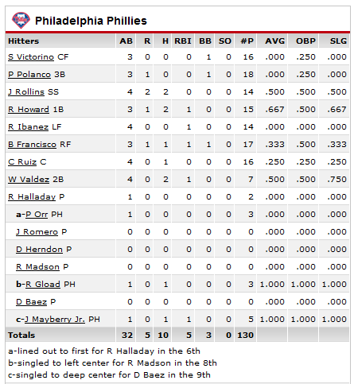
The Ultimate Table: The Box Score
Large amount of information in a very small space
So why does this work?
  Depends on the reader’s knowledge of the data

Slide 23
When a table is better than a chart
For a few data points, a table can do just as well…
Salesperson | Total Sales
Peacock | $225,763.68
Leverling | $201,196.27
Davolio | $182,500.09
Fuller | $162,503.78
Callahan | $123,032.67
King | $116,962.99
Dodsworth | $75,048.04
Suyama | $72,527.63
Buchanan | $68,792.25
The table carries more information in less space
and is more precise.

Slide 24

Data Ink
The amount of “ink” devoted to data in a chart
Tufte’s Data-Ink ratio:
  $Data−ink ratio=\frac{data−ink}{total ink used in graphic}$
Should be ~ 1
< 1 = more non-data related ink in graphic
= 1 implies all ink devoted to data
Tufte’s principle:
Erase ink whenever possible

Slide 25
Being conscious of data ink
Lower data-ink ratio
(worse)
Higher data-ink ratio
(better)

Slide 26
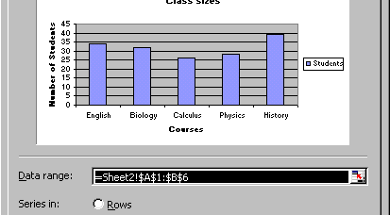
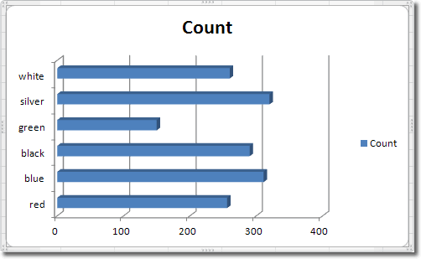
Office 2000 vs. Office 2010

Slide 27
What makes a good chart?
Sometimes it’s really a matter of preference.
These both minimize data ink.
Why isn’t a table better here?

Slide 28
3-D Charts
Evaluate this from a data-ink perspective.
How does it affect the clarity of the chart?

Slide 29
Chartjunk: Data Ink “gone wild”
Unnecessary visual clutter that doesn’t provide additional insight
Distraction from the story the chart is supposed to convey
When the data-ink ratio is low, chartjunk is likely to be high

Slide 30
Example: Moiré effects (Tufte 2009)
Creates illusion of movement
Stands out, in a bad way

Slide 31
Example: The Grid
Why are these examples of chartjunk?
What could you do to remedy it?

Slide 32
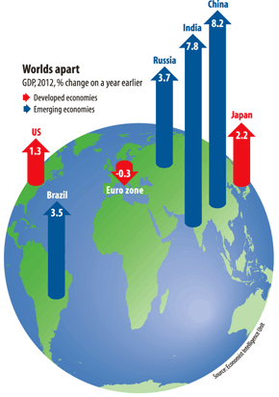
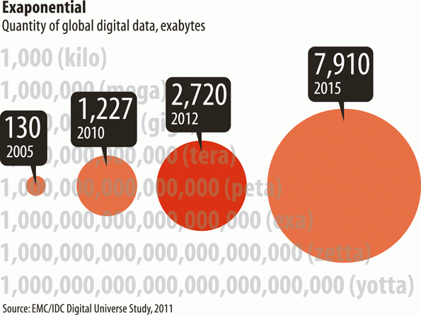
Data Ink Working Against Us
http://www.economist.com/node/21537922
http://www.economist.com/node/21537909

Slide 33
Data Ink Working For Us
Evaluate this chart in terms of Data Ink.
Imagine this as a bar chart. As a table!!

Slide 34
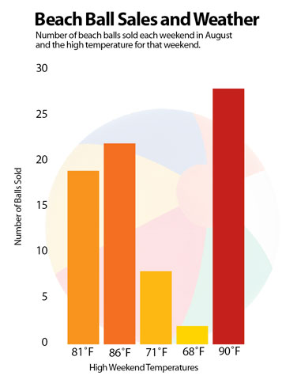
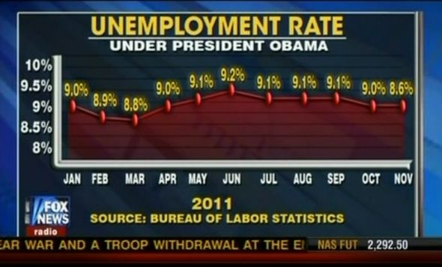
Review: What do you think of these?
http://www.economist.com/node/21537909
http://images.macworld.com/images/howto/graphics/134708-create-charts-good_376.jpg

Slide 35
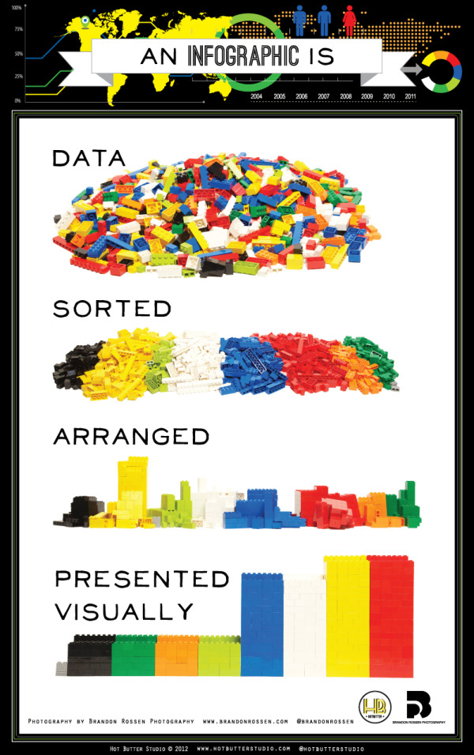
The Infographic
http://visual.ly/what-infographic-2
Check out more at www.coolinfographics.com

Slide 36
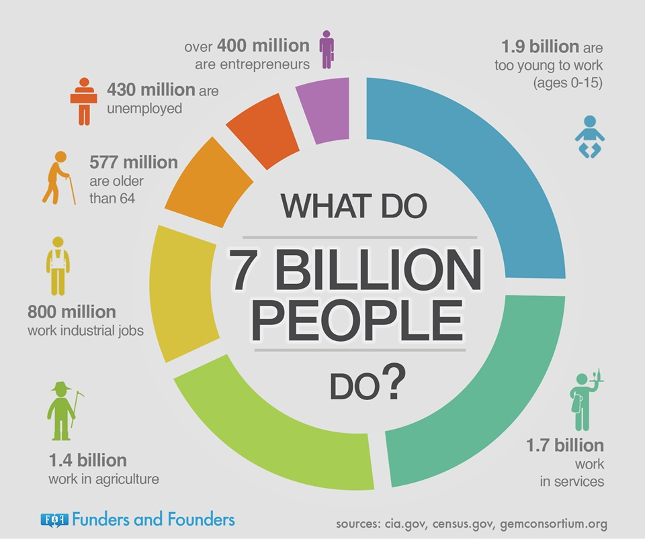

Slide 37

Another example
http://www.biztechmagazine.com/article/2012/08/how-make-sure-your-byod-plan-all-good-infographic

Slide 38

Where we are…
Data entry
Transactional Database
Data extraction
Analytical Data Store
Data analysis
Stores real-time transactional data
Stores historical transactional and summary data

Slide 39
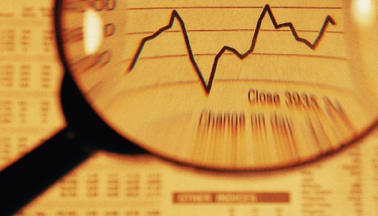

Analytics Procedures
Descriptive
Clustering
Association Rule Discovery
Sequential Pattern Discovery
Predictive
Classification
Regression
Neural Networks
Deviation Detection
Visualization

