Slide 1

MIS2502:
Data Analytics
The Things You Can Do With Data

Slide 2

Why Business Intelligence?
40%
61%
Say this is because there is “no good data”
72%
Want to increase their organization’s use of business intelligence
Of decisions by managers are made by using their “gut”
Source: http://advice.cio.com/thomas_wailgum/to_hell_with_business_intelligence_40_percent_of_execs_trust_gut

Slide 3

It all starts with data
Data
Gathering
Storing
Retrieving
Interpreting
Almost every business action requires at least one of these!

Slide 4
Examples of Data
Data
Quantity sold
Information
Course enrollment
Customer name
Discount
Star rating
?

Slide 5
Data vs. Information
Data
Information
product name | product quantity | item product price | total product revenue
Hair Hat T-Shirt | 3 | 16.73 | 50.19
Big Boy Sweatshirt | 1 | 32.46 | 32.46
Big Salad Sweatshirt | 1 | 29.89 | 29.89
Regifting Jeans | 1 | 71.94 | 71.94
Two Face Visor | 10 | 26.92 | 269.2
The Human Fund T-Shirt | 5 | 20.72 | 103.6
Botticellis T-Shirt | 3 | 21.68 | 65.04
The Human Fund T-Shirt | 1 | 20.72 | 20.72
Degifting T-Shirt | 1 | 13.53 | 13.53
Potato Salad Boxers | 1 | 26.1 | 26.1
Degifting T-Shirt | 1 | 13.53 | 13.53
Armoire T-Shirt | 4 | 17.67 | 70.68
Day-After Thank You Sweatshirt | 1 | 32.32 | 32.32
Moland Spring T-Shirt | 1 | 17.22 | 17.22
Grease Monkey Sweatshirt | 4 | 33.98 | 135.92
Big Boy Sweatshirt | 3 | 32.46 | 97.38
Bomb Defusing Robot T-Shirt | 5 | 20.9 | 104.5
Bad Breaker Upper Socks | 1 | 16.47 | 16.47
Fake Number T-Shirt | 8 | 20.52 | 164.16
Funeral Hello Hat | 2 | 24.92 | 49.84
Oranges Jeans | 1 | 74.44 | 74.44
Which product had the highest sales?
Which product has the lowest price?
Which product contributed the most to revenue?

Slide 6
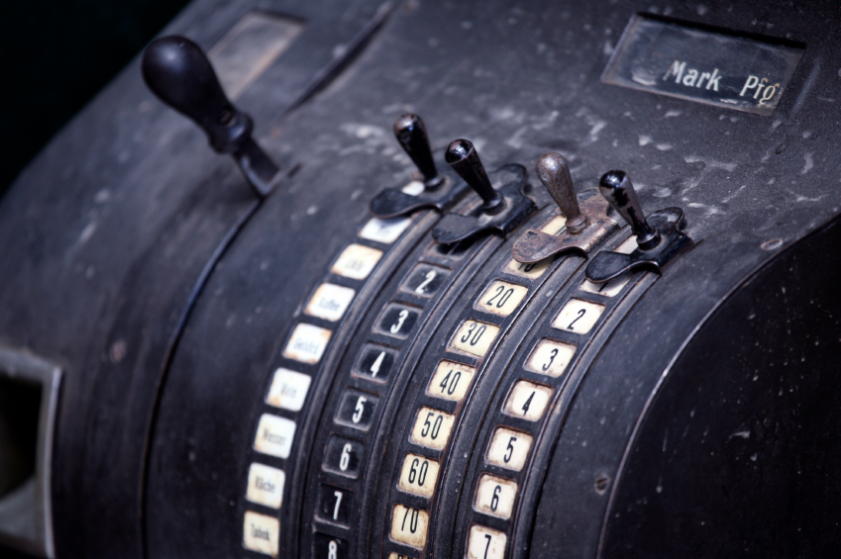

So then how do you turn data into information?

Slide 7
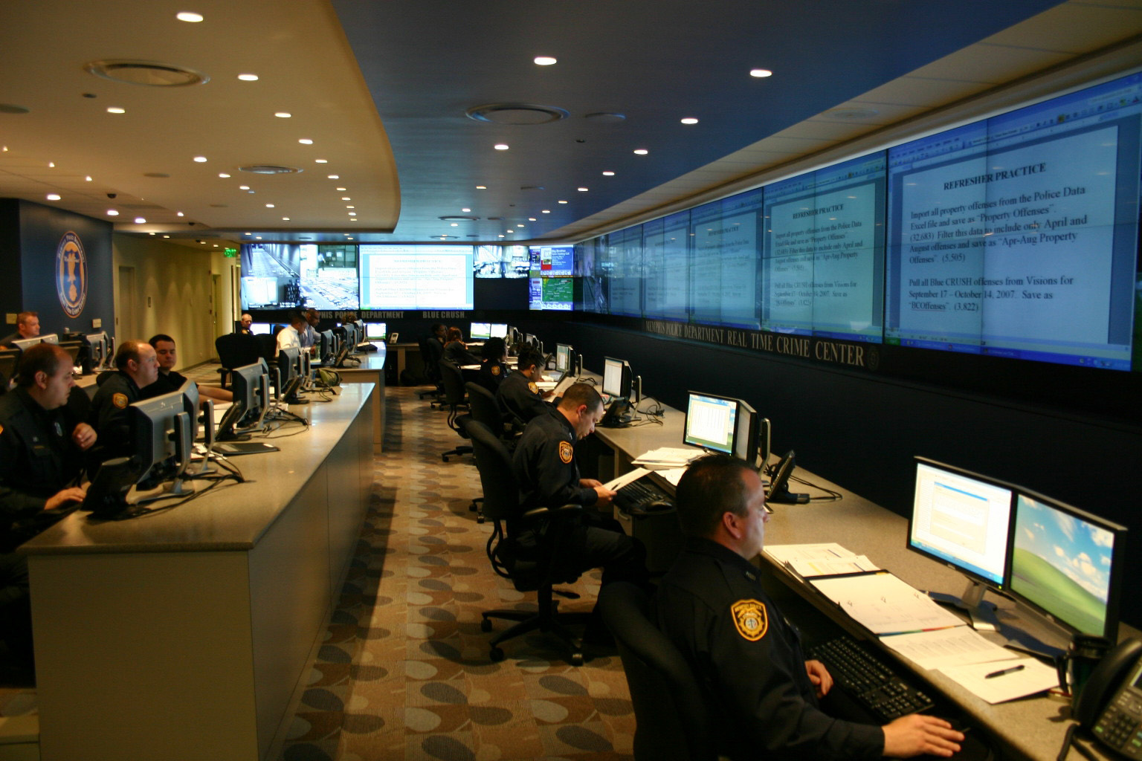
Memphis Police
  Used historical crime data
  Place police where and when crime was likely to occur
Example: Memphis Police
Used historical crime data
Place police where and when
crime was likely to occur
http://www-03.ibm.com/press/us/en/pressrelease/32169.wss

Slide 8

Example: New York Mets
  Look at fan ticket purchase, social media, and mobile data
  Personalize communications and promotions
  Growth in corporate sales; ticket base now 14000+
http://www.sas.com/en_us/insights/articles/analytics/New-York-Mets-sign-analytics.html

Slide 9
Two types of data
Transactional
Captures data describing and event
An exchange between actors
Analytical
Captures data to support analysis and reporting
An aggregated view of the business
Real-time
Historical
!
Explain the role of transactional and analytical data in the examples on the previous slides.

Slide 10

The Information Architecture of an Organization
Data entry
Transactional Database
Data extraction
Analytical Data Store
Data analysis
Stores real-time transactional data
Stores historical transactional and summary data
Called OLTP:
Online transaction processing
Called OLAP:
Online analytical processing
!
But this is changing rapidly….

Slide 11
Data versus information
Data
Discrete, unorganized, raw facts
Information
The transformation of those facts into meaning

Slide 12
Components of an information infrastructure
Transactional Database
Supports management of an organization’s data
Analytical Data Store
For periodic analysis
For everyday transactions
Supports managerial decision-making
This is what is commonly thought of as “database management”
This is the foundation for business intelligence

