Slide 1
Exam 2 Review

Slide 2
SQL – Create Table
REMEMBER!!
Create table mxws.Contact (
ContactID INT(10) NOT NULL,
.
.
.,
primary key (contactID));

Slide 3
Insert into mxws.employee
(EmployeeID,FirstName,LastName,Phone,Email)
VALUES (1001,'Lesley','Bland','215-555-5678','lbland@marketco.com');

Slide 4
Update mxws.employee
Set Phone='215-555-8800'
WHERE EmployeeID = 1001;
DELETE FROM m0ws.`Contact-Employee`
WHERE ContactEmployeeID=5003;

Slide 5
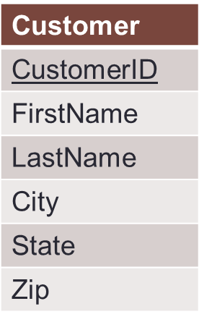
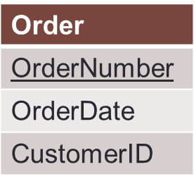
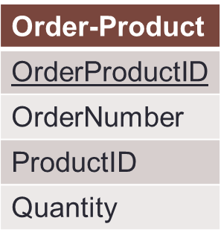
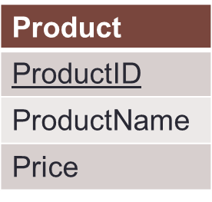
Joins
Identify the tables from which you need information
Identify the tables that lie in between these tables.
You will need to join all these tables.
Identify primary key-foreign key relationships to join these various tables.

Slide 6
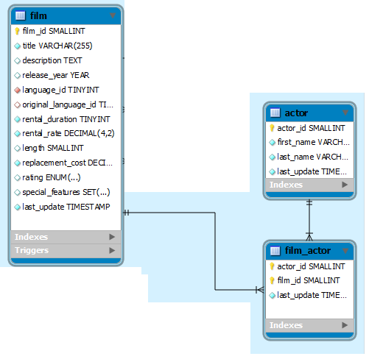
Joins
Which movies has Salma Nolte acted in?
Which tables do you need information from?

Slide 7
Joins
Which movies has Salma Nolte acted in?
Which tables do you need information from?
Which tables lie between the two tables?
What are the primary key-foreign key relationships between these tables?

Slide 8
Joins
Which movies has Salma Nolte acted in?
Which tables do you need information from?
Which tables lie between the two tables?
What are the primary key-foreign key relationships between these tables?
Select ………. From ……..
Where………………………

Slide 9
Subselects
What is wrong with this statement?
SELECT MIN(price),ProductName FROM orderdb.Product;

Slide 10
Subselects
What is wrong with this statement?
SELECT MIN(price),ProductName FROM orderdb.Product;
Select productname from orderdb.product
Where price = (SELECT MIN(Price) FROM orderdb.Product);

Slide 11
Subselects
What was the longest movie starring Salma Nolte? And how long is it? (Hint: Use a subselect statement with the MAX() function to return only the movie with the greatest length by Salma Nolte.)

Slide 12
Subselects
What was the longest movie starring Salma Nolte? And how long is it?
select max(length),first_name,last_name
from moviedb.film,moviedb.film_actor,moviedb.actor
where film.film_id = film_actor.film_id and film_actor.actor_id = actor.actor_id
and first_name = "Salma" and last_name = "Nolte";

Slide 13
Subselects
What was the longest movie starring Salma Nolte? And how long is it?
select length,first_name,last_name
from moviedb.film,moviedb.film_actor,moviedb.actor
where film.film_id = film_actor.film_id and film_actor.actor_id = actor.actor_id
and first_name = "Salma" and last_name = "Nolte" and length = (select max(length) from moviedb.film);

