Slide 1
The Three Analytics Techniques

Slide 2
Decision Trees – Determining Probability

Slide 3
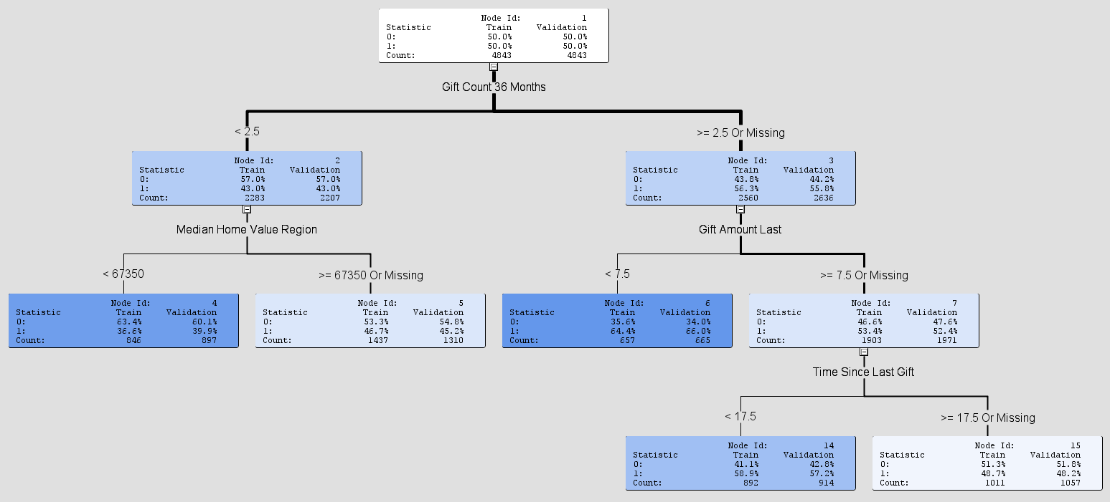

Slide 4
Decision Trees – Chi Square

Slide 5
Example: Chi-squared test
Is the proportion of the outcome class the same in each child node?
It shouldn’t be, or the classification isn’t very helpful
 | Observed
 | Owns | Rents
Default | 300 | 450 | 750
No Default | 550 | 200 | 750
 | 850 | 650 | 1500

Slide 6
Example: Chi-squared test
Is the proportion of the outcome class the same in each child node?
It shouldn’t be, or the classification isn’t very helpful
 | Observed
 | Owns | Rents
Default | 300 | 450 | 750
No Default | 550 | 200 | 750
 | 850 | 650 | 1500
 | Expected
 | Owns | Rents
Default | 425 | 325 | 750
No Default | 425 | 325 | 750
 | 850 | 650 | 1500
Root (n=1500)
Default = 750
No Default = 750
Owns (n=850)
Default = 300
No Default = 550
Rents (n=650)
Default = 450
No Default = 200

Slide 7
Chi-squared test
 | Observed
 | Owns | Rents
Default | 300 | 450 | 750
No Default | 550 | 200 | 750
 | 850 | 650 | 1500
 | Expected
 | Owns | Rents
Default | 425 | 325 | 750
No Default | 425 | 325 | 750
 | 850 | 650 | 1500
Small p-values (i.e., less than 0.05 mean it’s very unlikely the groups are the same)
So Owns/Rents is a predictor that creates two different groups
If the groups were the same, you’d expect an even split (Expected)
But we can see they aren’t distributed evenly (Observed)
But is it enough (i.e., statistically significant)?

Slide 8
Cluster Analysis – Cohesion and Separation

Slide 9
Cluster Analysis
What do you look for in the histogram that tells you a variable should not be included in the cluster analysis?

Slide 10
Cluster Analysis
What do you look for in the histogram that tells you a variable should not be included in the cluster analysis?
Cluster 1
Cluster 2
3
3.3
1
1.3
1.5
2
SSE₁ = 1² + 1.3² + 2² = 1 + 1.69 + 4 = 6.69
SSE₂ = 3² + 3.3² + 1.5² = 9 + 10.89 + 2.25 = 22.14

Slide 11
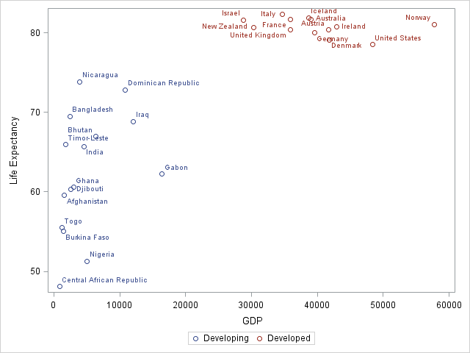
Separation and Cohesion
Distance within clusters is minimized
Which is better?
Distance between clusters is maximized

Slide 12
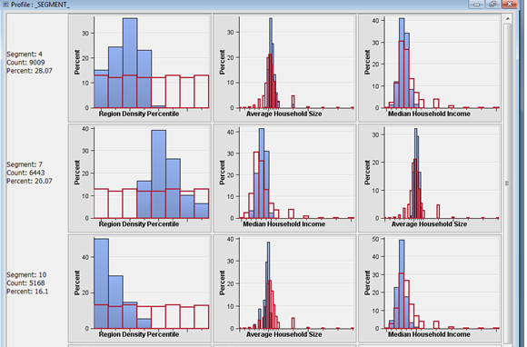
Segment Profile Plot

Slide 13
Association Rules Mining

Slide 14
Association Rules Mining
Support count (σ)
In how many baskets does the itemset appear?
σ{Milk, Beer, Diapers} = 2 (i.e., in baskets 3 and 4)
Support (s)
Fraction of transactions that contain all items in X → Y
s({Milk, Diapers, Beer}) = 2/5 = 0.4
Basket | Items
1 | Bread, Milk
2 | Bread, Diapers, Beer, Eggs
3 | Milk, Diapers, Beer, Coke
4 | Bread, Milk, Diapers, Beer
5 | Bread, Milk, Diapers, Coke

Slide 15
Confidence
Confidence is the strength of the association
Measures how often items in Y appear in transactions that contain X
Basket | Items
1 | Bread, Milk
2 | Bread, Diapers, Beer, Eggs
3 | Milk, Diapers, Beer, Coke
4 | Bread, Milk, Diapers, Beer
5 | Bread, Milk, Diapers, Coke
This says 67% of the times when you have milk and diapers in the itemset you also have beer!
c must be between 0 and 1 1 is a complete association
0 is no association

Slide 16
Lift Example
Basket | Items
1 | Bread, Milk
2 | Bread, Diapers, Beer, Eggs
3 | Milk, Diapers, Beer, Coke
4 | Bread, Milk, Diapers, Beer
5 | Bread, Milk, Diapers, Coke
What’s the lift for the rule: {Milk, Diapers} → {Beer}
So X = {Milk, Diapers} Y = {Beer} s({Milk, Diapers, Beer}) = 2/5 = 0.4 s({Milk, Diapers}) = 3/5 = 0.6 s({Beer}) = 3/5 = 0.6 So
When Lift > 1, the occurrence of X → Y together is more likely than what you would expect by chance

Slide 17
Another example
 | Checking Account
Savings Account |  | No | Yes
 | No | 500 | 3500 | 4000
 | Yes | 1000 | 5000 | 6000
 |  |  |  | 10000
Are people more inclined to have a checking account if they have a savings account?
Support ({Savings} →{Checking}) = 5000/10000 = 0.5
Support ({Savings}) = 6000/10000 = 0.6
Support ({Checking}) = 8500/10000 = 0.85
Confidence ({Savings} →{Checking}) = 5000/6000 = 0.83
Answer: No
In fact, it’s slightly less than what you’d expect by chance!

Slide 18
Final Question
Can you have high confidence and low lift?

