Slide 1
Exam 2
Exam 2 Study Guide is posted on the Course Site
The exam is on Friday, 11/2/2018 during class time.
I will hold an exam review session on Wednesday, 10/31.
ITA Nathaly will hold additional office hours on Thursday, 11/1, 1:00-3:00pm at Alter 604A.

Slide 2

MIS2502:
Review for Exam 2
Aaron Zhi Cheng
acheng@temple.edu
http://community.mis.temple.edu/zcheng

Slide 3
Overview
Date/Time: Friday, Nov 2, in class (50 minutes)
Place: Regular classroom
Please arrive 5 minutes early!
Multiple-choice and short-answer questions
Closed-book, closed-note
No computer

Slide 4
Coverage
Check the Exam 2 Study Guide
Not every item on this list may be on the exam, and there may be items on the exam not on this list.
**Advanced Analytics and R will be covered in Exam 3.

Slide 5
SQL Joins
Used to combine two or more tables, based on the common fields between them.
Suppose we have….
MyDB.Order
MyDB.Customer
OrderID | CustomerID | OrderDate | Amount
10308 | 2 | 1996-09-18 | 100
10309 | 1 | 1996-09-19 | 10
10310 | 1 | 1996-09-20 | 63
CustomerID | LastName | FirstName | Country
1 | Futterkiste | Alfreds | Germany
2 | Trujillo | Ana | US
3 | Moreno | Antonio | Mexico

Slide 6
A Correct, Simple Join
SELECT * FROM MyDB.Order, MyDB.Customer
WHERE Order.CustomerID=Customer.CustomerID;
MyDB.Order
MyDB.Customer
OrderID | CustomerID | OrderDate | Amount
10308 | 2 | 1996-09-18 | 100
10309 | 1 | 1996-09-19 | 10
10310 | 1 | 1996-09-20 | 63
CustomerID | LastName | FirstName | Country
1 | Futterkiste | Alfreds | Germany
2 | Trujillo | Ana | US
3 | Moreno | Antonio | Mexico
Order. OrderID | Order. CustomerID | Order. OrderDate | Order. Amount | Customer. CustomerID | Customer. LastName | Customer. FirstName | Customer. Country
10308 | 2 | 1996-09-18 | 100 | 2 | Trujillo | Ana | US
10309 | 1 | 1996-09-19 | 10 | 1 | Futterkiste | Alfreds | Germany
10310 | 1 | 1996-09-20 | 63 | 1 | Futterkiste | Alfreds | Germany

Slide 7
What If We Don’t Have the WHERE condition?
It will fetch every possible combination (pair) of records from the two tables
SELECT * FROM MyDB.Order, MyDB.Customer
WHERE Order.CustomerID=Customer.CustomerID;
MyDB.Order
MyDB.Customer
OrderID | CustomerID | OrderDate | Amount
10308 | 2 | 1996-09-18 | 100
10309 | 1 | 1996-09-19 | 10
10310 | 1 | 1996-09-20 | 63
CustomerID | LastName | FirstName | Country
1 | Futterkiste | Alfreds | Germany
2 | Trujillo | Ana | US
3 | Moreno | Antonio | Mexico
3×3 = 9 rows
Order. OrderID | Order. CustomerID | Order. OrderDate | Order. Amount | Customer. CustomerID | Customer. LastName | Customer. FirstName | Customer. Country
10308 | 2 | 1996-09-18 | 100 | 1 | Futterkiste | Alfreds | Germany
10308 | 2 | 1996-09-18 | 100 | 2 | Trujillo | Ana | US
10308 | 2 | 1996-09-18 | 100 | 3 | Moreno | Antonio | Mexico
10309 | 1 | 1996-09-19 | 10 | 1 | Futterkiste | Alfreds | Germany
10309 | 1 | 1996-09-19 | 10 | 2 | Trujillo | Ana | US
10309 | 1 | 1996-09-19 | 10 | 3 | Moreno | Antonio | Mexico
10310 | 1 | 1996-09-20 | 63 | 1 | Futterkiste | Alfreds | Germany
10310 | 1 | 1996-09-20 | 63 | 2 | Trujillo | Ana | US
10310 | 1 | 1996-09-20 | 63 | 3 | Moreno | Antonio | Mexico

Slide 8
More Variations to Join
Step 1: We start with a simple join
SELECT *
FROM MyDB.Order, MyDB.Customer
WHERE Order.CustomerID=Customer.CustomerID;
Step 2: We then end up with -
SELECT Customer.Country, SUM(Order.Amount)
FROM MyDB.Order, MyDB.Customer
WHERE Order.CustomerID=Customer.CustomerID
GROUP BY Customer.Country;
Q: What is the total order amount by country?
Order. OrderID | Order. CustomerID | Order. OrderDate | Order. Amount | Customer. CustomerID | Customer. LastName | Customer. FirstName | Customer. Country
10308 | 2 | 1996-09-18 | 100 | 2 | Trujillo | Ana | US
10309 | 1 | 1996-09-19 | 10 | 1 | Futterkiste | Alfreds | Germany
10310 | 1 | 1996-09-20 | 63 | 1 | Futterkiste | Alfreds | Germany
Customer. Country | SUM(Order.Amount)
US | 100
Germany | 73

Slide 9
SQL (Subselects)
Subselect query can return
  One single value (one column, one row)
  A temporary table (one or multiple columns, one or multiple rows)

Slide 10
One single value: Used With Comparison Operators
SELECT column_name1
FROM schema_name.table_name1
WHERE column_name2 comparison_operator
(SELECT column_name3
FROM schema_name.table_name2
WHERE condition);
Treated as a single value
comparison_operator could be equality operators such as =, >, <, >=, <=, <>.

Slide 11
Subselect as One Single Value: Example 1
MyDB.Order
Step 1. We start by write the subselect query that returns the average order amount:
SELECT AVG(Amount) FROM MyDB.Order
Step 2. We treat the subselect query as a single value:
SELECT OrderID, Amount FROM MyDB.Order
WHERE Amount <
(SELECT AVG(Amount) FROM MyDB.Order);
Q: What are the order IDs with order amount below average?
OrderID | CustomerID | OrderDate | Amount
10308 | 2 | 1996-09-18 | 100
10309 | 1 | 1996-09-19 | 10
10310 | 1 | 1996-09-20 | 63
Amount
57.6667
OrderID | Amount
10309 | 10

Slide 12
Subselect as One Single Value: Example 2
Q: Which German customer placed the order(s) with the highest order amount?
MyDB.Order
MyDB.Customer
OrderID | CustomerID | OrderDate | Amount
10308 | 2 | 1996-09-18 | 100
10309 | 1 | 1996-09-19 | 10
10310 | 1 | 1996-09-20 | 63
CustomerID | LastName | FirstName | Country
1 | Futterkiste | Alfreds | Germany
2 | Trujillo | Ana | US
3 | Moreno | Antonio | Mexico
SELECT * FROM MyDB.Order, MyDB.Customer
WHERE Order.CustomerID=Customer.CustomerID;
Recall the simple join query…
Order. OrderID | Order. CustomerID | Order. OrderDate | Order. Amount | Customer. CustomerID | Customer. LastName | Customer. FirstName | Customer. Country
10308 | 2 | 1996-09-18 | 100 | 2 | Trujillo | Ana | US
10309 | 1 | 1996-09-19 | 10 | 1 | Futterkiste | Alfreds | Germany
10310 | 1 | 1996-09-20 | 63 | 1 | Futterkiste | Alfreds | Germany

Slide 13
Subselect as One Single Value: Example 2
Q: Which German customer placed the order(s) with the highest order amount?
Step 1. We start by write the subselect query that returns the highest order amount for German customers:
SELECT MAX(Order.Amount)
FROM MyDB.Order, MyDB.Customer
WHERE Order.CustomerID=Customer.CustomerID
AND Customer.Country=‘Germany’;
Step 2. We treat the subselect query as a single value:
SELECT Customer.LastName, Customer.FirstName, Order.Amount
FROM MyDB.Order, MyDB.Customer
WHERE Order.CustomerID=Customer.CustomerID
AND Customer.Country=‘Germany’
AND Amount= (SELECT MAX(Order.Amount)
FROM MyDB.Order, MyDB.Customer
WHERE Order.CustomerID=Customer.CustomerID
AND Customer.Country=‘Germany’);
Amount
63
LastName | FirstName | Amount
Futterkiste | Alfreds | 63

Slide 14
As a temporary table
SELECT column_name(s)
FROM
(SELECT column_name(s)
FROM schema_name.table_name2
WHERE condition)
;
Treated as a table

Slide 15
Subselect as a temporary table
Q: How many countries are there in the customer table?
MyDB.Customer
CustomerID | LastName | FirstName | Country
1 | Futterkiste | Alfreds | Germany
2 | Trujillo | Ana | US
3 | Moreno | Antonio | Mexico
4 | Dean | Michael | US

Slide 16
Subselect as a temporary table
Q: How many countries are there in the customer table?
Step 1. We start by writing the subselect query that returns the distinct countries:
  SELECT DISTINCT Country
  FROM MyDB.Customer;
Country
Germany
US
Mexico
Step 2. We treat the subselect query as a temporary table:
  SELECT COUNT(*)
  FROM (SELECT DISTINCT Country
  FROM MyDB.Customer);
COUNT(*)
3

Slide 17
SQL (CREATE TABLE)
CREATE TABLE schema_name.table_name (
columnName1 datatype [NULL][NOT NULL],
columnName2 datatype [NULL][NOT NULL],
PRIMARY KEY (KeyName);
If there is no
foreign key:
CREATE TABLE schema_name.table_name (
columnName1 datatype [NULL][NOT NULL],
columnName2 datatype [NULL][NOT NULL],
PRIMARY KEY (KeyName),
FOREIGN KEY (ForeignKeyName) REFERENCES schema_name.reference_table_name(ReferenceKeyName));
If there is foreign key:
When to use NOT NULL?

Slide 18
DROP TABLE, ALTER TABLE
Drops a table
DROP TABLE schema_name.table_name;
ALTER TABLE schema_name.table_name
ADD COLUMN column_name datatype
[NULL][NOT NULL];
or
ALTER TABLE schema_name.table_name
DROP COLUMN column_name;
or
ALTER TABLE schema_name.table_name CHANGE COLUMN old_column_name
new_column_name datatype
[NULL][NOT NULL];
Adds a column to the table
Removes a column from the table
Changes a column in the table

Slide 19
INSERT INTO, UPDATE, DELETE FROM
To insert a record into a table:
  INSERT INTO schema_name.table_name
  (columnName1, columnName2, columnName3)
  VALUES (value1, value2, value3);
To change data in a row:
  UPDATE schema_name.table_name
  SET columnName1=value1, columnName2=value2
  WHERE condition;
To delete a row from a table:
DELETE FROM schema_name.table_name
WHERE condition;
What to use in the WHERE condition?
How about this WHERE condition?

Slide 20
Data Types
Data type | Description | Examples
INT | Integer | 3, -10
DECIMAL(p,s) | Decimal. Example: decimal(5,2) is a number that has 3 digits before decimal and 2 digits after decimal | 3.23, 3.14159
VARCHAR(n) | String (numbers and letters) with maximum length n | 'Hello, I like pizza, MySQL!'
DATETIME, DATE | Date/Time, or just Date | '2011-09-01 17:35:00', '2011-04-12'
BOOLEAN | Boolean value | 0 or 1
Q: What does DECIMAL(4, 1) indicate?
A: The value cannot go beyond -999.9~ 999.9

Slide 21
ETL and Assignment 4
Transform data into an analysis-ready format
Load it into the analytical data store
Extract data from the operational data store
What is it? Why is it important?
  Data consistency
  Data quality
Explain the purpose of each component (Extract, Transform, Load)
Excel Basics:
  Absolute and relative references
  Excel functions LEN, VLOOKUP and CONCATENATE

Slide 22
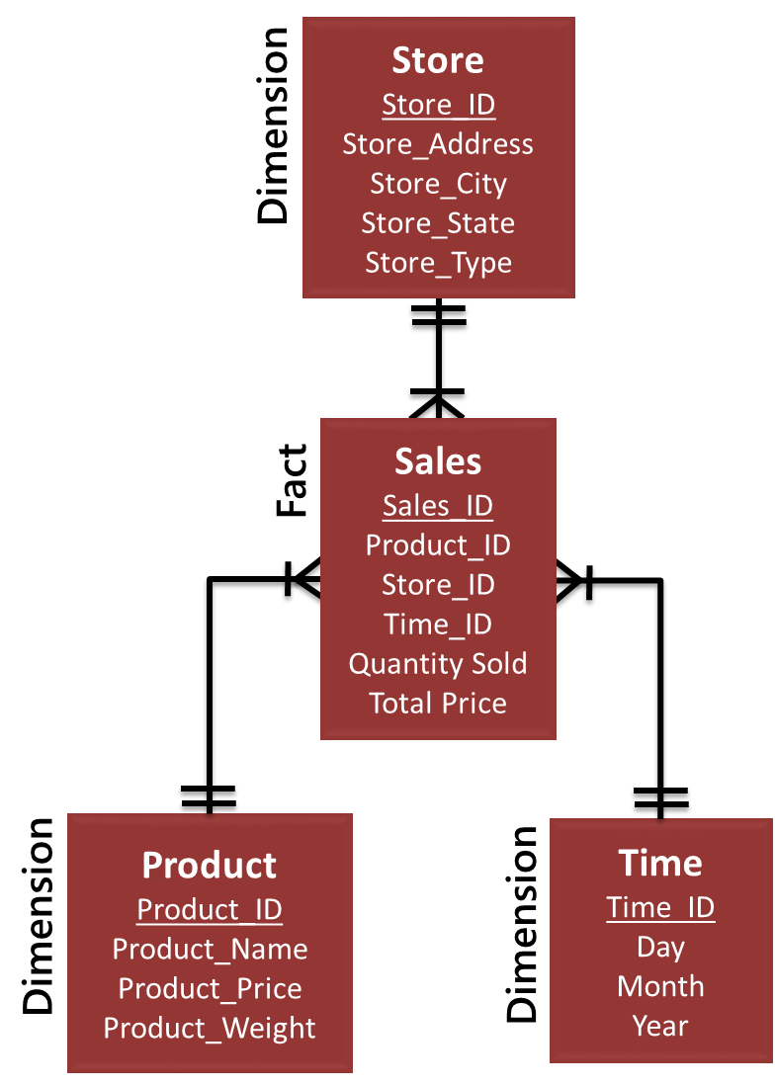
Dimensional Data Modeling
Data warehouse vs data mart vs data cube
Data Cube
Star schema
Kimball’s four step process for dimensional data modeling
“non-volatility” of data cubes
1. Choose the business process
2. Decide on the level of granularity
3. Identify the fact
4. Identify the dimensions

Slide 23
Pivot Tables
Given a question about a set of data, be able to identify the fields required to create a pivot table
Identify which fields are assigned as VALUES and which ones are assigned as ROWS
Identify the correct function for aggregation: i.e., SUM, COUNT, AVERAGE, etc.
Understand how to use sorting and label filter

Slide 24
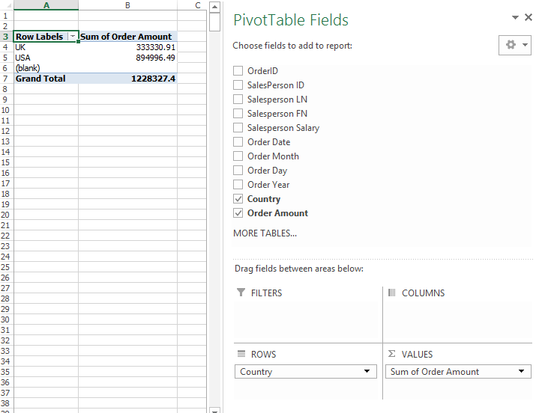
Pivot Tables vs. data cubes
Equivalent to “dimensions” in a data cube
Equivalent to “measured facts” in a data cube

Slide 25
Data Visualization
Data visualization principles.
  Tell a story
  Graphical integrity (lie factor)
  Minimize graphical complexity (data ink, chartjunk, Moiré effects )

Slide 26
Issues with this chart?
Example from ICA #6.1 - Chart #3:
Issues:
Tell a Story
  Vertical axis isn’t labeled. We don’t know the units
  Because there are many states to compare, horizontal lines may be helpful
Graphical Integrity
  The 3D chart makes it difficult to compare sizes
  The cone-shaped bars make it even harder to compare sizes
Graphical Complexity
  The 3D chart requires more ink (Chartjunk)
  The number labels are unnecessary

Slide 27
Good Luck!

