Slide 1
SQL – Getting Information Out of a Database
Part 1: Basic Queries
MIS2502: Data Analytics

Slide 2

Where we are…
Now we’re here…
Data entry
Transactional Database
Data extraction
Analytical Data Store
Data analysis
Stores real-time transactional data in a relational or NoSQL database
Stores historical transactional and summary data

Slide 3
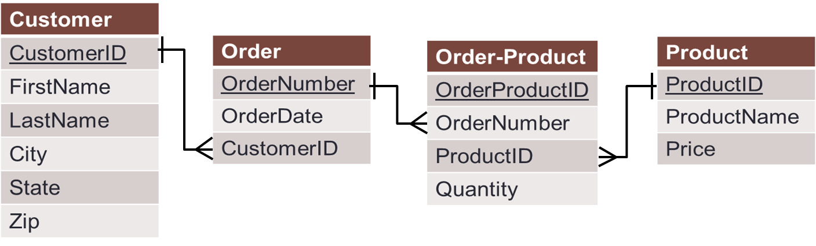
What do we want to do?
Database Management System
Get information out of the database (retrieve)
Put information into the database (modify/change)

Slide 4
To do this we use SQL
Structured Query Language (SQL)
A high-level set of statements (commands) that let you communicate with the database
With SQL, you can
  Retrieve records
  Join (combine) tables
  Insert records
  Delete records
  Update records
  Add and delete tables
A statement is any SQL command that interacts with a database.
A SQL statement that retrieves information is referred to as a query.
We will be doing this.
Notes:
Why learn language? Japanese?
Similar learning a new language
Words → keyword grammar → syntax
SQL is made up of series of commands called statement / statement interact with a database
We call a statement that retrieves an information from database a query.

Slide 5
Some points about SQL
It’s not a true programming language
It is used by programming languages to interact with databases
There is no standard syntax
MySQL, Oracle, SQL Server, and Access all have slight differences
There are a lot of statements and variations among them
We will be covering the basics, and the most important ones
A great online reference for SQL syntax:
http://www.w3schools.com/sql

Slide 6

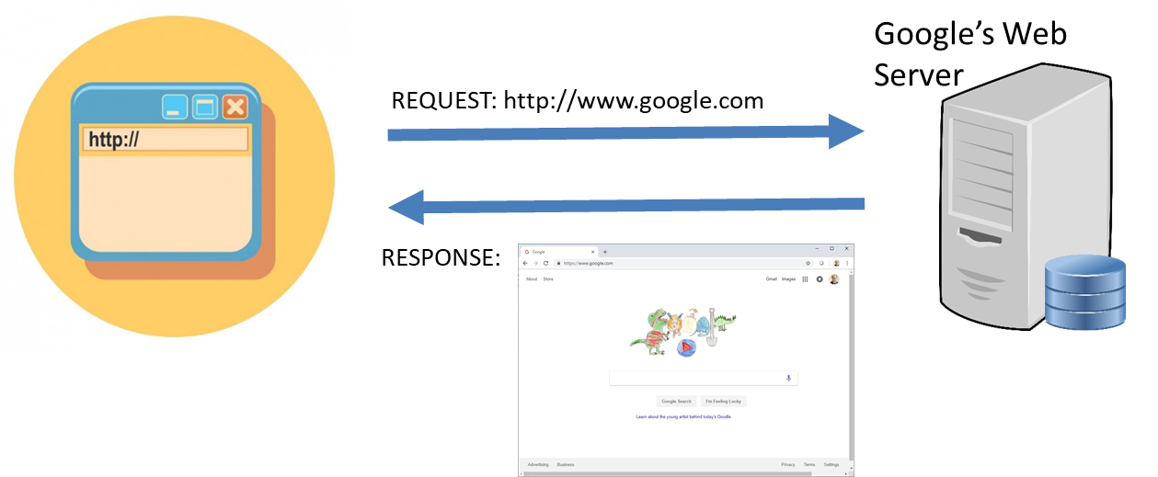
Interacting with MySQL
We’re going to use MySQL Workbench

Slide 7
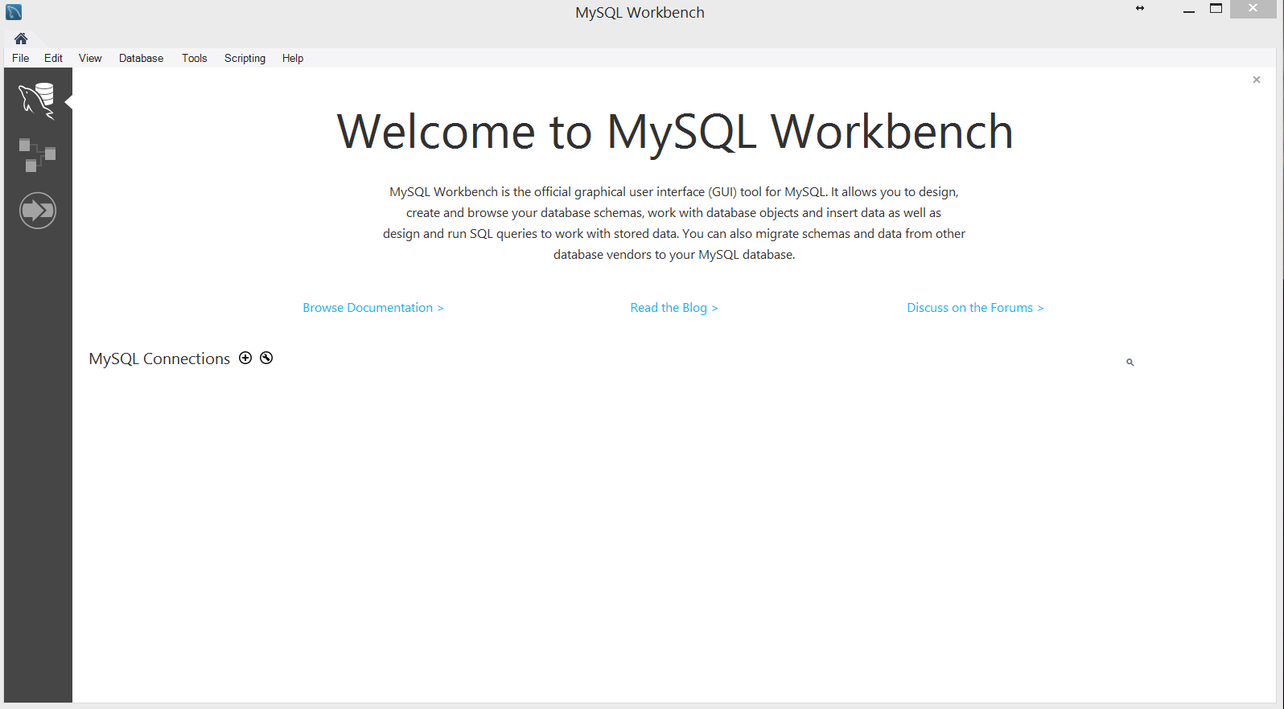

Connecting to a MySQL server
Click on the “plus sign” next to MySQL Connections to create a new connection.

Slide 8
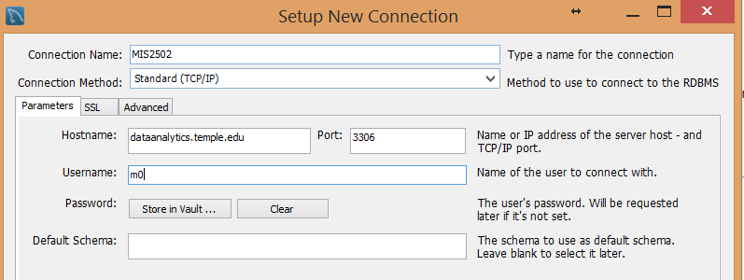
Connecting to a MySQL server
At the “Setup New Connection” dialog, fill in the information as follows:
Connection Name: mis2502
Hostname: dataanalytics.temple.edu
Username/PW: Your username given to you by the instructor
The username and password will be available on community.mis.edu. In the gradebook look for your username and password. They are the same for MongoDB, which we will use later this semester.

Slide 9
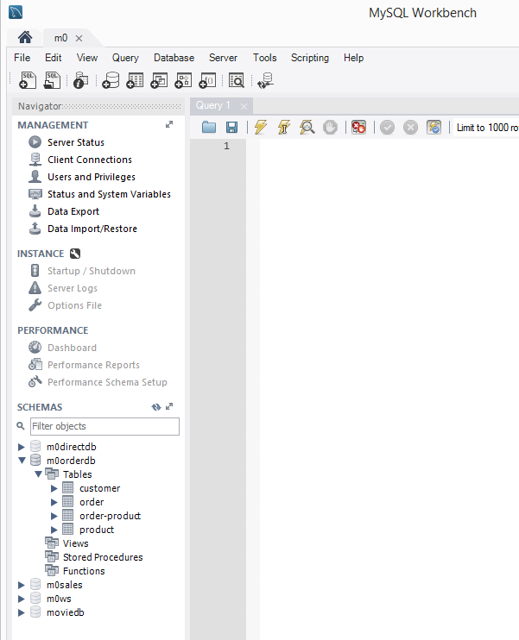
The MySQL Workbench interface
SQL Query panel
Overview tablesheet (the database schemas)
How many tables are in the m0orderdb schema?

Slide 10
SELECT statement
The SELECT statement is used to select data from a database.
Syntax:
A column is a table field that you would like to select from the table.
SELECT column_name(s)
FROM schema_name.table_name;
A schema is a collection of tables.
It is, essentially, the database.
It’s good practice to end every statement with a semicolon, especially when entering multiple statements.
Notes:
Syntax: is a grammar to communicate with computer
Schema
Semicolon indicates the end of the statement.
Keywords?

Slide 11
SELECT statement
Suppose we have a schema named “orderdb”.
We want to select the first names from the “Customer” table.
This is done using the SELECT statement:
SELECT FirstName FROM orderdb.Customer;
CustomerID | FirstName | LastName | City | State | Zip
1001 | Greg | House | Princeton | NJ | 09120
1002 | Lisa | Cuddy | Plainsboro | NJ | 09123
1003 | James | Wilson | Pittsgrove | NJ | 09121
1004 | Eric | Foreman | Warminster | PA | 19111
Customer
FirstName
Greg
Lisa
James
Eric
This returns the FirstName column for every row in the Customer table.
Called a “View.”
Your schema will use your mx MySQL ID
(i.e., m999orderdb.Customer)
Returns:
Notes:
What should we do if we want to select more than one?

Slide 12
Retrieving multiple columns
SELECT FirstName, State FROM orderdb.Customer;
SELECT * FROM orderdb.Customer;
FirstName | State
Greg | NJ
Lisa | NJ
James | NJ
Eric | PA
Returns:
The * means “return every column.”
CustomerID | FirstName | LastName | City | State | Zip
1001 | Greg | House | Princeton | NJ | 09120
1002 | Lisa | Cuddy | Plainsboro | NJ | 09123
1003 | James | Wilson | Pittsgrove | NJ | 09121
1004 | Eric | Foreman | Warminster | PA | 19111
Returns:

Slide 13
Capitalization and spacing
SQL syntax is not sensitive to cases and spacing
Best Practice:
  We will write all SQL keywords (e.g., SELECT and FROM) in upper case
  Use space appropriately for readability
SELECT FirstName FROM orderdb.Customer; | Correct Best Practice
select firstname from orderdb.customer; | Correct
SELECT FirstName FROM orderdb.Customer; | Correct
Notes:
Style issue? Camel case?
Space – why we use semicolon

Slide 14
Retrieving unique values
SELECT DISTINCT State
FROM orderdb.Customer;
SELECT DISTINCT City, State
FROM orderdb.Customer;
SELECT DISTINCT returns only distinct (different) values.
State
NJ
PA
City | State
Princeton | NJ
Plainsboro | NJ
Pittsgrove | NJ
Warminster | PA
In this case, each combination of City AND State is unique, so it returns all of them.
Notes:
Not unique distinct

Slide 15
Returning only certain records
Sometimes we want to filter records.
We use the WHERE clause to specify criterions.
Syntax:
SELECT * FROM schema_name.table_name WHERE condition;
Example:
SELECT * FROM orderdb.Customer WHERE State= 'NJ';
CustomerID | FirstName | LastName | City | State | Zip
1001 | Greg | House | Princeton | NJ | 09120
1002 | Lisa | Cuddy | Plainsboro | NJ | 09123
1003 | James | Wilson | Pittsgrove | NJ | 09121
1004 | Eric | Foreman | Warminster | PA | 19111
Let’s retrieve only those customers who live in New Jersey.
Customer
CustomerID | FirstName | LastName | City | State | Zip
1001 | Greg | House | Princeton | NJ | 09120
1002 | Lisa | Cuddy | Plainsboro | NJ | 09123
1003 | James | Wilson | Pittsgrove | NJ | 09121
returns this:
Notes:
Condition is a statement that is either true or false

Slide 16
More conditional statements
SELECT * FROM orderdb.Customer WHERE State <> 'NJ';
SELECT ProductName, Price FROM orderdb.Product WHERE Price > 2;
CustomerID | FirstName | LastName | City | State | Zip
1004 | Eric | Foreman | Warminster | PA | 19111
The <> means “not equal to.”
ProductName | Price
Cheerios | 3.99
Eggo Waffles | 2.99
French Toast | 3.99
Text Fields vs. Numeric Fields
Put single quotes around string (non-numeric) values. For example, 'NJ'
The quotes are optional for numeric values.

Slide 17
Operators in the WHERE Clause
The following list of operators that can be used in the WHERE clause:
Operator | Description
= | Equal to
> | Greater than
>= | Greater than or equal to
< | Less than
<= | Less than or equal to
<> | Not equal to

Slide 18
More conditional statements:
AND & OR Operators
SELECT * FROM orderdb.Product WHERE Price > 2 AND Price<=3.5;
SELECT * FROM orderdb.Customer
WHERE City = ‘Princeton’ OR City = ‘Pittsgrove’;
The AND operator displays a record if both the first condition AND the second condition are true.
ProductID | ProductName | Price
2505 | Eggo Waffles | 2.99
2700 | Granola Bars | 2.99
CustomerID | FirstName | LastName | City | State | Zip
1001 | Greg | House | Princeton | NJ | 09120
1003 | James | Wilson | Pittsgrove | NJ | 09121
The OR operator displays a record if either the first condition OR the second condition is true.

Slide 19
Pattern Match Search Condition
When searching for text, sometimes we want inexact match (e.g. like find all lastnames starting from “A…”)
We can use LIKE/NOT LIKE and % to test whether a string matches a specified pattern
  WHERE col_name LIKE ‘%berry’: will find all the text strings like ‘berry’, ‘cranberry’, ‘blackberry’ and so on.
  WHERE col_name LIKE ‘%d%’: will find all the text string that contain ‘d’ letter.
  WHERE col_name NOT LIKE ‘%d%’: will find all the text string that do not contain ‘d’ letter.

Slide 20
Pattern Match Search Condition
Example
List all the customers who live in the city that starts with “P” letter
What’s going to be the result?
CustomerID | FirstName | LastName | City | State | Zip
1001 | Greg | House | Princeton | NJ | 09120
1002 | Lisa | Cuddy | Plainsboro | NJ | 09123
1003 | James | Wilson | Pittsgrove | NJ | 09121
1004 | Eric | Foreman | Warminster | PA | 19111
SELECT *
FROM orderdb.Customer
WHERE City LIKE ‘p%’;

Slide 21
Sorting using ORDER BY
SELECT * FROM orderdb.Product
WHERE Price > 2
ORDER BY Price;
ORDER BY sorts results from lowest to highest based on a field
(in this case, Price)
ProductID | ProductName | Price
2505 | Eggo Waffles | 2.99
2700 | Granola Bars | 2.99
2251 | Cheerios | 3.99
2684 | French Toast | 3.99

Slide 22
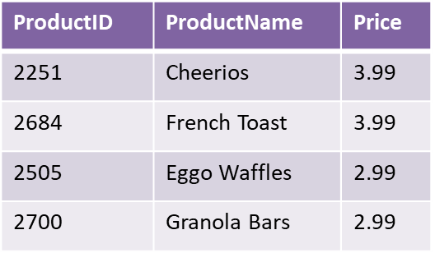
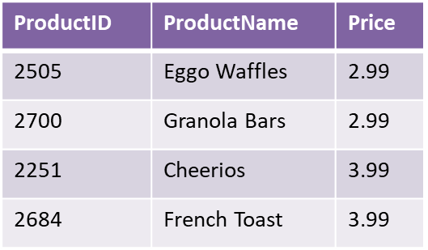
ORDER BY ASC and DESC
SELECT * FROM orderdb.Product
WHERE Price > 2
ORDER BY Price DESC;
Forces the results to be sorted in DESCending order
SELECT * FROM orderdb.Product
WHERE Price > 2
ORDER BY Price ASC;
Forces the results to be sorted in ASCending order

Slide 23
SQL Functions
SQL has many built-in functions for performing calculations
COUNT() - Returns the number of rows
MAX() - Returns the largest value
MIN() - Returns the smallest value
AVG() - Returns the average value
SUM() - Returns the sum

Slide 24
Functions: Counting records
SELECT COUNT(FirstName) FROM orderdb.Customer;
SELECT COUNT(CustomerID) FROM orderdb.Customer;
SELECT COUNT(*) FROM orderdb.Customer;
Total number of records in the table
where the field is not empty
(that is, missing values will not be counted) .
(don’t forget the parentheses!)
4
Why is this the same number as the previous query?
4
What number would be returned?
?

Slide 25
What if there is missing data?
CustomerID | FirstName | LastName | City | State | Zip
1001 |  | House | Princeton | NJ | 09120
1002 | Lisa | Cuddy | Plainsboro | NJ | 09123
1003 | James | Wilson | Pittsgrove | NJ | 09121
1004 | Eric | Foreman | Warminster | PA | 19111
Customer
SELECT COUNT(FirstName) FROM orderdb.Customer;
SELECT COUNT(CustomerID) FROM orderdb.Customer;
SELECT COUNT(*) FROM orderdb.Customer;
3
4
4
If missing data are possible, it is best to count using the primary key (e.g., COUNT(CustomerID)), or use COUNT(*)

Slide 26
Functions: Highest, lowest, average, sum
ProductID | ProductName | Price
2251 | Cheerios | 3.99
2282 | Bananas | 1.29
2505 | Eggo Waffles | 2.99
2684 | French Toast | 3.99
SELECT MAX(Price) FROM orderdb.Product;
SELECT MIN(Price) FROM orderdb.Product;
SELECT AVG(Price) FROM orderdb.Product;
SELECT SUM(Price) FROM orderdb.Product;
Product
Price
3.99
Price
1.29
Price
3.065
Price
12.26

Slide 27
What if we want to arrange records in groups?
CustomerID | FirstName | LastName | City | State | Zip
1001 | Greg | House | Princeton | NJ | 09120
1002 | Lisa | Cuddy | Plainsboro | NJ | 09123
1003 | James | Wilson | Pittsgrove | NJ | 09121
1004 | Eric | Foreman | Warminster | PA | 19111
How do we find the number of customers by each state?

Slide 28
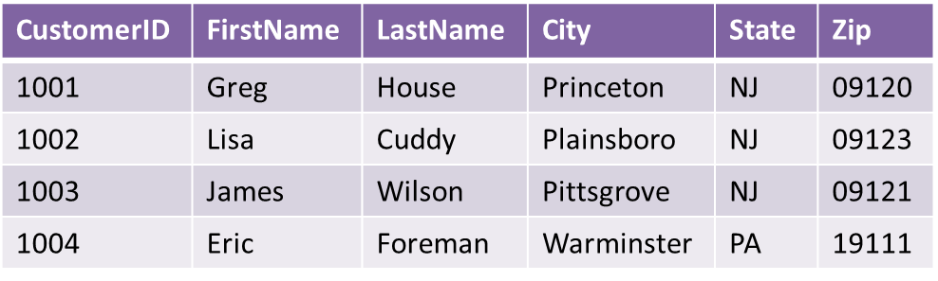
GROUP BY
SELECT State, COUNT(FirstName)
FROM orderdb.Customer
GROUP BY State;
State | COUNT(FirstName)
NJ | 3
PA | 1
So it looks for unique State values and then counts the number of records for each of those values.
GROUP BY is usually used in conjunction with the aggregate functions (COUNT, MAX, MIN, AVG, SUM), to group the results by one or more columns.

Slide 29
Another GROUP BY
OrderProductID | OrderNumber | ProductID | Quantity
1 | 101 | 2251 | 2
2 | 101 | 2282 | 3
3 | 101 | 2505 | 1
4 | 102 | 2251 | 5
5 | 102 | 2282 | 2
6 | 103 | 2505 | 3
7 | 104 | 2505 | 8
Ask: What is the total quantity sold per product?
Order-Product
SELECT ProductID, SUM(Quantity)
FROM orderdb.OrderProduct
GROUP BY ProductID;
ProductID | SUM(Quantity)
2251 | 7
2282 | 5
2505 | 12
Notes:
Explain group by
Do we need ‘productid in selection?

Slide 30
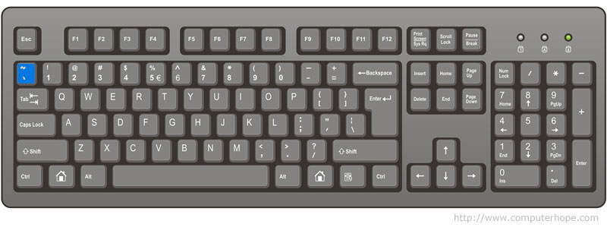
Back quotes?
We surround schema, table or column names with back quotes (in the form of `name`) when the name
  contains SQL reserved words
  contains blank space or special characters
Where is the back quote key on the keyboard?

Slide 31
Back quotes for reserved words
When the table/column name is a reserved word:
SELECT * FROM orderdb.`Order`;
Order is a reserved word in SQL. It is a command.
  As in “ORDER BY”
The back quotes tell MySQL to treat `Order` as a database object and not a command.
For a list of reserved words in MySQL, go to:
http://dev.mysql.com/doc/refman/5.1/en/reserved-words.html

Slide 32
Back quotes for space or special characters
Space or special characters in schema/table/column name contains :
SELECT * FROM orderDB.`Order-Product`
SELECT `Last Name` FROM hospitaldb.Patient

Slide 33
Counting and sorting
SELECT State, COUNT(FirstName)
FROM orderdb.Customer
GROUP BY State ORDER BY COUNT(FirstName);
GROUP BY organizes the results by column values.
ORDER BY sorts results from lowest to highest based on SUM(Quantity)
State | COUNT(FirstName)
PA | 1
NJ | 3

Slide 34
The LIMIT Clause
We could use LIMIT to find the state with the smallest number of customers:
SELECT State, COUNT(FirstName)
FROM orderdb.Customer
GROUP BY State ORDER BY COUNT(FirstName)
LIMIT 1;
LIMIT specify the number of records to return.
State | COUNT(FirstName)
PA | 1

Slide 35
Combining WHERE and COUNT
SELECT COUNT(FirstName) FROM orderdb.Customer WHERE State= 'NJ';
SELECT COUNT(ProductName) FROM orderdb.Product WHERE Price < 3;
Asks: How many customers live in New Jersey?
3
Asks: How many products cost less than $3?
2
Review: Does it matter which field in the table you use in the SELECT COUNT query?

Slide 36
WHERE, GROUP BY, and ORDER BY
Recall the Customer table:
CustomerID | FirstName | LastName | City | State | Zip
1001 | Greg | House | Princeton | NJ | 09120
1002 | Lisa | Cuddy | Plainsboro | NJ | 09123
1003 | James | Wilson | Pittsgrove | NJ | 09121
1004 | Eric | Foreman | Warminster | PA | 19111
Ask:
How many customers are there in each city in New Jersey? Sort the results alphabetically by city
Notes:
Emphasis the sequence of the ….

Slide 37
One more note: Combining WHERE, GROUP BY, and ORDER BY
X
SELECT City, COUNT(*)
FROM orderdb.Customer
WHERE State='NJ'
GROUP BY City
ORDER BY City ASC;
SELECT City, COUNT(*)
FROM orderdb.Customer
GROUP BY City
ORDER BY City ASC
WHERE State='NJ';
This is the correct SQL statement
This won’t work
City | COUNT(*)
Pittsgrove | 1
Plainsboro | 1
Princeton | 1
When combining WHERE, GROUP BY, and ORDER BY, write the WHERE condition first, then GROUP BY, then ORDER BY.
Notes:
Ascending? Correct? ICA 4?

Slide 38
Summary: The full syntax for SELECT
SELECT [DISTINCT] expression(s)
FROM schema_name.table_name(s)
[WHERE condition(s)]
[GROUP BY expression(s)]
[ORDER BY expression(s) [ ASC | DESC ]]
[LIMIT number_rows];
The [] means the element is optional
Element | Description
expression(s) | The column(s) or function(s) that you wish to retrieve.
schema_name.table_name(s) | The table(s) that you wish to retrieve records from.
DISTINCT | Optional. Return unique values.
WHERE condition(s) | Optional. The conditions that must be met for the records to be selected.
GROUP BY expression(s) | Optional. Organize the results by column values.
ORDER BY expression(s) | Optional. Sort the records in your result set
LIMIT number_rows | Optional. Restrict the maximum number of records to retrieve.

Slide 39
In Class Activity #2

