Slide 1
Principles of Data Visualization
MIS2502: Data Analytics
JaeHwuen Jung
jaejung@temple.edu
http://community.mis.temple.edu/jaejung

Slide 2

The agenda for the course
Weeks 1 through 6
Weeks
7 through 8
Weeks 9 through 15
Data entry
Transactional Database
Analytical Data Store
Data analysis
Data extraction
Stores real-time transactional data in a relational or NoSQL database
Stores historical transactional and summary data
Data interpretation,
visualization, communication

Slide 3
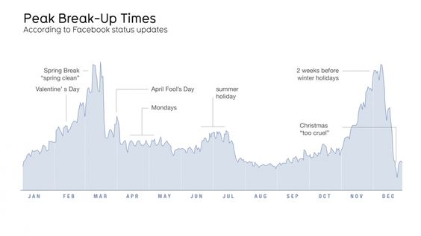
Why data visualization?
“Quite simply, humans are amazing pattern-recognition machines. They
have the ability to recognize many different types of patterns - and then
transform
these
‘recursive
probabalistic
fractals’
into
concrete,
actionable steps.” –Dominic Basulto
Ref. https://www.ted.com/talks/david_mccandless_the_beauty_of_data_visualization

Slide 4
Data visualization can:
Provide clear understanding of patterns in data
Detect hidden structures in data
Condense information

Slide 5
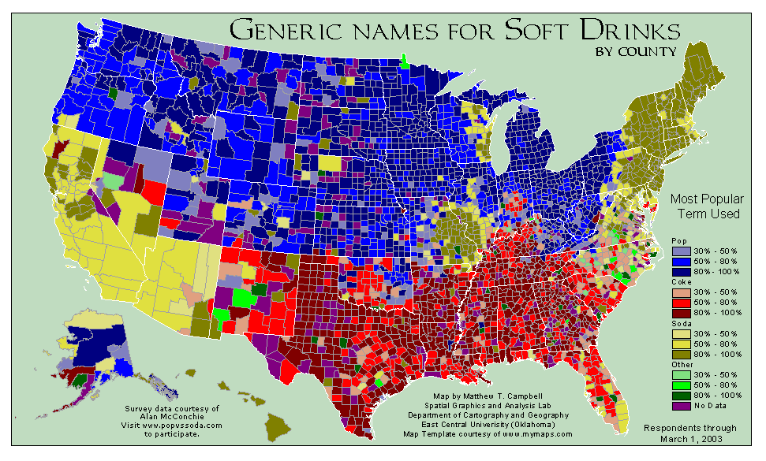
What can you learn from this map?
http://www.popvssoda.com/countystats/total-county.html

Slide 6
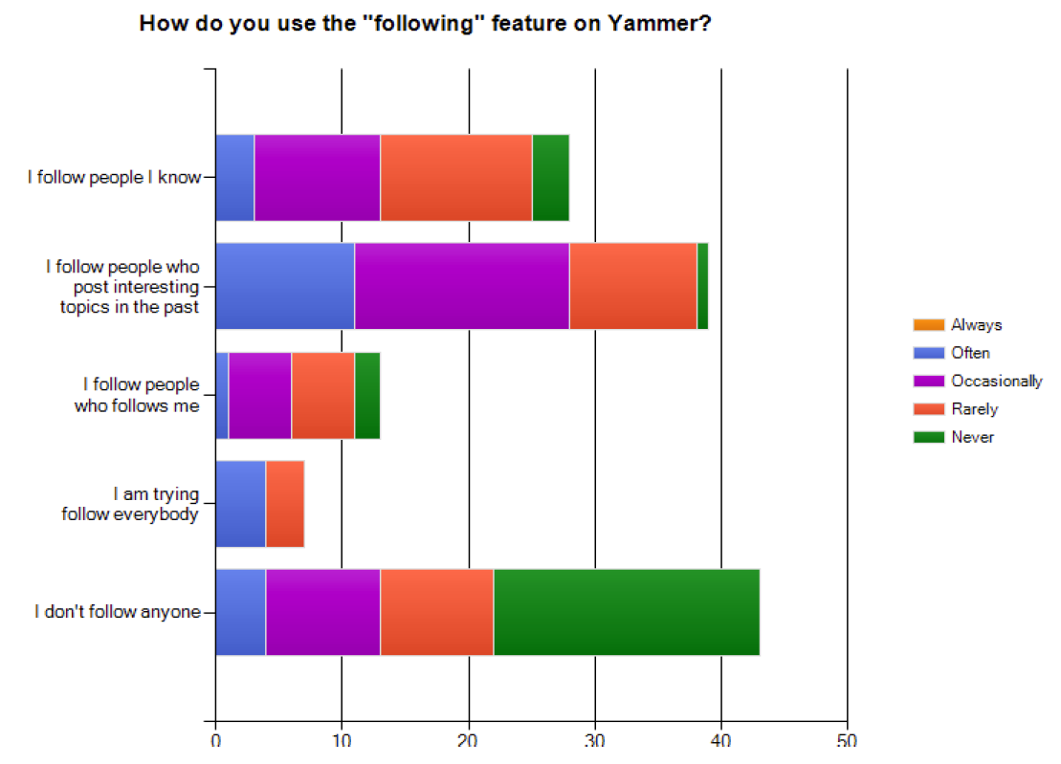
What makes a good chart?
This is from an academic conference paper.
What are the problems with this chart?
Zhang et al. (2010), “A case study of micro-blogging in the enterprise: use, value, and related issues,” Proceedings of the 28th International Conference on Human Factors in Computing Systems.

Slide 7
Some basic principles (adapted from Tufte 2009)
1
2
3
The chart should tell a story
The chart should have graphical integrity
The chart should minimize graphical complexity
Tufte’s fundamental principle:
Above all else show the data

Slide 8
Principle 1: The chart should tell a story
Graphics should be clear on their own
The chart should yield insight beyond the text
“If the statistics are boring, then you’ve got the wrong numbers.” (Tufte 2009)
The depictions should enable meaningful comparison

Slide 9
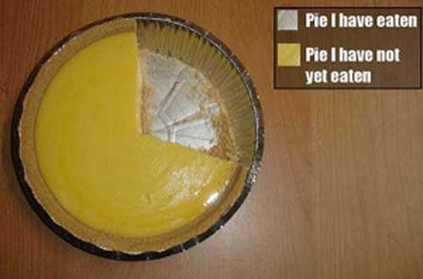
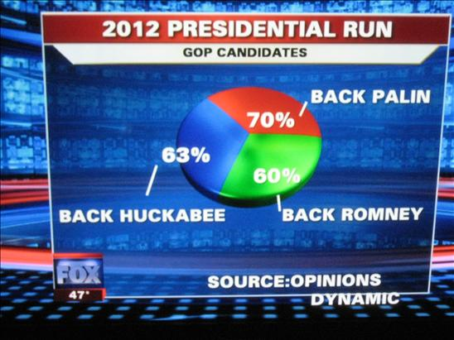
Do these tell a story?
http://www.evl.uic.edu/aej/491/week03.html
http://flowingdata.com/2009/11/26/fox-news-makes-the-best-pie-chart-ever/

Slide 10
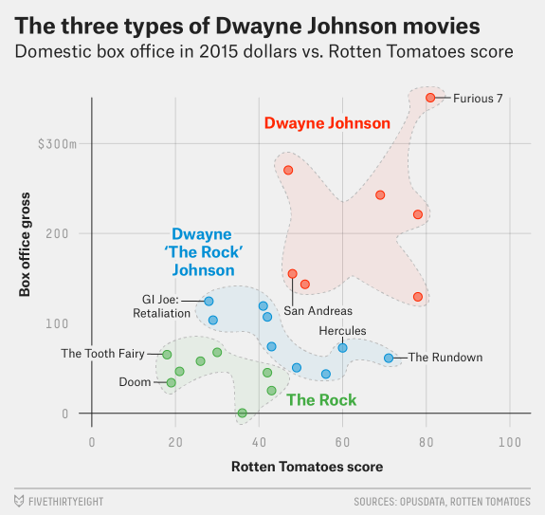
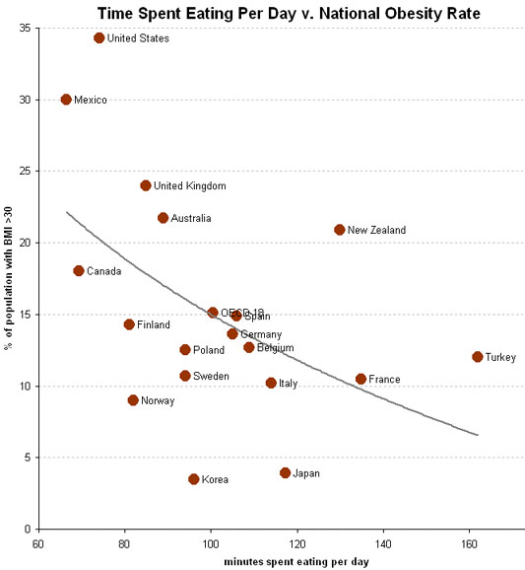

Telling a Story
http://fivethirtyeight.com/features/the-three-types-of-dwayne-the-rock-johnson-movies/
http://economix.blogs.nytimes.com/2009/05/05/obesity-and-the-fastness-of-food/

Slide 11
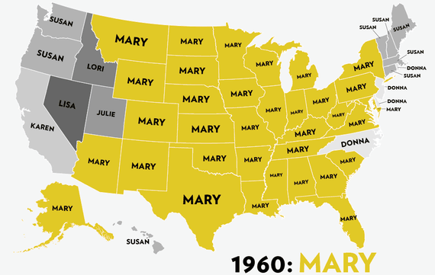
Most Popular Girl Names in Map
by Reuben Fischer-Baum (http://jezebel.com/map-sixty-years-of-the-most-popular-names-for-girls-s-1443501909)

Slide 12
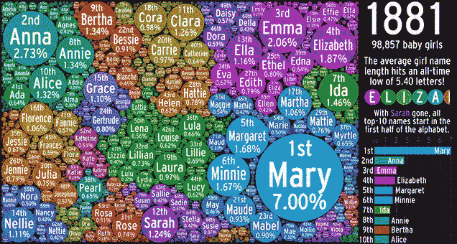
Popular Girls Names in Bubbling Visualization
http://gizmodo.com/over-100-years-of-popular-girls-names-in-one-bubbling-v-1691686567

Slide 13

Does it tell a good story?
http://gizmodo.com/8-horrible-data-visualizations-that-make-no-sense-1228022038

Slide 14
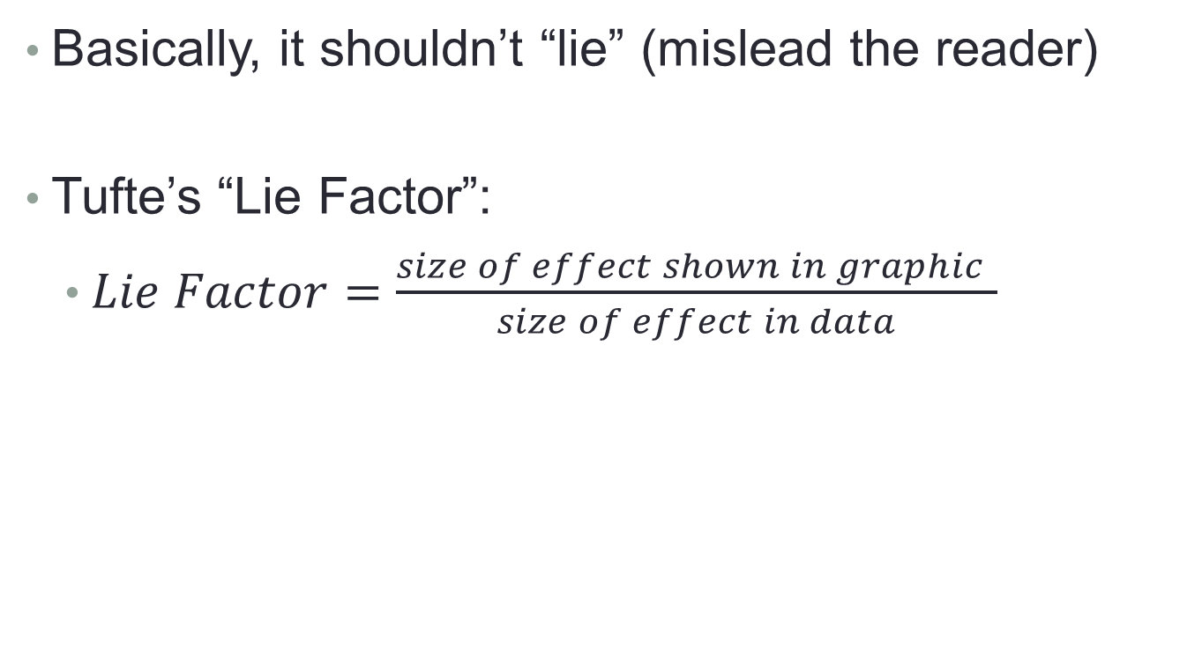
Principle 2: The chart should have graphical integrity
Basically, it shouldn’t “lie” (mislead the reader)
Tufte’s “Lie Factor”:
  $Lie Factor=\frac{size of effect shown in graphic }{size of effect in data}$
Should be ~ 1
> 1 = exaggerated effect
< 1 = understated effect

Slide 15
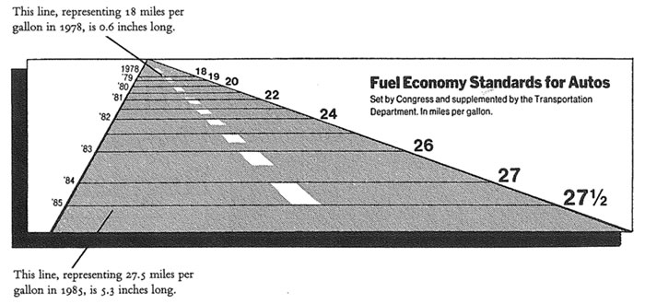
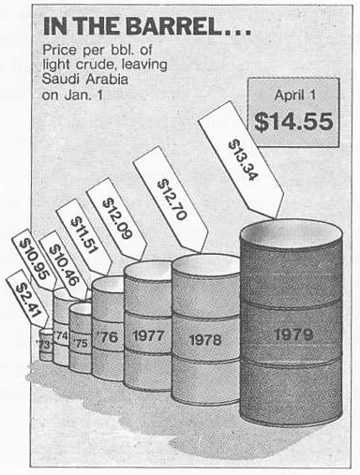
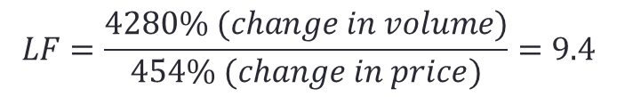
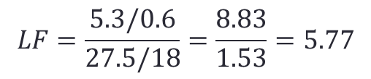
Examples of the “lie factor”
$$LF=\frac{5.3/0.6}{27.5/18}=\frac{8.83}{1.53}=5.77$$
Reprinted from Tufte (2009), p. 57 & p. 62
$$LF=\frac{4280\% (change in volume)}{454\% (change in price)}=9.4$$

Slide 16
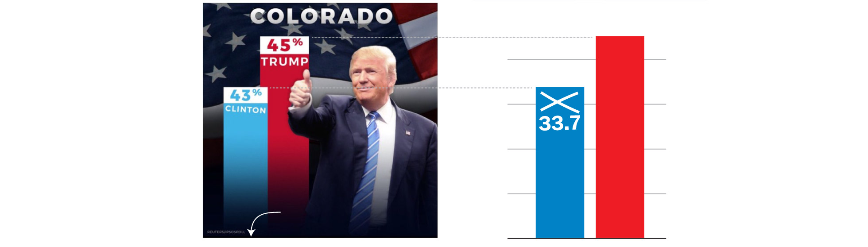
How is this deceptive?
The original graphic from President Trump’s tweet.
(Look at the y-axis)
https://www.washingtonpost.com/graphics/politics/2016-election/trump-charts/

Slide 17
How is this deceptive?
The original graphic from President Trump’s tweet.
(Look at the y-axis)
Does the scale match the numbers?
https://www.washingtonpost.com/graphics/politics/2016-election/trump-charts/

Slide 18
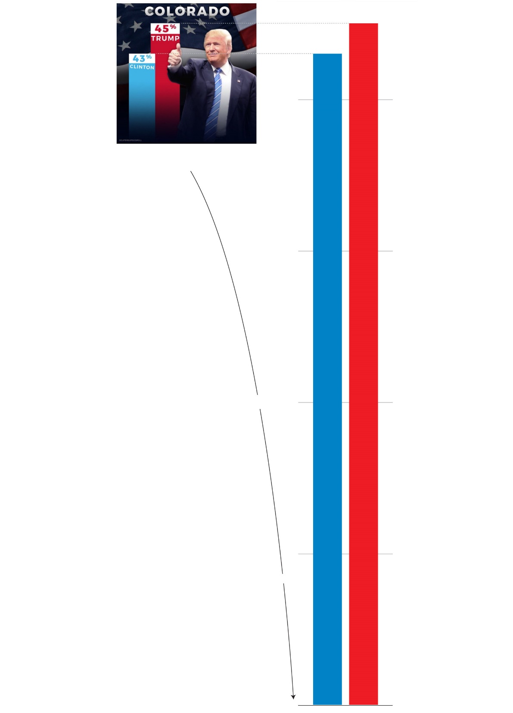
Where would the real baseline end up?
45
43
https://www.washingtonpost.com/graphics/politics/2016-election/trump-charts/

Slide 19
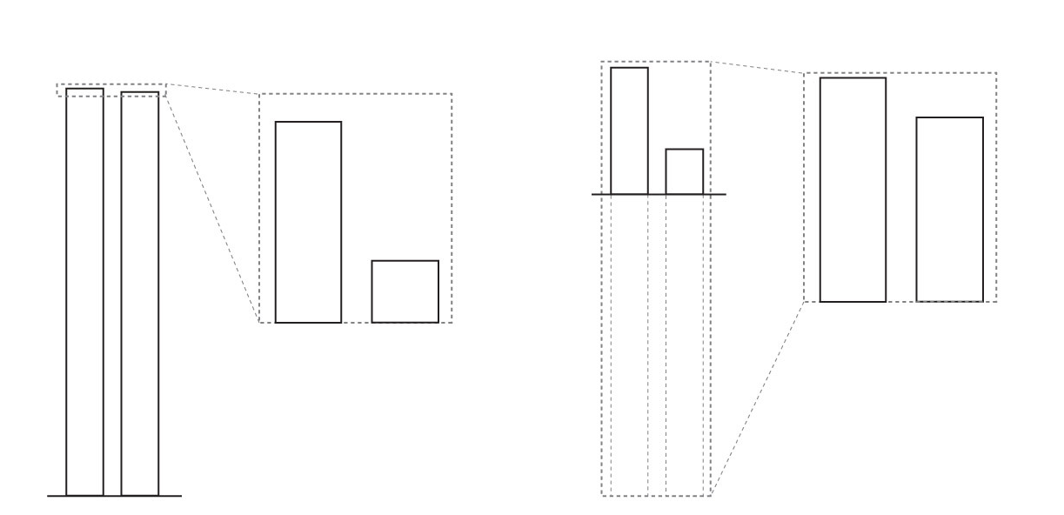
Exaggerated Effect
(LF>1)
Understated Effect
(LF<1)
A
A
A
B
A
B
B
B
https://www.washingtonpost.com/graphics/politics/2016-election/trump-charts/

Slide 20
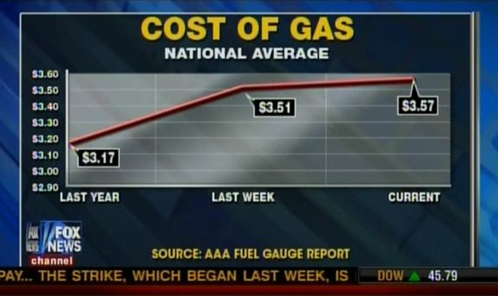
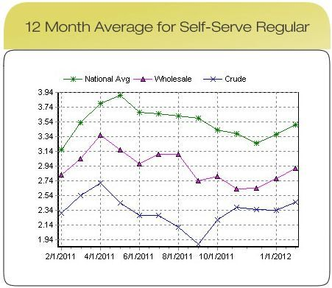
Present data in context
The original graphic from Fox News, Feb 2012.
In Reality…
http://mediamatters.org/research/2012/10/01/a-history-of-dishonest-fox-charts/190225

Slide 21
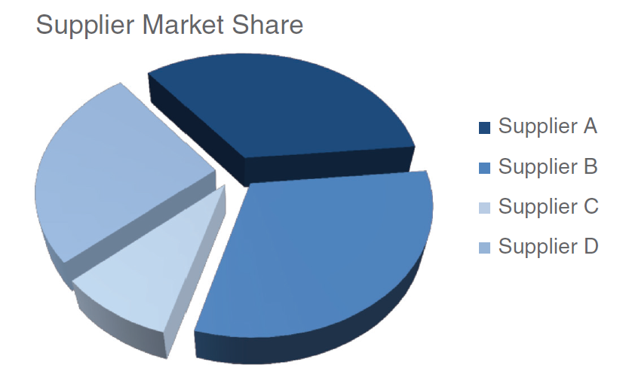
3D Pie Chart: which supplier is the largest?
Source: Knaflic (2015). Storytelling with Data: A Data Visualization Guide for Business Professionals. Chapter 2.

Slide 22
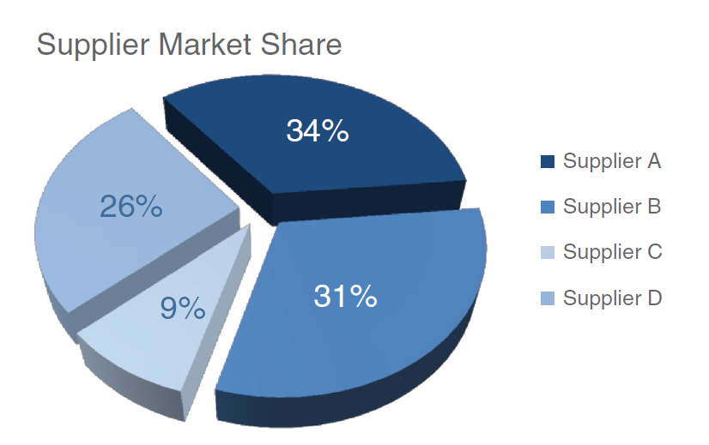
3D Pie Chart: which supplier is the largest?
Supplier B—which looks largest, at 31%—is actually smaller than Supplier A, at 34%!
Source: Knaflic (2015). Storytelling with Data: A Data Visualization Guide for Business Professionals. Chapter 2.

Slide 23
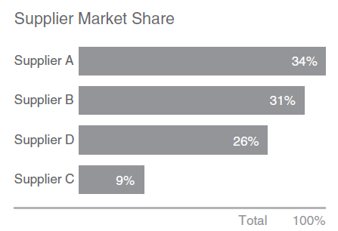
What can be used instead?

Slide 24
Principle 3: The chart should minimize graphical complexity
Generally, the simpler the better…
Key concepts
Data-ink
Sometimes a table is better
Chartjunk

Slide 25
Which one is better…?
For a few data points, a table can do just as well…
Salesperson | Total Sales
Peacock | $225,763.68
Leverling | $201,196.27
Davolio | $182,500.09
Fuller | $162,503.78
Callahan | $123,032.67
King | $116,962.99
Dodsworth | $75,048.04
Suyama | $72,527.63
Buchanan | $68,792.25
The table carries more information in less space
and is more precise.

Slide 26
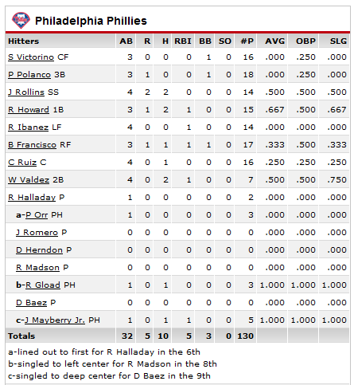
The Ultimate Table: The Box Score
Large amount of information in a very small space
So why does this work?
  Depends on the reader’s knowledge of the data

Slide 27

Data Ink
The amount of “ink” devoted to data in a chart
Tufte’s Data-Ink ratio:
  $Data−ink ratio=\frac{data−ink}{total ink used in graphic}$
Should be ~ 1
< 1 = more non-data related ink in graphic
= 1 implies all ink devoted to data
Tufte’s principle:
Erase ink whenever possible

Slide 28
Being conscious of data ink
Lower data-ink ratio
(worse)
Higher data-ink ratio
(better)

Slide 29
What makes a good chart?
Sometimes it’s really a matter of preference.
These both minimize data ink.
Why isn’t a table better here?

Slide 30
3-D Charts
Evaluate this from a data-ink perspective.
How does it affect the clarity of the chart?

Slide 31
One of the golden rules of data visualization is…..
Never use 3D!
Data Integrity/ Lie Factor
3D skews numbers, making them difficult to interpret or compare
Graphical Complexity
Adding 3D to graphs introduces unnecessary chart elements like side and floor panels
Source: Knaflic (2015). Storytelling with Data: A Data Visualization Guide for Business Professionals. Chapter 2.

Slide 32
Chartjunk: Data Ink “gone wild”
Unnecessary visual clutter that doesn’t provide additional insight
Distraction from the story the chart is supposed to convey
When the data-ink ratio is low, chartjunk is likely to be high

Slide 33
Example: Moiré effects (Tufte 2009)
Creates illusion of movement
Stands out, in a bad way

Slide 34
Example: The Grid
Why are these examples of chartjunk?
What could you do to remedy it?

Slide 35
Data Ink Working For Us
Evaluate this chart in terms of Data Ink.
Imagine this as a bar chart. As a table!!

Slide 36
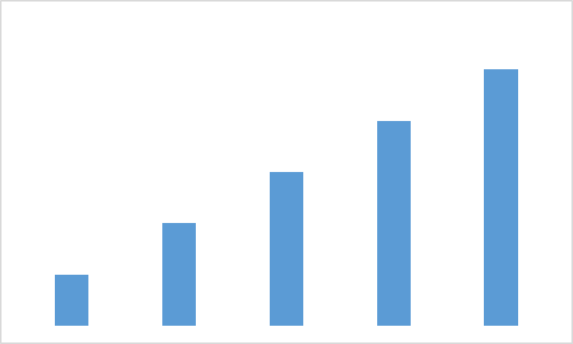
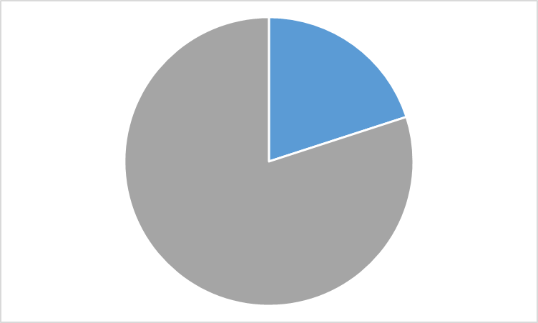
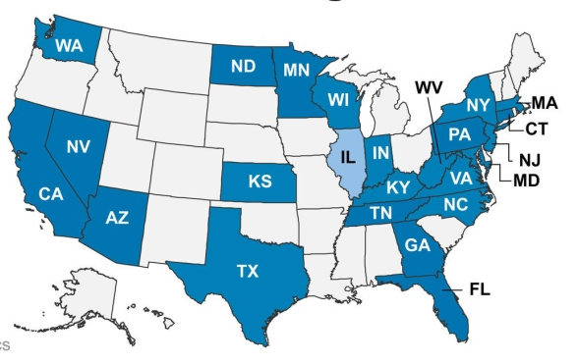
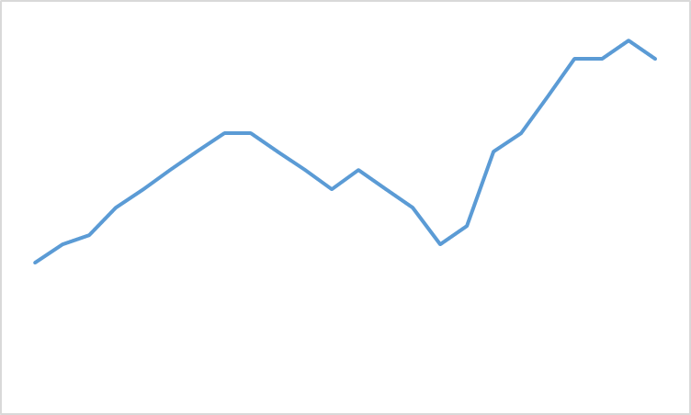
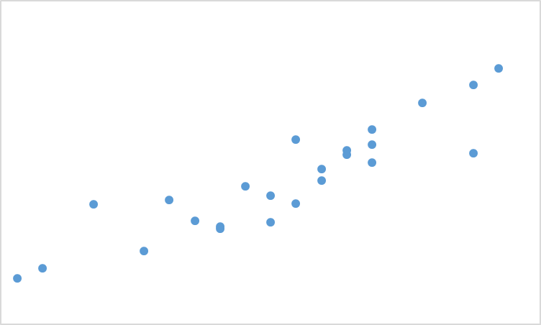
Common Chart Types
Bars
(For Comparison)
Pie
(For Composition)
Map
(For Spatial Comparison)
Line
(For Evolution)
Scatterplot
(Relationship)

Slide 37
Review: Data principles (adapted from Tufte 2009)
1
2
3
The chart should tell a story
The chart should have graphical integrity
The chart should minimize graphical complexity
Tufte’s fundamental principle:
Above all else show the data

Slide 38
In Class Activity #5

Slide 39
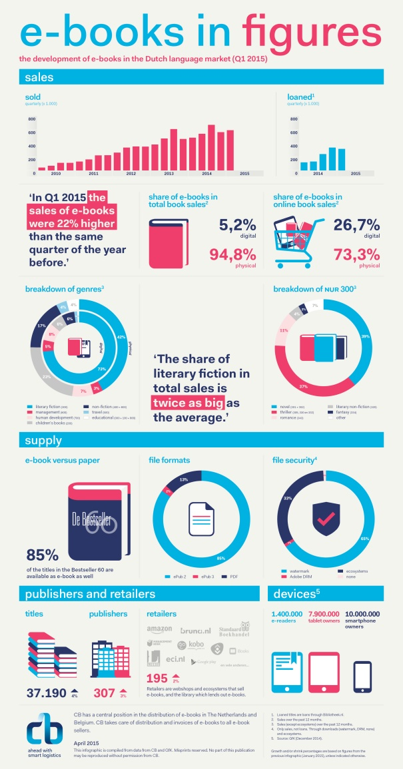
Infographics
i.e. Information graphics
Visualization of information, data or knowledge intended to present information quickly and clearly
We will have an ICA to create inforgraphics using Piktochart.
http://the-digital-reader.com/2015/04/13/infographic-ebooks-on-track-to-double-dutch-ebook-market-in-2014/

Slide 40
Some Visualization Tools
Excel (as always)
R, Stata, Tableau, SAS (useful for Statistical Plots).
Google Charts, FusionCharts (simple graphs as well as maps)
Piktochart (infographics)
Adobe Photoshop, Illustrator, etc (for graphical design)

Slide 41
Summary
Use data visualization principles to assess a visualization
  Tell a story
  Graphical integrity (lie factor)
  Minimize graphical complexity (data ink, chartjunk)
Explain how a visualization can be improved based on those principles
Types of visualization

