Slide 1
Exam 1 Review
MIS 2502, Spring 2020, Raven
This review does not include instructions and examples for SQL. For this, study the slide decks 4 and 5, and practice using the ICAs and assignments

Slide 2
Definition from Techopedia
“Data analytics
refers to qualitative and quantitative techniques and processes
used to enhance productivity and business gain.”

Slide 3
Course Overview
What this course is about
Introduce you to some fundamental and widely used concepts and techniques in data analytics
- designing and using database systems (e.g. SQL, NoSQL) and
- analyzing business data (e.g. Clustering, Classification)
- which have become part of today’s “business language”
Think about how you can use them in your future career
Expose you to various software tools (MySQL, R, Tableau Prep) to solve some problems using what you will learn.

Slide 4
Data versus information
Data
Information
Discrete, unorganized, raw facts
The transformation of those facts into meaning

Slide 5
Transactional versus analytical data
Transactional Database
Captures data describing an event
Analytical Data Store
Used in analysis and reporting
For everyday transactions
Extracted from transactional data
Supports management of an organization’s data
Supports managerial decision-making
Database: Software to manage the storage & retrieval of data
Data store: Generic; anywhere data is stored (i.e., a text file)

Slide 6

The Information Architecture of an Organization
Data entry
Transactional Database
Data extraction
Analytical Data Store
Data analysis
Stores real-time transactional data in a relational or NoSQL database
Stores historical transactional and summary data

Slide 7
The agenda for the course
Weeks 1 through 7
Weeks
8 through 9
Weeks 10 through 15
Data entry
Transactional Database
Analytical Data Store
Data analysis
Data extraction
Stores real-time transactional data in a relational or NoSQL database
Stores historical transactional and summary data
Data interpretation,
visualization, communication

Slide 8
The Transactional Database
Definition of Transaction
Examples of transactions
  Purchase a product
  Enroll in a course
  Hire an employee
In business, a transaction is the exchange of information, goods, or services.
For databases, a transaction is an action performed in a database management system.
Data is in real-time
  Reflects current state
  How things are “now”
Transactional databases deal with both: they store information about business transactions using database transactions

Slide 9
Relational Database (RDBMS)
The Relational Paradigm:
  How transactional data is collected and stored
Primary Goal: Minimize redundancy
  Reduce errors
  Less space required
Most database management systems are based on the relational paradigm
  MySQL, Oracle, Microsoft Access, SQL Server
?
Which of these do you think
is more important today

Slide 10
Relational Database
Student-Class enrollment Example
This is good because:
Information is entered and stored once
Minimizes redundancy

Slide 11
The Relational Database
Student-Class enrollment Example
A series of tables with logical associations between them
The associations (relationships) allow the data to be combined
Student
StudentID
Name
Major
GPA
Student-Class
StudentClassID
StudentID
ClassID
Class
ClassID
Name

Slide 12
NoSQL Database
Stands for “Not only SQL”
  Supports unstructured data
Primary Goal: flexibility and scalability
  schema-less and nested data
  Less space required
Better fit for Digital Economy requirements
  Facebook, Airbnb, Netflix, LinkedIn, …
?

Slide 13
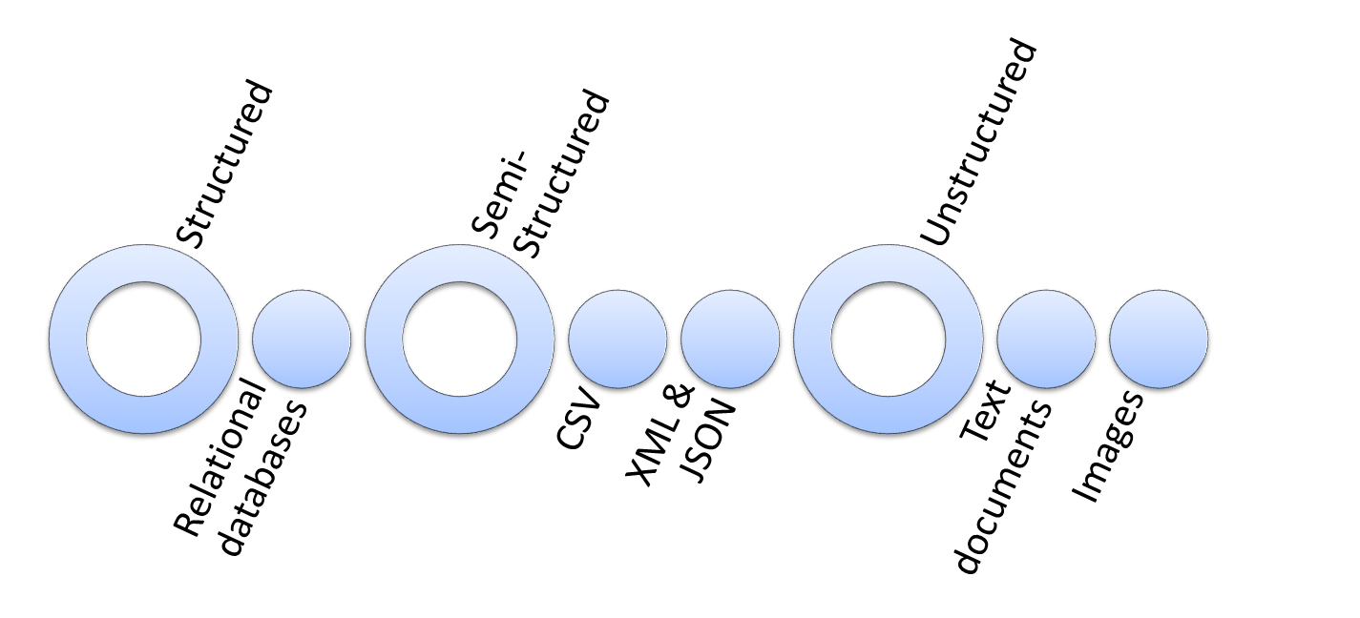
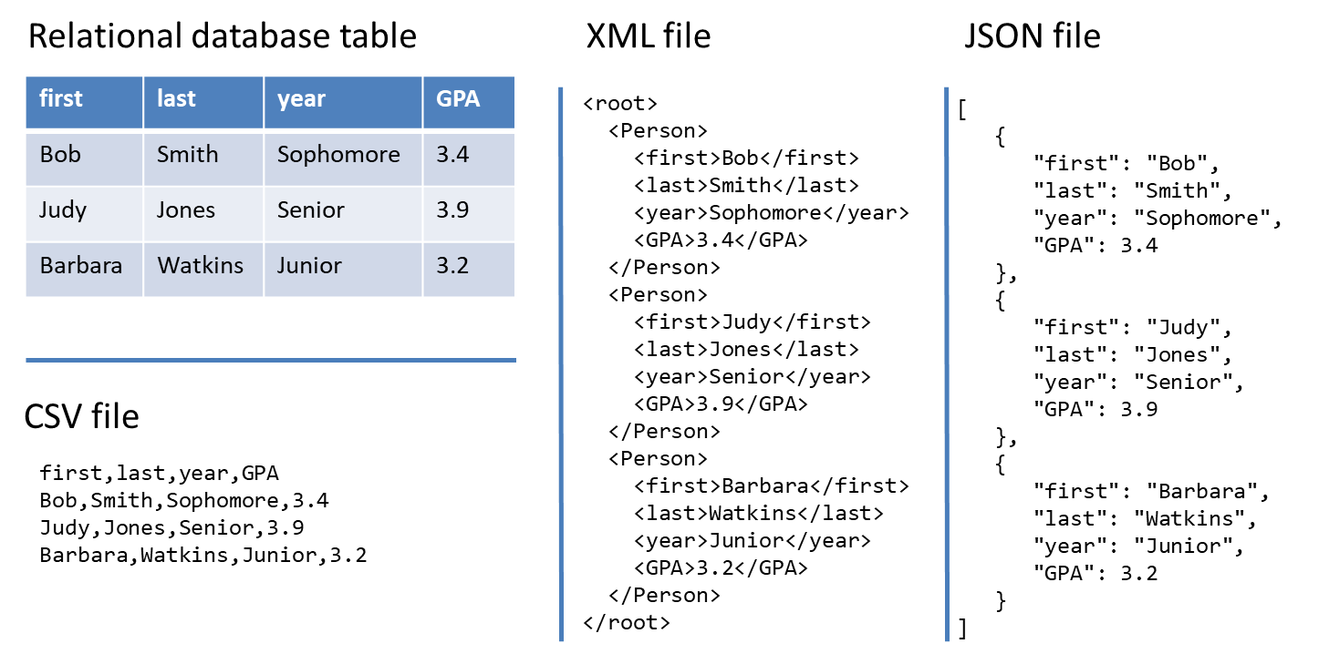
From structured to unstructured data

Slide 14
The Analytical Data Store
Stores historical and summarized data
  “Historical” means we keep everything
Data is extracted from the transactional database and reformatted for the analytical data store
Extract
Transform
Load
Transactional Database
Data conversion
Analytical Data Store
Query
Query
We’ll discuss this in much more detail later in the course!!

Slide 15
Comparing Transactional and Analytical Data Stores
Transactional Database | Analytical Data Store
Storage of real-time transactional data | Storage of historical transactional data
Optimized for storage efficiency and data integrity | Optimized for data retrieval and summarization
Supports day-to-day operations | Supports periodic and on-demand analysis

Slide 16
What is a Database Schema?
A Database Schema is
  A map of the tables and fields in the database
  This is what is implemented in the database management system
  Part of the “design” process
A database schema allows us to understand
  Entities in a database
  Attributes in a database
  Relationships between entities

Slide 17
Understanding Database Schema
Table Name
(Entity)
Table
Customer
CustomerID
FirstName
LastName
City
State
Zip
Order
OrderNumber
CustomerID
OrderDate
Primary Key
Foreign
Key
Field
(Attributes
of the
Entity)
Cardinality

Slide 18
Entity and Attribute
Table Name
(Entity)
Customer
CustomerID
FirstName
LastName
City
State
Zip
Entity represents an object/construct we want to manage
Attribute is a characteristic of an entity (or relationship)
Fields
(Attributes)
This depicts a Customer table with 6 columns.
CustomerID | FirstName | LastName | City | State | Zip
1001 | Greg | House | Princeton | NJ | 09120
1002 | Lisa | Cuddy | Plainsboro | NJ | 09123
1003 | James | Wilson | Pittsgrove | NJ | 09121
1004 | Eric | Foreman | Warminster | PA | 19111

Slide 19
Primary Key
Customer
CustomerID
FirstName
LastName
City
State
Zip
Entities need to be uniquely identifiable
  So you can tell them apart
Use a primary key
  One or more attributes that
  uniquely identifies an entity
Primary Key
How about these as primary keys for Customer:
First name and/or last name?
Social security number?
This depicts a Customer table with 6 columns.
CustomerID | FirstName | LastName | City | State | Zip
1001 | Greg | House | Princeton | NJ | 09120
1002 | Lisa | Cuddy | Plainsboro | NJ | 09123
1003 | James | Wilson | Pittsgrove | NJ | 09121
1004 | Eric | Foreman | Warminster | PA | 19111

Slide 20
Cardinality
Cardinality describes the rules of the association (relationship) between entities
  There are many ways of denoting cardinality, but we will use crows feet notation.
Customer
CustomerID
FirstName
LastName
City
State
Zip
Order
OrderNumber
CustomerID
OrderDate
Cardinality

Slide 21
Cardinality
Maximum
Cardinality
Customer
CustomerID
FirstName
LastName
City
State
Zip
Order
OrderNumber
CustomerID
OrderDate
Minimum
Cardinality
Maximum cardinality
  Describes the maximum number of entities that participate in a relationship (either or )
Minimum cardinality
  Describes the minimum number of entities that participate in a relationship (either or )

Slide 22
Maximum Cardinality
How to understand the notations:
at most - one
at most - many
Customer
CustomerID
FirstName
LastName
City
State
Zip
Order
OrderNumber
CustomerID
OrderDate
  One customer can have many orders.
  One order can only belong to one customer.

Slide 23
Minimum Cardinality
How to understand the notations:
at least - one
at least - zero
Customer
CustomerID
FirstName
LastName
City
State
Zip
Order
OrderNumber
CustomerID
OrderDate
  One customer can have no (zero) orders.
  One order has to belong to at least one customer.

Slide 24
Minimum Cardinality
Minimums are generally stated as either zero or one:
  0 (optional): participation in the relationship by the entity is optional.
  1 (mandatory): participation in the relationship by the entity is mandatory.
A programmer is mandatory for a certificate); or a certificate has to be issued to (at least) one programmer.
A certificate is optional for a programmer; or a programmer may not have any certificates
Programmer
Certificate
1:m maximum cardinality: a programmer
can have many certificates; a certificate is issued to (at most) one programmer
Notes:
When checking the requirement statement, you should check for the cardinality
If none, then you should make an assumption and own judement which may make more sense.
In many cases, regarding maximum cardinality there is an right and wrong answer.

Slide 25
One-to-One Relationship
One-to-One (1:1)
  A single instance of one entity is related to a single instance of another entity
Governor
State
A state has (at most) one governor
A governor governs (at most) one state

Slide 26
One-to-Many Relationship
One-to-Many (1:n or 1:m)
  A single instance of one entity is related to multiple instances of another entity
Publisher
Book
A publisher can publish many books
A book is published by (at most) one publisher

Slide 27
Many-to-Many Relationship
Many-to-Many (n:n or m:m)
  Each instance of one entity is related to multiple instances of another entity, and vice versa
Book
Author
A book can be written by many authors
An author can write many books

Slide 28
The Rules
1. Define entities and attributes and the relationship between entities
2. Create a table for every entity and table fields for every entity’s attributes
3. Implement relationships between the tables
1:1 relationships
  Put primary key field of one table into other table as foreign key field
1:many relationships
  Primary key field of “1” table put into “many” table as foreign key field
many:many relationships
  Create new table
  1:many relationships with original tables

Slide 29
Create Tables and Fields
Entity | Attribute
Customer | CustomerID, FirstName, LastName, City, State, Zip
Membership | MembershipID, Level, Points
Order | OrderNumber, OrderDate
Product | ProductID, ProductName, Price
Other attributes | Quantity (Attribute of both order and product)
Customer
CustomerID
FirstName
LastName
City
State
Zip
Membership
MembershipID
Level
Points
Order
OrderNumber
OrderDate
Product
ProductID
ProductName
Price

Slide 30
The Customer and Order Tables:
The m:m Relationship
many:many relationships
  Create new table
  1:many relationships with original tables
Order
OrderNumber
OrderDate
OrderProduct
OrderProductID
OrderNumber
ProductID
Quantity
Product
ProductID
ProductName
Price

Slide 31
Now the many:many relationship
Order Table
OrderProduct Table
Order Number | OrderDate | Customer ID
101 | 3-2-2011 | 1001
102 | 3-3-2011 | 1002
103 | 3-4-2011 | 1001
104 | 3-6-2011 | 1004
Order ProductID | Order number | Product ID | Quantity
1 | 101 | 2251 | 2
2 | 101 | 2282 | 3
3 | 101 | 2505 | 1
4 | 102 | 2251 | 5
5 | 102 | 2282 | 2
6 | 103 | 2505 | 3
7 | 104 | 2505 | 8
8 | 101 | 2684 | 2
9 | 104 | 2282 | 3
10 | 104 | 2700 | 2
Product Table
ProductID | ProductName | Price
2251 | Cheerios | 3.99
2282 | Bananas | 1.29
2505 | Eggo Waffles | 2.99
2684 | French Toast | 3.99
2700 | Granola Bars | 2.99
This table relates Order and Product to each other!

Slide 32
To figure out what each order contains
Match the Product IDs and Order IDs of the tables, starting with the table with the foreign keys (Order-Product):
OrderProduct Table
Order Table
Product Table
Order ProductID | Order Number | Product ID | Quantity | Order Number | Order Date | Customer ID | Product ID | Product Name | Price
1 | 101 | 2251 | 2 | 101 | 3-2-2011 | 1001 | 2251 | Cheerios | 3.99
2 | 101 | 2282 | 3 | 101 | 3-2-2011 | 1001 | 2282 | Bananas | 1.29
3 | 101 | 2505 | 1 | 101 | 3-2-2011 | 1001 | 2505 | Eggo Waffles | 2.99
4 | 102 | 2251 | 5 | 102 | 3-3-2011 | 1002 | 2251 | Cheerios | 3.99
5 | 102 | 2282 | 2 | 102 | 3-3-2011 | 1002 | 2282 | Bananas | 1.29
6 | 103 | 2505 | 3 | 103 | 3-4-2011 | 1001 | 2505 | Eggo Waffles | 2.99
7 | 104 | 2505 | 8 | 104 | 3-6-2011 | 1004 | 2505 | Eggo Waffles | 2.99
So which customers ordered Eggo Waffles (by their Customer IDs)?

Slide 33
This is a join
Order-Product Table
Order Table
Product Table
Order ProductID | Order Number | Product ID | Quantity | Order Number | Order Date | Customer ID | Product ID | Product Name | Price
1 | 101 | 2251 | 2 | 101 | 3-2-2011 | 1001 | 2251 | Cheerios | 3.99
2 | 101 | 2282 | 3 | 101 | 3-2-2011 | 1001 | 2282 | Bananas | 1.29
The ProductIDs match!
The
OrderNumbers match!
Keep in mind…
The field names don’t have to match (i.e., OrderNumber)
But they have to represent the same thing
This is “denormalized” data (it repeats)

Slide 34
Relationship attribute
OrderProduct Table
quantity is a relationship attribute because the value of the quantity is determined by more than one attribute
In other words, quantity describes the combination of both order and product
Order ProductID | Order number | Product ID | Quantity
1 | 101 | 2251 | 2
2 | 101 | 2282 | 3
3 | 101 | 2505 | 1
4 | 102 | 2251 | 5
5 | 102 | 2282 | 2
6 | 103 | 2505 | 3
7 | 104 | 2505 | 8
8 | 101 | 2684 | 2
9 | 104 | 2282 | 3
10 | 104 | 2700 | 2
We add relationship attribute into the new table we created

Slide 35
Our Order Database schema
Customer
CustomerID
FirstName
LastName
City
State
Zip
Order
OrderNumber
CustomerID
OrderDate
OrderProduct
OrderProductID
OrderNumber
ProductID
Quantity
Product
ProductID
ProductName
Price
Membership
MembershipID
CustomerID
Level
Points

Slide 36
A few notes on SQL
For the exam:
Practice, practice, practice, practice, practice, practice, practice, practice, practice, practice, practice, practice, practice, practice, practice, practice, practice, practice, practice, practice, practice, practice, practice, practice, practice, practice, practice, practice, practice, practice, practice, practice, practice, practice, practice, practice, practice, practice, practice, practice, practice, practice, practice, practice, practice, practice, practice, practice, practice, practice, practice, practice, practice, practice, practice, practice, practice, practice, practice, practice, practice, practice, practice, practice, practice, practice, practice, practice, practice, practice, practice, practice, practice, practice, practice, practice, practice, practice. Then practice some more.

Slide 37
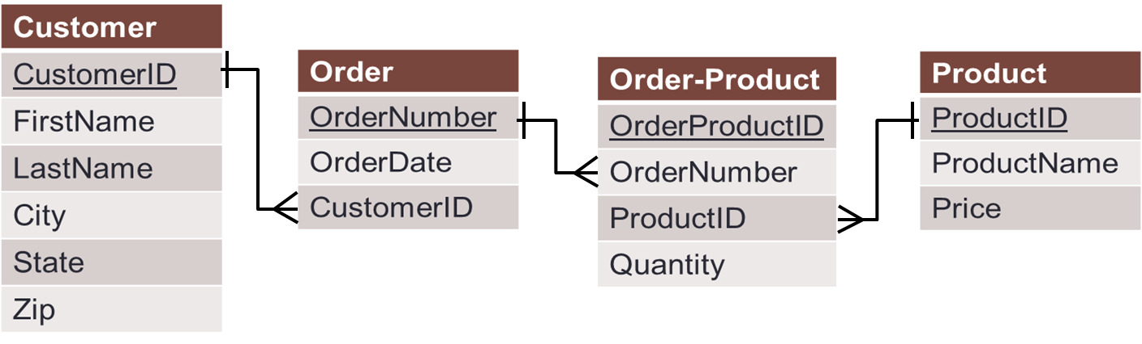
What do we want to do?
Database Management System
Get information out of the database (retrieve)
Put information into the database (modify/change)

Slide 38
To do this we use SQL
Structured Query Language (SQL)
A high-level set of statements (commands) that let you communicate with the database
With SQL, you can
  Retrieve records
  Join (combine) tables
  Insert records
  Delete records
  Update records
  Add and delete tables
A statement is any SQL command that interacts with a database.
A SQL statement that retrieves information is referred to as a query.
We will be doing this.
Notes:
Why learn language? Japanese?
Similar learning a new language
Words → keyword grammar → syntax
SQL is made up of series of commands called statement / statement interact with a database
We call a statement that retrieves an information from database a query.

Slide 39
Some points about SQL
It’s not a true programming language
It is used by programming languages to interact with databases
There is no standard syntax
MySQL, Oracle, SQL Server, and Access all have slight differences
There are a lot of statements and variations among them
We will be covering the basics, and the most important ones
A great online reference for SQL syntax:
http://www.w3schools.com/sql

Slide 40
Back quotes for reserved words
When the table/column name is a reserved word:
SELECT * FROM orderdb.`Order`;
Order is a reserved word in SQL. It is a command.
  As in “ORDER BY”
The back quotes tell MySQL to treat `Order` as a database object and not a command.
For a list of reserved words in MySQL, go to:
http://dev.mysql.com/doc/refman/5.1/en/reserved-words.html

Slide 41
Summary: The full syntax for SELECT
SELECT [DISTINCT] expression(s)
FROM schema_name.table_name(s)
[WHERE condition(s)]
[GROUP BY expression(s)]
[ORDER BY expression(s) [ ASC | DESC ]]
[LIMIT number_rows];
The [] means the element is optional
Element | Description
expression(s) | The column(s) or function(s) that you wish to retrieve.
schema_name.table_name(s) | The table(s) that you wish to retrieve records from.
DISTINCT | Optional. Return unique values.
WHERE condition(s) | Optional. The conditions that must be met for the records to be selected.
GROUP BY expression(s) | Optional. Organize the results by column values.
ORDER BY expression(s) | Optional. Sort the records in your result set
LIMIT number_rows | Optional. Restrict the maximum number of records to retrieve.

Slide 42
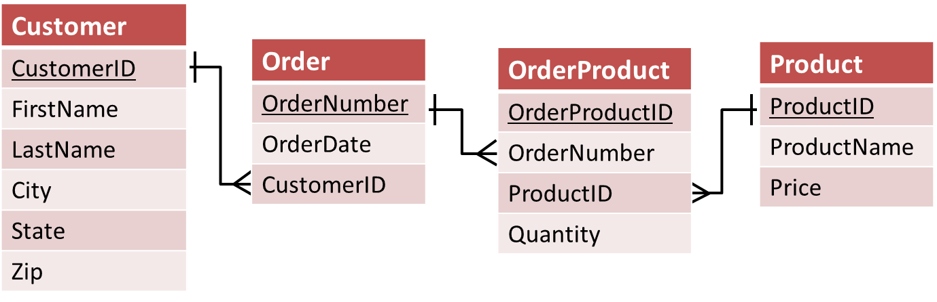
Querying multiple tables
Right now, you can answer with data from a single table
What if you need to combine two (or more) tables?
  For example, what if we want to find out the orders a customer placed?

Slide 43
How to do it?
We need information from Customer and Product (and OrderProduct)
To associate Customer table with Product table, we need to follow the path from Customer to Product

Slide 44
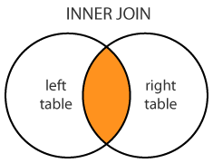
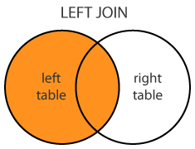
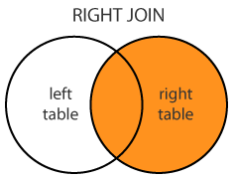
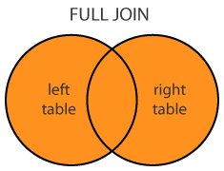
Outer Join
We need another operator
  for the item that have a match, it behaves like a Join,
  but for the items that have NO MATCH, it appends the record with NULLs
The operators with these properties are called outer joins. (There are several of them)
The operators that we studied already are also called inner joins (To distinguish them from outer joins)
reference: www.dofactory.com/sql/join

Slide 45
Where MIN() alone fails us…
SELECT MIN(price)
FROM orderdb.Product;
BUT
SELECT MIN(price),ProductName
FROM orderdb.Product;
Price
1.29
Price | ProductName
1.29 | Cheerios
Wait…. Cheerios’ price should be 3.99.
So what’s going on??

Slide 46
What’s wrong…
SELECT MIN(price),ProductName
FROM orderdb.Product;
It returns the MIN(price): $1.29
MIN() will always return only one row
So for ProductName, it chooses the first row in the Product column, i.e., Cheerios
Price | ProductName
1.29 | Cheerios
And it will do this for any function (AVG, SUM, etc.)

Slide 47
So we need a SQL subselect statement
It’s where you have a SELECT statement nested inside another SELECT statement!
SELECT Price,ProductName
FROM orderdb.Product
WHERE Price=
(SELECT MIN(Price) FROM orderdb.Product);
Now you get all records back with that (lowest) price and avoid the quirk of the MIN() function.
This is a temporary table from the database with one column and one row.

Slide 48
How would SQL execute this query?
SELECT Price,ProductName
FROM orderdb.Product
WHERE Price=
(SELECT MIN(Price) FROM orderdb.Product);
SELECT MIN(Price)
FROM orderdb.Product
Step 1: Execute what is in the parentheses to find the lowest price
Step 2: Plug the lowest price into the main query, and execute the main query
MIN(Price)
1.29
SELECT Price,ProductName
FROM orderdb.Product
WHERE Price=1.29;
Price | ProductName
1.29 | Bananas

Slide 49
Summary
Given a schema of a database, we now should be able to create a SQL statement (query) to answer a question
Understand how to use
  SELECT … FROM …
  DISTINCT
  WHERE (and how to specify conditions)
  AND/OR
  ORDER BY (ASC/DESC)
  Functions: COUNT, AVG, MIN, MAX, SUM
  GROUP BY
  LIMIT
  Joins (and differences between inner/outer join)
  Subselects

Slide 50
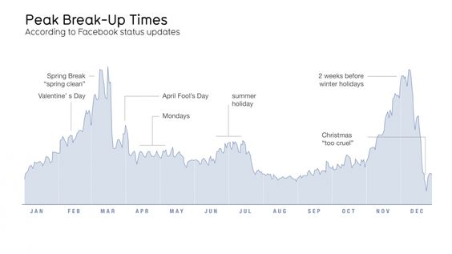
Why data visualization?
“Quite simply, humans are amazing pattern-recognition machines. They
have the ability to recognize many different types of patterns - and then
transform
these
‘recursive
probabalistic
fractals’
into
concrete,
actionable steps.” –Dominic Basulto
Ref. https://www.ted.com/talks/david_mccandless_the_beauty_of_data_visualization

Slide 51
Data visualization can:
Provide clear understanding of patterns in data
Detect hidden structures in data
Condense information

Slide 52
Some basic principles (adapted from Tufte 2009)
1
2
3
The chart should tell a story
The chart should have graphical integrity
The chart should minimize graphical complexity
Tufte’s fundamental principle:
Above all else show the data

Slide 53
Principle 1: The chart should tell a story
Graphics should be clear on their own
The chart should yield insight beyond the text
“If the statistics are boring, then you’ve got the wrong numbers.” (Tufte 2009)
The depictions should enable meaningful comparison

Slide 54

Principle 2: The chart should have graphical integrity
Basically, it shouldn’t “lie” (mislead the reader)
Tufte’s “Lie Factor”:
  $Lie Factor=\frac{size of effect shown in graphic }{size of effect in data}$
Should be ~ 1
> 1 = exaggerated effect
< 1 = understated effect

Slide 55
Principle 3: The chart should minimize graphical complexity
Generally, the simpler the better…
Key concepts
Data-ink
Sometimes a table is better
Chartjunk

Slide 56

Data Ink
The amount of “ink” devoted to data in a chart
Tufte’s Data-Ink ratio:
  $Data−ink ratio=\frac{data−ink}{total ink used in graphic}$
Should be ~ 1
< 1 = more non-data related ink in graphic
= 1 implies all ink devoted to data
Tufte’s principle:
Erase ink whenever possible

Slide 57
One of the golden rules of data visualization is…..
Never use 3D!
Data Integrity/ Lie Factor
3D skews numbers, making them difficult to interpret or compare
Graphical Complexity
Adding 3D to graphs introduces unnecessary chart elements like side and floor panels
Source: Knaflic (2015). Storytelling with Data: A Data Visualization Guide for Business Professionals. Chapter 2.

Slide 58
Chartjunk: Data Ink “gone wild”
Unnecessary visual clutter that doesn’t provide additional insight
Distraction from the story the chart is supposed to convey
When the data-ink ratio is low, chartjunk is likely to be high

Slide 59
Example: Moiré effects (Tufte 2009)
Creates illusion of movement
Stands out, in a bad way

