Slide 1
Introduction to Advanced Analytics and R
MIS2502: Data Analytics
JaeHwuen Jung
jaejung@temple.edu
http://community.mis.temple.edu/jaejung

Slide 2

The Information Architecture of an Organization
Now we’re here…
Data entry
Transactional Database
Data extraction
Analytical Data Store
Data analysis
Stores real-time transactional data in a relational or NoSQL database
Stores historical transactional and summary data

Slide 3
What is Advanced Data Analytics?
The examination of data or content using sophisticated techniques and tools, to discover deeper insights, make predictions, or generate recommendations.
Goals:
Extraction of implicit, previously unknown, and potentially useful information from data
Exploration and analysis of large data sets to discover meaningful patterns
Prediction of future events based on historical data

Slide 4
What advanced data analytics is not…
Sales analysis
How do sales compare in two different stores in the same state?
Profitability analysis
Which product lines are the highest revenue producers this year?
Sales force analysis
Did salesperson X meet this quarter’s target?

Slide 5
Advanced data analytics is about…
Sales analysis
Why do sales differ in two stores in the same state?
Profitability analysis
Which product lines will be the highest revenue producers next year?
Sales force analysis
How much likely will the salesperson X meet next quarter’s target?

Slide 6
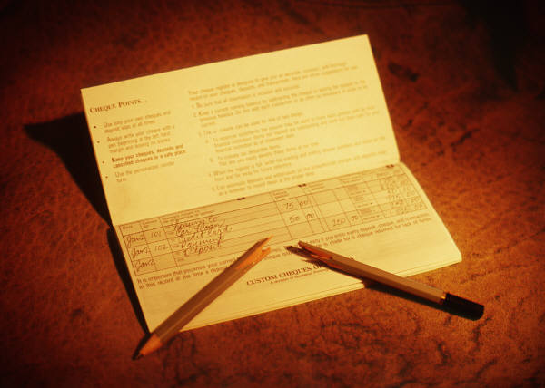
Example: Smarter Customer Retention
Consider a marketing manager for a brokerage
company
Problem: High churn (customers leave)
  Customers get an average reward of $150 to open an account
  40% of customers leave after the 6 month introductory period
  Getting a customer back after they leave is expensive
  Giving incentives to everyone who might leave is expensive

Slide 7

Answer: Not all customers have the same value
One month before the end of the introductory period, predict which customers will leave
Offer those customers something based on their future value
Ignore the ones that are not predicted to churn

Slide 8
Three Analytics Tasks We Will Be Doing in this Class
Decision Trees
Clustering
Association Rule Mining

Slide 9
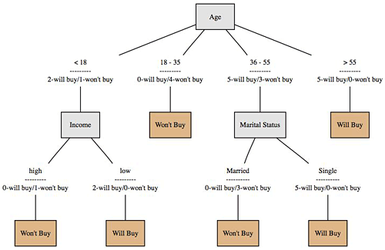
Decision Trees
Used to classify data
according to a
pre-defined outcome
Based on characteristics
of that data
Can be used to predict future outcomes
http://www.mindtoss.com/2010/01/25/five-second-rule-decision-chart/
Uses
Predict whether a customer should receive a loan
Flag a credit card charge as legitimate
Determine whether an investment will pay off

Slide 10
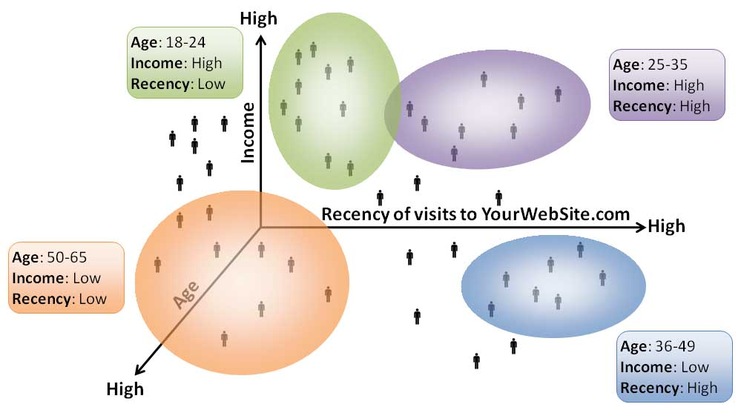
Clustering
Used to determine distinct groups of data
Based on data across multiple dimensions
Uses
Customer segmentation
Identifying patient care groups
Performance of business sectors
http://www.datadrivesmedia.com/two-ways-performance-increases-targeting-precision-and-response-rates/

Slide 11

Association Rule Mining
Find out which events predict the occurrence of other events
Often used to see which products are bought together
Uses
What products are bought together?
Amazon’s recommendation engine
Telephone calling patterns

Slide 12


Now we will start using R and RStudio heavily in class activities and assignments
R/RStudio has become one of the dominant software environments for data analysis
And has a large user community that contribute functionality
Make sure you download both on your computer!

Slide 13
Software development platform and programming language
Open source, free
Many, many, many statistical add-on “packages” that perform data analysis
Integrated Development Environment for R
Nicer interface that makes R easier to use
Requires R to run
(The base/engine)
(The pretty face)
If you have both installed, you only need to interact with Rstudio
Mostly, you do not need to touch R directly

Slide 14
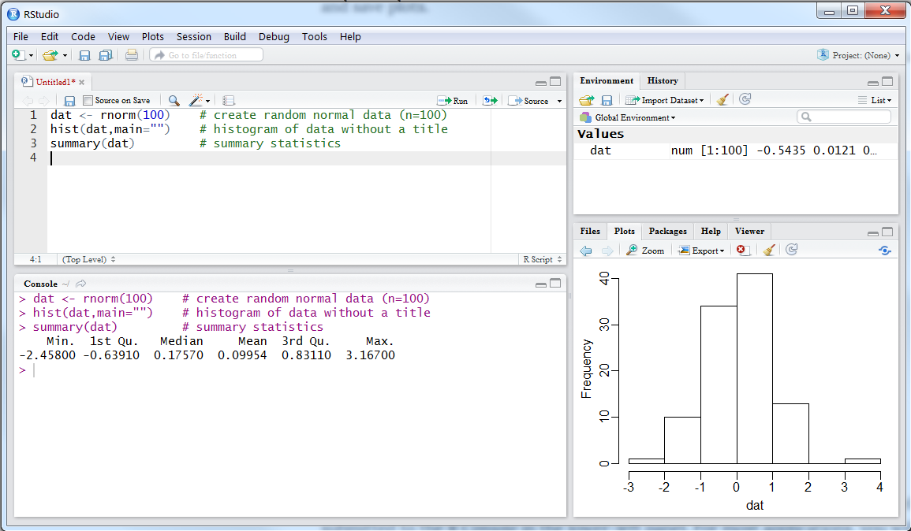
RStudio Interface
3) Environment panel
1) Script Panel
4) Utility panel
2) Console Panel

Slide 15
RStudio Interface
1) Script Panel
This is where the R code is shown and edited
When you open a R code file, its content shows up here
2) Console Panel
This is where R code is executed Results will show up here
If there is error with your code, the error message will also show up here
3) Environment Panel
This is where the variables and data are displayed
It helps to keep track of the variables and data you have
4) Utility Panel
This window includes several tabs
Files: shows the path to your current file, not often used
Plots: if you use R to plot a graph, it will show up here
Packages: install/import packages, more on this later
Help: manuals and documentations to every R functions, very useful

Slide 16
Creating and opening a .R file
The R script is where you keep a record of your work in R/RStudio.
To create a .R file
  Click “File|New File|R Script” in the menu
To save the .R file
  click “File|Save”
To open an existing .R file
  click “File|Open File” to browse for the .R file

Slide 17
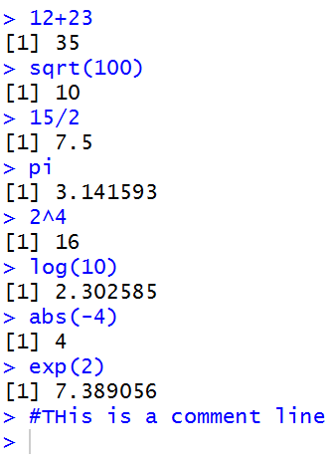
The Basics: Calculations
In its simplest form, R can be used as a calculator:
Type commands into the console and it will give you an answer

Slide 18
The Basics: Functions
sqrt(), log(), abs(), and exp() are functions.
Functions accept parameters (in parentheses) and return a value

Slide 19
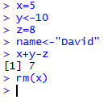
The Basics: Variables
  Variables are named containers for data
  The assignment operator in R is:
  <- or =
  Variable names can start with a letter or digits.
    Just not a number by itself.
    Examples: result, x1, 2b (not 2)
  R is case-sensitive (i.e. Result is a different variable than result)
<- and = do the same thing
rm() removes the variable from memory
x, y, and z are variables that can be manipulated

Slide 20
Basic Data Types
Type | Range | Assign a Value
Numeric | Numbers | X <-1 Y <- -2.5
Character | Text strings | name<-"Mark" color<-"red"
Logical (Boolean) | TRUE or FALSE | female<-TRUE

Slide 21
Advanced Data Types
Vectors
Data frames

Slide 22
Vectors of Values
A vector is a sequence of data elements of the same basic type.
> scores<-c(65,75,80,88,82,99,100,100,50)
> scores
[1] 65 75 80 88 82 99 100 100 50
> studentnum<-1:9
> studentnum
[1] 1 2 3 4 5 6 7 8 9
> ones<-rep(1,4)
> ones
[1] 1 1 1 1
> names<-c("Nikita","Dexter","Sherlock")
> names
[1] "Nikita" "Dexter" "Sherlock"
c() and rep() are functions

Slide 23
Indexing Vectors
We use brackets [ ] to pick specific elements in the vector.
In R, the index of the first element is 1
> scores
[1] 65 75 80 88 82 99 100 100 50
> scores[1]
[1] 65
> scores[2:3]
[1] 75 80
> scores[c(1,4)]
[1] 65 88

Slide 24
Simple statistics with R
You can get descriptive statistics from a vector
> scores
[1] 65 75 80 88 82 99 100 100 50
> length(scores)
[1] 9
> min(scores)
[1] 50
> max(scores)
[1] 100
> mean(scores)
[1] 82.11111
> median(scores)
[1] 82
> sd(scores)
[1] 17.09857
> var(scores)
[1] 292.3611
> summary(scores)
Min. 1st Qu. Median Mean 3rd Qu. Max.
50.00 75.00 82.00 82.11 99.00 100.00
Again, length(), min(), max(), mean(), median(), sd(), var() and summary() are all functions.
These functions accept vectors as parameter.

Slide 25
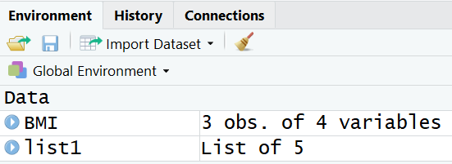
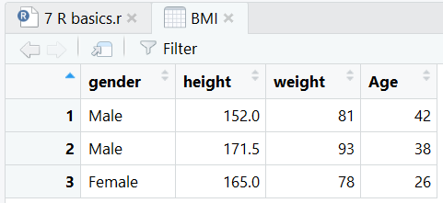
Data Frames
A data frame is a type of variable used for storing data tables
  is a special type of list where every element of the list has same length (i.e. data frame is a “rectangular” list)
> BMI<-data.frame(
+ gender = c("Male","Male","Female"),
+ height = c(152,171.5,165),
+ weight = c(81,93,78),
+ Age = c(42,38,26)
+ )
> BMI
gender height weight Age
1 Male 152.0 81 42
2 Male 171.5 93 38
3 Female 165.0 78 26
> nrow(BMI)
[1] 3
> ncol(BMI)
[1] 4

Slide 26
Identify elements of a data frame
To retrieving cell values
> BMI[1,3]
[1] 81
> BMI[1,]
gender height weight Age
1 Male 152 81 42
> BMI[,3]
[1] 81 93 78
More ways to retrieve columns as vectors
> BMI[[2]]
[1] 152.0 171.5 165.0
> BMI$height
[1] 152.0 171.5 165.0
> BMI[["height“]]
[1] 152.0 171.5 165.0

Slide 27
Packages
Packages (add-ons) are collections of R functions and code in a well-defined format.
To install a package:
  install.packages("pysch")
For every new R session (i.e., every time you re-open Rstudio), you must load the package before it can be used
    library(psych)
  or
    require(psych)
Each package only needs to be installed once

Slide 28
Import Data into R
R can handle all kinds of data files. We will mostly deal with csv files
Use read.csv() function to import csv data
  You need to specify path to the data file
  By default, comma is used as field delimiter
  First row is used as variable names
  You can simply do this by
  Download source file and csv file into the same folder (i.e., C:\RFiles).
  Set that folder as working directory by assigning source file location as working directory

Slide 29
Working directory
The working directory is where Rstudio will look first for scripts and files
Keeping everything in a self contained directory helps organize code and analyses
Check you current working directory with
  getwd()

Slide 30
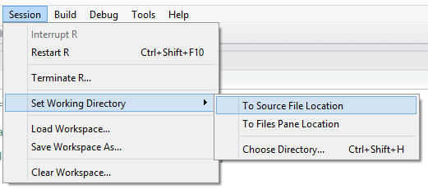
To change working directory
Use the Session | Set Working Directory Menu
  If you already have an .R file open, you can select “Set Working Directory>To Source File Location”.

Slide 31
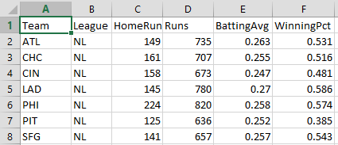
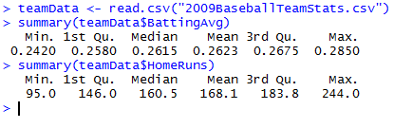
Reading data from a file
Usually you won’t type in data manually, you’ll get it from a file
Example: 2009 Baseball Statistics
(http://www2.stetson.edu/~jrasp/data.htm)
reads data from a CSV file and creates a data frame called teamData that store the data table.
reference the HomeRuns column in the data frame using TeamData$HomeRuns

Slide 32
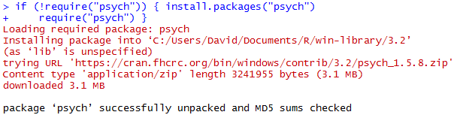
Looking for differences across groups:
The setup
We want to know if National League (NL) teams scored more runs than American League (AL) Teams
  And if that difference is statistically significant
To do this, we need a package that will do this analysis
  In this case, it’s the “psych” package
Downloads and installs the package
(once per R installation)

Slide 33
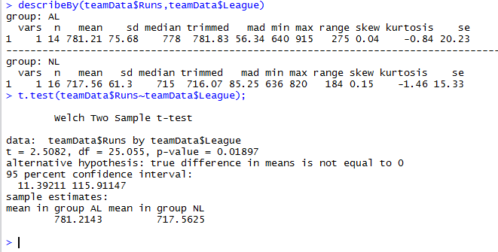
Looking for differences across groups: The analysis (t-test)
describeby(teamData$Runs, teamData$League)
Variable of interest (Runs)
Broken up by group (League)
Results of t-test for differences in Runs by League)

Slide 34
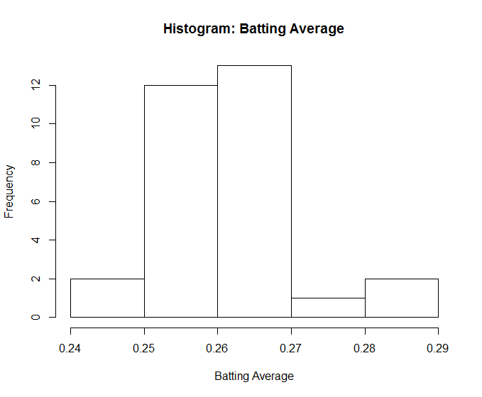
Histogram
hist(teamData$BattingAvg,
xlab="Batting Average",
main="Histogram: Batting Average")
hist()
first parameter – data values
xlab parameter – label for x axis
main parameter - sets title for chart

Slide 35
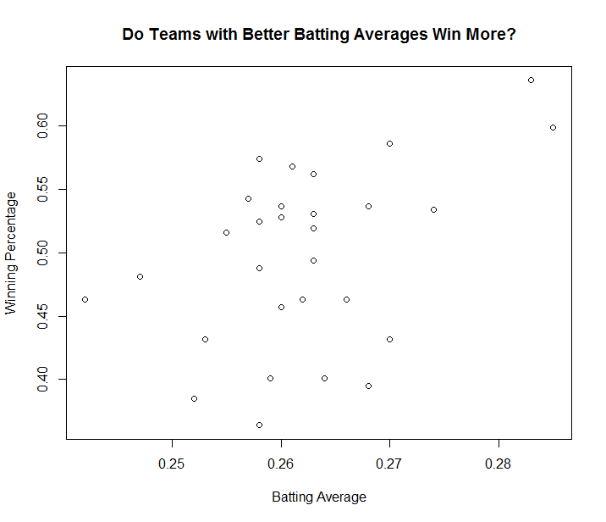
Plotting data
plot(teamData$BattingAvg,teamData$WinningPct,
xlab="Batting Average",
ylab="Winning Percentage",
main="Do Teams With Better Batting Averages Win More?")
plot()
first parameter – x data values
second parameter – y data values
xlab parameter – label for x axis
ylab parameter – label for y axis
main parameter - sets title for chart

Slide 36
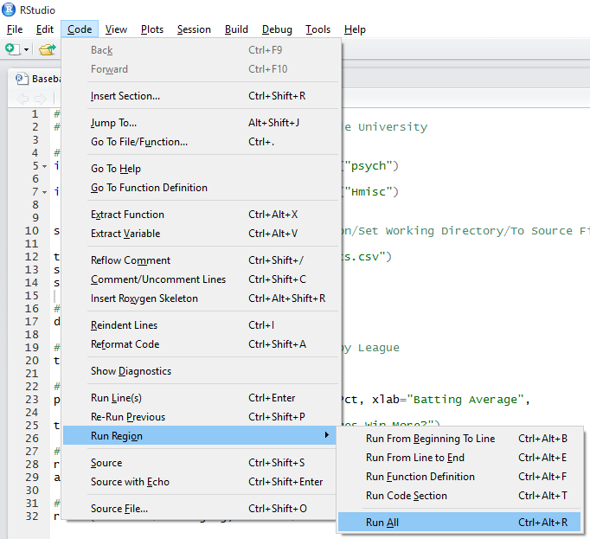
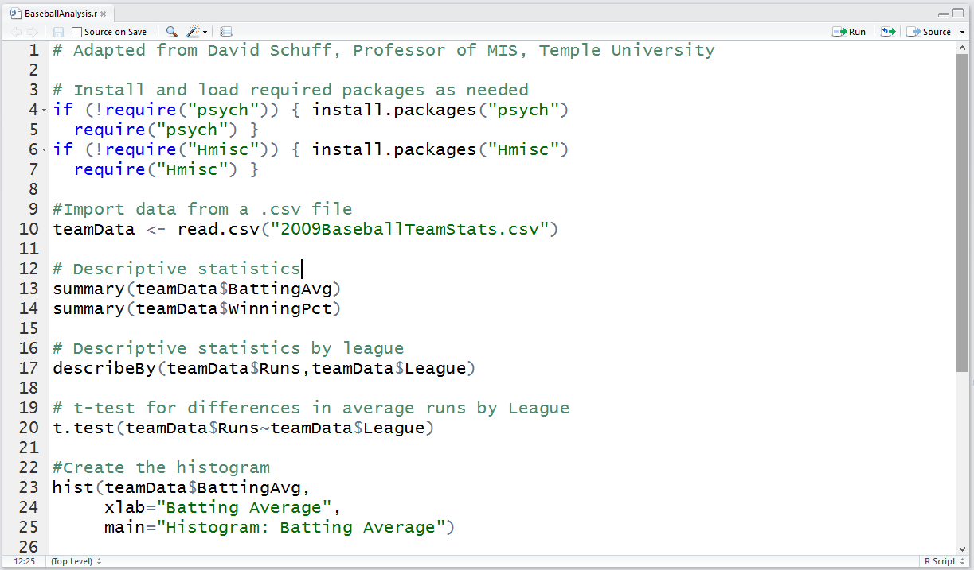
Running this analysis as a script
Use the Code | Run Region | Run All Menu
Commands can be entered one at a time, but usually they are all put into a single file that can be saved and run over and over again.

Slide 37
Getting help
help.start() | general help
help(mean) | help about function mean()
?mean | same. Help about function mean()
example(mean) | show an example of function mean()
help.search("regression") | get help on a specific topic such as regression.

Slide 38
Online Tutorials
If you’d like to know more about R, check these out:
  Quick-R (http://www.statmethods.net/index.html)
  R Tutorial (http://www.r-tutor.com/r-introduction)
  Learn R Programing (https://www.tutorialspoint.com/r/index.htm)
  Programming with R (https://swcarpentry.github.io/r-novice-inflammation/
There is also an interactive tutorial to learn R basics, highly recommended! (http://tryr.codeschool.com/)

Slide 39
In Class Activity #10

