Slide 1
Exam 2 Review
MIS 2502, Spring 2020, Raven
This review does not include instructions and examples for SQL. They are again on the exam. For this, study the slide decks 4 and 5, and practice using the ICAs and assignments
Not on the exam: Data Visualization, Tableau Prep, Sub-selects

Slide 2
Summary: The full syntax for SELECT
SELECT [DISTINCT] expression(s)
FROM schema_name.table_name(s)
[WHERE condition(s)]
[GROUP BY expression(s)]
[ORDER BY expression(s) [ ASC | DESC ]]
[LIMIT number_rows];
The [] means the element is optional
Element | Description
expression(s) | The column(s) or function(s) that you wish to retrieve.
schema_name.table_name(s) | The table(s) that you wish to retrieve records from.
DISTINCT | Optional. Return unique values.
WHERE condition(s) | Optional. The conditions that must be met for the records to be selected.
GROUP BY expression(s) | Optional. Organize the results by column values.
ORDER BY expression(s) | Optional. Sort the records in your result set
LIMIT number_rows | Optional. Restrict the maximum number of records to retrieve.

Slide 3
Summary
Given a schema of a database, we now should be able to create a SQL statement (query) to answer a question
Understand how to use
  SELECT … FROM …
  DISTINCT
  WHERE (and how to specify conditions)
  AND/OR
  ORDER BY (ASC/DESC)
  Functions: COUNT, AVG, MIN, MAX, SUM
  GROUP BY
  LIMIT
  Joins (and differences between inner/outer join)
  Subselects

Slide 4
Working with semi-structured data
MIS2502: Data Analytics
JaeHwuen Jung
jaejung@temple.edu
http://community.mis.temple.edu/jaejung

Slide 5
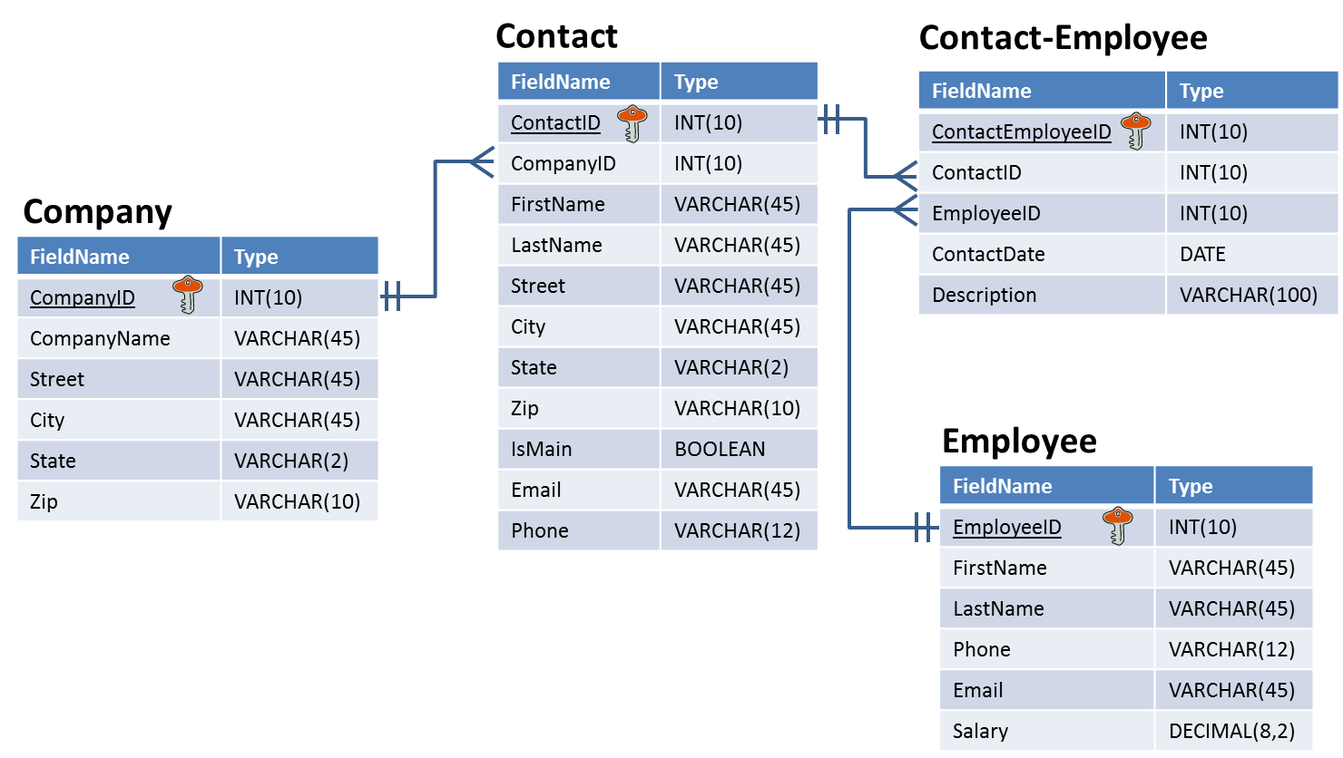
Relational databases are highly structured
Tables have the same number of fields for every record
Each field has a specified data type
Data types have a specified length and precision

Slide 6

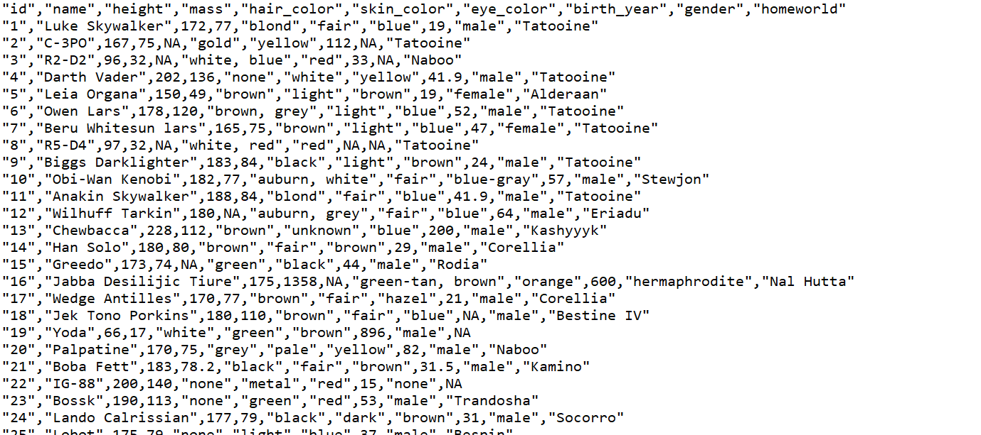
But not all data is stored like that
This is a comma-separated value (CSV) file.
Each value is separated by a comma.
Other than that it is plain text.
The first row is often the field names.
There are no specified field lengths.
From: Wookieepedia

Slide 7

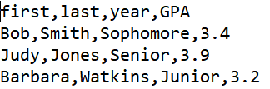
Role of quotation marks
The quotes don’t imply a data type.
Notice that the ID is in quotes but the height and mass are not.
The quotes just allow commas to be considered part of the value, not a separator.
This is also a valid
CSV file…
From: Wookieepedia

Slide 8
Some definitions
Structured data
Organized according to a formal data model (i.e., relational schema)
Semi-structured data
No formal data model, but contains symbols to separate and label data elements
Unstructured data
No data model and no pre-defined organization

Slide 9
From structured to unstructured data
Structured
Semi-Structured
Unstructured
Relational databases
CSV
XML & JSON
Text documents
Images
Would you consider an Excel spreadsheet structured, semi-structured, or unstructured?

Slide 10
Why care about semi-structured and unstructured data?
Semi-structured data
Common way to transfer data between software applications
Because plain-text is universal, datasets are often posted using semi-structured formats
Unstructured data
It’s everywhere
Up to 70% to 80% of an organization’s data may be in unstructured forms (Wikipedia)

Slide 11
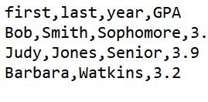
The CSV format is still quite structured
You can’t skip values in a row
You have to be careful when using commas as part of your data
…but there’s no way to create data hierarchies
  Can’t make “first” and “last” part of “name”
This means the year for Watkins is 3.2…
…and she doesn’t have a GPA
4

Slide 12
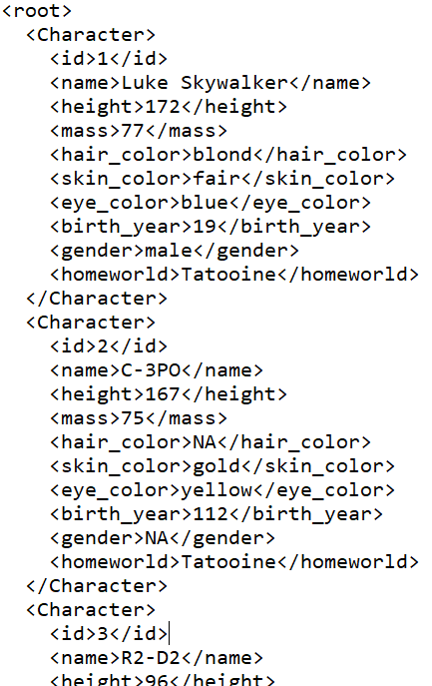
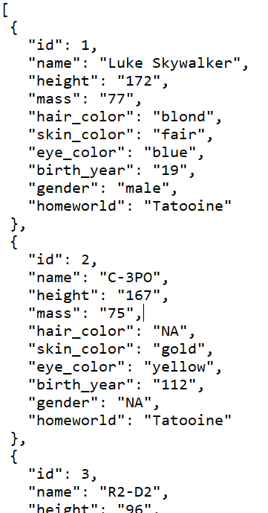
Alternatives to CSV for semi-structured data
XML
Extensible Markup Language
JSON
JavaScript Object Notation

Slide 13
Extensible Markup Language
Plain text file
Uses text for values between tags for labels
<opening tag>data</closing tag>
<height>172</height>
Values can be of any length
Commas and quotes are valid
Fields can be skipped…
Remove <mass>75</mass> from
C-3PO and skin color is still gold
Starts and ends with a tag (often <root> or <document>)

Slide 14
Hierarchies in XML
We know we can break up name into first and last
But we are also nesting it under name
  So first and last are now attributes of name
Easier to find what you’re looking for and organize your data
<Character>
<id>1</id>
<name>
<first>Luke</first> <last>Skywalker</last>
</name>
<height>172</height>
<mass>77</mass>
<hair_color>blond</hair_color>
<skin_color>fair</skin_color>
<eye_color>blue</eye_color>
<birth_year>19</birth_year>
<gender>male</gender>
<homeworld>Tatooine</homeworld>
</Character>
And id, name, height, mass, etc., are all nested under Character

Slide 15
Bottom line for XML
XML is better than CSVs for semi-structured data
  Allow for hierarchies
  More flexible
  Easier to read
But XML takes up a lot more space with all of those tags
  Starwars.csv → 6,251 bytes
  Starwars.xml → 28,521 bytes

Slide 16
JavaScript Object Notation
Plain text file
Organized as objects within braces { }
Uses key-value pairs
  key: value
  “name”: “C-3PO”
  keys are field names; strings in quotes
  values are the data; strings, numbers, Boolean (quotes around strings required)
  a comma separates the key-value pairs
Values can be any length
Fields can be skipped
  Remove “mass”: “75” from
  C-3PO and skin color is still gold
JSON object
JSON object

Slide 17
Object and Array in JSON
Object
Array
Objects are surrounded by curly braces {}.
Objects are written in key/value pairs.
{ Key1: Value1, Key2: Value2, …}
Array is surrounded by square bracket [].
Array can store multiple values.
Values must be separated by comma
[ Value1, Value2, Value3, … ]

Slide 18
Hierarchies in JSON
We can have first and last nested as attributes of name, just like XML
We can list multiple abilities using array
{
"Character": {
"id": "1",
"name": {
"first": "Luke",
"last": "Skywalker"
},
"height": "172",
"mass": "77",
“Abilities": [
“Lightsaber",“Multilingual“
],
"skin_color": "fair",
"eye_color": "blue",
"birth_year": "19",
"gender": "male",
"homeworld": "Tatooine"
}
}
JSON object
What are the differences between arrays and objects?
JSON array

Slide 19
Bottom line for JSON
Best aspects of XML and CSV
More lightweight than XML
  Starwars.csv → 6,251 bytes
  Starwars.xml → 28,521 bytes
  Starwars.json → 21,074 bytes
Supports hierarchies like XML
JSON becoming the standard for transferring data across the web

Slide 20
Same data, four different ways…
Relational database table
XML file
JSON file
first | last | year | GPA
Bob | Smith | Sophomore | 3.4
Judy | Jones | Senior | 3.9
Barbara | Watkins | Junior | 3.2
<root>
<Person>
<first>Bob</first>
<last>Smith</last>
<year>Sophomore</year>
<GPA>3.4</GPA>
</Person>
<Person>
<first>Judy</first>
<last>Jones</last>
<year>Senior</year>
<GPA>3.9</GPA>
</Person>
<Person>
<first>Barbara</first>
<last>Watkins</last>
<year>Junior</year>
<GPA>3.2</GPA>
</Person>
</root>
[
{
"first": "Bob",
"last": "Smith",
"year": "Sophomore",
"GPA": 3.4
},
{
"first": "Judy",
"last": "Jones",
"year": "Senior",
"GPA": 3.9
},
{
"first": "Barbara",
"last": "Watkins",
"year": "Junior",
"GPA": 3.2
}
]
CSV file
first,last,year,GPA
Bob,Smith,Sophomore,3.4
Judy,Jones,Senior,3.9
Barbara,Watkins,Junior,3.2

Slide 21






JSON and Web APIs
Web Application Program Interface (API)
  Software that exposes functionality through a web interface
  Use the language of web software to send and receive messages (and exchange data)
Some examples

Slide 22
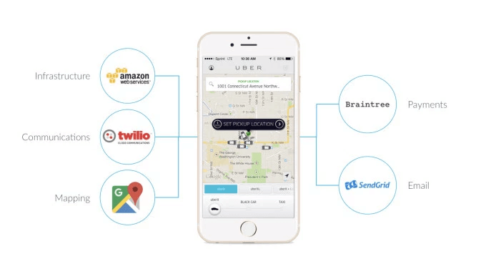
API’s Case Study: UBER
Requesting a ride?
Describe what happens...
  What are these systems?
  How do they work?
Source: https://www.okta.com/security-blog/2019/05/how-uber-takes-advantage-of-the-api-economy/
FOX
MIS
Notes:
Used to achieve Organizational Goals

Slide 23


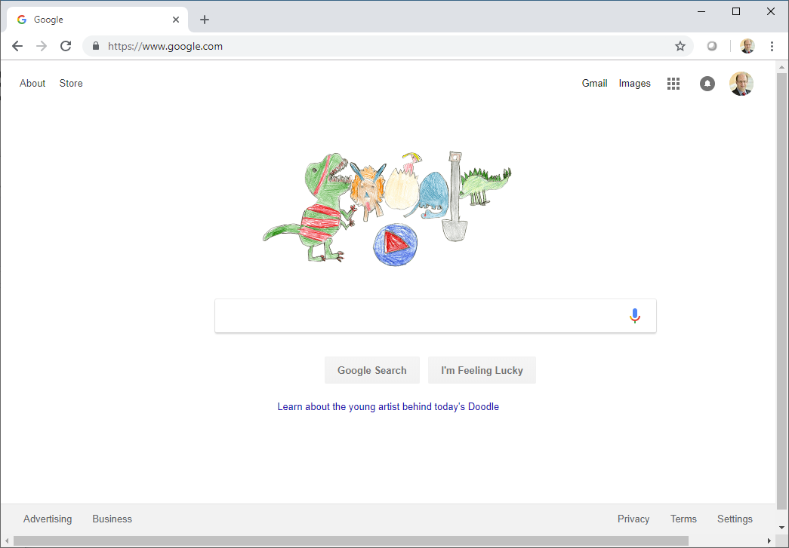
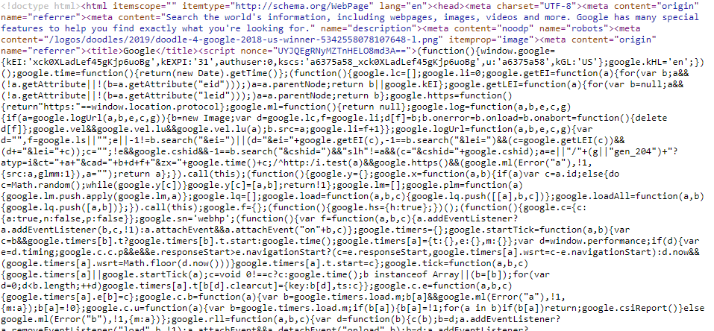
Requesting a web page
Google’s Web Server
REQUEST: http://www.google.com
RESPONSE:
which is really…
This is HTML and JavaScript and CSS. All you need to know is that the web server is sending back a lot of text that tells your web browser what to do.

Slide 24
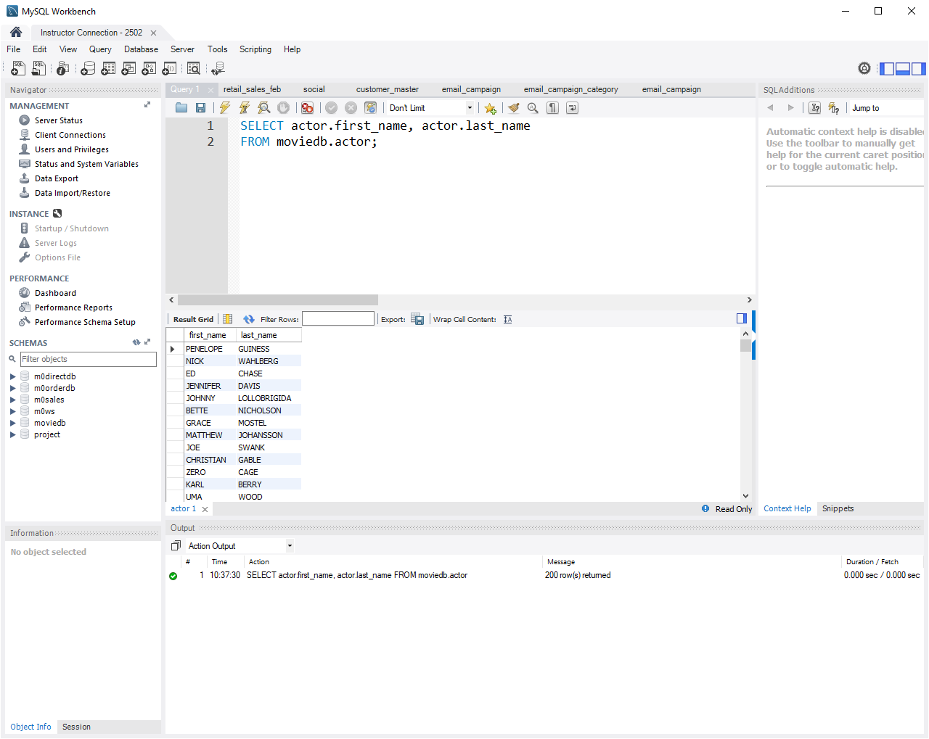
JSON and web APIs
For us, Web APIs are just a way of getting data
JSON is a popular format to package the data
MySQL Database Server
SELECT actor.first_name, actor.last_name
FROM moviedb.actor;
PENELOPE GUINESS, NICK WAHLBERG, ED CHASE, JENNIFER DAVIS….
Database Server with Web API
https://swapi.co/api/people/1/?format=json
{"name":"Luke Skywalker","height":"172","mass":"77",
"hair_color":"blond","skin_color":"fair“…
This works…try it!
Another example: https://openweathermap.org/api

Slide 25
Applications use APIs to communicate with each other by exchanging data
Note there is no web browser involved here!
http://api.paypal.com/payments/...
APPROVED!
Your web browser
on your phone, laptop, desktop computer
Amazon.com web server
serves the familiar web interface you know
Amazon.com application server
processes orders, maintains your cart, and makes recommendations
Amazon.com database server
stores customer, product, and order data

Slide 26
JSON and data analytics
JSON is just another data format
JSON files can be read by analytics software, including R
  So can CSV files
  And XML files
  And Excel files

Slide 27
NoSQL
Part 1: Basic Queries
MIS2502: Data Analytics
JaeHwuen Jung
jaejung@temple.edu
http://community.mis.temple.edu/jaejung

Slide 28
What is NoSQL?
Stands for “Not Only SQL”
Non-relational data storage systems
Supports unstructured format (no fixed schema)

Slide 29
Why RDBMS?
Relational Databases – popular and commonly used
Low Cost RDBMS alternatives (PostgreSQL, MySQL, SQLLite)
Supports Joins
  across multiple tables allowing for normalized
  forms of data to be stored once

Slide 30
Why NoSQL?
Supports semi-structured (unstructured) data
  Unique data type extensions can be easily
  integrated into existing collections
Handling “Big” data with better performance
  RDBMS normalization and joins are powerful, but add up in cost
Operational issues (scale, performance and availability)

Slide 31
RDBMS vs NoSQL
RDBMS | NoSQL
Pre-defined schema | Flexible schema
Data is distributed across multiple tables | Data is typically nested in a few collections
Based on relations | (Very few) relations
Vertical scaling | Horizontal/vertical scaling
Not good for hierarchical work | Best fit for hierarchical work

Slide 32
Categories of NoSQL
Key-Value Data Store
Stores data in unique key-value pairs
Example: Dynamo, Redis
Document Store
Stores data using JSON, XML, or BSON documents
Example: MongoDB, Couchbase
Column Database
Uses flat structure, but with keys stored in columns rather than rows
Example: Cassandra, Hbase
Graph Database
Uses edges and nodes to represent and store data
Example: Neo4j, JanusGraph

Slide 33
NoSQL vs RDBMS – How to pick?
Nature of data
  Row/column (structured)
  Unstructured, complex which needs nesting
Schema
  Static: RDBMS, Dynamic: NoSQL
Self contained: NoSQL, Joins: RDBMS
Flexibility of query
  RDBMS: Joins allow for flexibility
  NoSQL: Duplication of data, implement joins in middle-ware

Slide 34

What is MongoDB?
MongoDB is
  Created by 10gen
  (term coined from humongous)
  an open source, document-oriented database designed
  stores BSON (JSON-like) documents
  Schema-less

Slide 35
MongoDB Database
Database
Collection
Collection
Document
Document
Document
Document
Document
RDBMS | MongoDB
Database | Database
Table | Collection
Column | Field
Row | Document
Join | Embedded Document Linking across Document
Foreign Key | Reference

Slide 36
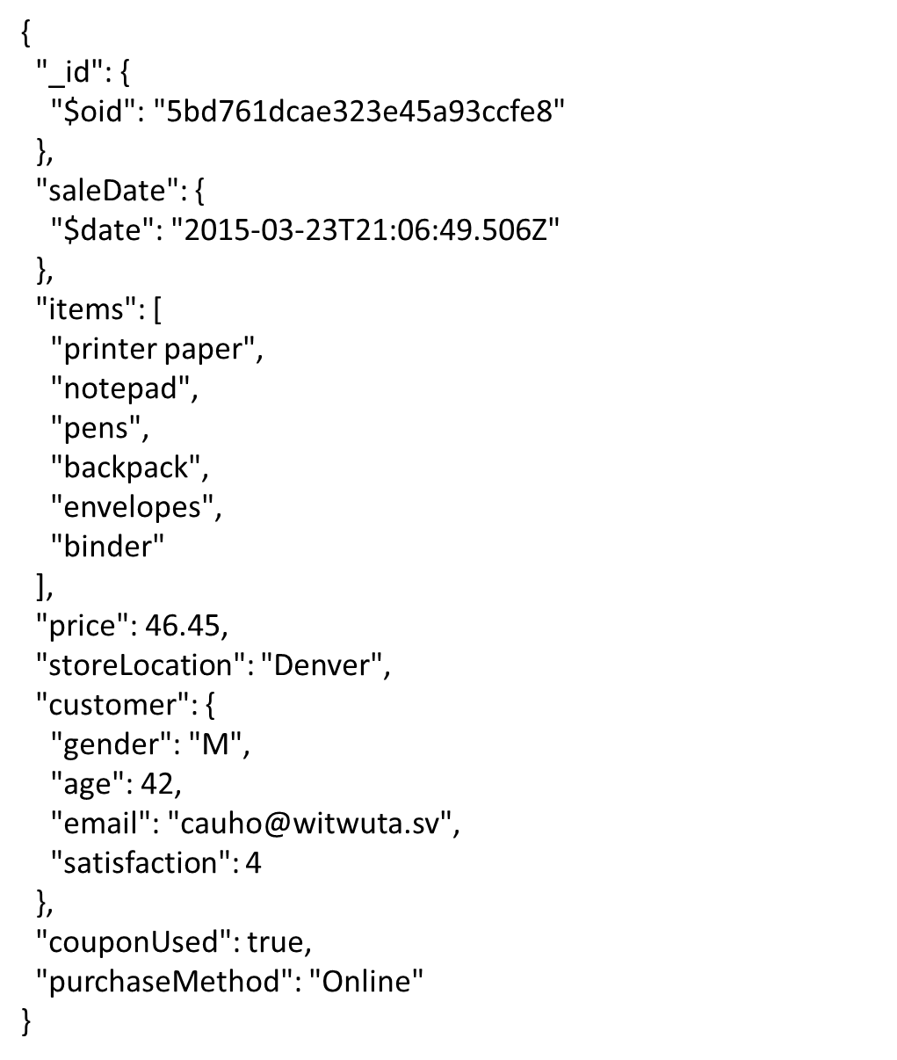
Dataset
salesdb.sales
JSON array
JSON object

Slide 37
Return the Specified Fields
Select $project stage and copy the following expression into the panel:
$project: { items: 1, storeLocation: 1, customer: 1 }
The operation corresponds to the following SQL statement:
SELECT items, storeLocation, customer
FROM salesdb.sales;
The _id field is, by default, included in the output documents. You can remove by setting the field to 0.
Ref: https://docs.atlas.mongodb.com/data-explorer/cloud-agg-pipeline

Slide 38
Specify Equality Condition
$match stage filters the documents to pass only the
documents that match the specified condition(s)
Syntax :
$match: { <field1>: <value1>, ... }
The below code corresponds to the following SQL statement:
$match: { storeLocation: "Seattle"}
SELECT items, storeLocation, customer
FROM salesdb.sales WHERE storeLocation = “Seattle”;
$match work as WHERE statement in a SQL query.

Slide 39
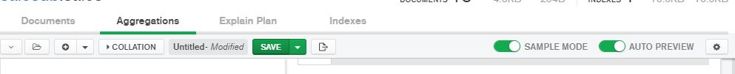
Compass vs MongoDB
Compass
$project: { items: 1, storeLocation: 1, customer: 1 }
$match: { storeLocation: "Seattle"}
MongoDB
Click Export To Language to see the code.
db.sales.aggregate{
[{ $project: {items: 1,storeLocation:1,customer:1}},
{ $match: {storeLocation: "Seattle"}}]
}

Slide 40
Specify Conditions Using Operators
Syntax :
$match: { <field1>: { <operator1>: <value1> }, ... }
For example,
$match: { price: { $gt: 200 } }
corresponds to the following SQL statement:
SELECT * FROM MIS2502.sales
WHERE price > 200;
Name | Description | Name | Description
$eq | equal to | $lt | less than
$gt | greater than | $lte | less than or equal to
$gte | greater than or equal to | $ne | not equal to

Slide 41
Does order matter?
What happens when we type in the following code? What happens when we switch the order of $project and $match?
$ project: { items: 1, storeLocation: 1, customer: 1 }
$ match: { price: { $gt: 200 } }
Unlike SQL, in the aggregation pipeline, each stage transforms the documents as they pass through the pipeline. Therefore, order matters!!!

Slide 42
AND and OR Conditions
Syntax :
$match: { $and(or) : [ { <condition1> }, { <condition2> } , …} ] }
$and and $or operator performs a logical operation on an array of two or more <conditions>.
$match: { $and: [
{ price: { $gt: 180} } ,
{ storeLocation: "Seattle"}
]}
The operation corresponds to the following SQL statement:
SELECT * FROM salesDB.sales
WHERE price > 180 AND storeLocation = “Seattle”;

Slide 43
Sort Results
Using $sort stage, we can specify the sort order of the returned documents.
$sort: { price: 1 }
The operation corresponds to the following SQL statement:
SELECT * FROM salesDB.sales ORDER By price ASC;
We can set the field to 1 (-1), to specify ascending (descending) order for a field,.

Slide 44
Limit Results
Using $limit stage, we can specify the number of the returned documents.
$limit: 3
The operation corresponds to the following SQL statement:
SELECT * FROM salesDB.sales LIMIT 3;
So, what may happen if we put $limit on the first stage?

Slide 45
Aggregation
$group documents by some specified expression and outputs to the next stage a document for each distinct grouping
Syntax :
$group: { _id: <expression>, <field1>: { <accumulator1> : <expression1> }, ... }
$group: { _id: "$purchaseMethod",
totalprice: { $sum: "$price"} }
corresponds to the following SQL statement:
SELECT purchaseMethod, sum(price) as totalprice
FROM salesDB.sales
Group by purchaseMethod;

Slide 46
Aggregation
Similar to GROUP BY in SQL, the output documents can contain computed filed
$group: { _id: "$purchaseMethod",
totalprice: { $sum: "$price"},
avgprice: { $avg: "$price"},
maxprice: { $max: "$price"},
number: { $sum:1} }
corresponds to the following SQL statement:
SELECT purchaseMethod, sum(price) as totalprice,
avg(price) as avgprice, max(price) as maxprice, count(price) as number
FROM salesDB.sales
Group by purchaseMethod;
In $group, we use $sum: 1 to count the number of documents.

Slide 47
Group by null
Grouping _id with null will calculate the total price and the average quantity as well as counts for all documents in the collection.
$group: { _id: null,
totalprice: { $sum: "$price"},
avgprice: { $avg: "$price"},
maxprice: { $max: "$price"},
number: { $sum:1} }
corresponds to the following SQL statement:
SELECT sum(price) as totalprice, avg(price) as avgprice, max(price) as maxprice, count(price) as number
FROM salesDB.sales;

Slide 48
MySQL vs MongoDB Query
MySQL | MongoDB
WHERE | $match
GROUP BY | $group
ORDER BY | $sort
SELECT expressions FROM.. | $project
LIMIT | $limit
Example..
SELECT purchaseMethod, sum(price) as totalprice
FROM salesDB.sales
WHERE couponUsed = FALSE
GROUP BY purchaseMethod
ORDER BY sum(price) ASC
LIMIT 2;
db.sales.aggregate(
[ { $match: { couponUsed: FALSE }},
{ $group: { _id: "$purchaseMethod",
totalprice: { $sum: "$price" }}},
{ $sort: { totalprice: 1 }},
{ $limit: 2 }
])

Slide 49
Summary
Given a semi structured database, we now should be able to create a NoSQL statement to answer a question
Understand how each stage in aggregation tap works and the relationship with SQL keywords
  $project
  $match
  $sort
  $limit
  $group

Slide 50
NoSQL
Part 2: Advanced Queries
MIS2502: Data Analytics
JaeHwuen Jung
jaejung@temple.edu
http://community.mis.temple.edu/jaejung

Slide 51
So far, we looked at how NoSQL query can be similar to SQL query.
However, due to the different properties of NoSQL dataset, there are more types of queries that can be useful when using NoSQL database.
Nested document
LastName: “WELLS”
GPA: 3.0
Major: “MIS”
Class: {ClassID: 1234,
ClassName:“MIS2101”}
…
Array
LastName: “NORBERT”
Major: [“FIN”, “MIS”,…]
Class: [{ClassID: 1235,
ClassName:“MIS2502”,…},
… ]
LastName: “KENDALL”
GPA: 3.5
Class: {ClassID: 1234,
ClassName:“MIS2101”}
…

Slide 52
Query on Nested Document
Can we only show sales occurred from customers less than 40 years old?
JSON array
JSON object

Slide 53
Query on Nested Document
We can use dot notation to specify a query condition on fields in an embedded/nested document
To return sales occurred from customers he less than 40 years old
$match: { "customer.age": { $lt : 40 } }
Make sure the fields are surrounded by “”.

Slide 54
Query on Nested Document
We can apply dot notation to combine conditions using AND and OR operator
To return sales happened from customers less than 40 years old AND male
$match: { $and:
[ {"customer.age": { $lt: 40} },
{"customer.gender":"M"} ]
}

Slide 55
Query an Array
{
"_id": {
"$oid": "5bd761dcae323e45a93ccfe8"
},
"saleDate": {
"$date": "2015-03-23T21:06:49.506Z"
},
"items": [
"printer paper",
"notepad",
"pens",
"backpack",
"envelopes",
"binder"
],
"price": 46.45,
"storeLocation": "Denver",
"customer": {
"gender": "M",
"age": 42,
"email": "cauho@witwuta.sv",
"satisfaction": 4
},
"couponUsed": true,
"purchaseMethod": "Online"
}
Can we only show sales that contain binder?
JSON array
JSON object

Slide 56
Query an Array
We can use the same {<field>: <value>} syntax to the array. So, let’s try
$match: { items: "binder" }
To specify equality condition on an array, <value>
should be the exact array to match.
$match: { items: ["binder"] }
This will return documents that satisfy exact array to match, including the order of the elements.
Then, how would the code below work?
$match: { items: ["binder", "pens"] }

Slide 57
Query an Array
$all operator selects the documents where the value of a field is an array that contains all the specified elements.
Syntax :
$match: { <field>: { $all: [ <value1> , <value2> ... ] } }
$all vs $and operator
The $all is equivalent to an $and operation of the
specified values; i.e. the following two statements
are identical:
$match: { items: { $all: [ "binder" ,"pens" ] } }
$match: { $and: [ {items: "binder"}, {items: "pens"}] }

Slide 58
Query an Array based on Size
$size operator matches any array with the number of elements specified by the argument
Syntax :
$match: { <field>: { $size: value } }
For example,
$match: { items: { $size: 2 } }
returns all documents in collection where items field is
an array with 2 elements.

Slide 59
Do we have to JOIN tables?
salesDB.sales
salesDB.saleslist
{
"_id": {
"$oid": "5bd761dcae323e45a93ccfe8"
},
"saleDate": {
"$date": "2015-03-23T21:06:49.506Z"
},
"items": [
"printer paper",
"notepad",
"pens",
"backpack",
"envelopes",
"binder"
],
"price": 46.45,
"storeLocation": "Denver",
"customer_id": "5bd761dcae323e45a93cd000",
"couponUsed": true,
"purchaseMethod": "Online"
}
{
"_id": {
"$oid": "5bd761dcae323e45a93ccfe8"
},
"saleDate": {
"$date": "2015-03-23T21:06:49.506Z"
},
"items": [
"printer paper",
"notepad",
"pens",
"backpack",
"envelopes",
"binder"
],
"price": 46.45,
"storeLocation": "Denver",
"customer": {
"gender": "M",
"age": 42,
"email": "cauho@witwuta.sv",
"satisfaction": 4
},
"couponUsed": true,
"purchaseMethod": "Online"
}
Embedded document
Reference
salesDB.customer
{ "_id": {
"$oid": "5bd761dcae323e45a93cd000"
},
"gender": "M",
"age": 42,
"email": "cauho@witwuta.sv",
"satisfaction": 4
}

Slide 60
Join with $lookup
$lookup performs a left (outer) join to another collection in the same database to filter in documents from the “joined” collection for processing.
Syntax :
$lookup: {
from: <collection to join>,
localField: <field from the input document>,
foreignField: <field from another document>,
as: <name of output array field>
}

Slide 61
Join with $lookup
To perform a left (outer) join from saleslist collection to customer collection
$lookup: { from: "customer",
localField: "customer_id",
foreignField: "_id",
as: "customer_info" }
The operation corresponds to the following SQL statement:
SELECT * FROM salesDB.saleslist
LEFT JOIN salesDB.customer
ON saleslist.customer_id = customer._id;

Slide 62
Extract, Transform, Load
MIS2502: Data Analytics
JaeHwuen Jung
jaejung@temple.edu
http://community.mis.temple.edu/jaejung

Slide 63

Extract, Transform, Load (ETL)
Extract data from the transactional database
Transform data into an analysis-ready format
Load it into the analytical data store

Slide 64
The Actual Process
Extract
Transform
Load
Transactional Database 1
Data conversion
Transactional Database 2
Data conversion
Analytical Data store
Other Sources
Data conversion
Relational database
Dimensional database

Slide 65
ETL’s Not That Easy!
Data Consistency
What if the data is in different formats?
Data Quality
How do we know it’s correct?
What if the data we need isn’t there?
What if there is missing data?

Slide 66
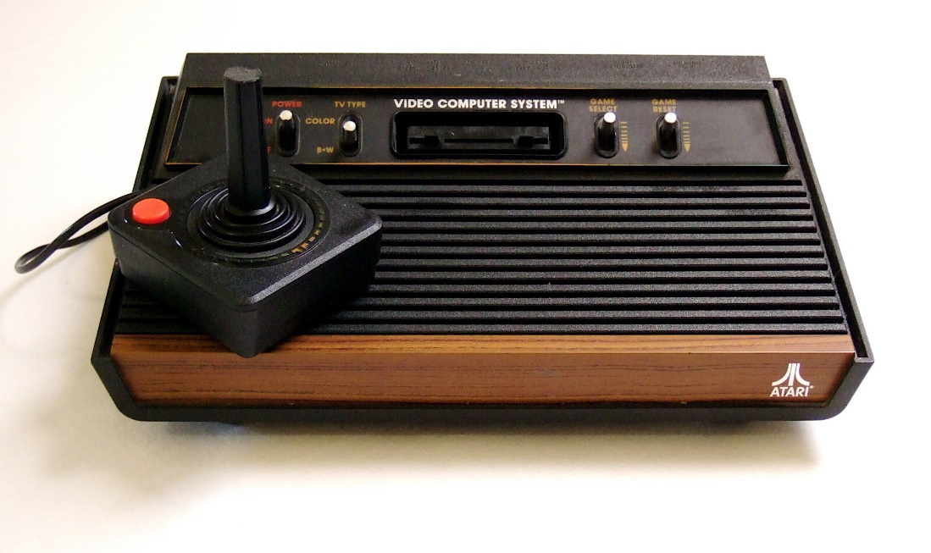
Data Consistency:
The Problem with Legacy Systems
An IT infrastructure evolves over time
Systems are created and acquired by different people using different specifications
This can happen through:
Changes in management
Mergers & Acquisitions
Externally mandated standards
Generally poor planning

Slide 67
Why Not Replacing Legacy Systems?
Too much risk
Prohibitive cost
User reluctance
Limited business agility
Speed of delivery
https://www.onbase.com/~/media/Files/hyland/whitepaper/wp_trouble-with-legacy-systems.pdf
https://thenextweb.com/finance/2017/04/10/ancient-programming-language-cobol-can-make-you-bank-literally/

Slide 68
Problems with Data Consistency
The same data element stored in different formats
Redundant data across the organization
Different naming conventions
“Management Information Systems” versus “MIS” versus “Man. Info. Sys.”
Different unique identifiers used
AccessNet account versus Temple ID
Customer record maintained by accounts receivable and marketing
Social Security number (123-45-6789 versus 123456789)
Date (10/9/2015 versus 9/10/2015)

Slide 69
What’s the big deal?
This is a fundamental problem for creating the analytical data store
We often need to combine information from several transactional databases
How do we know if we’re talking about the same customer or product?

Slide 70
Now think about this scenario
Hotel Reservation Database
Café Database
What are the differences between a “guest” and a “customer”?
Is there any way to know if a customer of the café is staying at the hotel?

Slide 71
Solution: “Single view” of data
The entire organization understands a unit of data in the same way
It’s both a business goal and a technology goal
but it’s really more this…
...than this

Slide 72
Closer look at the Guest/Customer
Guests
Guest_number
Guest_firstname
Guest_lastname
Guest_address
Guest_city
Guest_zipcode
Guest_email
Customer
Customer_number
Customer_name
Customer_address
Customer_city
Customer_zipcode
vs.
Getting to a “single view” of data:
What would you use to uniquely identify a guest/customer?
Would you include email address?
How would you represent “name?”
How do you figure out if you’re talking about the same person?

Slide 73
Data Transformation Steps
Parsing
  Decomposes data elements
  Example: [name: Joe Cool ]→[FirstName: Joe, LastName: Cool)
Correcting
  Corrects parsed data elements
  Example: street name does not exist and is replaced with the "closest" one
Standardizing
  Transforms data into its preferred format
  Example: Broad ST → Broad Street
Matching
  Matches records within and across data sources

Slide 74
Data Quality
The degree to which the data reflects the actual environment
Do we have the right data?
Is the collection process reliable?
Is the data accurate?
Choose data consistent with the goals of analysis
Verify that the data really measures what it claims to measure
Build fault tolerance into the process
Manual verification through sampling
Periodically run reports, check logs, and verify results
Use the knowledge
expert

Slide 75
Summary
What is ETL? Why is it important?
  Data consistency
  Data quality
Explain the purpose of each component (Extract, Transform, Load)

