Slide 1
Exam 3 Review
MIS 2502, Spring 2020, Raven
This exam will not have SQL or ETL/Tableau Prep questions.

Slide 2

MIS2502:
Data Analytics
Descriptive and Inferential Statistics
Jeremy Shafer
Jeremy.Shafer@temple.edu
http://community.mis.temple.edu/jshafer

Slide 3

The Information Architecture of an Organization
Getting ready to go here…
Data entry
Transactional Database
Data extraction
Analytical Data Store
Data analysis
Stores real-time transactional data
Stores historical transactional and summary data

Slide 4
Types of statistics
Descriptive
Describes the features of a full set of data
Inferential
Seeks to draw an inference from a data sample
Used when a the full population can not be obtained

Slide 5

Descriptive Statistics
Definition: Descriptive statistics is the discipline of quantitatively describing the main features of a collection of information.
Descriptive statistics aim to summarize a sample.
http://en.wikipedia.org/wiki/Descriptive_statistics

Slide 6

“Need to know” information
Descriptive Concepts
  Mean, Median, Mode
  Skew
  Outliers
Inferential Concepts
  What’s a hypothesis?
  How to interpret a
  p-value

Slide 7
Mean
Definition: The mean (specifically the arithmetic mean) is also called the average and is the the sum of a discrete number of values divided by the number of values.

Slide 8
Median
Definition: The median of a finite list of numbers can be found by arranging all the observations from lowest value to highest value and picking the middle one (e.g., the median of {3, 3, 5, 9, 11} is 5). If there is an even number of observations, then there is no single middle value; the median is then usually defined to be the mean of the two middle values.
http://en.wikipedia.org/wiki/Median

Slide 9
Mode
Definition: The mode is the value that appears most often in a set of data.
http://en.wikipedia.org/wiki/Median

Slide 10
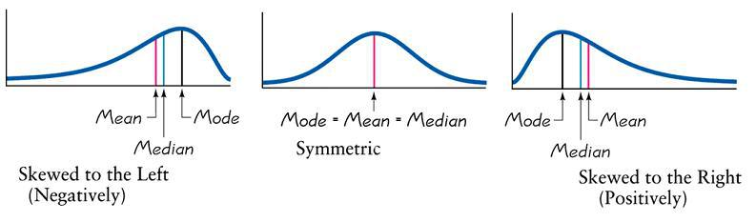
Skew
When we compare the mean, median, and mode of a collection of data, we get a sense of how the data is skewed.
http://rchsbowman.wordpress.com/2010/08/30/statistics-notes-the-shape-of-distributions/

Slide 11
Outliers
In statistics, an outlier is an observation point that is distant from other observations.
One or more outliers can impact the mean. While mode and median remain unaffected.
A simple illustration of this can be found here:
http://www.mathsisfun.com/data/outliers.html

Slide 12
Population Vs Sample
Population
Sample

Slide 13
Learning from a Sample
?
Population
Sample

Slide 14
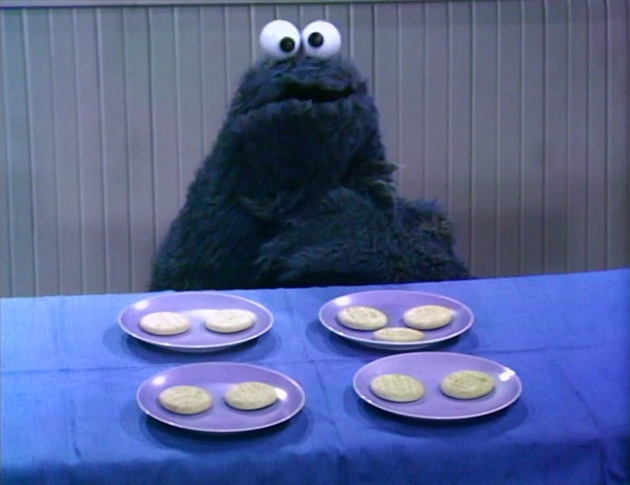
Inferential Statistics – Hypothesis testing
Statistical tests are set up to disprove the null hypothesis, and prove the alternate hypothesis.
The null hypothesis (H₀), is the the assertion that two populations of data are the same. Statistical tests are set up to disprove the null hypothesis, and prove the alternate hypothesis.
The null hypothesis (H₀), is the the assertion that two populations of data are the same.
The alternate hypothesis (H_{A}) is the assertion that two populations are different in some specific way.
The null and alternate hypothesis statements can’t both be true. So we run tests to determine which one is true.
There are different kinds of tests that can be performed, but generally the output of the test is the p-value.

Slide 15
p-values
A p-value is basically a probability. A p-value will be some number between 0 and 1. It indicates the probability that any evidence we are seeing in the data to support the alternate hypothesis can be attributed to chance.
Specifically, the p-value is defined as the probability of obtaining a result equal to or "more extreme" than what was actually observed, when the null hypothesis is, in fact, true
So… the lower the p-value the more likely it is that the alternate hypothesis is true.

Slide 16
p-values
Typically, a p-value of .05 or less is (generally) considered sufficient to challenge the null hypothesis.
A mnemonic device: if the p-value is low, then H₀ must go.
A good summary of this can he found here:
https://www.youtube.com/watch?v=eyknGvncKLw

Slide 17
Introduction to Advanced Analytics and R
MIS2502: Data Analytics
JaeHwuen Jung
jaejung@temple.edu
http://community.mis.temple.edu/jaejung

Slide 18
The Information Architecture of an Organization
Now we’re here…
Data entry
Transactional Database
Data extraction
Analytical Data Store
Data analysis
Stores real-time transactional data in a relational or NoSQL database
Stores historical transactional and summary data

Slide 19
What is Advanced Data Analytics?
The examination of data or content using sophisticated techniques and tools, to discover deeper insights, make predictions, or generate recommendations.
Goals:
Extraction of implicit, previously unknown, and potentially useful information from data
Exploration and analysis of large data sets to discover meaningful patterns
Prediction of future events based on historical data

Slide 20
What advanced data analytics is not…
Sales analysis
How do sales compare in two different stores in the same state?
Profitability analysis
Which product lines are the highest revenue producers this year?
Sales force analysis
Did salesperson X meet this quarter’s target?

Slide 21
Advanced data analytics is about…
Sales analysis
Why do sales differ in two stores in the same state?
Profitability analysis
Which product lines will be the highest revenue producers next year?
Sales force analysis
How much likely will the salesperson X meet next quarter’s target?

Slide 22
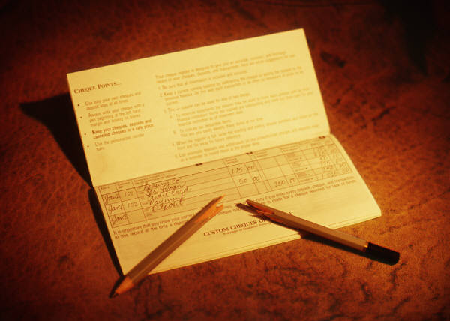
Example: Smarter Customer Retention
Consider a marketing manager for a brokerage
company
Problem: High churn (customers leave)
  Customers get an average reward of $150 to open an account
  40% of customers leave after the 6 month introductory period
  Getting a customer back after they leave is expensive
  Giving incentives to everyone who might leave is expensive

Slide 23
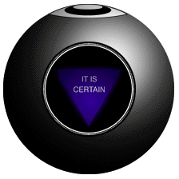
Answer: Not all customers have the same value
One month before the end of the introductory period, predict which customers will leave
Offer those customers something based on their future value
Ignore the ones that are not predicted to churn

Slide 24
Three Analytics Tasks We Will Be Doing in this Class
Decision Trees
Clustering
Association Rule Mining

Slide 25
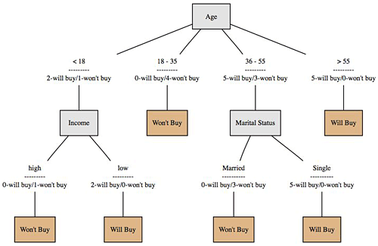
Decision Trees
Used to classify data
according to a
pre-defined outcome
Based on characteristics
of that data
Can be used to predict future outcomes
http://www.mindtoss.com/2010/01/25/five-second-rule-decision-chart/
Uses
Predict whether a customer should receive a loan
Flag a credit card charge as legitimate
Determine whether an investment will pay off

Slide 26
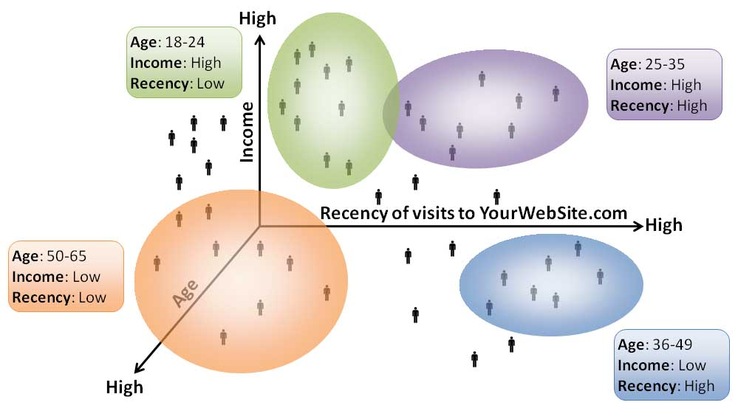
Clustering
Used to determine distinct groups of data
Based on data across multiple dimensions
Uses
Customer segmentation
Identifying patient care groups
Performance of business sectors
http://www.datadrivesmedia.com/two-ways-performance-increases-targeting-precision-and-response-rates/

Slide 27

Association Rule Mining
Find out which events predict the occurrence of other events
Often used to see which products are bought together
Uses
What products are bought together?
Amazon’s recommendation engine
Telephone calling patterns

Slide 28


Now we will start using R and RStudio heavily in class activities and assignments
R/RStudio has become one of the dominant software environments for data analysis
And has a large user community that contribute functionality
Make sure you download both on your computer!

Slide 29
Software development platform and programming language
Open source, free
Many, many, many statistical add-on “packages” that perform data analysis
Integrated Development Environment for R
Nicer interface that makes R easier to use
Requires R to run
(The base/engine)
(The pretty face)
If you have both installed, you only need to interact with Rstudio
Mostly, you do not need to touch R directly

Slide 30
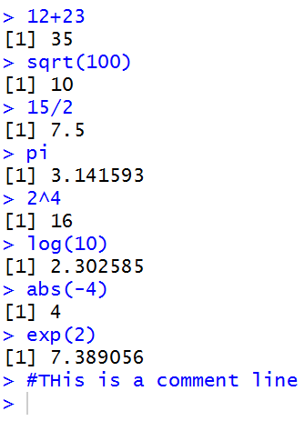
The Basics: Calculations
In its simplest form, R can be used as a calculator:
Type commands into the console and it will give you an answer

Slide 31
The Basics: Functions
sqrt(), log(), abs(), and exp() are functions.
Functions accept parameters (in parentheses) and return a value

Slide 32
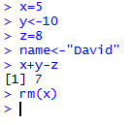
The Basics: Variables
  Variables are named containers for data
  The assignment operator in R is:
  <- or =
  Variable names can start with a letter or digits.
    Just not a number by itself.
    Examples: result, x1, 2b (not 2)
  R is case-sensitive (i.e. Result is a different variable than result)
<- and = do the same thing
rm() removes the variable from memory
x, y, and z are variables that can be manipulated

Slide 33
Basic Data Types
Type | Range | Assign a Value
Numeric | Numbers | X <-1 Y <- -2.5
Character | Text strings | name<-"Mark" color<-"red"
Logical (Boolean) | TRUE or FALSE | female<-TRUE

Slide 34
Advanced Data Types
Vectors
Data frames

Slide 35
Vectors of Values
A vector is a sequence of data elements of the same basic type.
> scores<-c(65,75,80,88,82,99,100,100,50)
> scores
[1] 65 75 80 88 82 99 100 100 50
> studentnum<-1:9
> studentnum
[1] 1 2 3 4 5 6 7 8 9
> ones<-rep(1,4)
> ones
[1] 1 1 1 1
> names<-c("Nikita","Dexter","Sherlock")
> names
[1] "Nikita" "Dexter" "Sherlock"
c() and rep() are functions

Slide 36
Indexing Vectors
We use brackets [ ] to pick specific elements in the vector.
In R, the index of the first element is 1
> scores
[1] 65 75 80 88 82 99 100 100 50
> scores[1]
[1] 65
> scores[2:3]
[1] 75 80
> scores[c(1,4)]
[1] 65 88

Slide 37
Simple statistics with R
You can get descriptive statistics from a vector
> scores
[1] 65 75 80 88 82 99 100 100 50
> length(scores)
[1] 9
> min(scores)
[1] 50
> max(scores)
[1] 100
> mean(scores)
[1] 82.11111
> median(scores)
[1] 82
> sd(scores)
[1] 17.09857
> var(scores)
[1] 292.3611
> summary(scores)
Min. 1st Qu. Median Mean 3rd Qu. Max.
50.00 75.00 82.00 82.11 99.00 100.00
Again, length(), min(), max(), mean(), median(), sd(), var() and summary() are all functions.
These functions accept vectors as parameter.

Slide 38
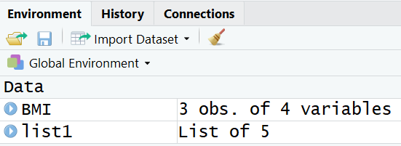
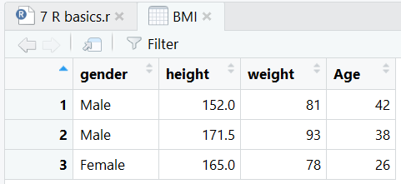
Data Frames
A data frame is a type of variable used for storing data tables
  is a special type of list where every element of the list has same length (i.e. data frame is a “rectangular” list)
> BMI<-data.frame(
+ gender = c("Male","Male","Female"),
+ height = c(152,171.5,165),
+ weight = c(81,93,78),
+ Age = c(42,38,26)
+ )
> BMI
gender height weight Age
1 Male 152.0 81 42
2 Male 171.5 93 38
3 Female 165.0 78 26
> nrow(BMI)
[1] 3
> ncol(BMI)
[1] 4

Slide 39
Identify elements of a data frame
To retrieving cell values
> BMI[1,3]
[1] 81
> BMI[1,]
gender height weight Age
1 Male 152 81 42
> BMI[,3]
[1] 81 93 78
More ways to retrieve columns as vectors
> BMI[[2]]
[1] 152.0 171.5 165.0
> BMI$height
[1] 152.0 171.5 165.0
> BMI[["height“]]
[1] 152.0 171.5 165.0

Slide 40
Packages
Packages (add-ons) are collections of R functions and code in a well-defined format.
To install a package:
  install.packages("pysch")
For every new R session (i.e., every time you re-open Rstudio), you must load the package before it can be used
    library(psych)
  or
    require(psych)
Each package only needs to be installed once

Slide 41
Import Data into R
R can handle all kinds of data files. We will mostly deal with csv files
Use read.csv() function to import csv data
  You need to specify path to the data file
  By default, comma is used as field delimiter
  First row is used as variable names
  You can simply do this by
  Download source file and csv file into the same folder (i.e., C:\RFiles).
  Set that folder as working directory by assigning source file location as working directory

Slide 42
Working directory
The working directory is where Rstudio will look first for scripts and files
Keeping everything in a self contained directory helps organize code and analyses
Check you current working directory with
  getwd()

Slide 43
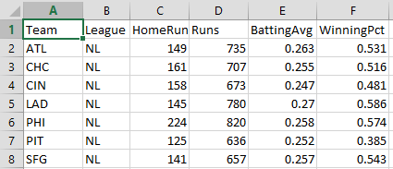
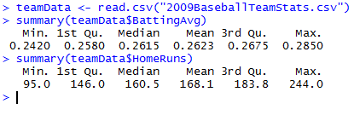
Reading data from a file
Usually you won’t type in data manually, you’ll get it from a file
Example: 2009 Baseball Statistics
(http://www2.stetson.edu/~jrasp/data.htm)
reads data from a CSV file and creates a data frame called teamData that store the data table.
reference the HomeRuns column in the data frame using TeamData$HomeRuns

Slide 44
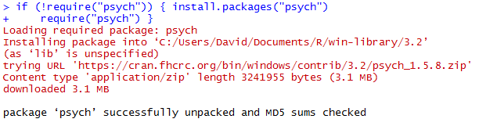
Looking for differences across groups:
The setup
We want to know if National League (NL) teams scored more runs than American League (AL) Teams
  And if that difference is statistically significant
To do this, we need a package that will do this analysis
  In this case, it’s the “psych” package
Downloads and installs the package
(once per R installation)

Slide 45
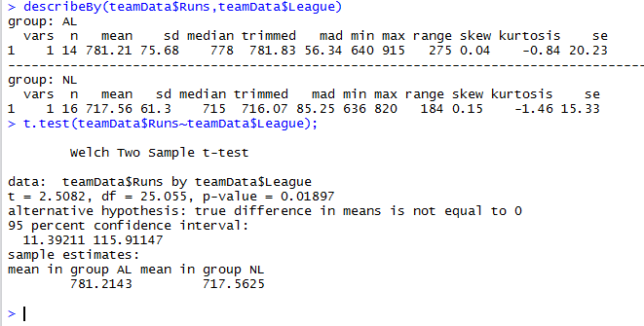
Looking for differences across groups: The analysis (t-test)
describeby(teamData$Runs, teamData$League)
Variable of interest (Runs)
Broken up by group (League)
Results of t-test for differences in Runs by League)

Slide 46
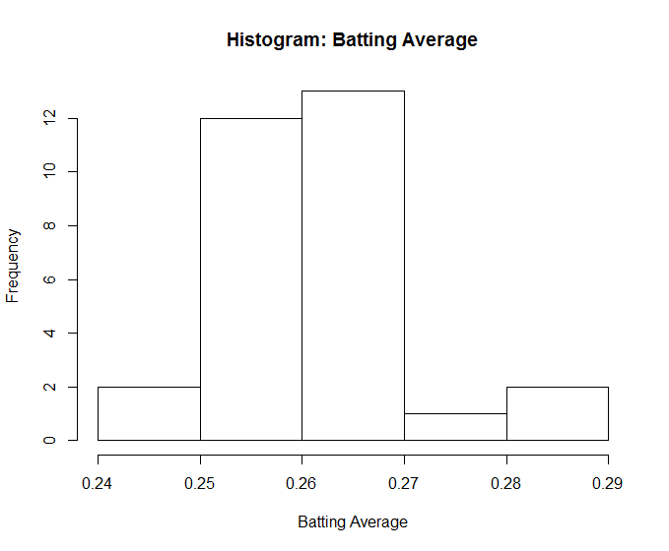
Histogram
hist(teamData$BattingAvg,
xlab="Batting Average",
main="Histogram: Batting Average")
hist()
first parameter – data values
xlab parameter – label for x axis
main parameter - sets title for chart

Slide 47
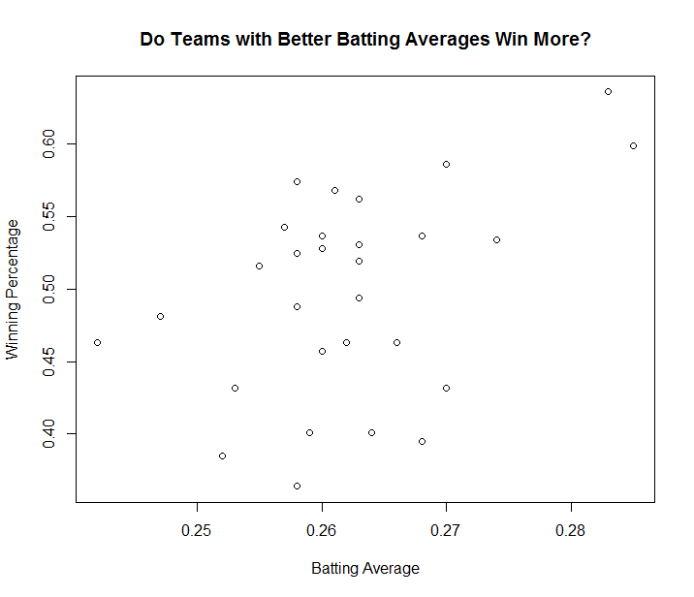
Plotting data
plot(teamData$BattingAvg,teamData$WinningPct,
xlab="Batting Average",
ylab="Winning Percentage",
main="Do Teams With Better Batting Averages Win More?")
plot()
first parameter – x data values
second parameter – y data values
xlab parameter – label for x axis
ylab parameter – label for y axis
main parameter - sets title for chart

Slide 48
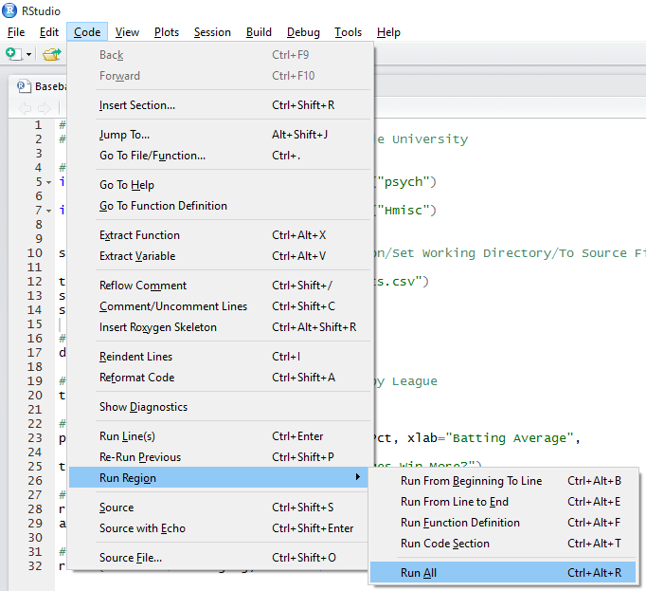
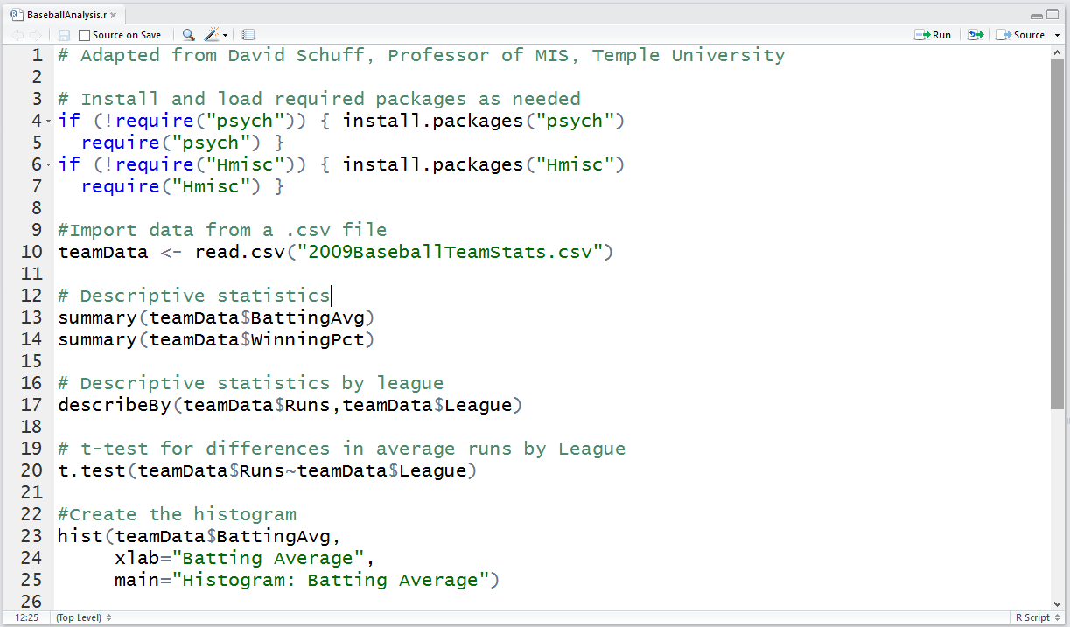
Running this analysis as a script
Use the Code | Run Region | Run All Menu
Commands can be entered one at a time, but usually they are all put into a single file that can be saved and run over and over again.

Slide 49
Classification using Decision Trees
MIS2502: Data Analytics
JaeHwuen Jung
jaejung@temple.edu
http://community.mis.temple.edu/jaejung

Slide 50
Case: Banks Dilemma While Working to Protect You From Fraud
To satisfy consumer demands, most banks today practice a 99% transaction approval rate on credit cards.
Yet with no proactive monitoring and fraud prevention mechanisms in place, financial institutions become vulnerable to all sorts of credit card scams.
"Machine learning can start modeling out what are the appropriate behaviors“
- Kurt Long, the CEO of FairWarning

Slide 51
What is Classification?
A statistical method used to determine to what category (or “class”) a new observation belongs
  On the basis of a training data set containing observations whose categories were known
Examples
Task | Observations | Categories (Classes)
Flagging a credit card transaction as a fraudulent charge | Credit card transactions | Fraudulent vs. legitimate
Filtering spam emails | Emails | Spam vs. non-spam
Determining whether a customer should be given a loan | Customers | Default vs. no default

Slide 52
How Classification Works
1
  Choose a categorical outcome variable
2
  Split the data set into training and validation subsets
3
  Use the training set to find a model that predicts the outcome as a function of the other attributes
4
  Apply the model to the validation set to check accuracy
5
  Apply the final model to future cases (i.e. prediction)

Slide 53
How Classification Works
Training Set
TID | Income | Debt | Owns/ Rents | Outcome
1 | 25k | 35% | Owns | Default
2 | 35k | 40% | Rent | Default
3 | 33k | 15% | Owns | No default
4 | 28k | 19% | Rents | Default
5 | 55k | 30% | Owns | No default
6 | 48k | 35% | Rent | Default
7 | 65k | 17% | Owns | No default
8 | 85k | 10% | Rents | No default
…
Derive model
Classification software (such as R)
Validation Set
TID | Income | Debt | Owns/ Rents | Outcome
1 | 80k | 35% | Rent | ?
2 | 20k | 40% | Owns | ?
3 | 15k | 15% | Owns | ?
4 | 50k | 19% | Rents | ?
5 | 35k | 30% | Owns | ?
Apply model

Slide 54
Goals
Accuracy
It won’t be 100% accurate, but should be as close as possible
Prediction
An automated, reliable way to predict the outcome
The trained model should assign new observations to the right category
The model’s rules can be applied to new records as they come along

Slide 55

Classification Method: Decision Tree
A model to determine membership of cases or values of a outcome variable based on one or more predictor variables (Tan, Steinback, and Kumar 2004)

Slide 56


Classification Method: Decision Tree
Classification tree
Split over income
Income
Age
<50K
>=50K
Age
45
Yes
Split over age
<45
>=45
X
Yes
X
No
50K
Default
Did not default
Income
X New customer

Slide 57
How Decision Tree algorithm works
Start with single node with all training data
Yes
Are samples all of same classification?
No
No
Are there predictor(s) that will split the data?
Yes
Partition node into child nodes according to predictor(s)
No
Are there more nodes (i.e., new child nodes)?
DONE!
Yes
Go to next node.

Slide 58
Example: Credit Card Default
Predictors
Classification
TID | Income | Debt | Owns/ Rents | Outcome
1 | 25k | 35% | Owns | Default
2 | 35k | 40% | Rent | Default
3 | 33k | 15% | Owns | No default
4 | 28k | 19% | Rents | Default
5 | 55k | 30% | Owns | No default
6 | 48k | 35% | Rent | Default
7 | 65k | 17% | Owns | No default
8 | 85k | 10% | Rents | No default
…
We create the tree from a set of training data
Each unique combination of predictors is associated with an outcome
This set was “rigged” so that every combination is accounted for and has an outcome
Training Set

Slide 59
Example: Credit Card Default
Predictors
Classification
Child node
Leaf node
TID | Income | Debt | Owns/ Rents | Outcome
1 | 25k | 35% | Owns | Default
2 | 35k | 40% | Rent | Default
3 | 33k | 15% | Owns | No default
4 | 28k | 19% | Rents | Default
5 | 55k | 30% | Owns | No default
6 | 48k | 35% | Rent | Default
7 | 65k | 17% | Owns | No default
8 | 85k | 10% | Rents | No default
…
Root node
Debt > 20%
Default
Income
<40k
Owns house
No Default
Debt < 20%
Rents
Default
Credit
Approval
Owns house
No Default
Debt > 20%
Income
>40k
Rents
Default
Debt < 20%
No Default
Training Set

Slide 60
Same Data, Different Tree
Predictors
Classification
Credit
Approval
Owns
Rents
Income < 40k
Income > 40k
Debt > 20%
Default
Debt < 20%
No Default
No Default
Income < 40k
Income > 40k
Default
Debt > 20%
Default
Debt < 20%
No Default
TID | Income | Debt | Owns/ Rents | Outcome
1 | 25k | 35% | Owns | Default
2 | 35k | 40% | Rent | Default
3 | 33k | 15% | Owns | No default
4 | 28k | 19% | Rents | Default
5 | 55k | 30% | Owns | No default
6 | 48k | 35% | Rent | Default
7 | 65k | 17% | Owns | No default
8 | 85k | 10% | Rents | No default
…
Training Set
We just changed the order of the predictors.

Slide 61
Start with root node
Credit
Approval
Income
<40k
Income
>40k
Debt > 20%
Rents
Debt > 20%
Debt < 20%
Owns house
Rents
Owns house
Debt < 20%
Default
No Default
Default
No Default
Default
No Default
There are both “defaults” and “no defaults” in the set
So we need to look for predictors to split the data
Credit
Approval

Slide 62
First split: on income
Credit
Approval
Income
<40k
Income
>40k
Debt > 20%
Rents
Debt > 20%
Debt < 20%
Owns house
Rents
Owns house
Debt < 20%
Default
No Default
Default
No Default
Default
No Default
Income (with 40k as the cutoff point) is a factor that produces the greatest “separation”
  More income, less default
But there are also a combination of defaults and no defaults within each income group
So look for another split
Credit
Approval
Income <40k
Income >40k

Slide 63
Second split: on debt
Credit
Approval
Income
<40k
Income
>40k
Debt > 20%
Rents
Debt > 20%
Debt < 20%
Owns house
Rents
Owns house
Debt < 20%
Default
No Default
Default
No Default
Default
No Default
Debt is a factor
  (Income < 40, Debt < 20, Owns = No default)
  but
  (Income < 40, Debt < 20, Rents = Default)
But there are also a combination of defaults and no defaults within some debt groups
So look for another split
Credit
Approval
Income <40k
Income >40k
Debt >20%
Debt <20%
Debt >20%
Debt <20%

Slide 64
Third split: on owns/rents
Credit
Approval
Income
<40k
Income
>40k
Debt > 20%
Rents
Debt > 20%
Debt < 20%
Owns house
Rents
Owns house
Debt < 20%
Default
No Default
Default
No Default
Default
No Default
Credit
Approval
Income <40k
Income >40k
Debt >20%
Debt <20%
Debt >20%
Debt <20%
Default
Owns house
Rents
No Default
Default
Owns house
Rents
No Default
Default
No Default
Owns/Rents is a factor
For some cases it doesn’t matter, but for some it does
So you group similar branches
…And we stop because we’re out of predictors!

Slide 65

How does it know when and how to split?
There are statistics that show
When a predictor variable maximizes distinct outcomes
(if age is a predictor, we should see that older people buy; younger people don’t)
When a predictor variable separates outcomes
(if age is a predictor, we should not see older people who buy mixed up with older people who don’t)

Slide 66
Decision Tree Algorithm
The decision tree algorithm takes a large set of training data to compute the tree
In the data:
Similar cases may have different outcomes
So probability of an outcome is computed
Credit
Approval
Income
<40k
Income
>40k
Debt > 20%
Rents
Debt > 20%
Debt < 20%
Owns house
Rents
Owns house
Debt < 20%
Default
No Default
Default
No Default
Default
No Default
0.6
For instance, you may find:
When income > 40k, debt > 20%, and the customers rents, default occurs 60% of the time.

Slide 67
Reading the Decision Tree Result
Outcome cases are not 100% certain
  There are probabilities attached to each outcome in a node
  So let’s code “Default” as 1 and “No Default” as 0
Credit
Approval
Income <40k
Income >40k
Debt >20%
Debt <20%
Debt >20%
Debt <20%
Owns house
Rents
Owns house
Rents
0.85
0.20
How many leaf nodes are there?
0.30
0.22
0.60
0.26

Slide 68
Reading the Decision Tree Result
Outcome cases are not 100% certain
  There are probabilities attached to each outcome in a node
  So let’s code “Default” as 1 and “No Default” as 0
Credit
Approval
Income <40k
Income >40k
Debt >20%
Debt <20%
Debt >20%
Debt <20%
Owns house
Rents
Owns house
Rents
Numbers next to the leaf nodes:
Represent the probabilities of the predicted outcome being 1 (1=“Default”)
0.85
0.20
0.30
0.22
0.60
0.26

Slide 69
Reading the Decision Tree Result
Outcome cases are not 100% certain
  There are probabilities attached to each outcome in a node
  So let’s code “Default” as 1 and “No Default” as 0
Credit
Approval
Income <40k
Income >40k
Debt >20%
Debt <20%
Debt >20%
Debt <20%
1
Owns house
Rents
0
0
Owns house
Rents
0
1
0
Numbers next to the leaf nodes:
Represent the probabilities of the predicted outcome being 1 (1=“Default”)
0.85
0.20
0.30
0.22
0.60
0.26

Slide 70
Reading the Decision Tree Result
Outcome cases are not 100% certain
  There are probabilities attached to each outcome in a node
  So let’s code “Default” as 1 and “No Default” as 0
Credit
Approval
Income <40k
Income >40k
Debt >20%
Debt <20%
Debt >20%
Debt <20%
1
Owns house
Rents
0
0
Owns house
Rents
0
1
0
0.85
0.20
For example, for people with income<40K, Debt>20%,
the probability of “default” is 0.85
(or 85%)
0.30
0.22
0.60
0.26

Slide 71
Reading the Decision Tree Result
Outcome cases are not 100% certain
  There are probabilities attached to each outcome in a node
  So let’s code “Default” as 1 and “No Default” as 0
Value of 1:
we predict that these people are likely to
“Default”
Credit
Approval
Income <40k
Income >40k
Debt >20%
Debt <20%
Debt >20%
Debt <20%
1
Owns house
Rents
0
0
Owns house
Rents
0
1
0
0.85
0.20
0.30
0.22
Value of 0:
we predict that these people are likely to “No Default”
0.60
0.26

Slide 72
Reading the Decision Tree Result
Outcome cases are not 100% certain
  There are probabilities attached to each outcome in a node
  So let’s code “Default” as 1 and “No Default” as 0
Credit
Approval
Income <40k
Income >40k
Debt >20%
Debt <20%
Debt >20%
Debt <20%
1
Owns house
Rents
0
0
Owns house
0
1
0
Rents
So what is the chance that:
1. A renter making more than $40,000 and debt more than 20% of income will default?
2. A home owner making less than $40,000 and debt less than 20% of income will default?
0.85
0.20
0.30
0.22
0.60
0.26

Slide 73
Reading the Decision Tree Result
Outcome cases are not 100% certain
  There are probabilities attached to each outcome in a node
  So let’s code “Default” as 1 and “No Default” as 0
Credit
Approval
Income <40k
Income >40k
Debt >20%
Debt <20%
Debt >20%
Debt <20%
1
Owns house
Rents
0
0
Owns house
0
1
0
Rents
So what is the chance that:
1. A renter making more than $40,000 and debt more than 20% of income will default?
2. A home owner making less than $40,000 and debt less than 20% of income will default?
0.85
0.20
0.30
0.22
0.60
0.26

Slide 74
Reading the Decision Tree Result
Outcome cases are not 100% certain
  There are probabilities attached to each outcome in a node
  So let’s code “Default” as 1 and “No Default” as 0
Credit
Approval
Income <40k
Income >40k
Debt >20%
Debt <20%
Debt >20%
Debt <20%
1
Owns house
Rents
0
0
Owns house
0
1
0
Rents
So what is the chance that:
1. A renter making more than $40,000 and debt more than 20% of income will default?
2. A home owner making less than $40,000 and debt less than 20% of income will default?
0.85
0.20
0.30
0.22
0.60
0.26

Slide 75
Reading the Decision Tree Result
Outcome cases are not 100% certain
  There are probabilities attached to each outcome in a node
  So let’s code “Default” as 1 and “No Default” as 0
Credit
Approval
Income <40k
Income >40k
Debt >20%
Debt <20%
Debt >20%
Debt <20%
1
Owns house
Rents
0
0
Owns house
Rents
0
1
0
0.85
0.20
Describe the characteristics of the most likely and least likely groups to default.
0.30
0.22
0.60
0.26

Slide 76
Reading the Decision Tree Result
Outcome cases are not 100% certain
  There are probabilities attached to each outcome in a node
  So let’s code “Default” as 1 and “No Default” as 0
Credit
Approval
Income <40k
Income >40k
Debt >20%
Debt <20%
Debt >20%
Debt <20%
1
Owns house
Rents
0
0
Owns house
Rents
0
1
0
0.85
0.20
Describe the characteristics of the most likely and least likely groups to default.
0.30
0.22
0.60
0.26

Slide 77
Apply to new (validation) data
Validation Set
Credit
Approval
Income
<40k
Income
>40k
Debt > 20%
Rents
Debt > 20%
Debt < 20%
Owns house
Rents
Owns house
Debt < 20%
Default
No Default
Default
No Default
Default
No Default
TID | Income | Debt | Owns/ Rents | Decision (Predicted) | Decision (Actual)
1 | 80k | 35% | Rent | Default | No Default
2 | 20k | 40% | Owns | Default | Default
3 | 15k | 15% | Owns | No Default | No Default
4 | 50k | 19% | Rents | No Default | Default
5 | 35k | 30% | Owns | Default | Default
How well did the decision tree do in predicting the outcome?
When it’s “good enough,” we’ve got our model for future decisions.

Slide 78
Classification Accuracy:
How often does the tree make a correct prediction?
Error rate: Percent of misclassified records out of the total records
Correct classification rate: Percent of correctly classified records out of the total records
Error rate + Correct classification rate = 100%
A good decision tree model should have high classification accuracy, meaning
  Low error rate
  High correct classification rate

Slide 79
Classification Accuracy: A Numeric Example
A Confusion Matrix compares the predicted outcomes to the observed (actual) outcomes
The Confusion Matrix
 |  | Predicted outcome:
 |  | Default | No default
Observed outcome: | Default | 600 | 100
 | No default | 150 | 650 | Total: 1500
Error rate = (150+100) /1500= 16.7%
Correct classification rate = (100%-16.7%) = 83.3%
  (Another way to compute:
  Correct classification rate = (600+650)/1500 = 83.3%)

Slide 80
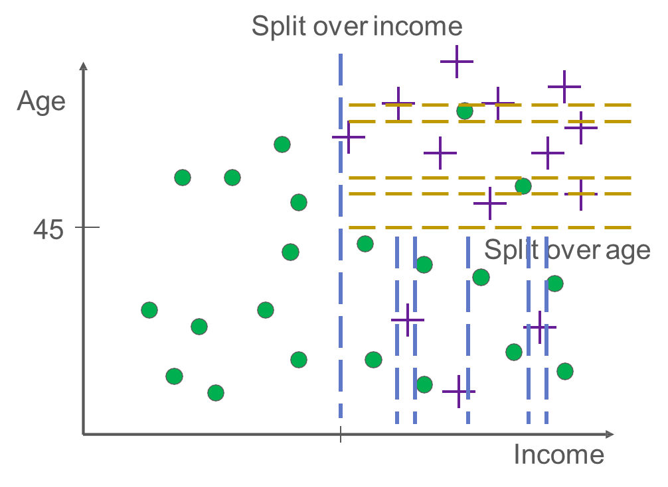
Can we keep splitting as long as it can?
You may get better classification accuracy for the training set
But the tree will become too complex
  Difficult to interpret
Another Problem: “Overfitting”

Slide 81
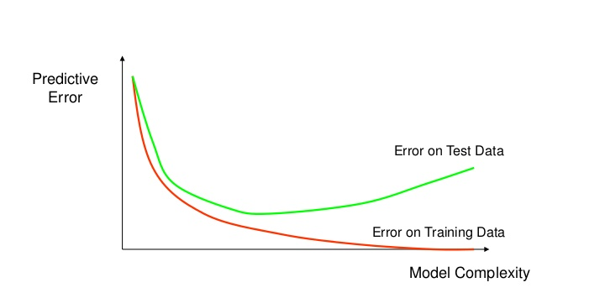
How overfitting affects prediction
  If the tree is too complex, it may have poor predictive performance for new data, as it can exaggerate minor fluctuations (noises) in the training data.
Error rate
Validation set
Training set
Tree size
“A good model must not only fit the training data well but also accurately classify records it has never seen.”

Slide 82
Avoid Overfitting: Control Tree Size
In R, you can control tree size using:
Minimum split
  Minimum number of observations in each node needed to add an additional split.
  Smaller minimum split →
  more complex tree
Complexity factor
  Minimum reduction in error needed to add an additional split.
  Smaller complexity factor →
  more complex tree

Slide 83
Avoid Overfitting: Prune the Tree
“Prune” the tree
Idea behind pruning:
A very large tree is likely to overfit the training set
Therefore the weakest branches, which hardly reduce error rate, should be removed

Slide 84
Summary
What is classification
Structure of a decision tree
  Outcome variables: categorical values
  Predictor variables
Classification accuracy:
  Error rate and correct classification rate
Interpret a decision tree
  Determine the probability of an event happening based on predictor variable values
Pros and cons of a complex tree
  Overfitting

Slide 85
Clustering and Segmentation
MIS2502: Data Analytics
JaeHwuen Jung
jaejung@temple.edu
http://community.mis.temple.edu/jaejung

Slide 86
Case: Walmart’s Customer Segmentation
Wal-Mart has partitioned its 200 million customers into three core consumer groups. The three are:
Value-Price Shoppers - Those with like low prices who can’t afford much more.
Brand Aspirationals - People with low incomes who are fixated on brand names like KitchenAid; and,
Price-Sensitive Affluents - Wealthier shoppers who love deals;
Armed with its new insights, Wal-Mart said, from now on, all product decisions would be organized around the three groups.
Link: http://www.scdigest.com/assets/newsViews/07-03-27-2.php?cid=977

Slide 87
What is Cluster Analysis?
The process of grouping data so that
Observations within a group will be similar to one another
Observations from different groups will be dissimilar
Distance within clusters is minimized
http://www.datadrivesmedia.com/two-ways-performance-increases-targeting-precision-and-response-rates/
Distance between clusters is maximized

Slide 88
Applications
Marketing (Market Segmentation)
Discover distinct customer groups for targeted promotions
Industry analysis
Finding groups of similar firms based on profitability, growth rate, market size, products, etc.
Political forecasting
Group neighborhoods by demographics, lifestyles and political view
Biology
Finance
Group similar plants into species
Define groups of similar stocks based on financial characteristics, and select stocks from different groups to create balanced portfolios

Slide 89
What cluster analysis is NOT
Classification
(like Decision Trees)
People simply place items into categories
Simple categorization by attributes
Dividing students into groups by last name
The clusters must be learned from the data, not from external specifications.
Creating the “buckets” beforehand is categorization, but not clustering.

Slide 90
How would you design an algorithm to group these data points?
Here is the initial data set

Slide 91
K-Means: Overview
“K” stands for number of clusters
  We have to choose a “K” first
The idea is assign each observation to one and only one cluster based on the similarity among observations
We call the center of each cluster as “centroid”

Slide 92
K-Means Demonstration
Choose K points as initial centroids

Slide 93
K-Means Demonstration
Assign data points according to distance

Slide 94
K-Means Demonstration
Recalculate the centroids

Slide 95
K-Means Demonstration
And re-assign the points

Slide 96
K-Means Demonstration
And keep doing that until you settle on a final set of clusters

Slide 97
K-Means Algorithm
Choose K clusters
Select K points as initial centroids
Assign each point to the cluster with the closest centroid
Yes
Recompute the centroid of each cluster
No
Did the center change?
DONE!

Slide 98
Another Interaction Demonstration
http://stanford.edu/class/ee103/visualizations/kmeans/kmeans.html
https://www.naftaliharris.com/blog/visualizing-k-means-clustering/

Slide 99

Choosing the initial centroids
It matters
Choosing the right number “K”
Choosing the right initial location
Bad choices create bad groupings
They won’t make sense within the context of the problem
Unrelated data points will be included in the same group
There’s no single, best way to choose initial centroids

Slide 100
Example of Poor Initialization
This may “work” mathematically but the clusters don’t make much sense.

Slide 101
Before Clustering:
Normalize (Standardize) the data
Sometimes we have variables in very different scales
  For example, income between $0-1 billion versus age between 0-100
Normalization: Adjusts for differences in scale
How to normalize data?
  Subtracting with the average and dividing by the standard deviation
  This transform data into a “standard” scale
    New average = 0
    New standard deviation = 1

Slide 102
Normalization: A Numeric Example
If we have 10 students’ age values:
The normalized age values would be:
Age
19
22
23
20
20
21
21
22
18
20
Age
-1.06
0.93
1.59
-0.40
-0.40
0.27
0.27
0.93
-1.73
-0.40
Average: 20.6
Standard deviation: 1.51
New average: 0
New standard deviation: 1
Normalizing 1st student’s age: (19-20.6)/1.51= -1.06
Normalizing 2nd student’s age: (22-20.6)/1.51= 0.93

Slide 103
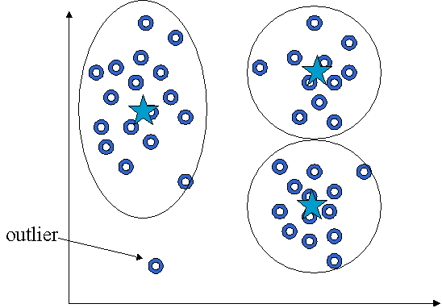
Before Clustering: Remove outliers
Find observations that are very different from others
  To reduce dispersion that can skew the cluster centroids
  And they don’t represent the population anyway
http://web.fhnw.ch/personenseiten/taoufik.nouri/kbs/clustering/DM-Part5.htm

Slide 104
Clusters can be ambiguous
How many clusters?
6
2
4
The difference is the threshold you set.
How distinct must a cluster be to be it’s own cluster?
adapted from Tan, Steinbach, and Kumar. Introduction to Data Mining (2004)

Slide 105
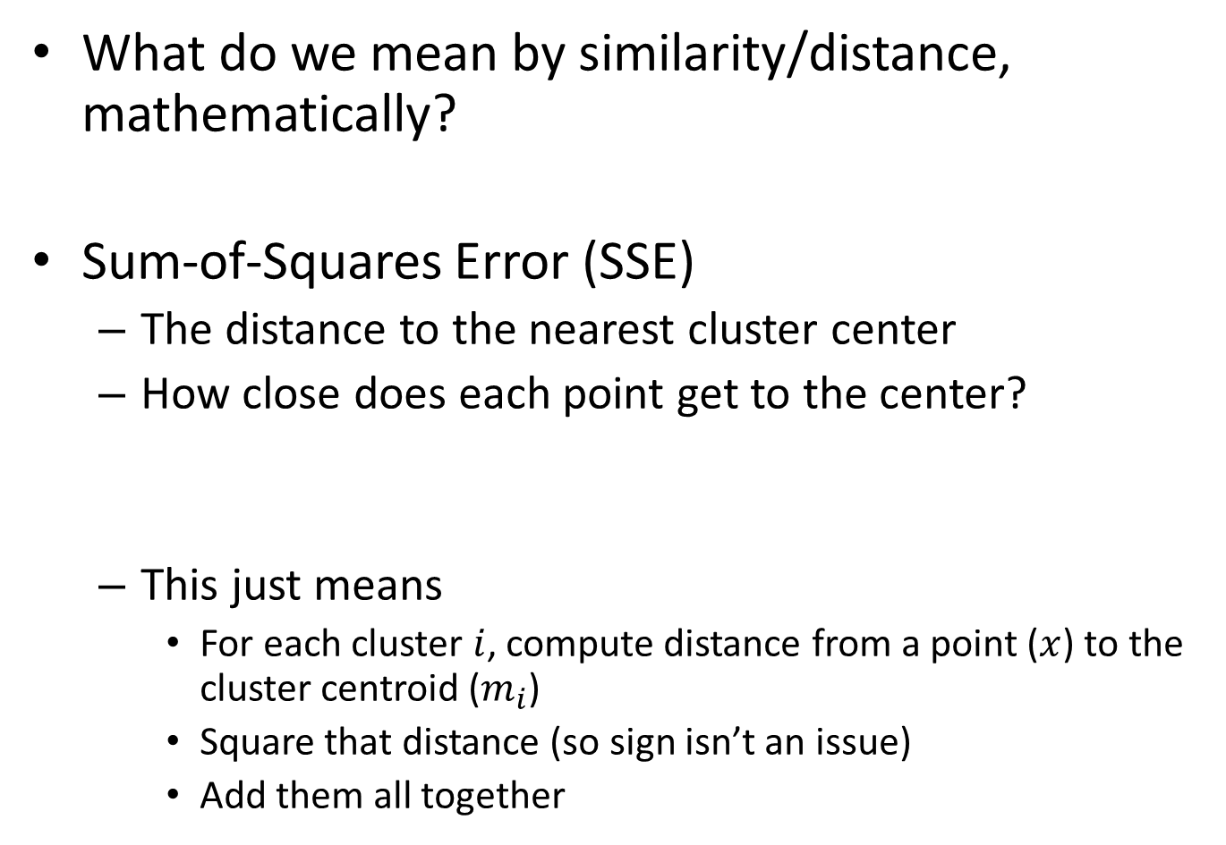
Evaluating K-means Clusters
What do we mean by similarity/distance, mathematically?
Sum-of-Squares Error (SSE)
  The distance to the nearest cluster center
  How close does each point get to the center?
  This just means
    For each cluster $i$, compute distance from a point ($x$) to the cluster centroid ($m_{i}$)
    Square that distance (so sign isn’t an issue)
    Add them all together
SSE is always non-negative (>=0)

Slide 106
Example: Within-Cluster SSE
Cluster 1
Cluster 2
3
3.3
1
1.3
1.5
2
SSE₁ = 1² + 1.3² + 2² = 1 + 1.69 + 4 = 6.69
SSE₂ = 3² + 3.3² + 1.5² = 9 + 10.89 + 2.25 = 22.14
Within-cluster SSE measures cohesion – how tightly grouped each cluster is

Slide 107
Within-Cluster SSE
Considerations
Lower individual within cluster SSE = a better cluster
Lower total SSE = a better set of clusters
More clusters will reduce within-cluster SSE
Reducing within-cluster SSE increases cohesion
(we want that)

Slide 108
SSE between clusters
(Between-cluster SSE)
What we are missing is: distance between centroids
Also can use SSE
  You’d want to maximize SSE between clusters
Increasing between-cluster SSE increases separation
(we want that)
Cluster 1
Cluster 5

Slide 109
Trade-off: Cohesion versus Separation
2 clusters
6 clusters
versus
More clusters → higher cohesion (good)
(lower within cluster SSE)
More clusters → lower separation (bad)
(lower between cluster SSE)

Slide 110
Choosing the number of clusters (K)
Can be determined by external reasons
In many cases, there’s no single answer…
But here’s what we can do:
  Make sure the clusters are describing distinct groups (separation).
  Make sure that the range of values on each variable within a cluster is not too large to be useful (cohesion).

Slide 111

Figuring out if our clusters are good
“Good” means
  Meaningful
  Useful
  Provides insight
How to interpret the clusters?
  Obtain summary statistics
  Visualize the clusters
This is somewhat subjective and depends upon the expectations of the analyst

Slide 112
Limitations of K-Means Clustering
K-Means gives unreliable results when
Clusters vary widely in size
Clusters vary widely in density
The data set has a lot of outliers
Clusters are not in rounded shapes
The clusters may never make sense.
In that case, the data may just not be well-suited for clustering!

Slide 113
The Keys to Successful Clustering
High cohesion
Low within-cluster SSE
High separation
High between-cluster SSE
We want:
Choose the right number of clusters
Choose the right initial centroids
No easy way to do this
Trial-and-error, knowledge of the problem, and looking at the output

Slide 114
Summary
What is cluster analysis?
When to use this technique (applications)?
What is the basic idea behind K-means clustering algorithm?
  K: the number of clusters
  Centroid
How to process data before clustering?
  Normalization
  Removing outliers
Sum of squares errors (SSE) – to measure distance
  Within-cluster SSE: Cohesion
  Between-cluster SSE: Seperation

Slide 115
Classification versus Clustering
Differences | Classification | Clustering
Prior Knowledge of classes (categories)? | Yes | No
Goal | Classify new cases into known classes | Suggest groups based on patterns in data
Algorithm | Decision Trees | K-means
Type of model | Predictive (to predict future data) | Descriptive (to understand or explore data)

Slide 116
Association Rule Mining
MIS2502: Data Analytics
JaeHwuen Jung
jaejung@temple.edu
http://community.mis.temple.edu/jaejung

Slide 117
Association Rule Mining
Find out which items predict the occurrence of other items
Also known as “affinity analysis” or “market basket” analysis

Slide 118
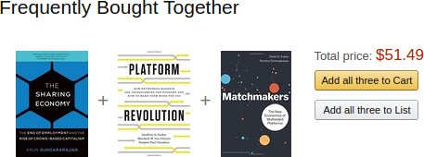
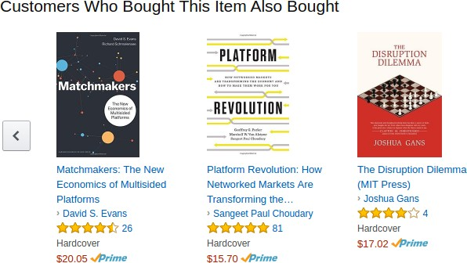
Case 1: Amazon Recommender System
Figure: Amazon recommendations while viewing a book

Slide 119
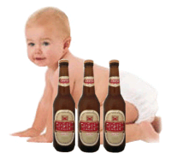
Case 2: The parable of the beer and diapers
It goes (with minor variations) like this:
Some time ago, one retail store decided to combine the data from its loyalty card system with that from its point of sale systems. The former provided the store with demographic data about its customers, the latter told it where, when and what those customers bought.
Once combined, the data was mined extensively and many correlations appeared. Some of these were obvious; people who buy gin are also likely to buy tonic. However, one correlation stood out like a sore thumb because it was so unexpected.
On Friday afternoons, young American males who buy diapers also have a predisposition to buy beer. No one had predicted that result, so no one would ever have even asked the question in the first place.

Slide 120
Market-Basket Transactions
Basket | Items
1 | Bread, Milk
2 | Bread, Diapers, Beer, Eggs
3 | Milk, Diapers, Beer, Coke
4 | Bread, Milk, Diapers, Beer
5 | Bread, Milk, Diapers, Coke
We usually start from a data set like this – with baskets of transactions
And the idea is to find associations between products

Slide 121
Market-Basket Transactions
Basket | Items
1 | Bread, Milk
2 | Bread, Diapers, Beer, Eggs
3 | Milk, Diapers, Beer, Coke
4 | Bread, Milk, Diapers, Beer
5 | Bread, Milk, Diapers, Coke
X → Y
(antecedent → consequent)
(aka LHS →RHS)
{Diapers} → {Beer},
{Milk, Bread} → {Diapers}
{Beer, Bread} → {Milk},
{Bread} → {Milk, Diapers}
Association Rules from these transactions

Slide 122
Core idea: The itemset
Itemset
A group of items of interest
{Milk, Diapers, Beer}
Association rules express relationships between itemsets
  X → Y
  {Milk, Diapers} → {Beer}
  “when you have milk and diapers, you are also likely to have beer”
Basket | Items
1 | Bread, Milk
2 | Bread, Diapers, Beer, Eggs
3 | Milk, Diapers, Beer, Coke
4 | Bread, Milk, Diapers, Beer
5 | Bread, Milk, Diapers, Coke

Slide 123
Support Count (σ)
Basket | Items
1 | Bread, Milk
2 | Bread, Diapers, Beer, Eggs
3 | Milk, Diapers, Beer, Coke
4 | Bread, Milk, Diapers, Beer
5 | Bread, Milk, Diapers, Coke
Support count (σ)
  In how many baskets does the itemset appear?
  σ{Milk, Diapers, Beer} = 2
  (i.e., in baskets 3 and 4)
You can calculate support count for both X and Y separately
  σ{Milk, Diapers} = ?
  σ{Beer} = ?
X
Y
2 baskets have milk, beer, and diapers
5 baskets total

Slide 124
Support (s)
Basket | Items
1 | Bread, Milk
2 | Bread, Diapers, Beer, Eggs
3 | Milk, Diapers, Beer, Coke
4 | Bread, Milk, Diapers, Beer
5 | Bread, Milk, Diapers, Coke
Support (s)
  Fraction of transactions that
  contain all items in the itemset
  s({Milk, Diapers, Beer})
  = σ{Milk, Diapers, Beer} /(# of transactions)
  =2/5 = 0.4
You can calculate support for both X and Y separately
  Support for X: s{Milk, Diapers}= ?
  Support for Y: s{Beer}= ?
X
Y
This means 40% of the baskets contain Milk, Diapers and Beers

Slide 125
Confidence (c)
Confidence (c) is the strength of the association
  Measures how often items in Y appear in transactions that contain X
Basket | Items
1 | Bread, Milk
2 | Bread, Diapers, Beer, Eggs
3 | Milk, Diapers, Beer, Coke
4 | Bread, Milk, Diapers, Beer
5 | Bread, Milk, Diapers, Coke
Support for total itemset X and Y
Support for X
This says 67% of the times when you have milk and diapers in the itemset you also have beer!
c must be between 0 and 1
1 is a complete association
0 is no association

Slide 126
Calculating and Interpreting Confidence
Basket | Items
1 | Bread, Milk
2 | Bread, Diapers, Beer, Eggs
3 | Milk, Diapers, Beer, Coke
4 | Bread, Milk, Diapers, Beer
5 | Bread, Milk, Diapers, Coke
Association Rule (a→b) | Confidence (a→b) | What it means
{Milk,Diapers} → {Beer} | 0.4/0.6 = 2/3= 0.67 | 2 baskets have milk, diapers, beer 3 baskets have milk and diapers So, 67% of the baskets with milk and diapers also have beer
{Milk,Beer} → {Diapers} | 0.4/0.4 = 2/2= 1.0 | 2 baskets have milk, diapers, beer 2 baskets have milk and beer So, 100% of the baskets with milk and beer also have diapers
{Milk} → {Diapers,Beer} | 0.4/0.8 = 2/4 = 0.5 | 2 baskets have milk, diapers, beer 4 baskets have milk So, 50% of the baskets with milk also have diapers and beer

Slide 127
But don’t blindly follow the numbers
i.e., high confidence suggests a strong association…
But this can be deceptive
Consider {Bread} →{Diapers}
Support for the total itemset is 0.6 (3/5)
And confidence is 0.75 (3/4) – pretty high
But is this just because both are frequently occurring items (s=0.8)?
You’d almost expect them to show up in the same baskets by chance

Slide 128
Lift
Takes into account how co-occurrence differs from what is expected by chance
  i.e., if items were selected independently from one another
Support for total itemset X and Y
Support for X times support for Y

Slide 129
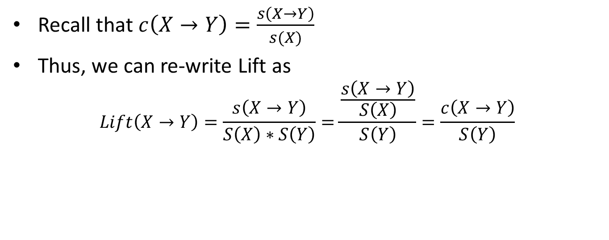
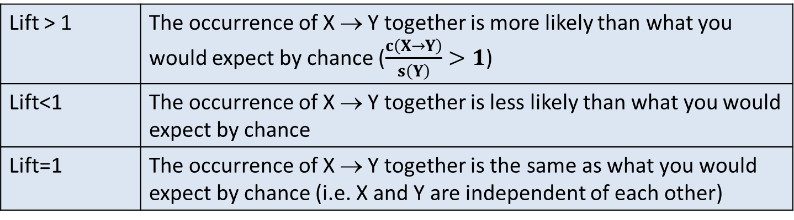
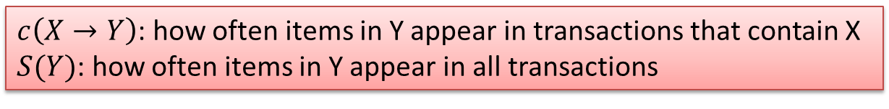
What does the Lift mean?
    Recall that$c\left(X→Y\right)=\frac{s\left(X→Y\right)}{s(X)}$
Thus, we can re-write Lift as
$$Lift\left(X→Y\right)=\frac{s\left(X→Y\right)}{S\left(X\right)∗S\left(Y\right)}=\frac{\frac{s\left(X→Y\right)}{S\left(X\right)}}{S\left(Y\right)}=\frac{c\left(X→Y\right)}{S\left(Y\right)}$$
$c\left(X→Y\right)$: how often items in Y appear in transactions that contain X
$S(Y)$: how often items in Y appear in all transactions
Lift > 1 | The occurrence of X → Y together is more likely than what you would expect by chance ($\frac{c\left(X→Y\right)}{s\left(Y\right)}>1$)
Lift<1 | The occurrence of X → Y together is less likely than what you would expect by chance
Lift=1 | The occurrence of X → Y together is the same as what you would expect by chance (i.e. X and Y are independent of each other)

Slide 130
Lift Example
Basket | Items
1 | Bread, Milk
2 | Bread, Diapers, Beer, Eggs
3 | Milk, Diapers, Beer, Coke
4 | Bread, Milk, Diapers, Beer
5 | Bread, Milk, Diapers, Coke
What’s the lift for the rule:
{Milk, Diapers} → {Beer}
So X = {Milk, Diapers}
Y = {Beer}
s({Milk, Diapers} → {Beer}) = 2/5 = 0.4
s({Milk, Diapers}) = 3/5 = 0.6
s({Beer}) = 3/5 = 0.6
So
When Lift > 1, the occurrence of
X → Y together is more likely than what you would expect by chance

Slide 131
Another example
 | Netflix
Cable TV |  | No | Yes
 | No | 200 | 3800
 | Yes | 8000 | 1000
What is the effect of Netflix on Cable TV?
(Netflix → CableTV)
Total = 200 + 3800 + 8000 + 1000 = 13000
People with both services = 1000/13000 → 7%
People with Cable TV = (8000+1000)/13000 → 69%
People with Netflix = (3800+1000)/13000 → 37%
Having one negatively affects the purchase of the other
(lift < 1)

Slide 132
Selecting the rules
The steps
List all possible association rules
Compute the support and confidence for each rule
Drop rules that don’t make the thresholds
Use lift to further check the association
We know how to calculate the measures for each rule
  Support
  Confidence
  Lift
Then we set up thresholds for the minimum rule strength we want to accept

Slide 133
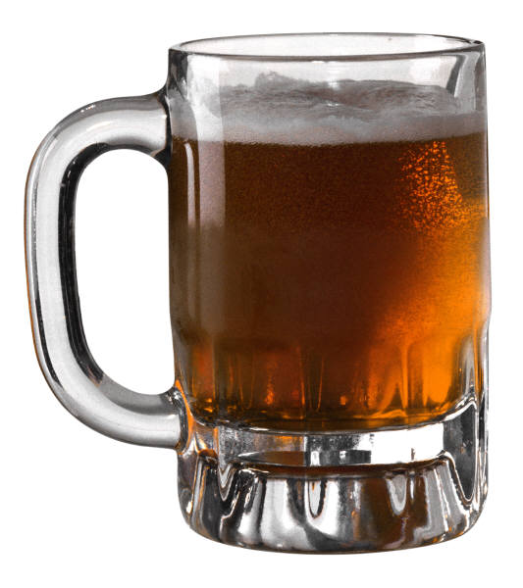
Once you are confident in a rule, take action
{Diapers} → {Beer}
Possible Marketing Actions
Put diaper next to beer in the store
What are some others?
Put diaper away from beer in the store (why?)
Bundle beer and diaper into “New Parent Coping Kit”

Slide 134
Summary
Support, confidence, and lift
  Explain what each means
    Can you have high confidence and low lift?
  How to compute
In-Class Activity:
  Part 1: Computing Confidence, Support, and Lift
  Part 2: Association Rule Mining Using R

Slide 135
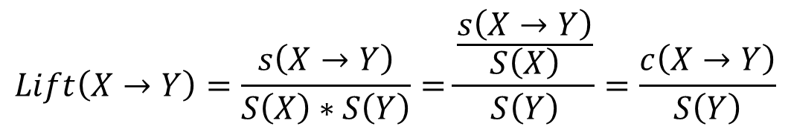
Support
  Fraction of transactions that contain all items
Confidence
  Measures how often items in Y appear in transactions that contain X
Lift
  How co-occurrence differs from what is expected by chance
$$Lift\left(X→Y\right)=\frac{s\left(X→Y\right)}{S\left(X\right)∗S\left(Y\right)}=\frac{\frac{s\left(X→Y\right)}{S\left(X\right)}}{S\left(Y\right)}=\frac{c\left(X→Y\right)}{S\left(Y\right)}$$

