Slide 1
MIS2502: Data Analytics Course Introduction
Zhe (Joe) Deng
deng@temple.edu
http://community.mis.temple.edu/zdeng

Slide 2
A little bit about Me
Zhe (Joe) Deng (Just call me Joe or Deng)
Ph.D. student, RA, Presidential Fellow (Temple University)
Background:
M.S. Information Systems and Operations Management (University of Florida)
B.S. Information Management and Information Systems (Northwest University)
Research area:
Economics of IS (Education), Healthcare IS, Social Network Mining
Randomized field experiment, Econometric analysis
Current programming languages: Stata, R, Python, SPSS

Slide 3
Office hours
Instructor: Zhe Deng (deng@temple.edu )
Wednesdays, 15:00 – 17:00, 201 Speakman Hall
Or by email appointment
Please put [MIS2502] into the subject line
ITA: David Shin (david.shin@temple.edu)
Mondays, 15:00 – 16:30, 602 Alter Hall
Please put [MIS2502] into the subject line

Slide 4
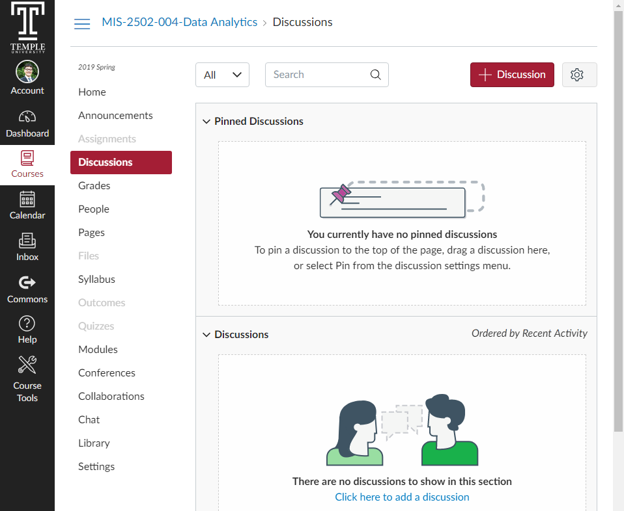
Discussion Board on Canvas
Maybe the best way to find your common questions and the fastest way to get feedback.

Slide 5
A little bit about You
MIS 2502 Survey: Getting to know you
(Please complete the survey by Jan 14th)

Slide 6
Course Websites
Website | Usage
Community Site: http://community.mis.temple.edu/mis2502sec004s2019 | syllabus, schedule, class announcements, slide decks, in-class exercises, assignment instructions, as well as other course documents.
Canvas: https://canvas.temple.edu | assignment submission, share solutions, and post grades.

Slide 7
Evaluation and Grading
Item | Percentage
Exams (3) | 60%
Assignments (8) | 30%
In-class activities | 5%
Presence & participation | 5%

Slide 8
Exams
There will be three exams.
Tentative exam schedules:
Exam 1: 2/19 during class time
Exam 2: 3/26 during class time
Exam 3: 5/7 during class time
Makeup examinations will only be given in accordance with the official University policy.

Slide 9
Assignments
# | Assignment
1 | ER Modeling
2 | SQL #1 – Getting Data out of the Database in mySQL
3 | SQL #2 – Putting Data into the Database in mySQL
4 | ETL in Tableau Prep
5 | Introduction to R
6 | Decision Trees in R
7 | Clustering in R
8 | Association Rules in R

Slide 10
Late Assignment Policy
All assignments will be assessed a 50% penalty (subtracted from that assignment’s score) for the first day (i.e. 24 hours) they are late.
No credit will be given for assignments turned in more than 24 hours past the deadline.
Equipment failure is not an acceptable reason for turning in an assignment late

Slide 11
In-Class Activities
You learn data analytics skills through
Your own hands-on experience
Interaction with peers and instructor
Classroom presentation
(in the order of decreasing priority)
Deliverables:
Submit by the end of the class
Graded based on completeness and correctness
Graded by success or fail
Will not accept late submission
Allowed to miss two submissions for in-class activities

Slide 12
Presence & Participation
Although class presence and participation are not a part of the evaluation, I will occasionally check the participation and use the record as a reference in case I curve the grades.
You should be in class at the moment I check the attendance to get a credit.

Slide 13
Plagiarism and Academic Dishonesty
Copying material directly, word-for-word, from a source (including the Internet)
Turning in an assignment from a previous semester as if it were your own
Having someone else complete your homework or project and submitting it as if it were your own
Using material from another student’s assignment in your own assignment
Penalties for such actions can range from a failing grade for the individual assignment, to a failing grade for the entire course, to expulsion from the program.

Slide 14
A Note on Regrade Requests
Must be submitted within 1 week of the date when the grade was returned.
I and the ITA reserve the right to regrade the entire assignment/exam and thus your grade may go up or down.

Slide 15
Professional Achievement Point Requirement (MIS Majors Only)
All MIS majors are required to earn a minimum of 200 professional achievement points by the end of the semester.
Students who do not earn the minimum number of professional achievement points by the end of the semester will receive an “Incomplete” for this course

Slide 16
Q
What comes to your mind when you think of
Data Analytics?

Slide 17
Definition from Wikipedia
“Data Analytics
is the discovery and communication of meaningful patterns in data.”

Slide 18
Definition from WhatIs.com
“Data analytics
is the science of examining raw data
with the purpose of drawing conclusions about that information.”

Slide 19
Definition from Techopedia
“Data analytics
refers to qualitative and quantitative techniques and processes
used to enhance productivity and business gain.”

Slide 20
Getting from Data to Decisions
It is about asking the right questions and being curious – be a “data detective”

Slide 21
Steps to be a Data Detective
1. Set objectives: What do you want to achieve?
2. Gather data , analyze data: What do you need to know?
3. Generate insights: What did you learn? What questions still need to be answered?
4. Make decisions: How can you turn data-based insights into action?

Slide 22
Course Overview
What this course is about
Introduce you to some fundamental and widely used concepts and techniques in data analytics
- designing database systems (e.g. ERD, SQL) and
- analyzing business data (e.g. Clustering, Classification)
- which have become part of today’s “business language”
Think about how you can use them in your future career
Expose you to various software tools (MySQL, R, Tableau Prep) to actually solve some problems using what you will learn

Slide 23
Course Overview
What this course is NOT about
Ask you to memorize definitions, formulas, algorithms, or software commands
- Understanding and intuitions are far more important than short-term memory, and a lot harder to forget
- In any homework/exam, I will never ask you to reproduce a definition, but will ask you to express your understanding of certain concepts
Train you to be a skilled programmer

Slide 24
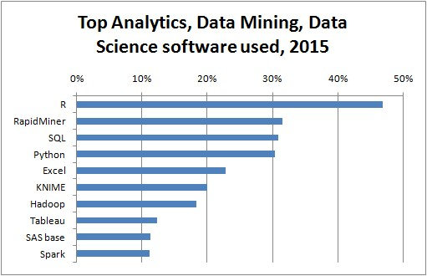
http://www.kdnuggets.com/2015/05/poll-r-rapidminer-python-big-data-spark.html

