Slide 1



MIS2502:
Data Analytics
Things You Can Do With Data
&
Information Architecture
Zhe (Joe) Deng
deng@temple.edu
http://community.mis.temple.edu/zdeng

Slide 2

Why data analytics?
2009
40% of decisions by managers are made by using their “gut”¹
2016
60% were “not very confident” in their data and analytics insights²
2018
92% concerned about impact of data and analytics on reputation³
¹ https://www.cio.com/article/2373576/enterprise-software/to-hell-with-business-intelligence--40-percent-of-execs-trust-gut.html
² https://www.cio.com/article/3138049/analytics/executives-still-mistrust-insights-from-data-and-analytics.html
³ https://www.zdnet.com/article/most-executives-dont-trust-their-organizations-data-analytics-and-ai

Slide 3

It all starts with data
Data
Gathering
Storing
Retrieving
Interpreting
Almost every business action requires at least one of these!

Slide 4

Data versus information
Data
Information
Discrete, unorganized, raw facts
The transformation of those facts into meaning

Slide 5
Examples of Data
Data
Quantity sold
Information
Course enrollment
Star rating
Customer name
Discount
?

Slide 6

Examples of Data:
UC Irvine Machine Learning Repository
http://archive.ics.uci.edu/ml/index.php

Slide 7
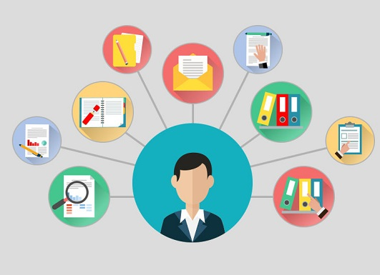
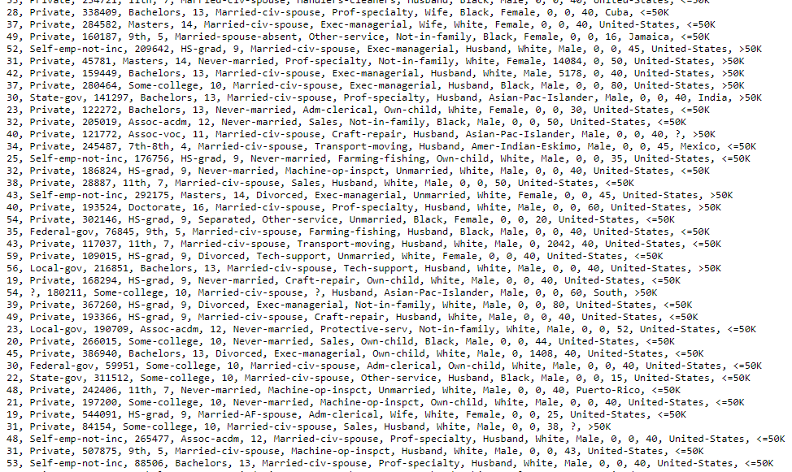
So then how do companies turn data into information?

Slide 8
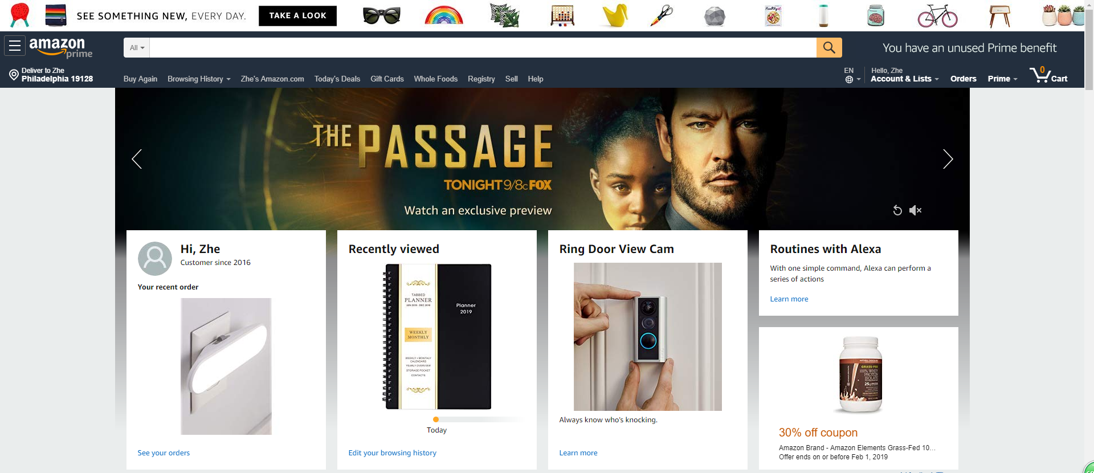

Collect my family members’ online purchasing data
Predict/recommend products/services we may need
https://www.linkedin.com/pulse/big-data-walmart-future-retail-bernard-marr
https://www.dezyre.com/article/how-big-data-analysis-helped-increase-walmart-s-sales-turnover/109

Slide 9
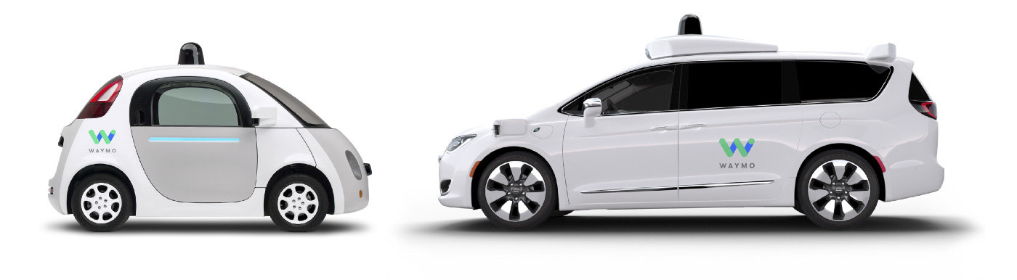

Autonomous Driving:
Waymo(formerly the Google self-driving car project)
https://waymo.com

Slide 10
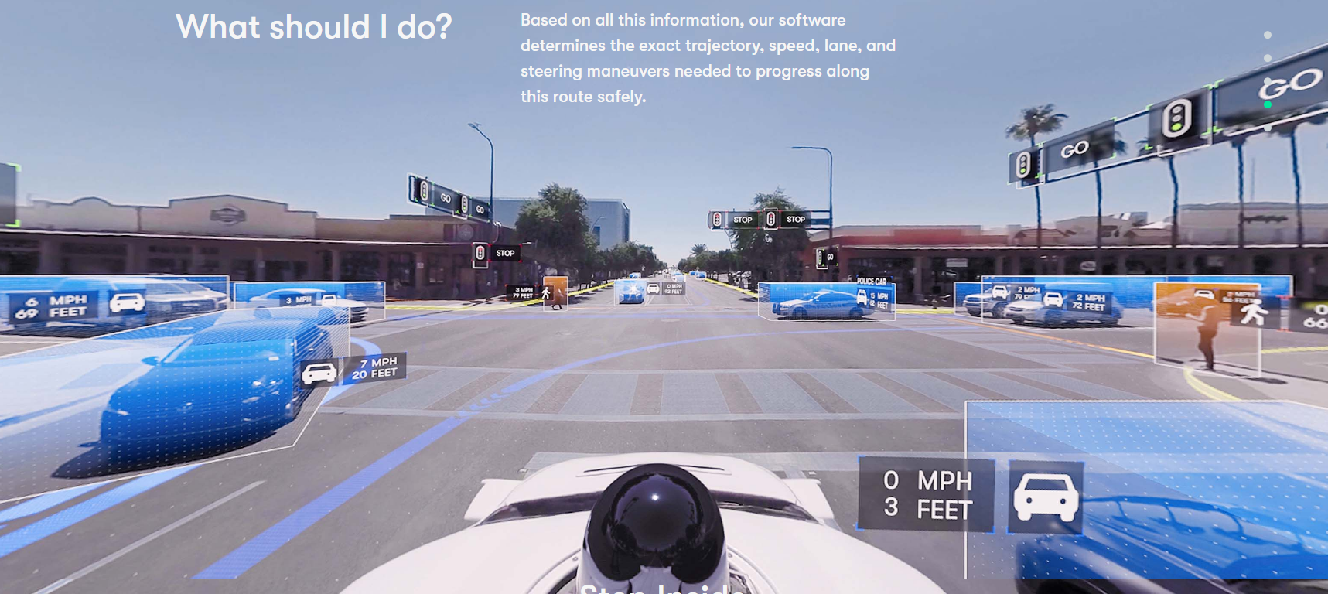
https://waymo.com
To realize this:
What kind of data does Waymo need to gather/store?
What operational info can the system retrieve/interpret/predict?

Slide 11
Q: Your Own Examples?
Social Genome project
  Increase effectiveness of advertising on social networks
  Predict what people want to buy, based on their conversations with friends
Own search engine Polaris
  use sophisticated semantic analysis to work out what a customer wants

Slide 12
Two types of data
Transactional
Captures data to support operation
Analytical
Captures data to support analysis and reporting
An aggregated view of the business
Real-time
Historical
Data describing an event
!
Explain the role of transactional and analytical data in the examples on the previous slides.

Slide 13

The information architecture of an organization
Data entry
Transactional Database
Data extraction
Analytical
Data Store
Data analysis
Series of tables stored in a relational database
Stored as structured or unstructured data in a variety of formats.

Slide 14
Transactional versus analytical data
Transactional Database
Captures data describing an event
Analytical Data Store
Used in analysis and reporting
For everyday transactions
Extracted from transactional data
Supports management of an organization’s data
Supports managerial decision-making
Database: Software to manage the storage & retrieval of data
Data store: Generic; anywhere data is stored (i.e., a text file)

Slide 15
Why do we need both?
Transactional Database
Analytical Data Store
Does not minimize redundancy
Minimizes redundancy
Slow for data retrieval
Fast for data retrieval
Uses storage space efficiently
Uses storage space inefficiently
Not native format for analysis
Analysis ready data
Good for maintaining high quality, high accuracy data
Good for performing high speed data analytics

Slide 16
The tools we’ll use in this course
R and RStudio
Data entry
Transactional Database
Data extraction
Analytical
Data Store
Data analysis
MySQL Server &
MySQL Workbench
Plain-text file
(csv, JSON, XML)
Tableau Prep

