Slide 1



MIS2502:
Data Analytics
Relational Data Modeling 2
Zhe (Joe) Deng
deng@temple.edu
http://community.mis.temple.edu/zdeng

Slide 2


The Entity Relationship Diagram (ERD)
The primary way of modeling a relational database
ER Diagrams --- are sketches like this one!
Primary Key
TUID
Cardinality
Course
number
Name
Student
contains
Course
Attribute
GPA
Entity
Relationship
Course Title

Slide 3
The Entity Relationship Diagram (ERD)
Three main diagrammatic elements
Entity
A uniquely identifiable thing (i.e., person, order)
Rectangle
Attribute
A characteristic of an entity or relationship (i.e., first name, order number)
Ellipse
Relationship
Describes how two entities relate to one another
(i.e., makes)
Diamond

Slide 4

Crow’s Foot Notation
Last component: Cardinality
Customer
makes
Order
There are other ways of denoting cardinality, but this one is pretty standard.
So called because this…
…looks something like this
There are also variations of the crows feet notion!

Slide 5
Cardinality
Defines the rules of the association between entities
Maximum cardinality
(Close to entities)
Customer
makes
Order
Minimum cardinality
(Close to relationship)
Maximum cardinality
  Describes the maximum number of entities that participate in a relationship (either or )
Minimum cardinality
  Describes the minimum number of entities that must participate in a relationship (either or )

Slide 6
Cardinality
How to understand the notations:
Entity – Relationship – Cardinality – Entity
Customer
makes
Order
Minimum cardinality:
at least – one
at most - one
at least – zero (optional)
at most - many
Maximum cardinality:
Maxinum cardinality:
  One customer can have many orders.
  One order can only belong to one customer.
Minimum cardinality:
  A customer could have no orders.
  An order has to belong to at least one customer.

Slide 7
Maximum and Minimum Cardinality
Maximum cardinality (type of relationship)
  Describes the maximum number of entity instances that participate in a relationship
    One-to-one
    One-to-many
    Many-to-many
Minimum cardinality
  Describes the minimum number of entity instances that must participate in a relationship
    Either optional or mandatory

Slide 8
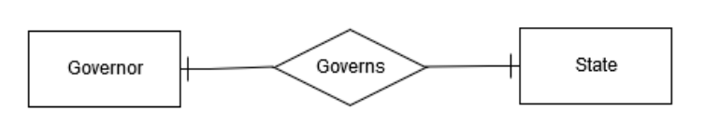
Maximum cardinality: One-to-One Relationship
One-to-One (1:1)
  A single instance of one entity is related to a single instance of another entity
A state has (at most) one governor
A governor governs (at most) one state

Slide 9
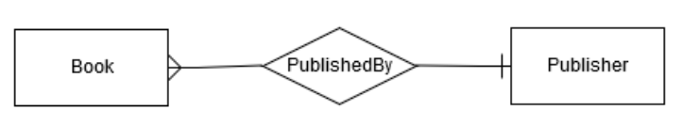
Maximum cardinality: One-to-Many Relationship
One-to-Many (1:n or 1:m)
  A single instance of one entity is related to multiple instances of another entity
A publisher can publish many books
A book is published by (at most) one publisher
Notes:
most common
Award
Pet owner

Slide 10
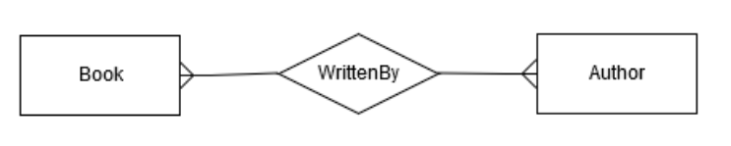
Maximum cardinality: Many-to-Many Relationship
Many-to-Many (n:n or m:m)
  Each instance of one entity is related to multiple instances of another entity, and vice versa
A book can be written by many authors
An author can write many books

Slide 11
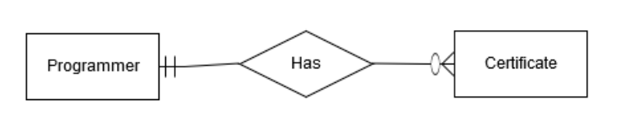
Minimum Cardinality
Minimums are generally stated as either zero or one:
  0 (optional): participation in the relationship by the entity is optional.
  1 (mandatory): participation in the relationship by the entity is mandatory.
A programmer is mandatory for a certificate); or a certificate has to be issued to (at least) one programmer.
A certificate is optional for a programmer; or a programmer may not have any certificates
1:m maximum cardinality: a programmer
can have many certificates; a certificate is issued to (at most) one programmer

Slide 12
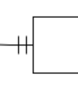
Crow’s Foot Notation Summary
Symbol | Minimum Cardinality + Maximum Cardinality
 | Optional + One
 | Mandatory + One
 | Optional + Many
 | Mandatory + Many

Slide 13
The Order-Product Example:
A Many-to-Many (m:m) Relationship
An order can be composed of many products.
An order has to have at least one product.
A product can be a part of many orders.
A product has to be associated with at least one order.
Order
number
Order Date
Order
at most – many
at least – one
contains
Quantity
Does it make sense for the maximum cardinality to be 1 for either entity?
Does it make sense for the minimum cardinality to be 0 (optional) for either entity?
at least – one
at most - many
Product
Product
name
Price
Product
ID

Slide 14
Relationship Attributes
Name
TUID
The grade and semester describes the combination of student and course
(i.e., Bob takes MIS2502 in Fall 2011 and receives a B; Sue takes MIS2502 in Fall 2012 and receives an A)
Student
Grade
contains
Semester
Course
Course
number
Course Title

Slide 15
Cardinality is defined by business rules
What would the cardinality be in these situations?
Order
?
contains
?
Product
Course
?
has
?
Section
Employee
?
has
?
Office

Slide 16
A scenario: The auto repair shop
A car is described by a VIN, make, and model.
A mechanic is described by a name and SSN.
A repair is described by a price.
A transaction occurs on a particular date.
An invoice has an invoice number and a billing name, city, state, and zip code.
Each transaction is associated with a car, a mechanic, and a repair.
Many transactions can make up an invoice.
A transaction can only belong to one invoice.
Cars, mechanics, and repairs can all be part of multiple transactions.

Slide 17
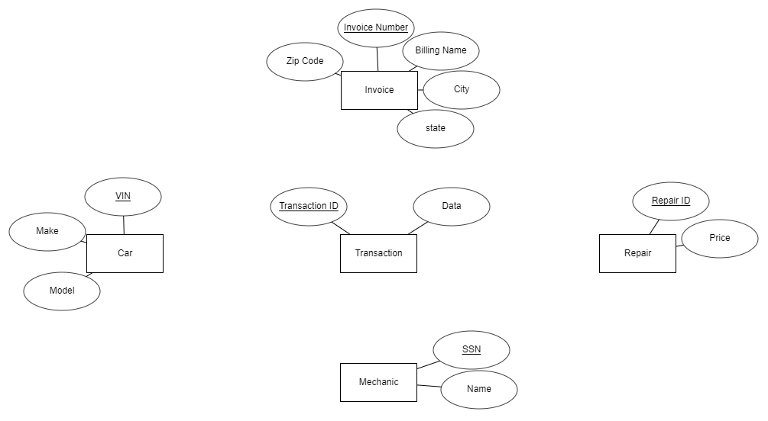
Solution: Entities

Slide 18
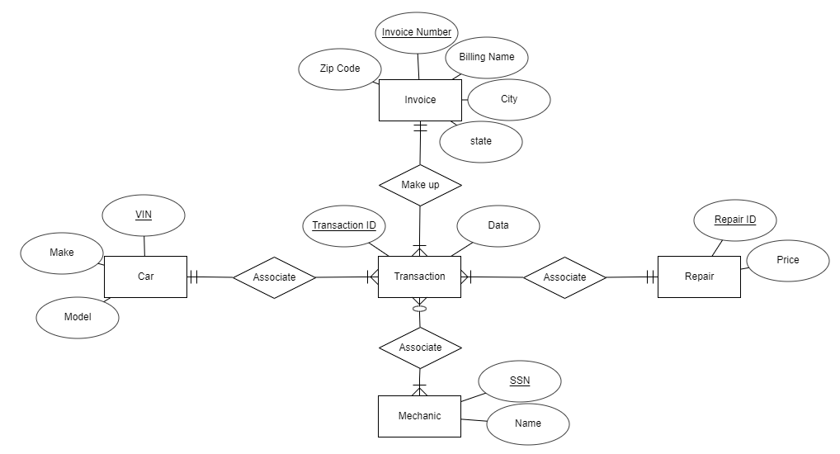
Solution: EDR
TIPS: ONE relationship can ONLY link TWO entities.
If one needs more connections, it should be a NEW entity! (E.g., transaction, order, record, etc.)

Slide 19
Normalization
Organizing data to minimize redundancy (repeated data)
This is good for several reasons
  The database takes up less space
  Fewer inconsistencies in your data
  Easier to search and navigate the data
It’s easier to make changes to the data
  The relationships take care of the rest

Slide 20

Normalizing your ER Model
If an entity has multiple sets of related attributes, split them up into separate entities
Don’t do this…
Vendor Name
Vendor Phone
Vendor Address
Vendor Name
Vendor Phone
Vendor Address
Vendor
Vendor ID
Product
ID
Product
Product
name
sells
Price
…do this →
Then you won’t have to repeat vendor information for each product.
Product
Product
name
Price
Product
ID

Slide 21
Normalizing your ER Model
Each attribute should be atomic – you can’t (logically) break it up any further.
Don’t do this…
…do this
Phone
Address
Phone
First Name
Customer
ID
Customer
First/Last
Name
Customer
ID
Customer
Last Name
Street
City
State
Zip
This way you can search or sort by last name OR first name, and by city, state, or zip code.

Slide 22
Summary of ERD
Key concepts
  Entity
  Relationship
  Attributes
    Entity attributes: primary key vs. non-key
    Relationship attributes
  Cardinality
    Minimum cardinality: optional or mandatory (i.e., 0 or 1)
    Maximum cardinality: 1:1, 1:m, m:m
    Crow’s foot notation
Key skills
  Interpret simple ERDs
  Draw an ERD based on a scenario description

Slide 23
Mapping natural language
English grammar structure | ER structure
Proper noun | Entity
Transitive verb | Relationship type
Adjective | Attribute for entity
Adverb | Attribute for relationship
Chen, P. P. S. (1997). English, Chinese and ER diagrams. Data & Knowledge Engineering, 23(1), 5-16.

Slide 24
Drawing ERD With ERDPlus: A Checklist
Entities
Entity attributes
  Primary key
  Non-key attributes
Relationships
  Minimum cardinality
  Maximum cardinality
Relationship attributes

Slide 25


Time for our 2nd ICA!

