Slide 1



MIS2502:
Data Analytics
Data Extract, Transform, Load(ETL)
Zhe (Joe) Deng
deng@temple.edu
http://community.mis.temple.edu/zdeng

Slide 2

Where we are…
Now we’re here…
Data entry
Transactional Database
Data extraction
Analytical
Data Store
Data analysis
Series of tables stored in a relational database
Stored as structured or unstructured data in a variety of formats.

Slide 3
The tools we use in this course
R and RStudio
Data entry
Transactional Database
Data extraction
Analytical
Data Store
Data analysis
MySQL Server &
MySQL Workbench
Plain-text file
(csv, JSON, XML)
Tableau Prep

Slide 4

Extract, Transform, Load (ETL)
Extract data from the operational data store
Transform data into an analysis-ready format
Load it into the analytical data store

Slide 5
The Actual Process
Extract
Transform
Load
Transactional Database 1
Data conversion
Transactional Database 2
Data conversion
Analytical Data store
Other Sources
Data conversion
Relational database
Dimensional database

Slide 6

ETL is Not That Easy!
Data Consistency
What if the data is in different formats?
Data Quality
How do we know it’s correct?
What if the data we need isn’t there?
What if there is missing data?

Slide 7
Data Consistency:
The Problem with Legacy Systems
Legacy System: a previous or outdated computer system still in use
  US Department of Defense computers used to operate nuclear weapons still running on computers from the 1970s at a cost of billions of dollars each year to taxpayers
  Most car rental companies are still using MS-DOS to manage rental transactions

Slide 8
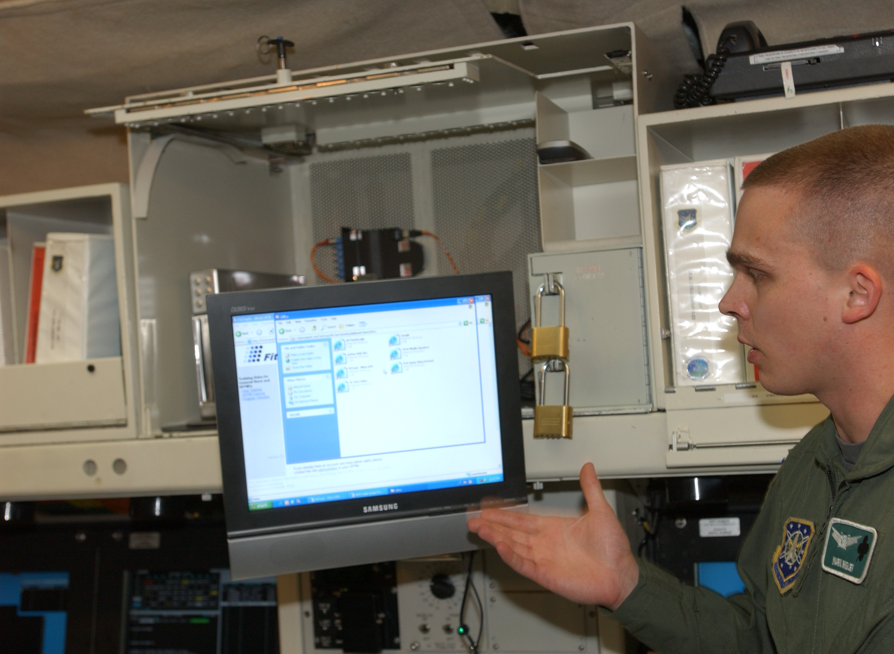

Data Consistency:
Legacy Systems Example

Slide 9
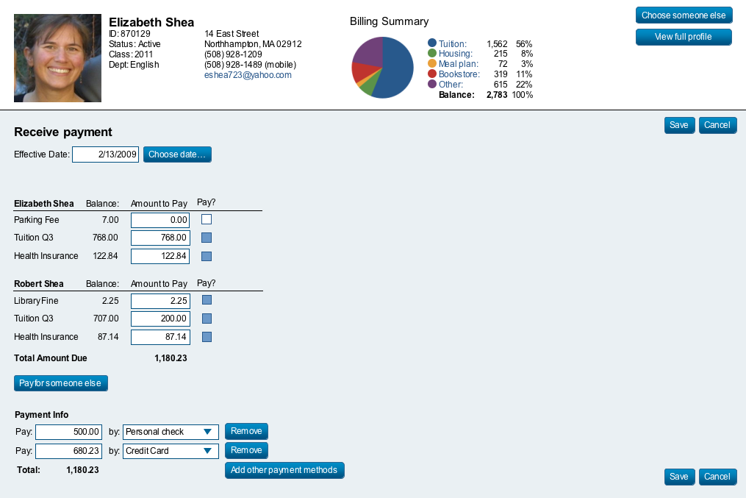
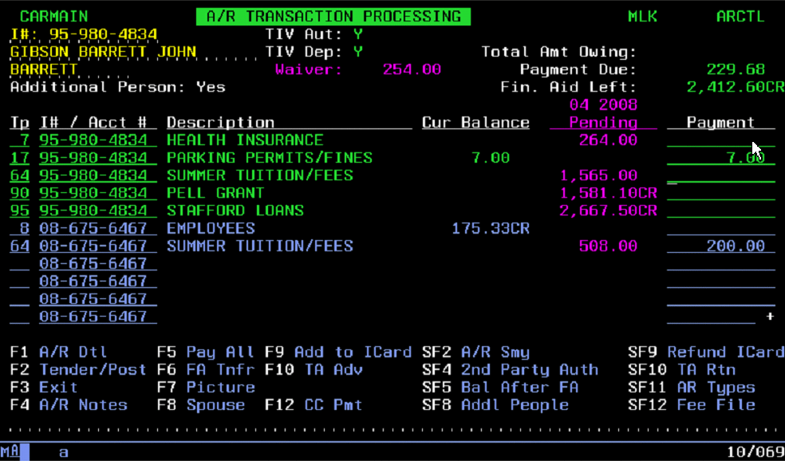
Data Consistency:
Legacy Systems Example

Slide 10
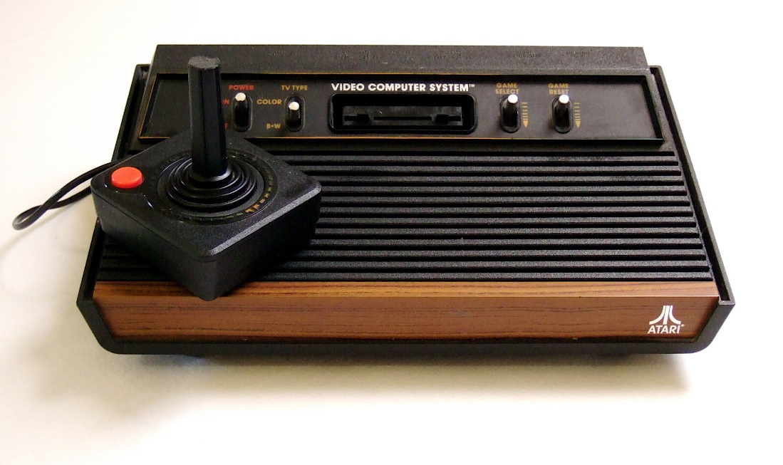
Data Consistency:
The Problem with Legacy Systems
An IT infrastructure evolves over time
Systems are created and acquired by different people using different specifications
This can happen through:
Changes in management
Mergers & Acquisitions
Externally mandated standards
Generally poor planning

Slide 11
Why Not Replacing Legacy Systems?
Too much risk
Prohibitive cost
User reluctance
Limited business agility
Speed of delivery
Source: https://www.onbase.com/~/media/Files/hyland/whitepaper/wp_trouble-with-legacy-systems.pdf

Slide 12
This leads to many issues
Redundant data across the organization
Customer record maintained by accounts receivable and marketing
The same data element stored in different formats
Social Security number (123-45-6789 versus 123456789)
Different naming conventions
“Doritos” versus “Frito-Lay’s Doritos” verus “Regular Doritos”
Different unique identifiers used
Account_Number versus Customer_ID
What are the problems with each of these
?

Slide 13
What’s the big deal?
This is a fundamental problem for creating data cubes
We often need to combine information from several transactional databases
How do we know if we’re talking about the same customer or product?

Slide 14
Now think about this scenario
Hotel Reservation Database
Café Database
What are the differences between a “guest” and a “customer”?
Is there any way to know if a customer of the café is staying at the hotel?

Slide 15
Solution: “Single view” of data
The entire organization understands a unit of data in the same way
It’s both a business goal and a technology goal
but it’s really more this…
...than this

Slide 16
Closer look at the Guest/Customer
Guests
Guest_number
Guest_firstname
Guest_lastname
Guest_address
Guest_city
Guest_zipcode
Guest_email
Customer
Customer_number
Customer_name
Customer_address
Customer_city
Customer_zipcode
vs.
Getting to a “single view” of data:
What would you use to uniquely identify a guest/customer?
Would you include email address?
How would you represent “name?”
How do you figure out if you’re talking about the same person?

Slide 17
Data Transformation Steps
Parsing
Decomposes data elements
Standardizing
Transforms data into its preferred format
Matching
Matches records within and across data sources
Correcting
Corrects parsed data elements
Example: street name does not exist and is replaced with the "closest" one
Example: [name: Joe Cool ] → [FirstName: Joe, LastName: Deng)
Example: Broad ST → Broad Street

Slide 18
Data Quality
The degree to which the data reflects the actual environment
Do we have the right data?
Is the collection process reliable?
Is the data accurate?
Choose data consistent with the goals of analysis
Verify that the data really measures what it claims to measure
Include the analysts in the design process
Know where the data comes from
Manual verification through sampling
Use of knowledge experts
Verify calculations for derived measures
Build fault tolerance into the process
Periodically run reports, check logs, and verify results
Keep up with (and communicate) changes
Adapted from http://www2.ed.gov/about/offices/list/os/technology/plan/2004/
site/docs_and_pdf/Data_Quality_Audits_from_ESP_Solutions_Group.pdf

Slide 19
Summary
What is ETL? Why is it important?
  Data consistency
  Data quality
Explain the purpose of each component (Extract, Transform, Load)

Slide 20


Time for our 7th ICA!

